Slide 1
The parable of the Lost Coin
Wednesday 10th Febuary

Slide 2
Learning intention and success criteria
We are learning what to do to please the angels of Heaven and what this means.
I can explain what happens in the parable of The Lost Coin.
I can think of examples of how to please the angels of Heaven.

Slide 3
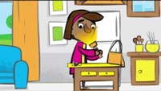

Slide 4
The Story
The main lesson in this story is that if we can avoid sin and follow God, living our life as Jesus did, then we will please the angels. This means we will be pleasing God and will find our way to Heaven.

Slide 5
Task
Your task for today is to think about the message “When someone chooses to be close to God, there will be a celebration in Heaven!”
What types of things could we do to show God that we love him and are close to him?
Create a poster which is bright and colourful. Explain what this message means and how you may be able to do this!

