Slide 1
2D Shapes
The properties of 2D shapes

Slide 2
Today…
Learning Intention – We are learning about the angles of 2D shapes.
Success Criteria –
I can list the total number of angles each shape has.
I can name different 2D shapes

Slide 3
Properties of 2D Shapes
Watch this!

Slide 4
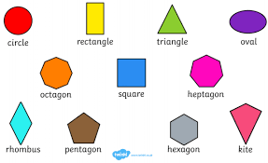
2D Shapes

Slide 5
Properties of a square
How many corners in total?
4
How many angles / vertices?
4

Slide 6
Properties of a triangle
How many corners in total?
3
How many angles/vertices?
3

Slide 7
Properties of a trapezium Try this one by yourself!
How many corners in total?
?
How many angles/vertices?
?

Slide 8
Properties of a rhombus Try this one by yourself!
How many corners in total?
?
How many angles/vertices?
?

Slide 9
Today’s activity 1!
Complete the activity sheet on the blog.
Fill in the name of the shape and the angles/vertices of the shape.
Use the information on this PowerPoint to help you!
Don’t worry if you are not sure, just try your best!!

Slide 10
Today’s activity 2!
Go on a 2D shape hunt around your house!
What shapes can you find? How many edges and angles do they have in them?
E.g.
Coaster (Square) 4 edges 4 angles!

