Slide 1
Vincent Van Gogh

Slide 2
Learning Intention and Success Criteria!
We are learning who Vincent Van Gogh is and recreating some of his most famous work.
I can explain who Van Gogh is and why he is famous.
I can describe some of his famous work.
I can try to recreate a piece of his most famous work.

Slide 3
Who is Vincent Van Gogh?

Slide 4
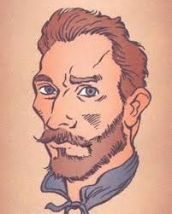
His Success!
Vincent is one of the most famous artists in the world!
But as we now know, he wasn’t successful until after he died!
He showed that sometimes you need to try and try, even when other people don’t see why you bother!
Let’s have a look at some of his work! Have a look at the different colours that he uses!

Slide 8
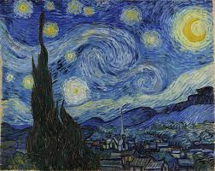
Starry Night
This image is the one we are going to focus on!
It is the landscape of Saint-Rémy-de-Provence.
This is one of his most famous pieces of work.

Slide 9
Your job!
Your task is to recreate this piece of work!
However, instead of Saint-Rémy-de-Provence, I would like you to use Dundee!
Choose some popular Dundee buildings that you could put underneath your starry sky!
If you are stuck, then have a look out your window and use that instead!
Have a think about the colours and designs which he used!
Use the next few slides to help! Good luck!

