Slide 1
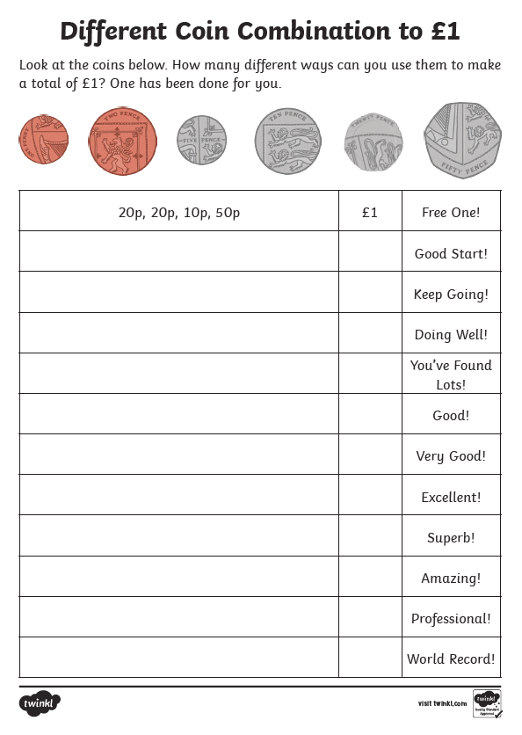
Chilli Challenge 1
Can you make £1?

Slide 2
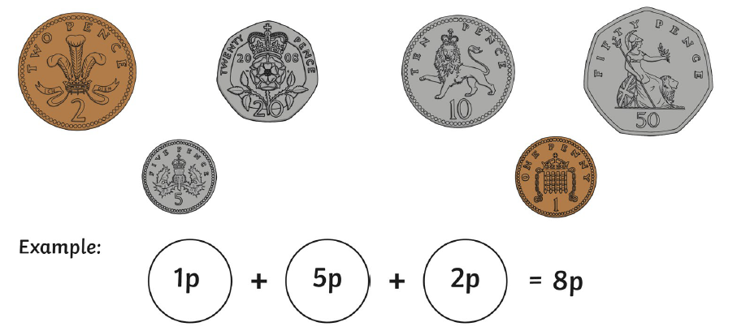
Chilli Challenge 1 (part 2)
Using 3 different coins each time, how many totals can you make?
Write them down on a piece of paper or in your jotter.

Slide 3
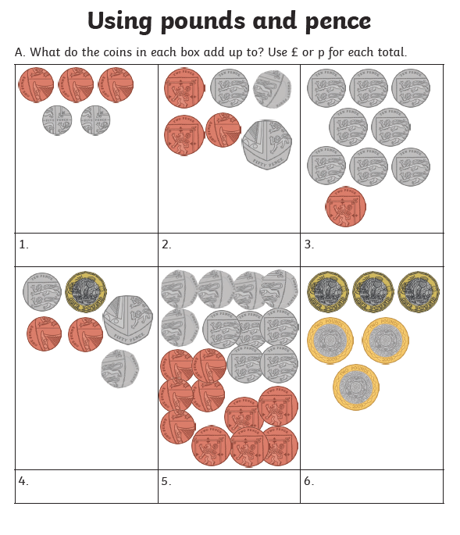
Chilli Challenge 2
Can you count amounts up to £5?
Count the coins.
Start with the largest amount.
Count on using adding strategies.

Slide 4
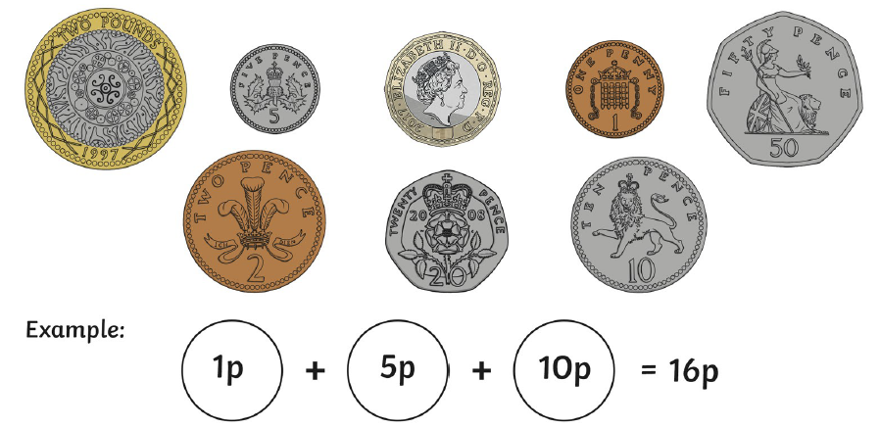
Chilli Challenge 2 (Part 2)
Using 3 different coins each time, how many totals can you make?
Write them down on a piece of paper or in your jotter.

Slide 5
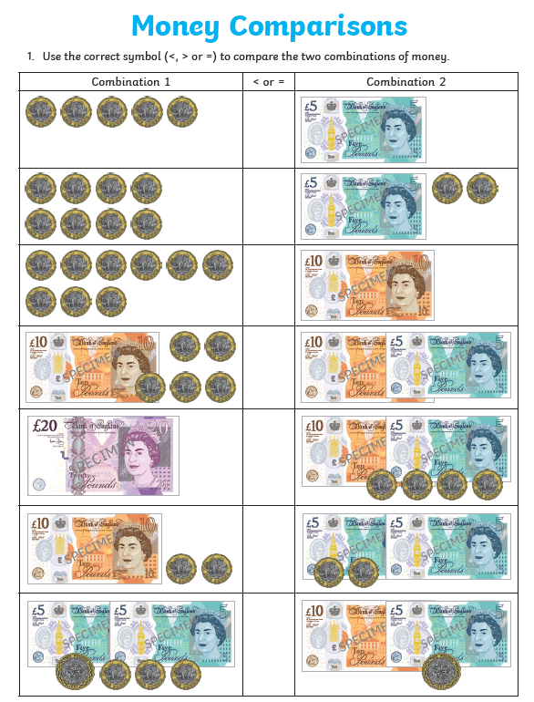
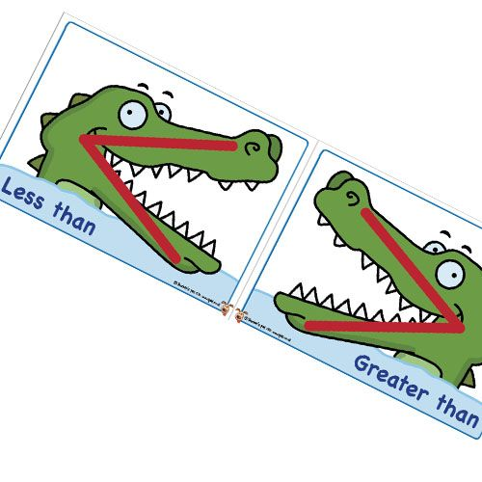
Chilli Challenge 3 Count amounts beyond £10
Add the coins in each box.
Show which box is greater and
which box is less using these
symbols < and > .
Remember the crocodile eats the bigger number!

Slide 6
Chilli Challenge 3 (part 2) - Extra Challenge

