Slide 1
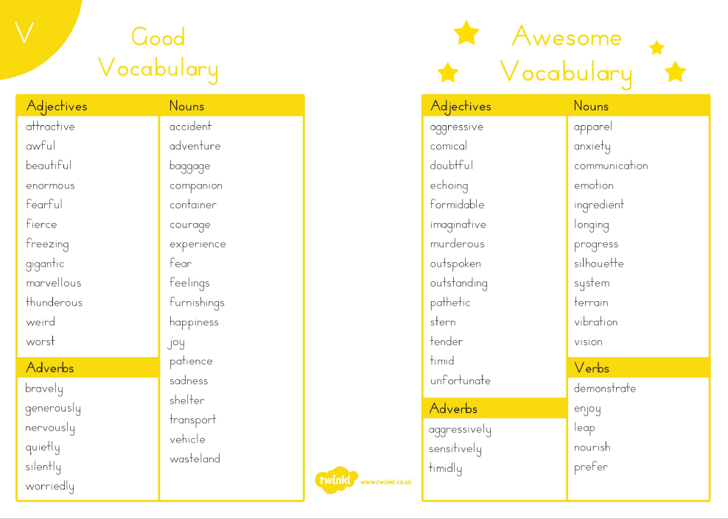

Slide 2
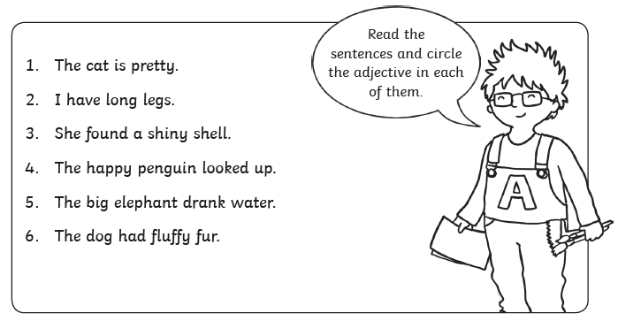
Chilli Challenge 1
Re-write the sentences and circle the adjective. Then change the adjective to make it more exciting.

Slide 3
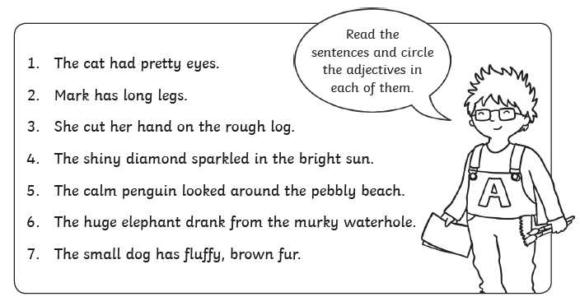
Chilli Challenge 2
Re-write the sentences and circle the adjective. Then change the adjective to make it more exciting.

Slide 4
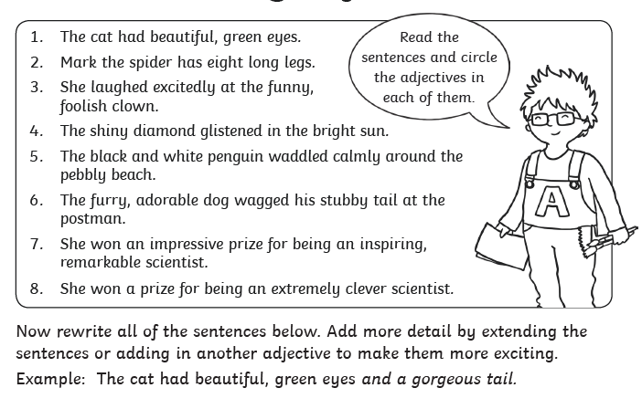
Chilli Challenge 3

Slide 5
Challenge area
Can you spot all of the boring adjectives in this passage and improve them? Choose powerful adjectives that will create a clear picture for the reader.
Taking a big gulp of air, the tired climber dug his ice tool into the hard surface of the mountain. His hands and feet were cold, and he wasn’t sure if he was going to be able to make it. Would this dangerous cliff face really defeat him?
Some powerful adjective ideas...
big
tired
hard
cold
dangerous
great
weary
solid
perished
treacherous
considerable
exhausted
unyielding
icy
perilous
substantial
fatigued
rigid
frozen
hazardous
Can you continue this story? What happens to the tired climber?

