Slide 1
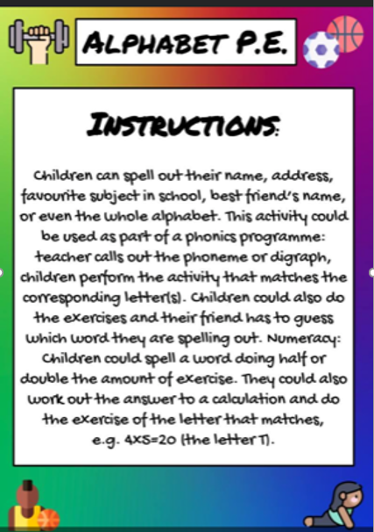
Join in with some alphabet P.E!

Slide 2
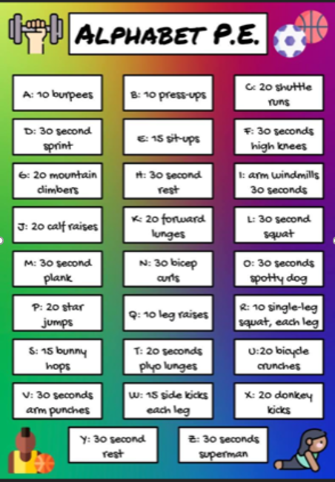
HERE IS AN EXERCISE FOR EACH LETTER!
Can you exercise out your name?
Can you exercise your best friend’s name?
Can you exercise out your address?
If you are unsure of an exercise, type it in Google and it will come up! Lots of examples are also on YouTube.

