Slide 1
The Prodigal son
Thursday 29th January

Slide 2
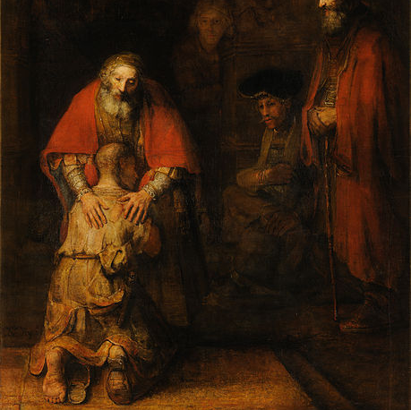
Have a look at this image and answer the questions
Who do you think these people are?
What do you think is happening?

Slide 3
The Prodigal son
This image is by Rembrandt.
He called it the Return of the Prodigal Son.
Watch the video on the next slide to learn who this is!

Slide 5
The Story
The main lesson in this story is that sometimes people make mistakes and make bad choices. However, the best thing that we can do is to forgive people who make mistakes and welcome them back with open arms.

Slide 6
Time for you to think
Have you ever made a bad choice or a mistake that you would like to be forgiven for?
Contact this person and apologise, this will mean more than you think!
Is there someone that you would like to forgive? Think about someone who has maybe done something wrong. Forgiving someone and welcoming them back is an amazing thing to do

Slide 7
Prodigal son
Using the video in this presentation can you recreate the story in present day?
Think about what jobs, buildings, clothes, activities etc may be different if this was now and not back then!
You can use whatever you like to show this! You may make a comic, write a story, create an animation – the choice is yours!

