Slide 1
Numeracy
Subtraction Word Problems
Thursday 28th January

Slide 2
Today…
Learning Intention – We are learning how to answer subtraction word problems.
Success Criteria –
I can recognise subtraction vocabulary in a problem.
I can choose a method to solve the problem.
I can use the method I choose properly to solve a problem.

Slide 3
Word Problems!
A subtraction word problem in maths will look something like this:
Mr White has 32 pens in his pencil case. Miss Keesing borrows 12 of them. How many pens does Mr White have left?
But how would we solve this problem?

Slide 4
Maths Vocabulary
The first step which we need to take is to think about maths vocabulary!
We need to think about all of the different words which we can use to say "subtraction"
Can you try to write down as many as you can think of?
Check the next slide to see how many you got right!

Slide 5
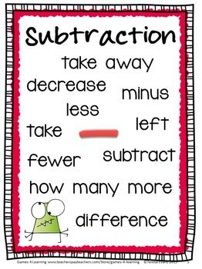

Slide 6
Step 2
The next step is to choose a method which you would like to use to solve the problem!
This could be any method you can think of for subtraction! Choose one that you find the easiest to do!
Then use that method to solve the problem!
That's it! Simples!

Slide 7
Example!

Slide 8
Task 1
Choose a chilli Challenge on the next few pages!
Remember to choose one which you think is a challenge but not too big challenge that your brain explodes!

Slide 9
55

Slide 12
Think Board!
Your last task is that I want you to create a Think Board using these skills!
Can you think of your own problems to solve?
Use the headings on the next page but change the information I have filled in!
Remember we did these on the tables last term!

Slide 13
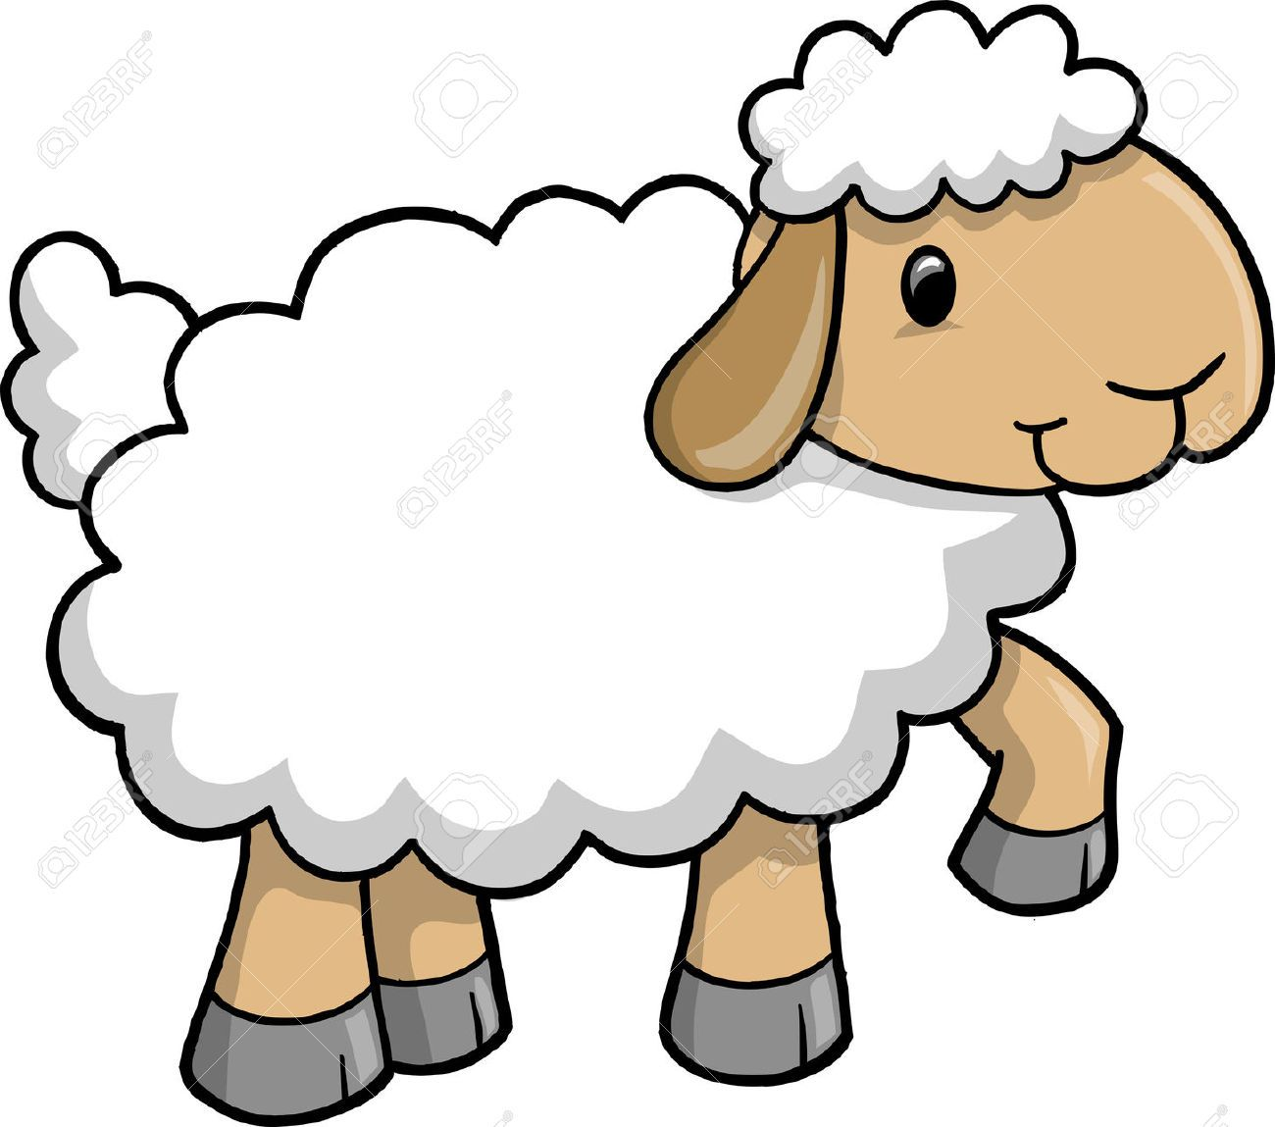
Word Problem
I had 10 sheep in a pen. 5 of them escaped. How many of them were left?
Picture
10 - 5
Materiels
Answer
5

