Slide 1
Andy Warhol – Pop Art
Wednesday 27th January

Slide 2
Who is Andy Warhol?

Slide 3
What is Pop Art?

Slide 4
Have a look at the these!
Take a look a these pieces of pop art!
What colours can you see?
What types of people or items are they using?
How could you recreate your own versions of these?

Slide 9
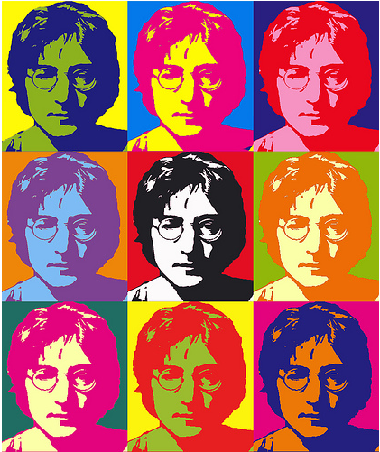

Slide 10
Task!
Using these examples, I would like you to have a go creating your own piece of Pop Art!
You may want to choose a famous person, item or logo!!
Repeat this design and change your colours just like Mickey Mouse and John Lennon above!
Give it a go and see what you can come up with!!

