Slide 1
Numeracy
Addition Word Problems
Wednesday 27th January

Slide 2
Today…
Learning Intention – We are learning how to answer addition word problems.
Success Criteria –
I can recognise addition vocabulary in a problem.
I can choose a method to solve the problem.
I can use the method I choose properly to solve a problem.

Slide 3
Word Problems!
A word problem in maths will look something like this:
Mr White has 25 children in his class. Miss Keesing has 24 children in her class. How many children do they have altogether?
But how would we solve this problem?

Slide 4
Maths Vocabulary
The first step which we need to take is to think about maths vocabulary!
We need to think about all of the different words which we can use to say "addition"
Can you try to write down as many as you can think of?
Check the next slide to see how many you got right!

Slide 5
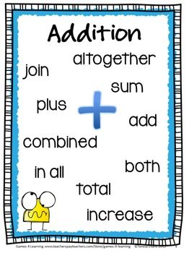

Slide 6
Step 2
The next step is to choose a method which you would like to use to solve the problem!
This could be any method you can think of for addition! Choose one that you find the easiest to do!
Then use that method to solve the problem!
That's it! Simples!

Slide 7
Example!

Slide 8
Task 1
Choose a chilli Challenge on the next few pages!
Remember to choose one which you think is a challenge but not too big challenge that your brain explodes!

Slide 12
Think Board!
Your last task is that I want you to create a Think Board using these skills!
Can you think of your own problems to solve?
Use the headings on the next page but change the information I have filled in!
Remember we did these on the tables last term!

Slide 13
Word Problem
I had 10 sweets and my sister had five sweets. How many sweets did we have altogether?
Picture
10 + 5
Materiels
Answer
15

