Slide 1
Avengers Assemble Home Circuit

Slide 2
Rules
1.Choose 10 activities to make your circuit.
2. After each activity, note how many infinity stones you achieved.
3. Write them down at the end of your session and let your teacher know how you get on – try to beat your teacher!
4. Take a 30 second break after each exercise if needed.
Equipment needed:
Yourself
Clear area
Sofa
Steps
Books
Heavy water bottle
Select 10 Avengers and complete their exercises. For each exercise you complete, you gain a infinity stone.
1 – 10 seconds
2 – 20 seconds
3 – 30 seconds
4 – 40 seconds
5 – 50 seconds
6 – 60 seconds

Slide 3
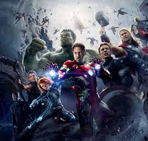
Avengers Assemble – Prepare for Battle
Jog on the spot for 30 seconds.
Repeat 2x
Complete your own dynamic stretches – make sure you stretch your whole body!
Complete your own static stretches!

Slide 4
Avengers Circuit – Who are you choosing?
Incline Iron Man Pushups
Black Widow Bicycle Crunches
The Hulk Tricep Dips
Thor Tuck Jump
Captain America Crab Walks
Black Panther Burpees
Ant-man Arm Circles
Wasp Wall Sit
Doctor Strange Deadbug
Hawkeye High Knees
Falcon Forward Lunges
Spidermen Step Ups
Gamora Goblet Squats
Groot Glute Bridges
Starlord Sit Ups
Rocket Reverse Lunges
Captain Marvel Calf Raises
Scarlett Witch Squat Jumps
Shuri Scissor Kicks
Okoye Overhead Press

Slide 5
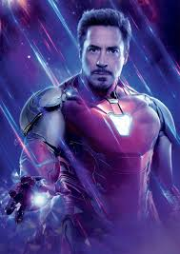
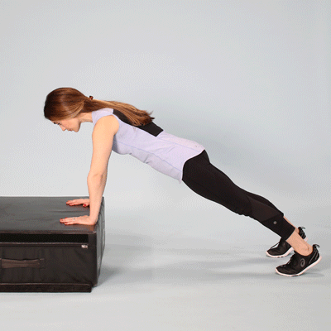
Incline Iron Man Press ups
Stand in front of your box/sofa.
Place both hands on either side of it with your fingers pointing forward with arms shoulder with apart.
Once your hands are in the right position, step your body back into a plank position, one leg at a time. Make sure your body is in a straight line and head aligned with your spine.
Bend your arms to help you slowly lower your chest toward the box. Straighten your arms to bring yourself back up into a straight line.

Slide 6
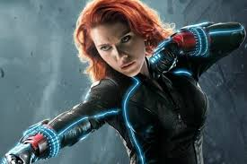
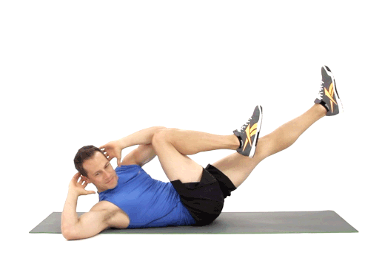
Black Widow Bicycle Crunches
Lift one leg just off the ground and extend it out.
Lift the other leg and bend your knee towards your chest.
Twist through your core so the opposite arm comes towards the raised knee

Slide 7
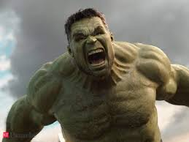
The Hulk – Tricep Dips
1. Hands shoulder width apart with your arms straight.
2. Squeeze your core and glutes, and raise your chin and chest to keep your body tight.
3. Dip your elbows to 90 degrees.
4. Pause at the bottom and press up.5. Don’t lock your arms.

Slide 8
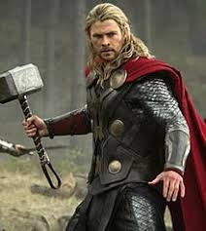
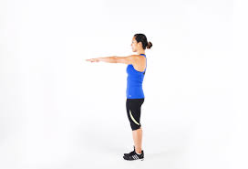
Thor Tuck Jumps
1. Stand with your feet shoulder width apart.
Drop into a quarter squat and explode into the ar.
Keep your back straight and tuck your knees towards your chest.
Land on both feet.

Slide 9
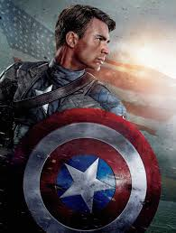
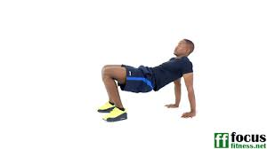
Captain America Crab Walks
Sit on the floor with your feet hit distance apart in front of you.
Arms behind your back with fingers facing hips.
Lift your hips off the floor and tighten your abs.
Start by walking by moving your left hand followed by your right foot, and then your right hand followed by your left foot.

Slide 10
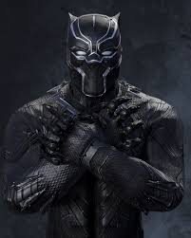
Black Panther Burpees
1. Start by standing with your arms above your head.
2. Bring yourself into a squat position with your feet shoulder width apart.
3.Lower your hands to the floor.
4. Put your weight on your hands, and kick back so your hands and toes are in a push up position.
5. Keeping your body straight – do a push up.
6. Bring your knees in to your chest.
7. Stand up and reach your arms above your head.

Slide 11
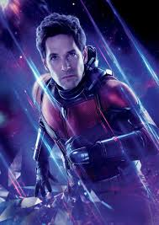
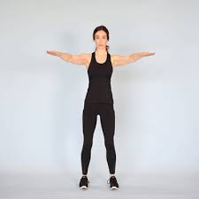
Ant-Man Arm Circles
Stand with your arms out to the side of you.
Slowly rotate your arms forward or backwards.
Make sure you are making mini circles.

Slide 12
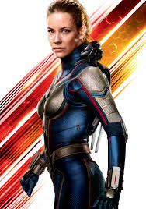
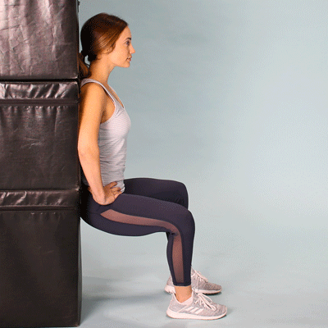
Wasp Wallsit
Lean back against the wall with your feet shoulder-width apart.
Press back and slide down the wall until your thighs are parallel with the ground.
Your knees should be above your ankles and bent at right-angles.
Keep your head, shoulders and upper back against the wall and hold the position.

Slide 13
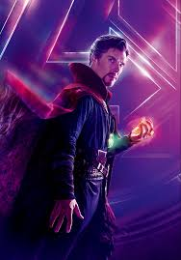
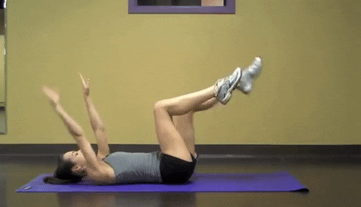
Doctor Strange Deadbug
1. Lie flat on your back with your arms held out in front of you pointing to the ceiling.
2. Bring your legs up so your knees are bent at 90-degree angles.
3. Slowly lower your right arm and left leg at the same time, exhaling as you go.
4. Keep going until your arm and leg are just above the floor, being careful not to raise your back off the ground.
5. Then slowly return to the starting position and repeat with the opposite limbs.

Slide 14
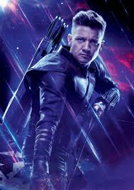
Hawkeye High Knees
Start standing with feet hip-distance apart.
Lift up right knee as high as it will go and raise the opposite arm, then switch quickly so left knee is up before right foot lands.

Slide 15
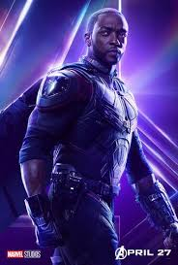
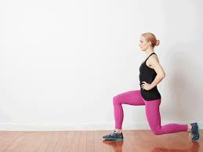
Falcon Forward Lunge
Stand with your feet shoulder-width apart
2. Step forwards with one leg into a long stride and lower into a lunge, bending both knees and keeping your posture upright while ensuring your knees don't travel over your toes.
3. Drive through your front heel to return to standing.

Slide 16
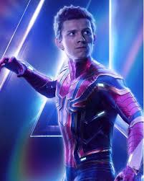
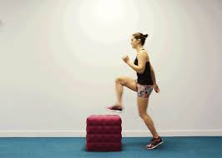
Spiderman Step Ups
Step up with the right foot, pressing through the heel to straighten your right leg.
Bring the left foot to meet your right foot on top of the step.
Bend your right knee and step down with the left foot.
Bring the right foot down to meet the left foot on the ground.

Slide 17
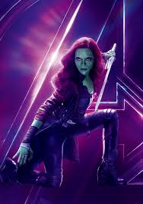
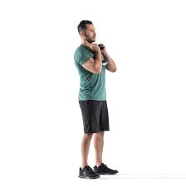
Gamora Goblet Squats
Stand with your feet positioned just a tad wider than your shoulders.
Hold a weight against your chest, with your elbows tucked in
As you squat, keep your elbows inside the line of your knees, and the heels of your feet flat on the ground.
Go as low as you can in this position, then come back up, pushing through your heels.

Slide 18
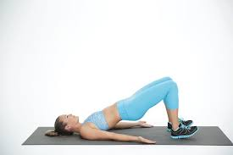
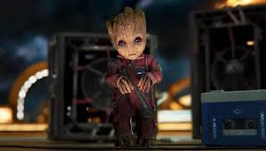
Groot Glute Bridges
Lieface up on the floor, with your knees bent and feet flat on the ground.
Keep your arms at your side with your palms down.
Lift your hips off the ground until your knees, hips and shoulders form a straight line. Squeeze those glutes hard and keep your abs drawn in.
Hold your bridged position for a couple of seconds before easing back down.

Slide 19
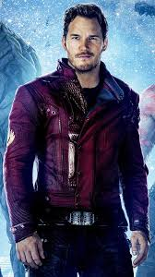
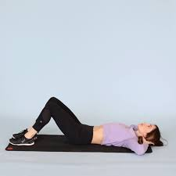
Starlord Sit ups
1. Lie on the floor facing the ceiling with a slight bend in your knees and arms bent at the elbows and hands lightly touching your head by the ears.
Engage your core and lift your upper body so your right elbow touches your left knee.
Return to the start position then lift your upper body so your left elbow touches your right knee.
Return to the start position.

Slide 20
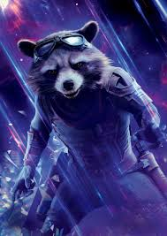
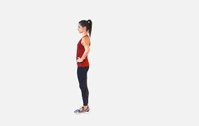
Rocket Reverse Lunges
1. Stand with feet hip-width apart
2. Step backwards with your right leg until your knees are at 90-degree angles
3. Your right knee should be pointing towards the ground and your right knee should be in line with your toes.
4. Push yourself forward to the start position and repeat with your left leg.

Slide 21
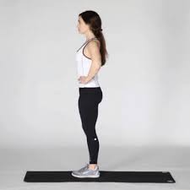
Captain Marvel Calf Raises
1. Stand up straight, then push through the balls of your feet and raise your heel until you are standing on your toes.
Then lower slowly back to the start.

Slide 22
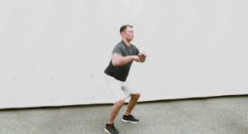
Scarlett Witch Squat Jumps
1.Start standing with feet hip distance apart and lower into a squat position by bending the knees.
2. Make sure to keep your spine straight, chest lifted, and knees behind toes.
3. Arms are in front of the chest for balance.
4. Jump straight up and swing arms overhead.
5. Return to squat.

Slide 23
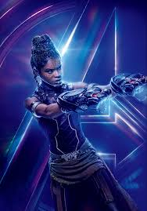
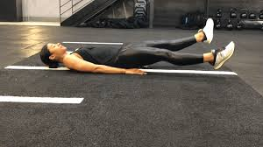
Shuri Scissor Kicks
Lie on your back with your legs extended out in front of you.
Place your arms by your sides, palms down.
Engage your core by pressing your lower back into the mat and tucking your pelvis.
Lift both legs off the ground around a 45-degree angle.
With your core tight and neck relaxed, lower one leg toward the floor as you lift the other leg up.

Slide 24
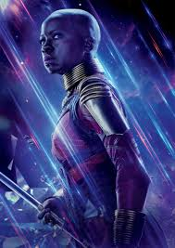
Okoye Overhead Press
Stand upright and keep the back straight.
Hold a book or heavy waterbottle in each hand at the shoulders.
Raise the books/waterbottles bove the head in a controlled motion.
Return the books/waterbottles to the shoulder.

