Slide 1
The Romans
Timeline in History

Slide 2
Today…
Learning Intention – We are learning about how to use a timeline.
Success Criteria –
I know what a timeline is and what it is used for.
I understand what the terms BC and AD mean.
I can put dates in order using a timeline.

Slide 3
What is a timeline?
A timeline is a tool that organizes information. It is used to describe the order in which events happened. Timelines can also help show how events in history are related. A timeline can cover a short amount of time in great detail, or it can offer a more general overview of a long period of time.

Slide 4
What is BC and AD?
BC
BC means ‘Before Christ’.
This means that if a date is BC, it happened before Christ was born.
AD
AD means ‘Anno Domini’ - the year of our lord.
This means that if a date is AD, it happened after Christ was born.

Slide 5
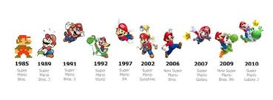
Here is an example of a timeline.

Slide 6
Activity
Use the timeline template on the blog to put in the events on the next slide.
I have marked when Jesus was born on the timeline.

Slide 7
Activity
1912 AD – The Titanic sinks.
500 BC - The Celtic people arrive from Central Europe.
1939 – 1945 AD – Second World War.
2,000 BC – Stonehenge completed.
2020 AD – Covid 19
25,000 BC – Ice Age
1914 – 1918 AD – First World War.
79 AD – Romans invade Scotland.
30 AD Jesus crucified
1863 AD – The London Underground opens

