Slide 1
Numeracy
Multiplication

Slide 2
Today…
Learning Intention – We are recapping how to use different methods to work out multiplication sums.
Success Criteria –
  I understand the different methods I can use to solve multiplication problems.
  I can use different methods to solve multiplication problems.

Slide 3
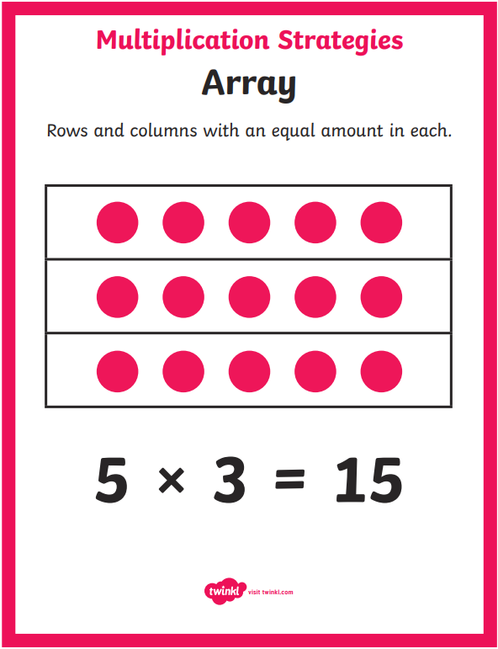
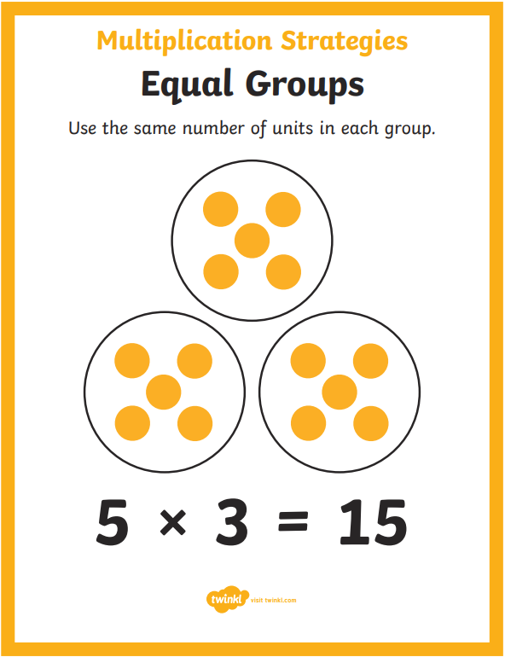
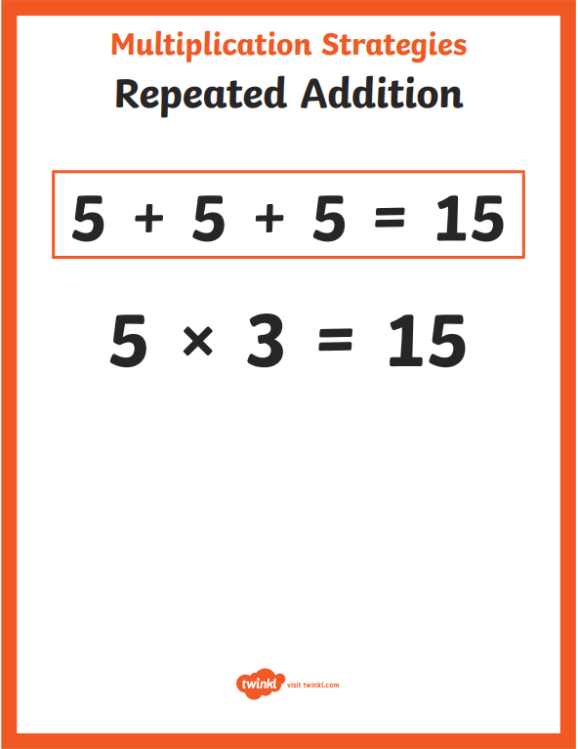
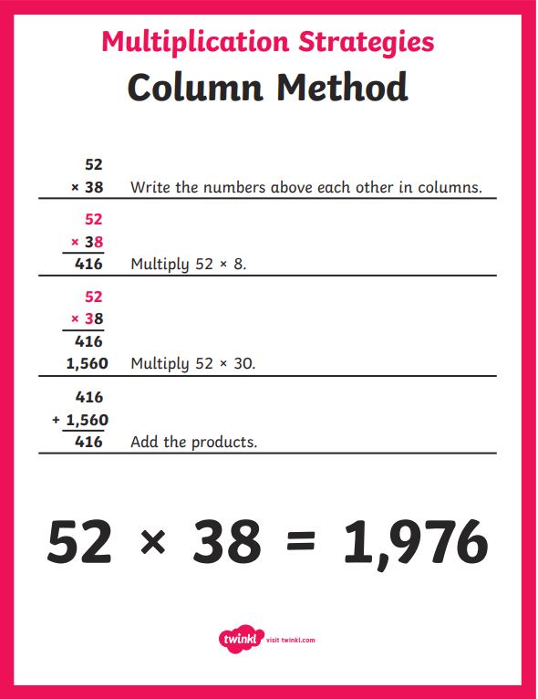
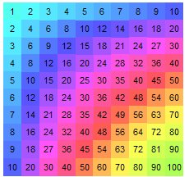
Recap of Methods

Slide 4
Remember the methods in the slide before…
Use these methods to help you solve the multiplication sums on the worksheet.
Don’t worry if you can’t remember how to do one, we will revisit the methods during our maths lessons in the next few weeks ☺

