Slide 1
Numeracy
Addition

Slide 2
Today…
Learning Intention – We are recapping how to use different methods to work out addition sums.
Success Criteria –
I understand the different methods I can use to solve addition problems.
I can use different methods to solve addition problems.

Slide 3
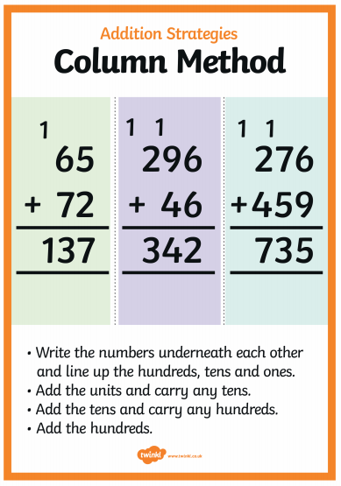
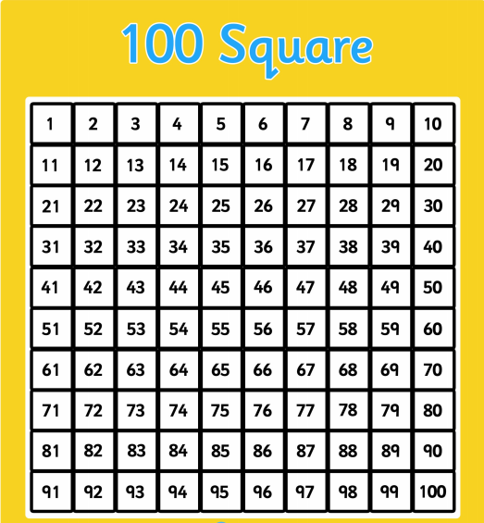
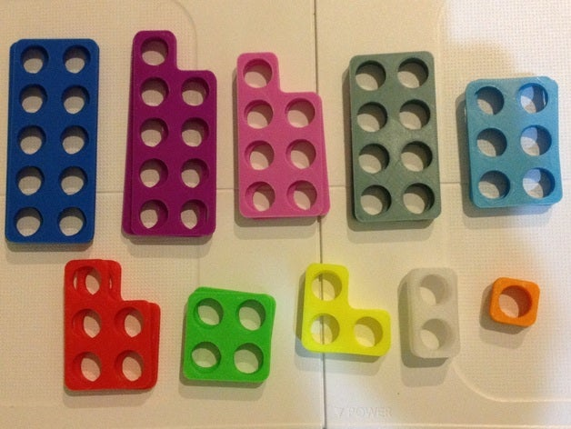
Recap of Methods
This Photo by Unknown Author is licensed under CC BY-SA

Slide 4
Remember the methods in the slide before…
Use these methods to help you solve the addition sums on the worksheet.
Don’t worry if you can’t remember how to do one, we will revisit the methods during our maths lessons in the next few weeks ☺

