Slide 1
Numeracy Resources and Activities Monday 11th January 2021

Slide 2
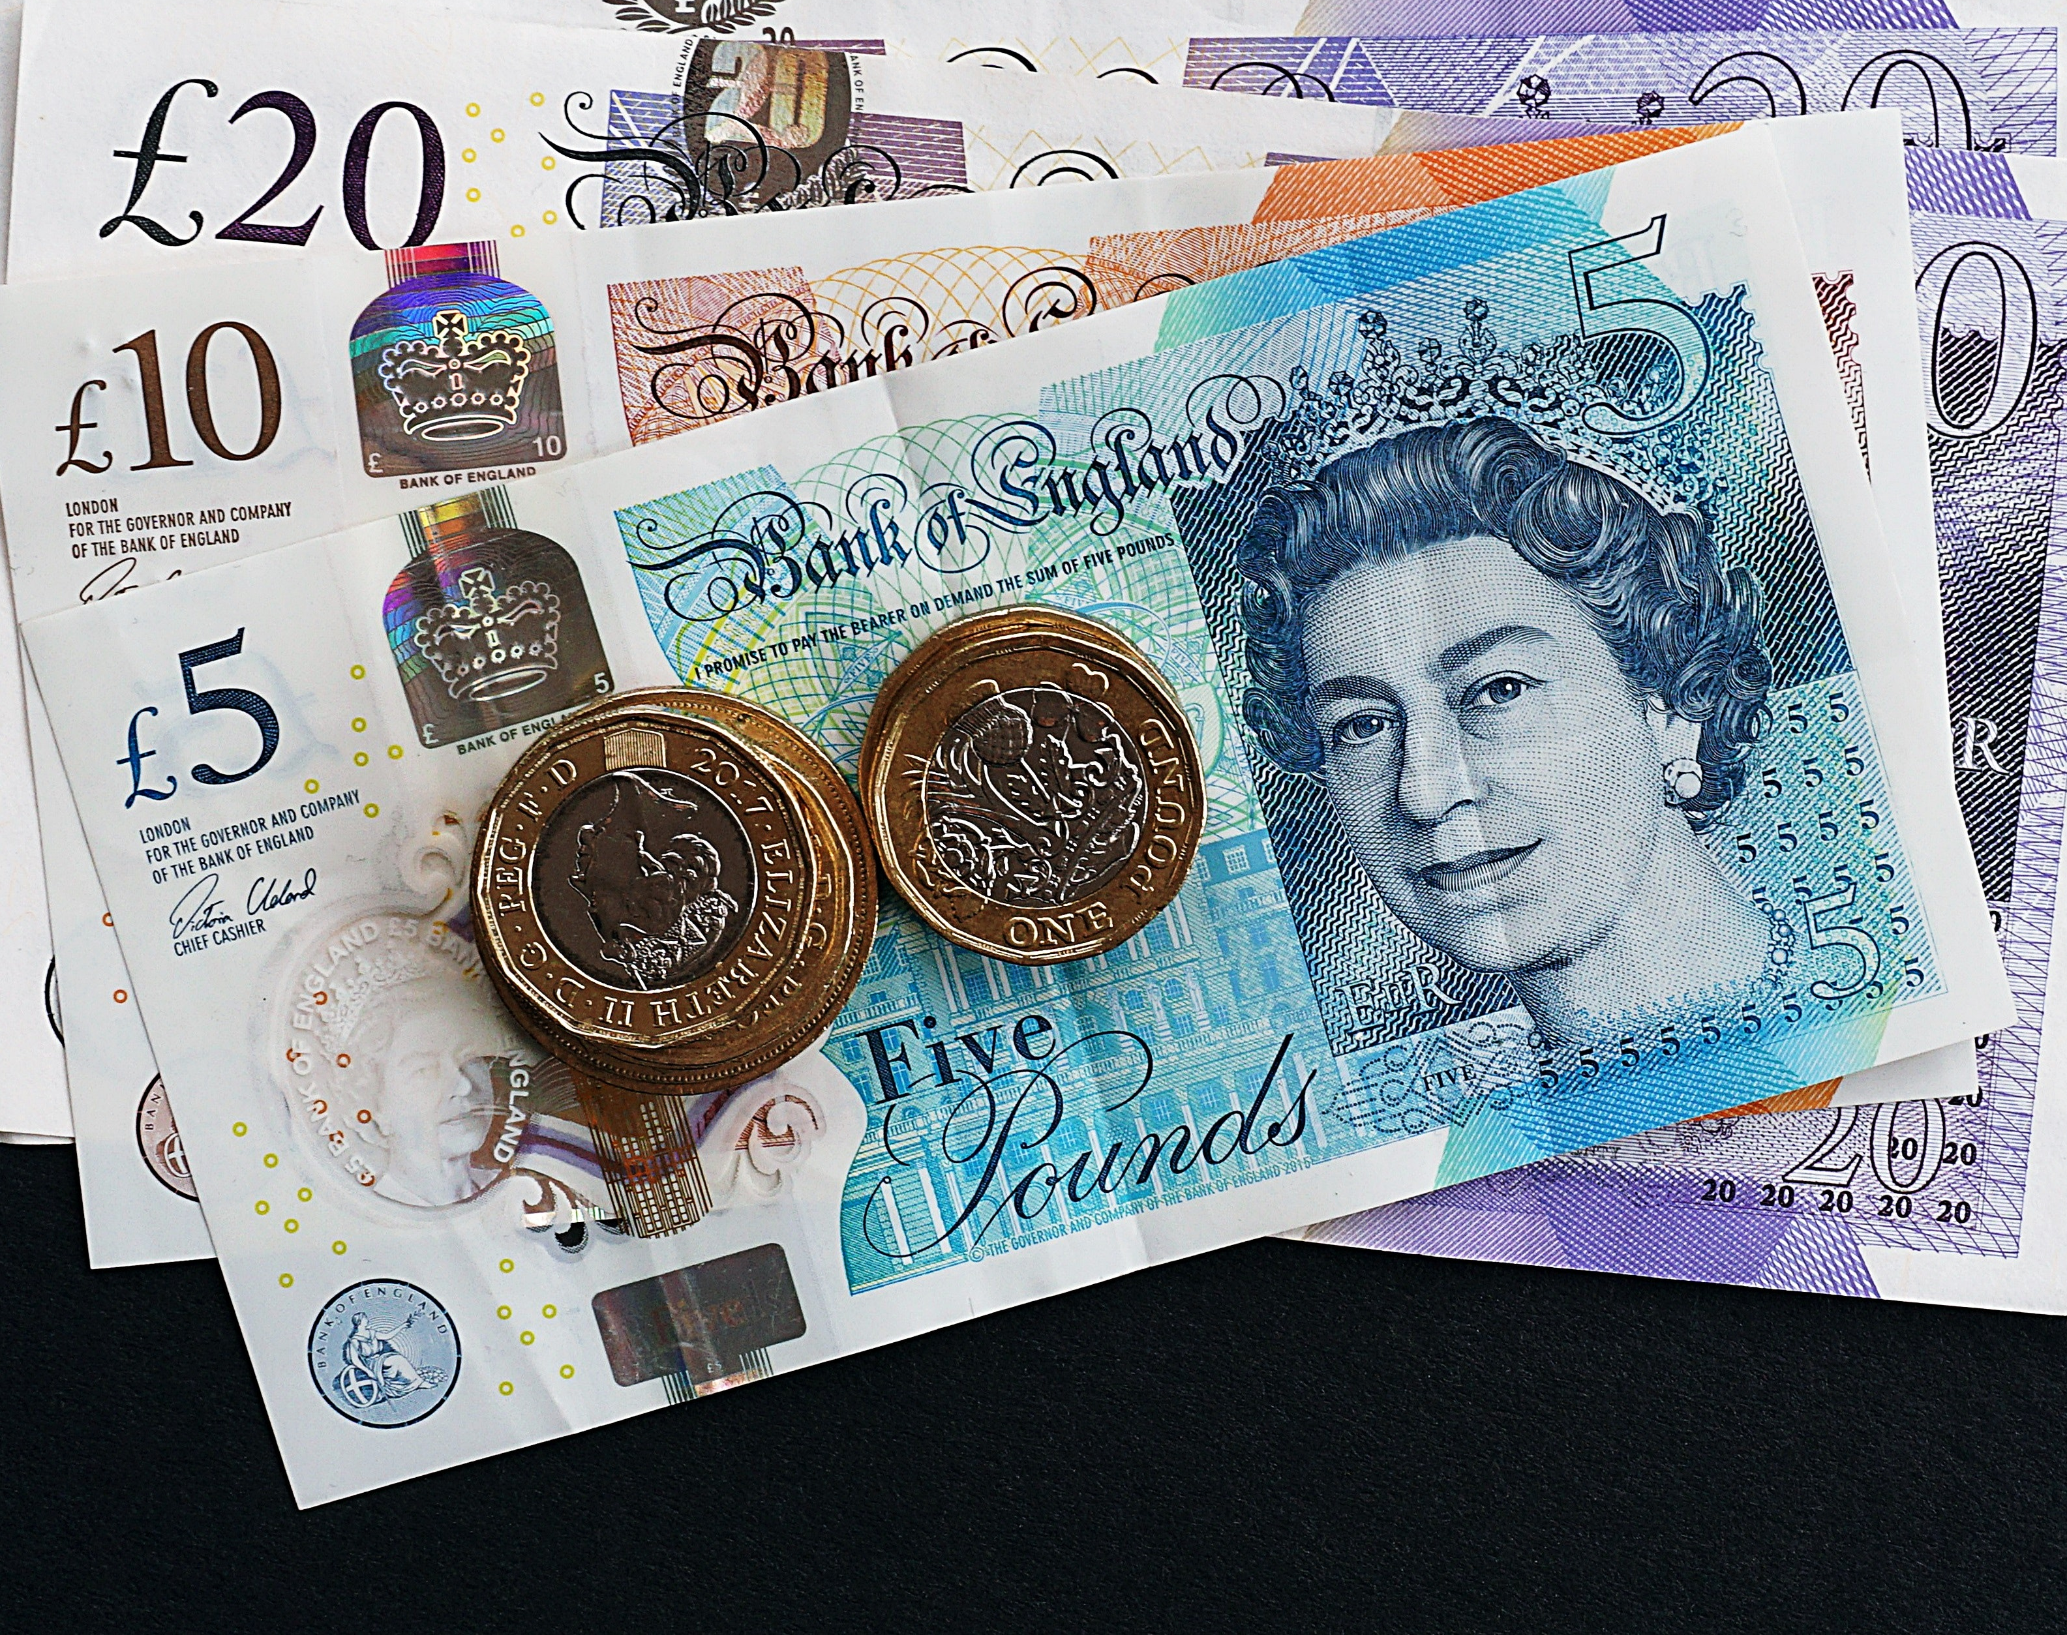
This term we will be focusing on…
Money

Slide 3
What are we learning?
LI: to identify and use money in it’s physical form.
SC:
I can name different types of money – e.g coins and notes.
I can identify how many coins can make up a note.
I can explain how to make a sum of money using different coins and notes.

Slide 4
Let’s remind ourselves. This is all the different coins and notes we use here in the UK. If you have any of these at home, they may be useful to you today. Do not worry if you don’t, you can always come back and use this slide for help!

Slide 5
Activity Options
Today’s activities come in the form of a chilli challenge.
Remember chilli challenge is there for you to choose the activity you think best suits you meaning you would feel confident to complete it.
The worksheets have a coloured chilli at the top – green = mild, yellow = medium and red = hot.
Complete your worksheet in either your homework jotter or if you are able to on a Word document.

