Slide 1
RME
Learning Intention:
To listen to, understand and reflect on The Word of God
To understand the symbols of baptism
Success Criteria:
I can explain why baptism is special
I know some of the symbols and artefacts used in baptism
I can tell someone else what the artefacts are used for.

Slide 2
Today we hear about Jesus’s baptism in the river Jordan. Baptism is the way that we are welcomed into the Church. Let’s think a bit more about all this today.
This week’s Gospel comes from Mark 1:7-11
John the Baptist announced to the people, “The man who will come after me is much greater than I am. I am not good enough even to bend down and untie his sandals. I baptize you with water, but he will baptize you with the Holy Spirit.”
Not long afterward Jesus came from Nazareth in the province of Galilee, and was baptized by John in the River Jordan. As soon as Jesus came up out of the water, he saw heaven opening and the Spirit coming down on him like a dove. And a voice came from heaven saying, “You are my own dear Son. I am pleased with you.”

Slide 3
Click the link below to watch a video about the baptism of Jesus!
https://www.youtube.com/watch?v=_VMNO2MAmwA

Slide 4
What happens during a baptism now?

Slide 5
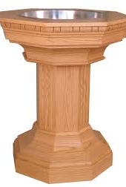
We are going to investigate some of the symbols in baptism.
This is a baptismal font
It has water in it to wash away our sins.

Slide 6
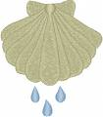
We are going to investigate some of the symbols in baptism.
A shell is sometimes used to pour water over the baby’s head.
This reminds us that the first Christians were baptised by the river or the seashore.

Slide 7
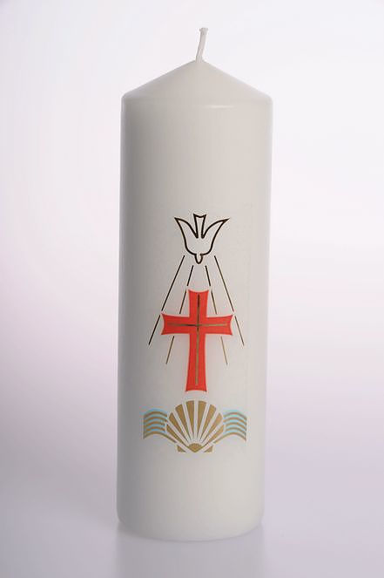
We are going to investigate some of the symbols in baptism.
Sometimes a candle is given to the parents.
This reminds us of Jesus Christ who is called the light of the world.

Slide 8
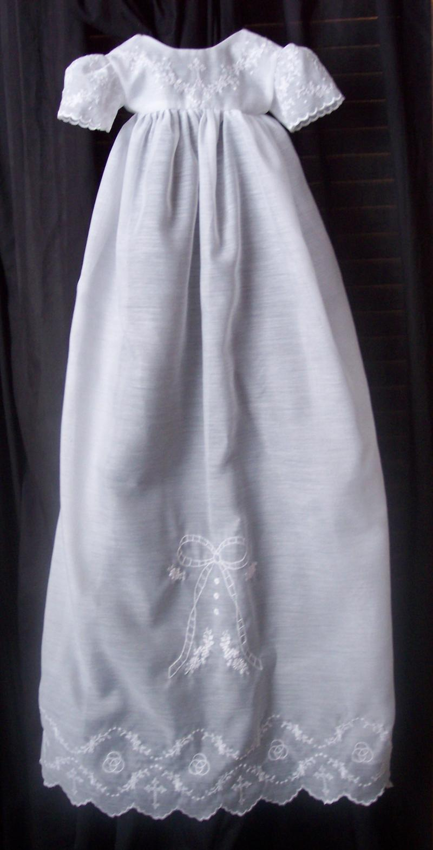
We are going to investigate some of the symbols in baptism.
Babies will often wear a christening gown for their baptism representing purity.

Slide 9
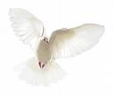
We are going to investigate some of the symbols in baptism.
The dove is a symbol of the holy spirit which is important to Christians.

Slide 10
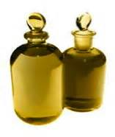
We are going to investigate some of the symbols in baptism.
A special oil that has been blessed by the bishop is poured on the baby’s head as a sign of the presence of the Holy Spirit who will help the baby in his or her Christian life.

Slide 11
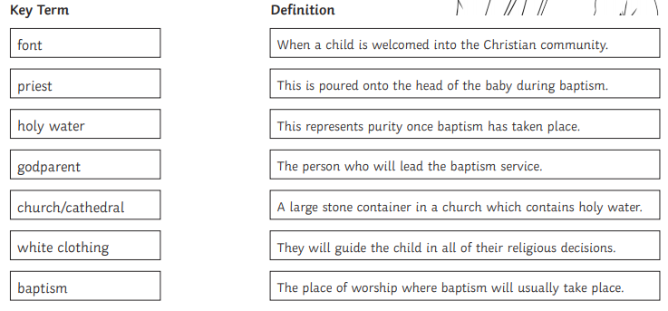
Task In your jotter, match the correct key term to the definition. .
Extension Use the PowerPoint to draw the key symbols and colour them in

