Slide 2
Using the link below, listen along to Chapter 1 of Harry Potter & the Philosopher’s Stone.
https://www.youtube.com/watch?v=x8jwdXXooMs
A PDF of Chapter 1 is also available for you to read along whilst listening. Copies of the novel are available to be collected from school on a Friday, if you require one.

Slide 3
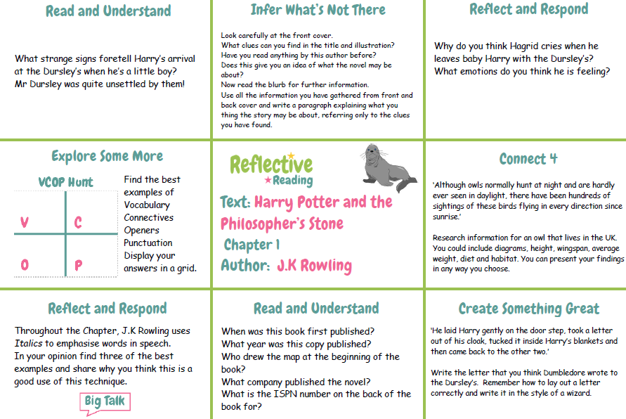
Today’s Task: Complete any 4 tasks from the Task Map

Slide 4
How do I complete a Task Map?
long date
titles
Monday 11th January 2021
Task Map
Harry Potter – Chapter 1
Reflect and Respond
Sub-title for each activity
You can do this on any paper you have, in your homework jotter or using ICT, it is up to you.

Slide 5
A PDF copy of the chapter has been uploaded to Glow Blogs to help you complete the Task Map.
Good Luck and let us know if you need any help!

