Slide 1
St Mary’s RC primary school Friday 19th February19.02.21
P3 and P4

Slide 2
Morning Prayer
Father in heaven you love me
You are with me night and day
I want to love you always
In all I do and say
I’ll try to please you Father
Bless me through this day
Amen

Slide 4
Literacy - writing
Learning Intention:
We are learning to improve our handwriting.
Success Criteria:
- I can use what I have seen to answer questions.
I can describe what my senses are sensing.
I can use adjectives to improve my writing.

Slide 5
Language; Film & Literacy
https://www.literacyshed.com/lilyandthesnowman.html
Click on the link to watch this lovely story. Have a hanky ready though.
Then answer the questions on the next slide and complete the activity.

Slide 6
Answer the following questions in your jotter.
1. What did Lily use to make the eyes, nose and mouth of the snowman?
2. Why is Lily looking sad when the snowman starts to melt?
3. Why does Lily put the snowman in the fridge?
4. When Lily grows up what reminds her of her old friend the snowman?
5. What do you think will happen next?
6. What is the message of the story?

Slide 7
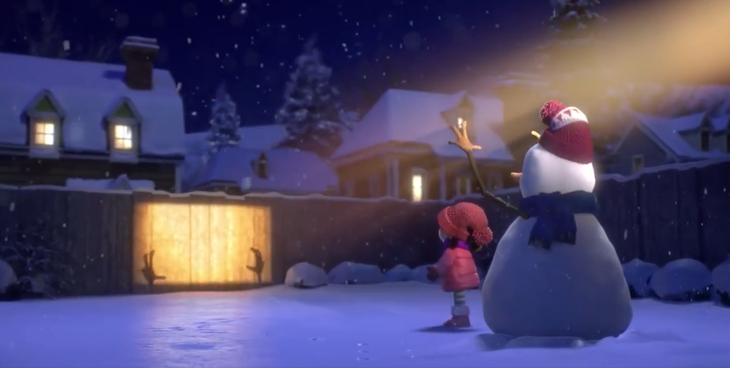
Select 4 senses and in your jotter write a descriptive sentence for each sense.
e.g. I can hear the snow softly landing on the path.
Start each sentence and end with a full stop.
What can you touch?
What can you smell?
What can you hear?
What can you see?
What can you taste?

Slide 8
Numeracy
Learning Intention
We are learning to use subtraction.
Success Criteria
Complete the following number tasks on Topmarks.
Choose the Mild, Hot or Spicy Chilli challenge.
Don’t worry if you do have internet access, complete a number activity in your home learning pack.

Slide 9
Numeracy https://www.topmarks.co.uk/maths-games/daily10
Mild | Hot | Spicy
Choose level 2. Choose Subtraction. Choose Two-Digit Numbers. Choose manual so you can control the time limit. Mark your answers at the end. | Choose level 2. Choose Subtraction. Choose Two-Digit Numbers with Decomposition. Choose manual so you can control the time limit. Mark your answers at the end. | Choose level 3 Choose Subtraction Choose Two-Digit Numbers with Decomposition. Choose manual so you can control the time limit. Mark your answers at the end.

Slide 10
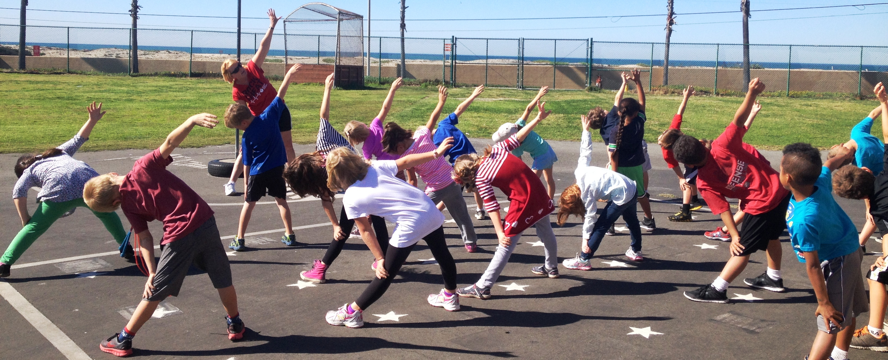
Weekly Journal
For the Weekly Journal we would like to hear about how you are experiencing your learning.
In your jotters please tell us what has been your favourite thing you have done in learning this week and tell us why. Have you enjoyed completing your learning at home with family? Do you enjoy going at your own pace?
We would also like to know if there has been anything you have missed not being in school. Do you miss your friends? Do you miss your teachers?
If you have the know how and would rather make a video of yourself we would be more than happy to receive these to know how you are getting on and see your smiling faces.
This Photo by Unknown Author is licensed under CC BY

Slide 11
Interactive School Assembly
Please follow the link on the P3 and P4 blog for an invite into the school assembly via Microsoft Teams.

Slide 12
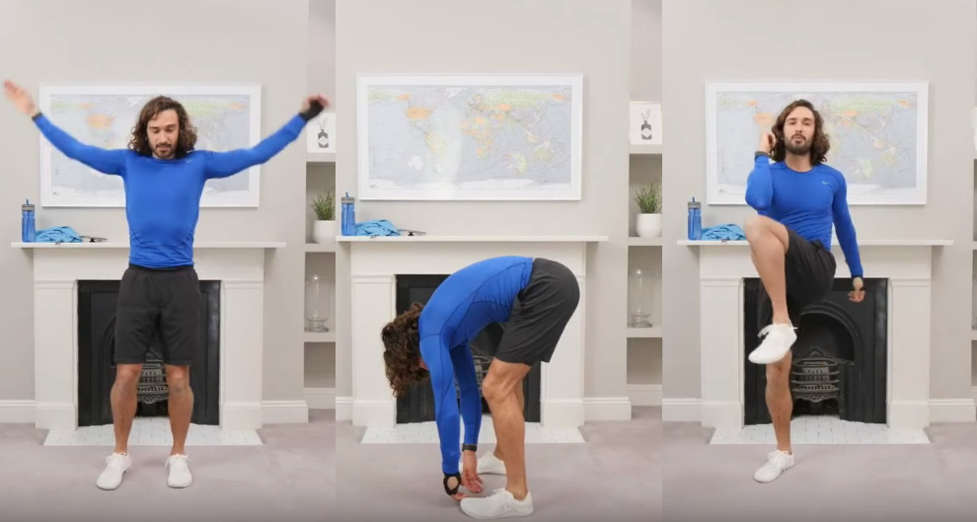
P.E
Follow the link to Joe Wicks P.E Lesson. Watch the video and complete the activities.
https://www.youtube.com/watch?v=YvrtftiOOVw

Slide 13
Night time prayer
God our Father, I come to say thank you for your love today.
Thank you for my family and all the friends you give to me.
Guard me in the dark of night and in the morning send your light.Amen.

