Slide 1

St Mary’s RC primary school
Thursday 11.02.21
P3 and P4

Slide 2

Morning Prayer
Father in heaven you love me
You are with me night and day
I want to love you always
In all I do and say
I’ll try to please you Father
Bless me through this day
Amen

Slide 3
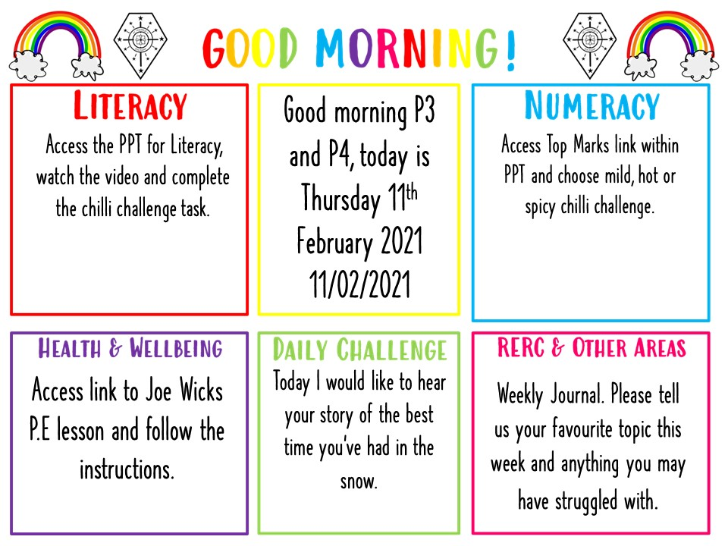

Slide 4
Literacy - writing
Learning Intention:
We are learning to improve our writing.
Success Criteria:
I can use adjectives in my sentences.
I can use connectives in my writing.
I can use a variety of openers in my writing.

Slide 5
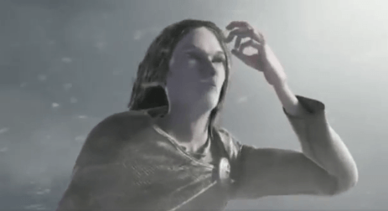
Click the following link to watch Jotun – Journey of a Viking
https://www.literacyshed.com/jotun.html#
Select a Mild, Hot or Spicy Chilli Challenge from the following slides.

Slide 6

In your jotter please copy and complete the following sentences adding in adjectives, connectives or openers where needed.
1. Jotun is a _________ Viking man with ___________ hair.
Insert: 2 adjectives – Tall, Strong, Thin, Straight, Long
2. _________ is wearing a _________ cloak.
Inset 1 opener and 1 adjective – Jotun, He, Furry, Warm, Long
3. Jotun walks through the _______ forest ____ it is very _______
Insert 2 adjectives and 1 connective – Dark, Cold, Snowy, And, Because
4. Jotun enters a ______ cave where he finds a piece of the monsters hammer ________ in ice.
Insert 2 adjectives – Dark, Frozen, Stuck, Hidden
5. At the end of the story Jotun replaces the piece of hammer to his house, he must have felt _________.
Insert 1 adjective of your choice.

Slide 7
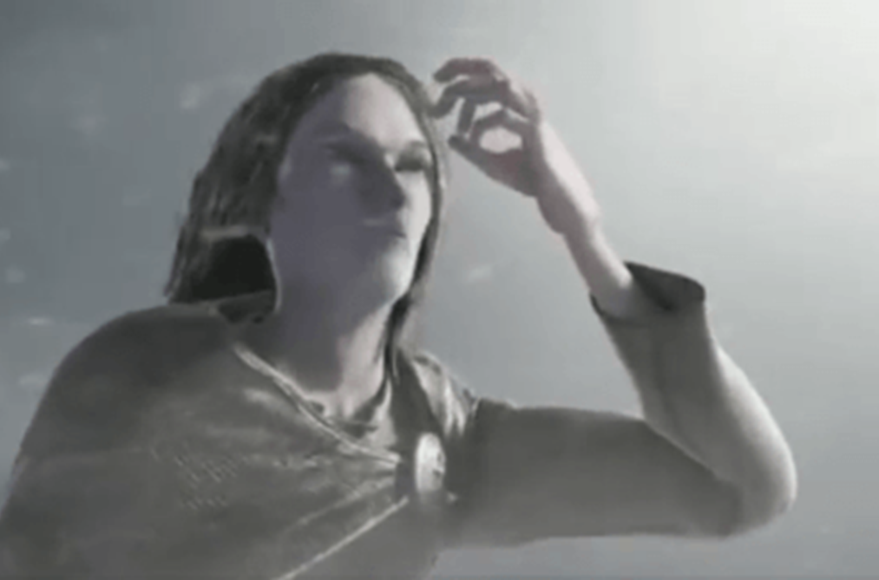
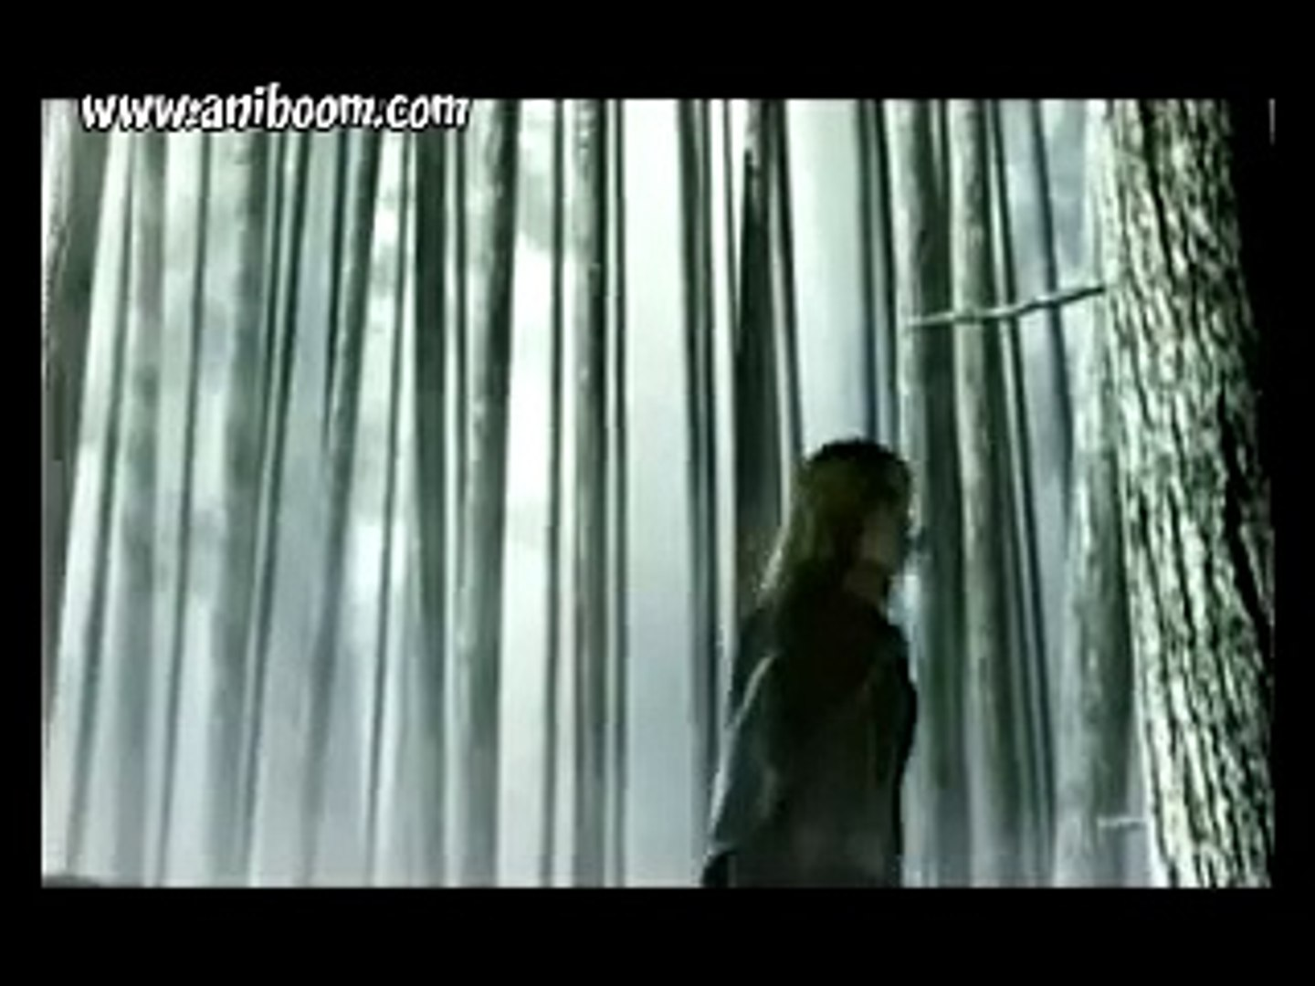
In your jotter I would like you to write 2 sentences describing Jotun.
Each sentence must contain 2 adjectives and 1 connective.
In your jotter I would like you to write 2 sentences describing the setting of the film.
Each sentence must contain 2 adjectives and 1 connective and a different opener for each.

Slide 8
In your jotter I would like you to write a character description of Jotun.
Your description must contain 4 adjectives and 2 connective and a variety of openers.
In your jotter I would like you to write a setting description of the film. Your description must contain 4 adjectives and 2 connective and a variety of openers.
I would then like you to tell me what you think happens next in the story like a post credit scene. Be as imaginative as you can this should be at least 4 sentences long including adjectives, openers and connectives.

Slide 9

Numeracy
Learning Intention
We are learning to use multiplication.
Success Criteria
Complete the following number tasks on Topmarks.
Choose the Mild, Hot or Spicy Chilli challenge.
Don’t worry if you do have internet access, complete a number activity in your home learning pack.

Slide 10
Numeracy https://www.topmarks.co.uk/maths-games/daily10
Mild | Hot | Spicy
Choose level 2. Choose Multiplication. Choose Mixed tables x2, 5, 10. Choose manual so you can control the time limit. Mark your answers at the end. | Choose level 2. Choose Mulitplication. Choose Mixed tables x2, 3, 4, 5, 8, 10. Choose manual so you can control the time limit. Mark your answers at the end. | Choose level 5. Choose Multiplication Choose Mixed tables x2, 3, 4, 5, 8, 10. Choose manual so you can control the time limit. Mark your answers at the end.

Slide 11

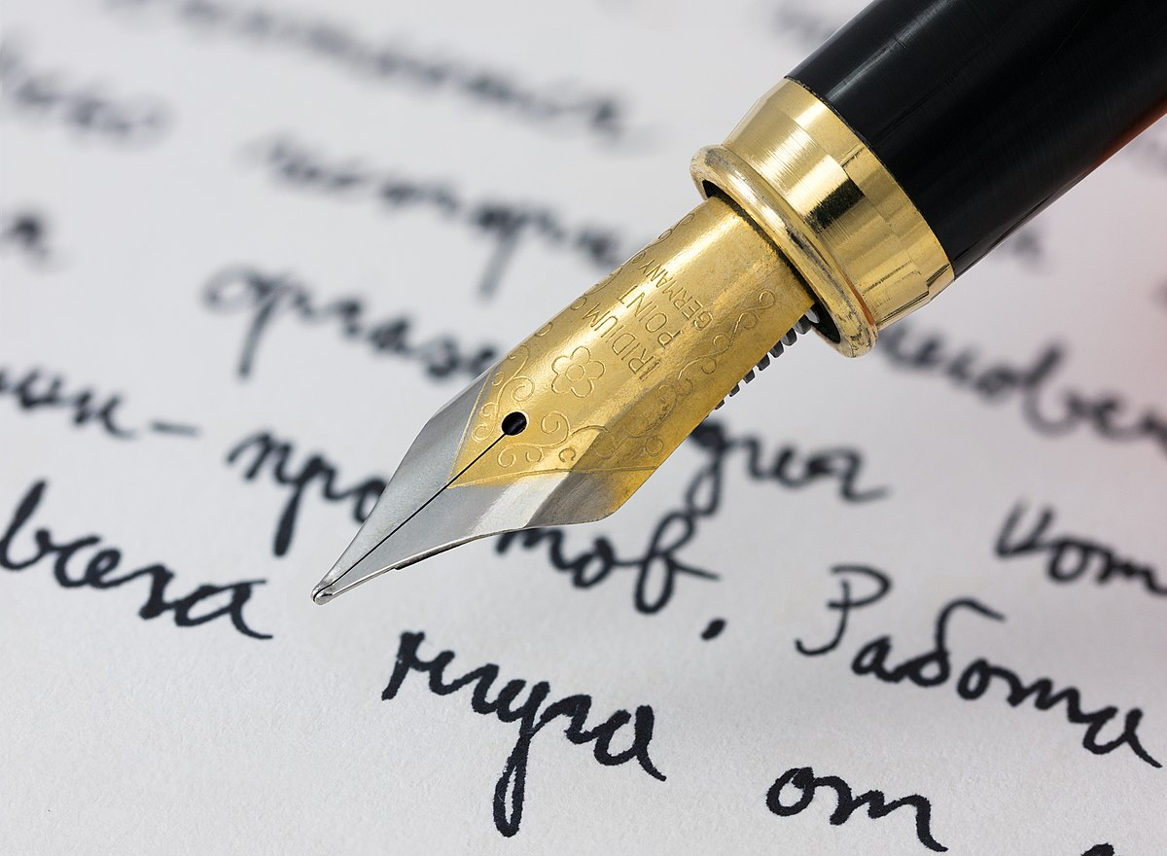
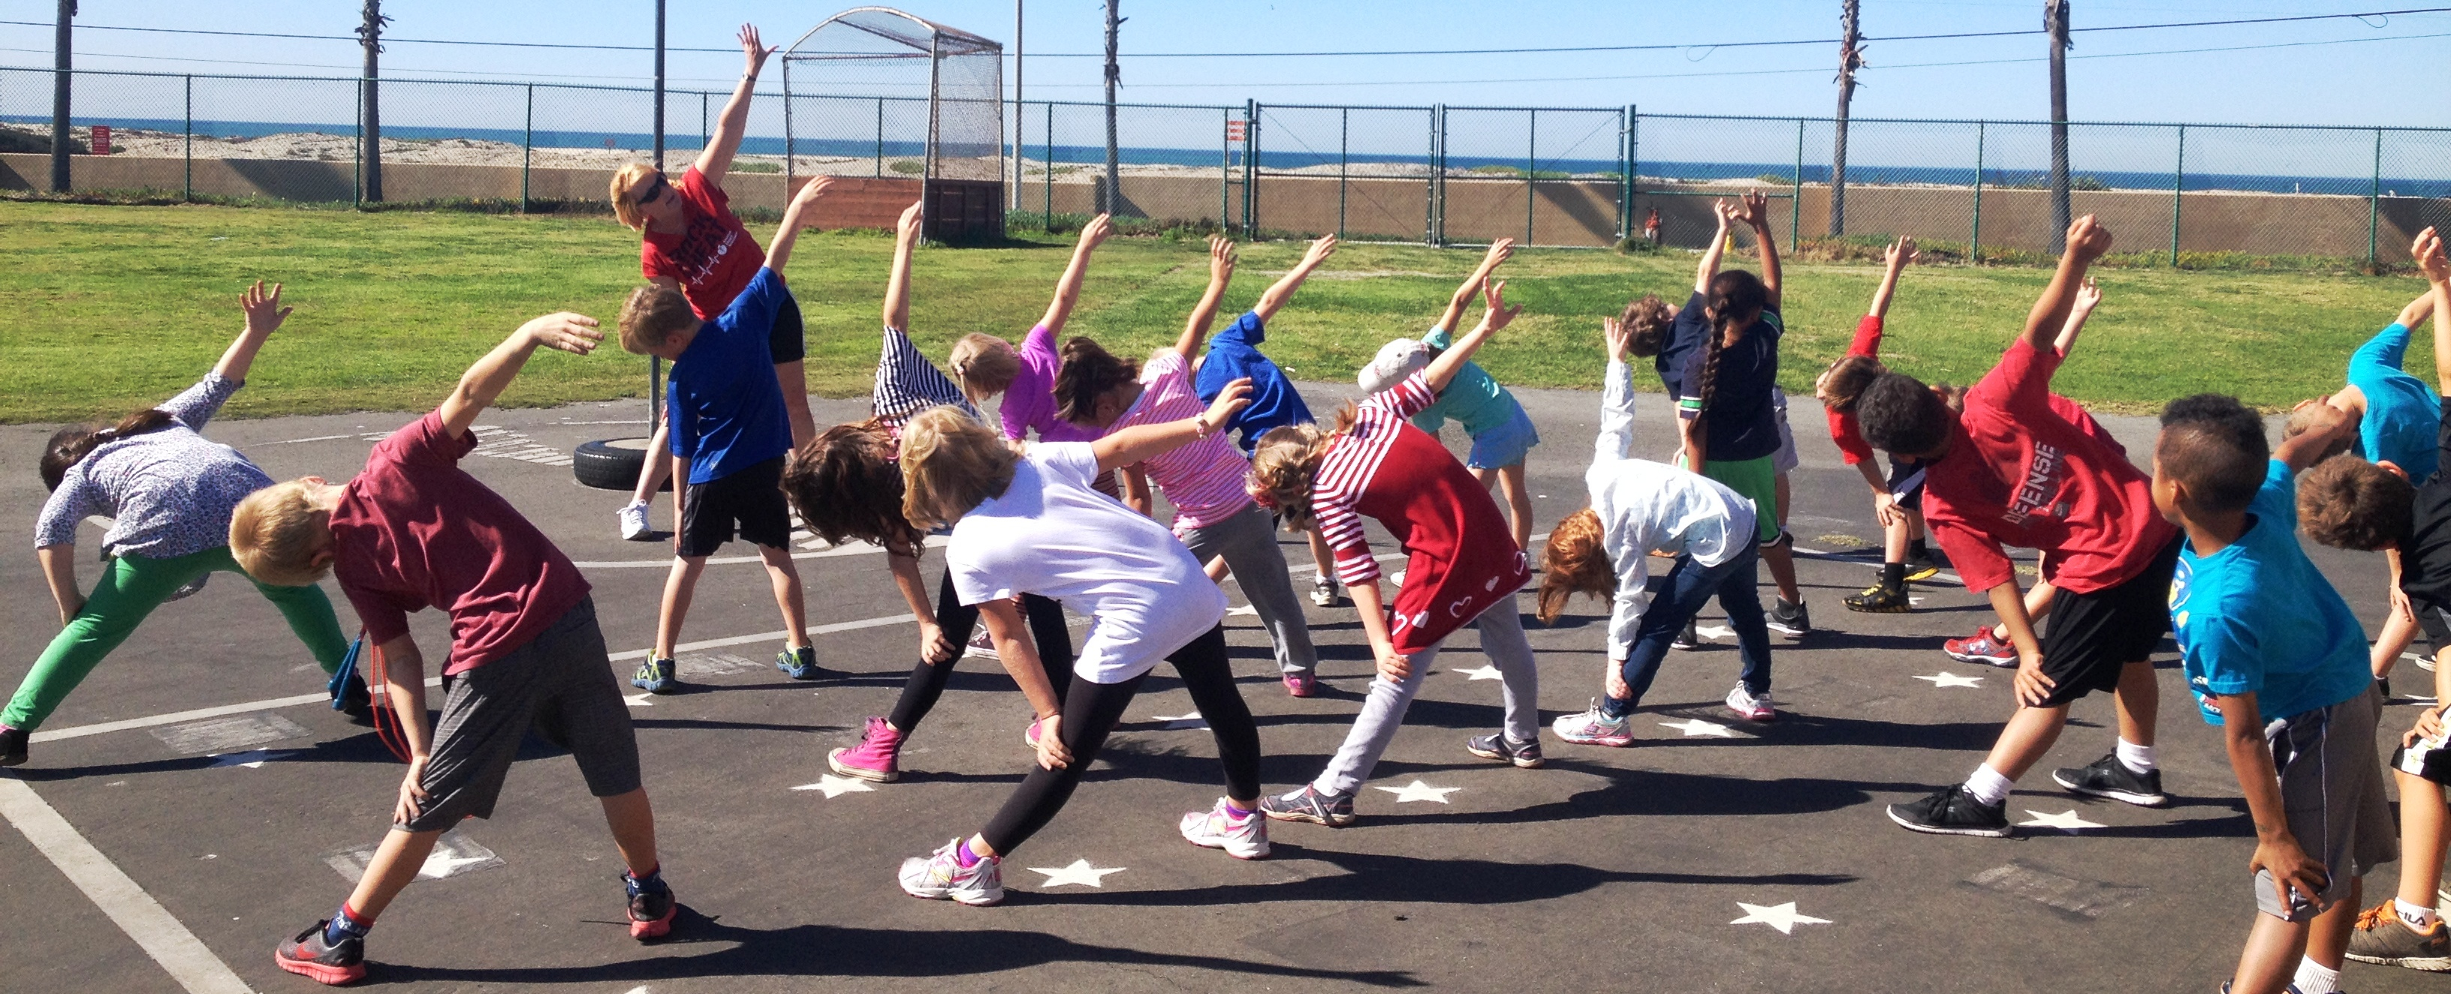

Weekly Journal
For the Weekly Journal we would like to hear about how you are experiencing your learning.
In your jotters please tell us what has been your favourite thing you have done in learning this week and tell us why. Have you enjoyed completing your learning at home with family? Do you enjoy going at your own pace?
We would also like to know if there has been anything you have missed not being in school. Do you miss your friends? Do you miss your teachers?
If you have the know how and would rather make a video of yourself we would be more than happy to receive these to know how you are getting on and see your smiling faces.
This Photo by Unknown Author is licensed under CC BY

Slide 12
Interactive School Assembly
Please follow the link on the P3 and P4 blog for an invite into the school assembly via Microsoft Teams.

Slide 13
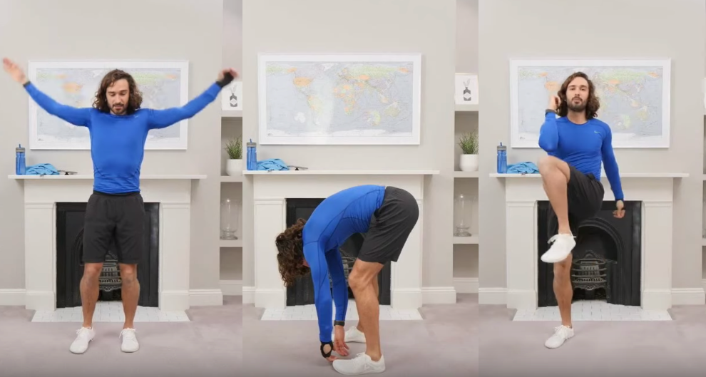
P.E
Follow the link to Joe Wicks P.E Lesson. Watch the video and complete the activities.
https://www.youtube.com/watch?v=yOvqLXv88L4

Slide 14
Night time prayer
God our Father, I come to say thank you for your love today.
Thank you for my family and all the friends you give to me.
Guard me in the dark of night and in the morning send your light.Amen.

