Slide 1

St Mary’s RC primary school
Wednesday 10.02.21
P3 and P4

Slide 2

Morning Prayer
Father in heaven you love me
You are with me night and day
I want to love you always
In all I do and say
I’ll try to please you Father
Bless me through this day
Amen

Slide 3
Literacy
Learning Intention:
We are learning to gather answers from a text.
Success Criteria:
I can read the information sheet.
I can use the information from the sheet to answer questions.

Slide 4
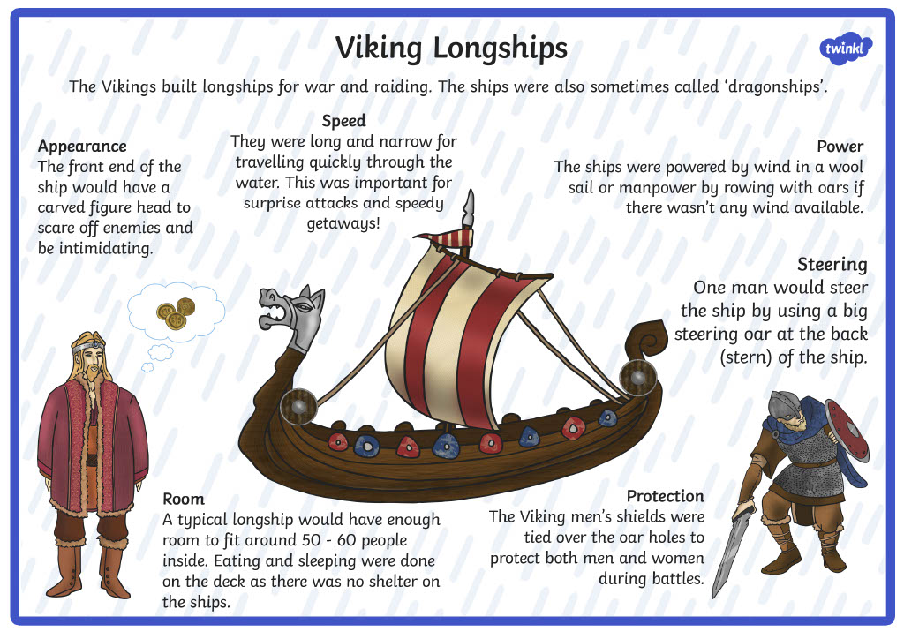
Carefully read the following passage. Then choose one of the three Chilli challenges and answer the questions in your jotter.

Slide 5
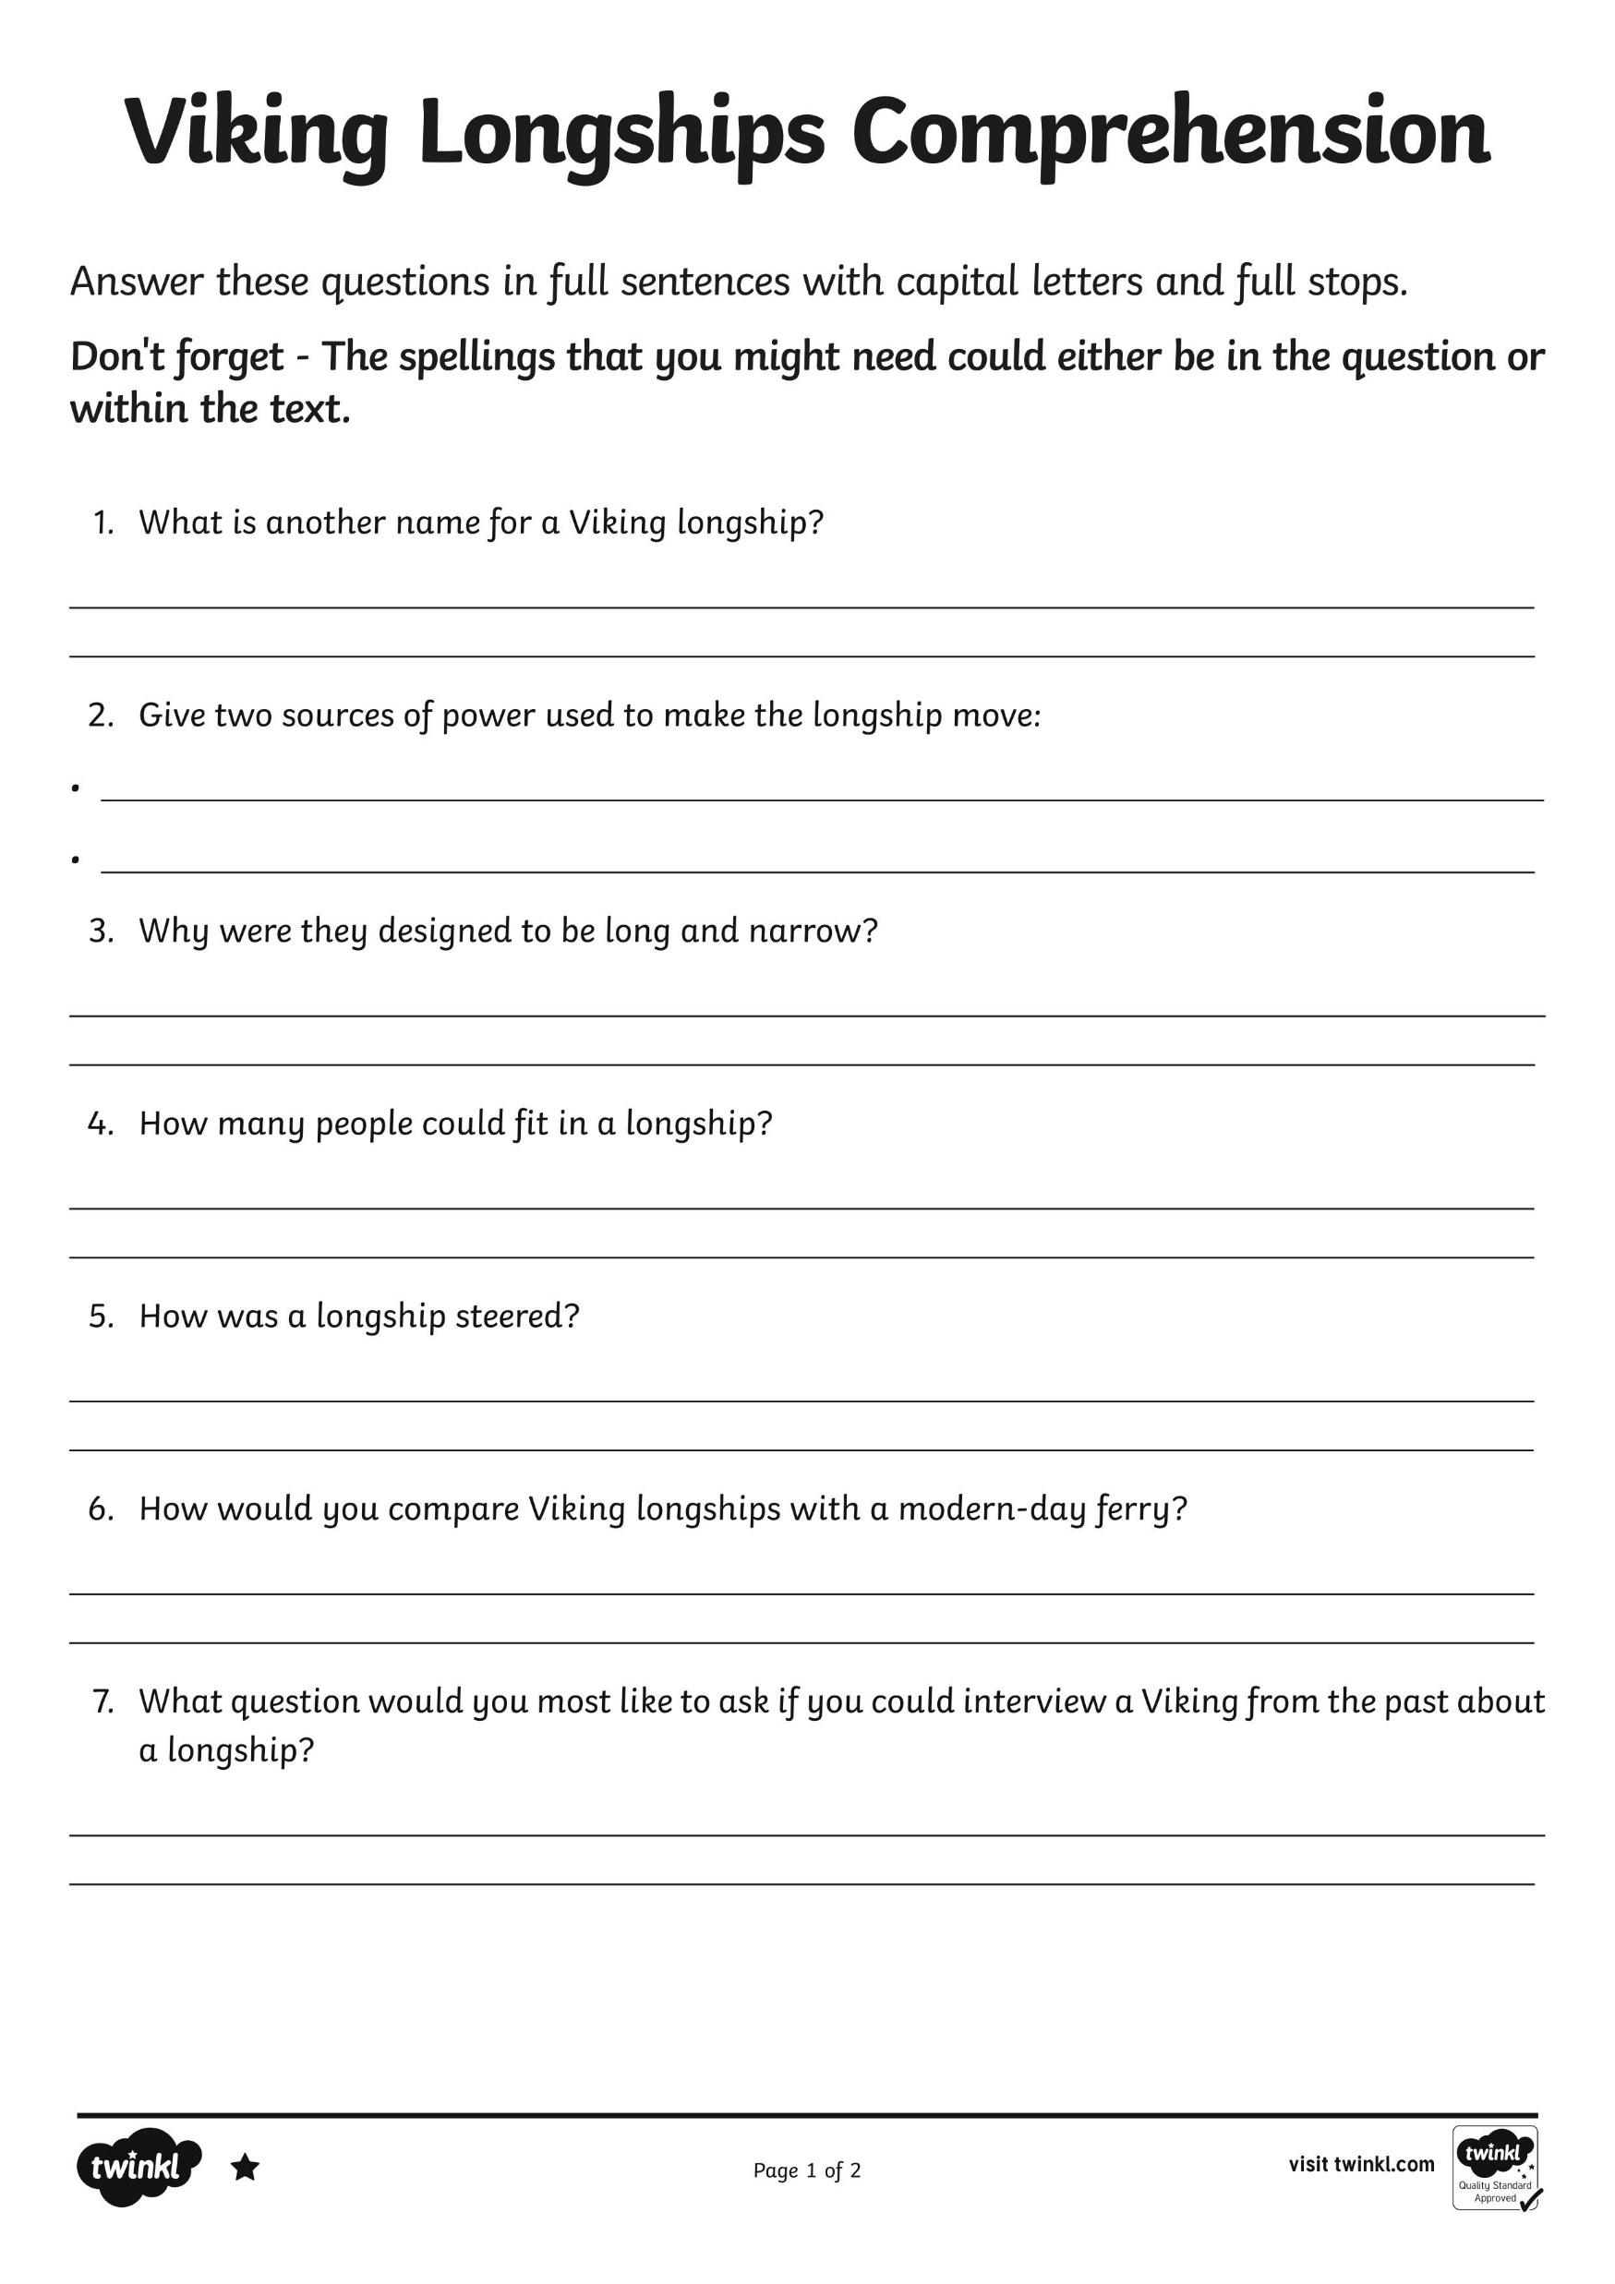
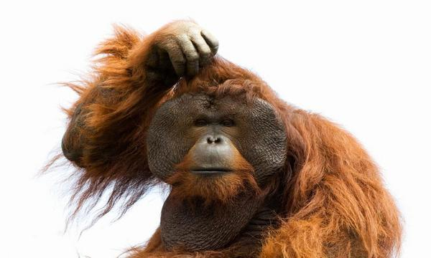


Slide 6
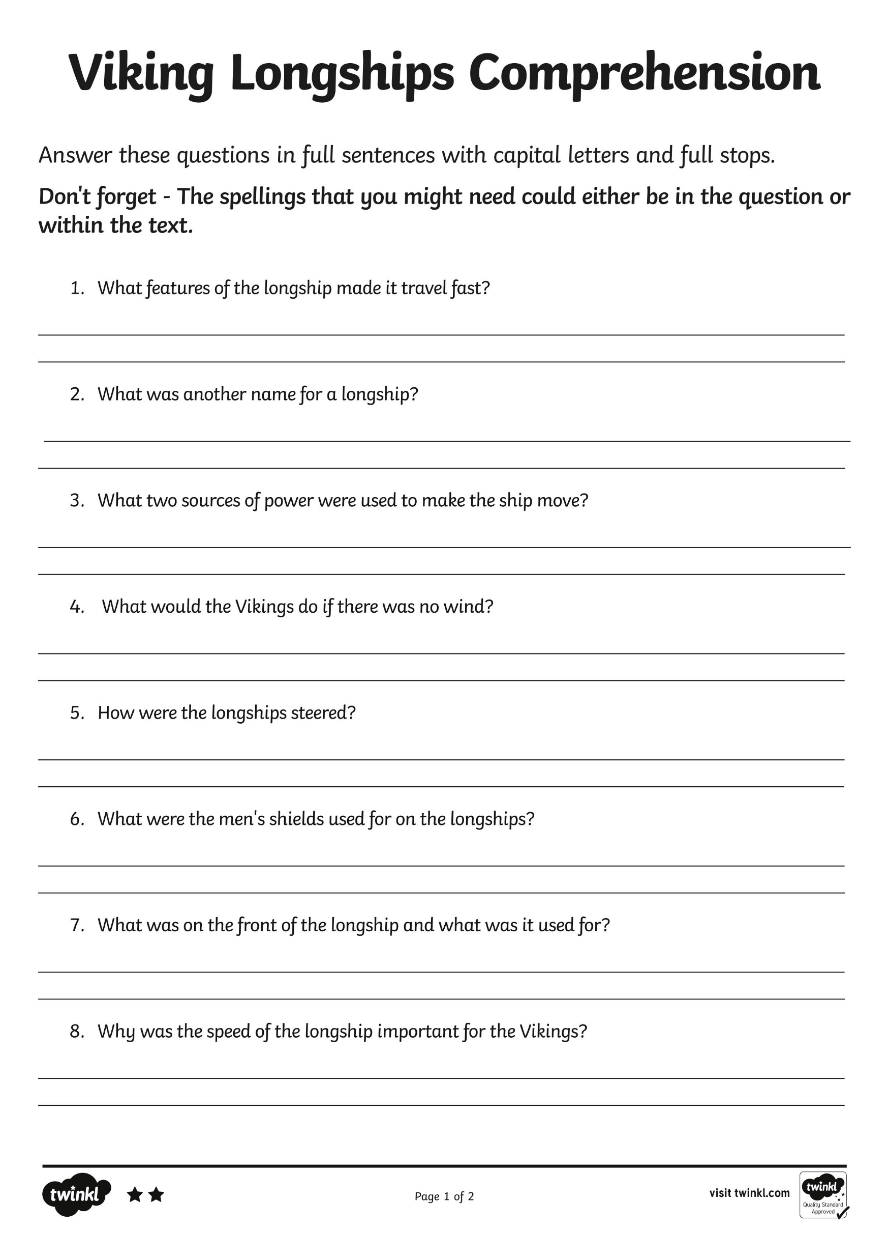
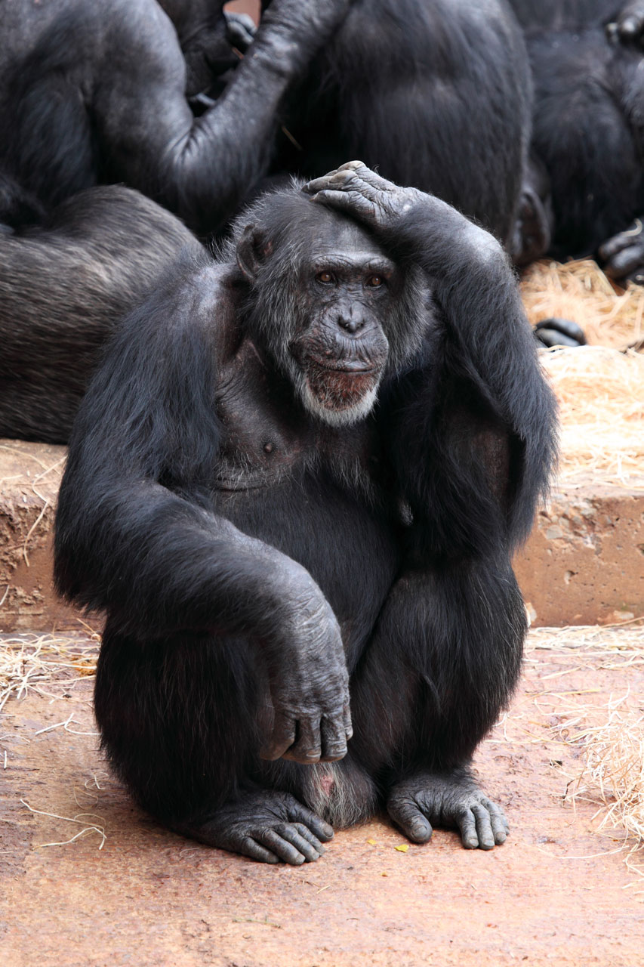

Slide 7
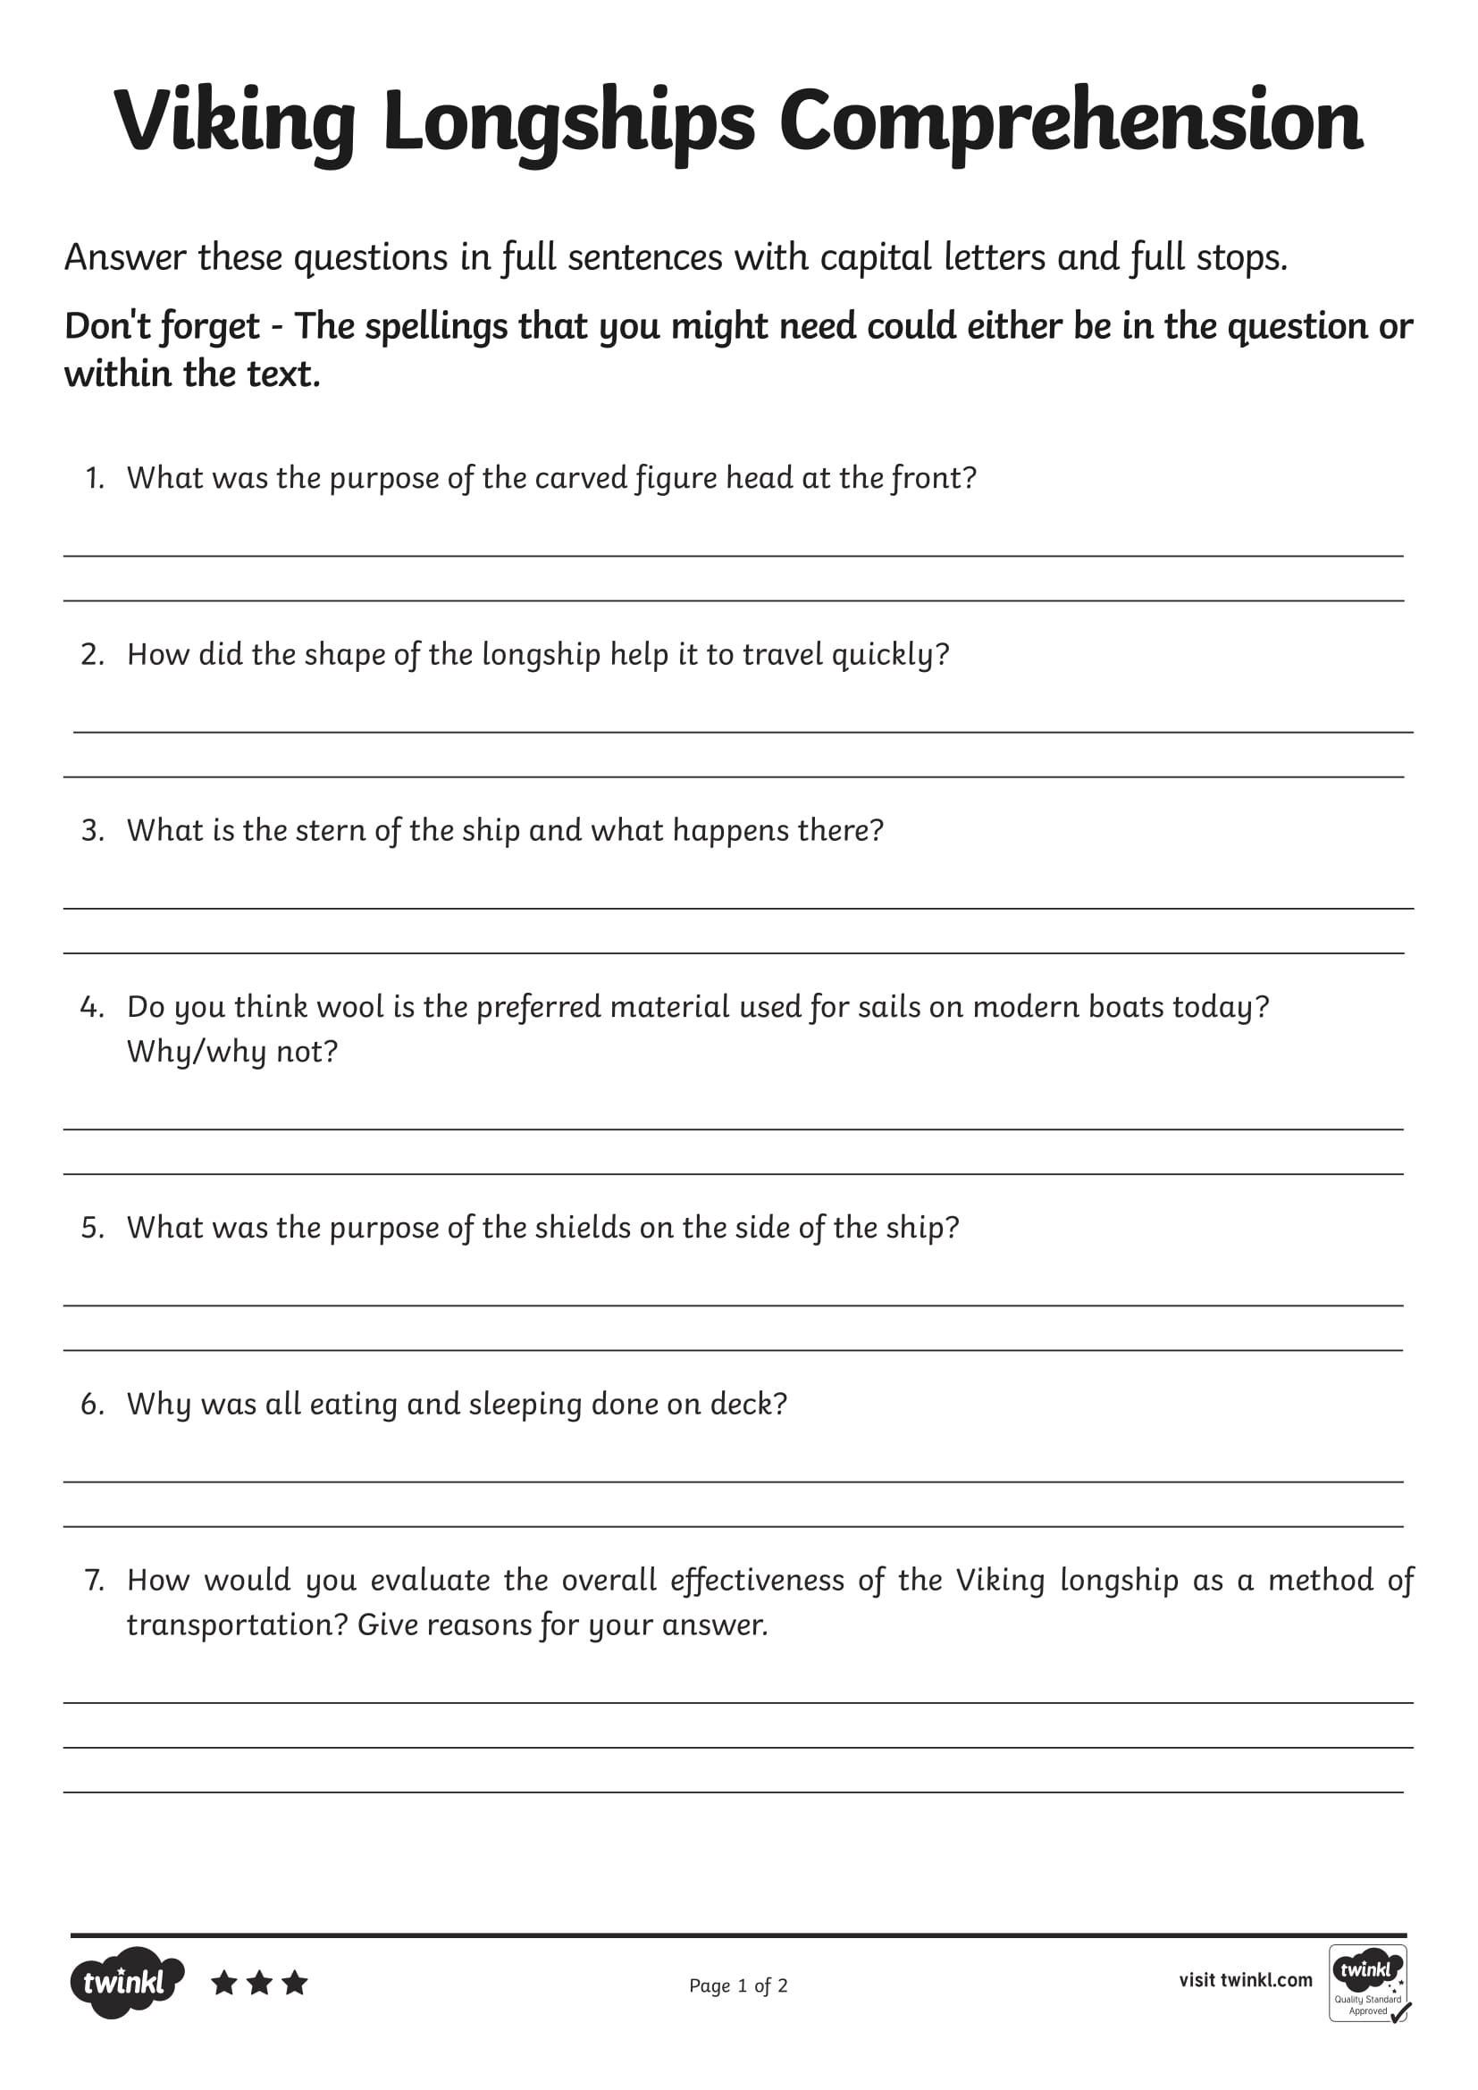
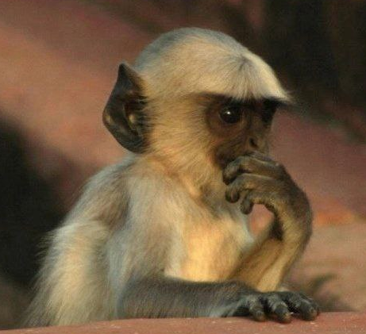

Slide 8

Numeracy
Learning Intention
We are learning to understand multiplication and our times tables.
Success Criteria
- Pick a mild, hot or spicy chilli challenge from the following slides to complete in you jotter - you can do all three if you wish!
Write the answers in your jotter.
Remember to check your work.

Slide 9
Today we are learning our 10 times tables.
Please copy and complete the 10 times table into your jotter then select 1 of the chilli challenges to complete as well.
10 x 0 =
10 x 1 =
10 x 2 =
10 x 3 =
10 x 4 =
10 x 5 =
10 x 6 =
10 x 7 =
10 x 8 =
10 x 9 =
10 x 10 =
10 x 10 =
9 x 10 =
8 x 10 =
7 x 10 =
6 x 10 =
5 x 10 =
4 x 10 =
3 x 10 =
2 x 10 =
1 x 10 =
0 x 10 =

Slide 10
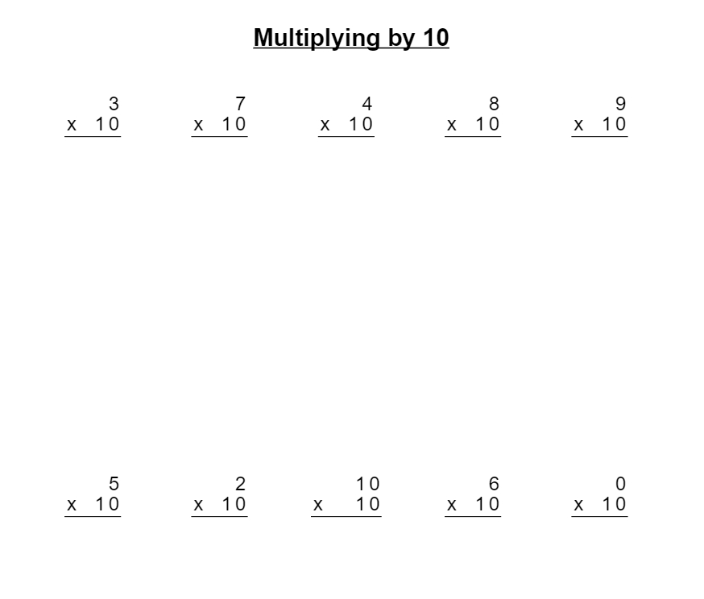
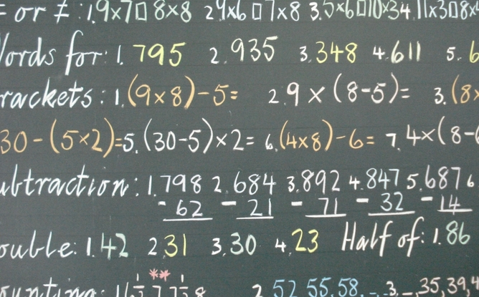
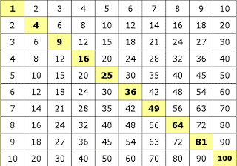

Slide 11
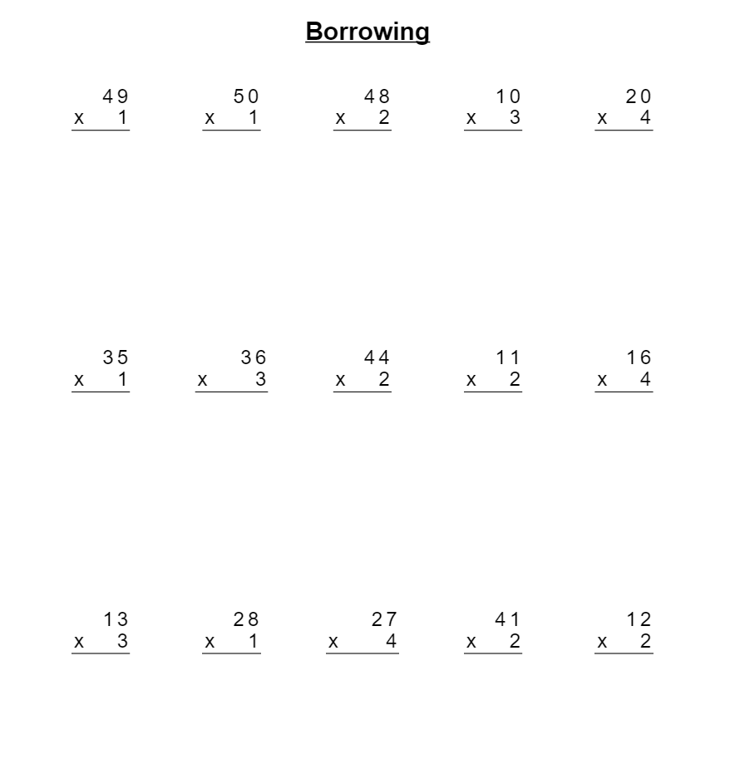

Slide 12
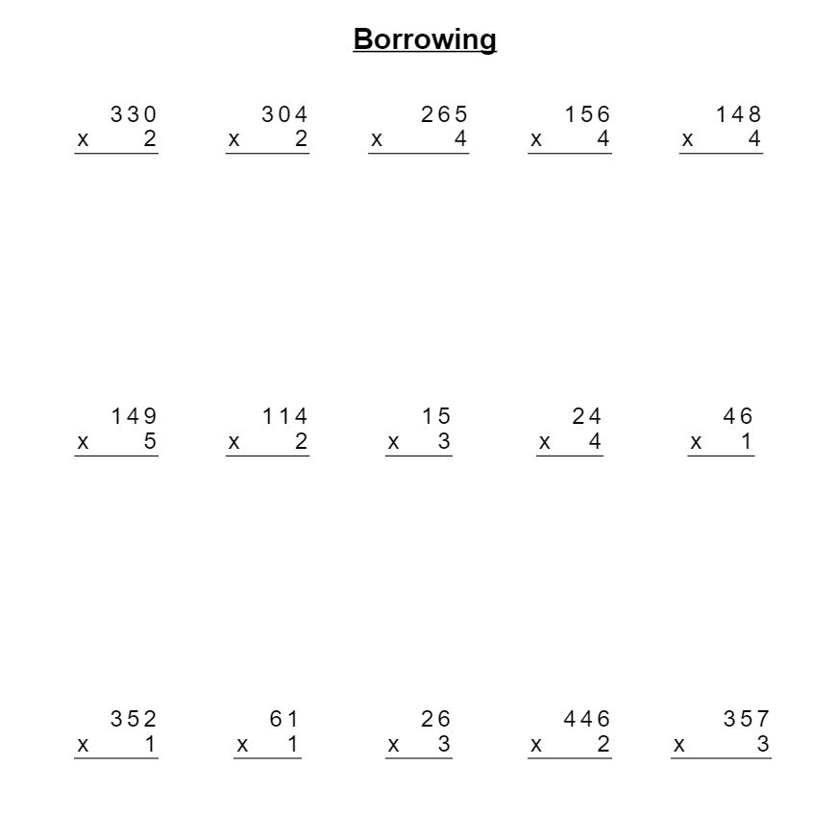

Slide 13
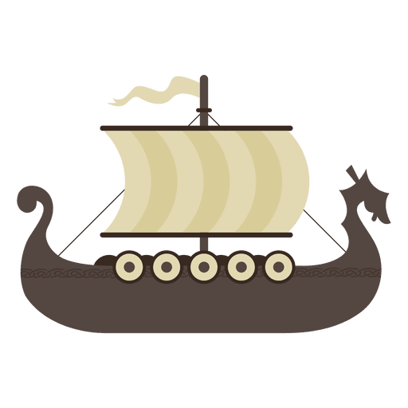
Art
Click the link below and follow the instructions on how to create your own Viking Long Ship.
How to Draw a VIKING SHIP!!! - YouTube

Slide 14
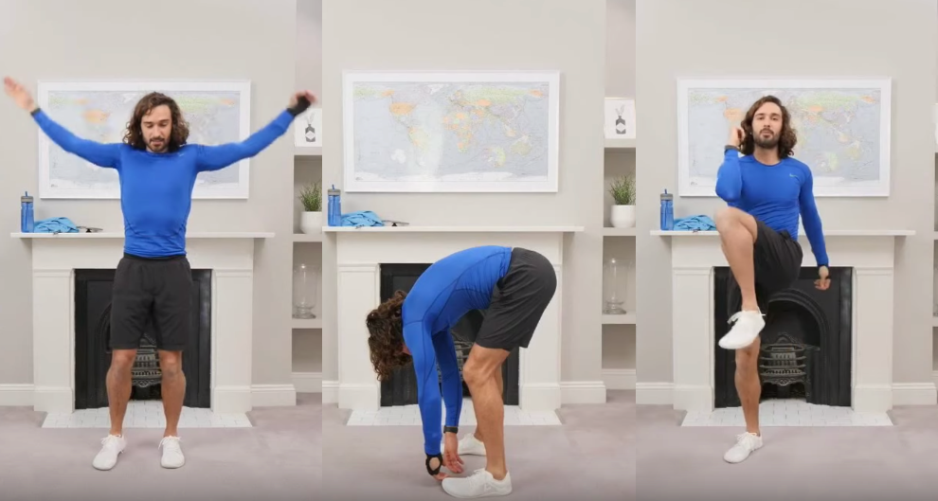
P.E
Follow the link to Joe Wicks and complete the activities.
https://www.youtube.com/watch?v=0VHkFJ8nqPw

Slide 15
Night time prayer
God our Father, I come to say thank you for your love today.
Thank you for my family and all the friends you give to me.
Guard me in the dark of night and in the morning send your light.Amen.

