Slide 1
St Mary’s RC primary school Tuesday 9th February 2021
P3 and P4

Slide 2
Morning Prayer
Father in heaven You love me
You are with me night and day
I want to love you always
In all I do and say
I’ll try to please you Father
Bless me through this day
Amen

Slide 3
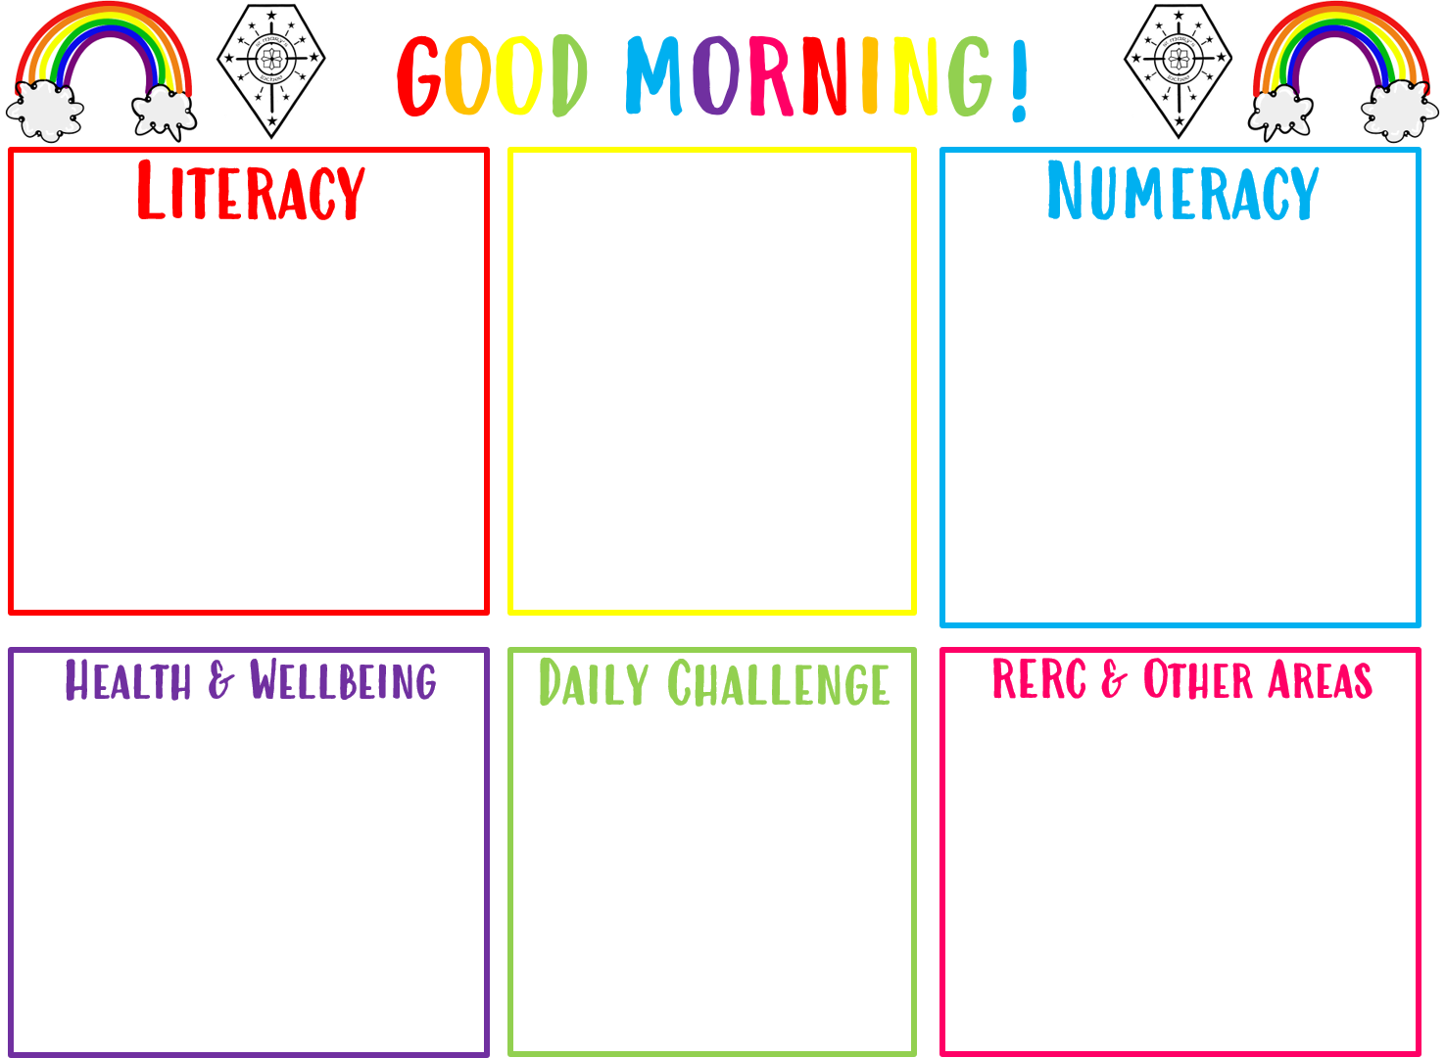
Good morning P3 and P4, today is
Tuesday 09th February 2021
09/02/2021
Access the PPT for Literacy and choose a chilli challenge and complete the sentences into your jotter adding any missing punctuation.
Access numeracy slides in the power point and select a subtraction chilli challenge to complete in your jotter.
Access link to Cosmic Kids Yoga video and complete activity.
If you could go anywhere in the world at any time where would you go and why?
Learn about the Viking alphabet and complete the language activities in your jotter.

Slide 4
Morning Challenge
Would you rather?
Be able to run really fast?
Be able to control the weather?
Be able to turn into a giant?
Write your favourite in your jotter and draw a picture.

Slide 5
Grammar and Punctuation.
Learning Intention:
We are learning to use punctuation in our sentences.
Success Criteria:
I can use a capital letter at the start of a sentence.
I can end a sentence with he correct punctuation (?, !, .).
I can write a punctuated sentence correctly in my jotter.

Slide 6
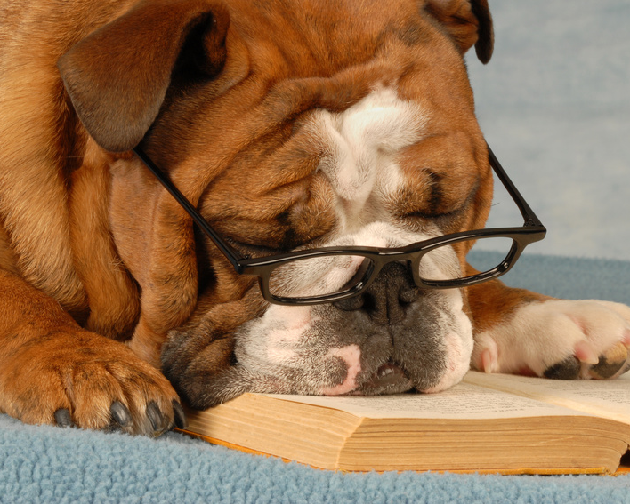
Why do we need to make sure that we use the correct punctuation in our writing?
If we do not use the correct punctuation, our writing may be unclear or misleading to the reader.
Punctuation structures our writing clearly, makes the information easy to understand and adds extra information in a clear and precise way.

Slide 7
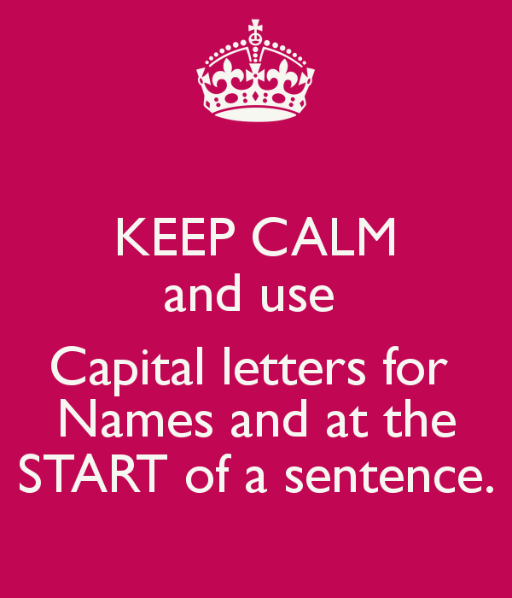
When to Use Capital Letters
To Start a Sentence - This means that, after a full stop, you always use a capital letter. If the previous sentence ends with a question mark (?) or exclamation mark (!), you should also use a capital letter.
For Proper Nouns - Proper nouns name a particular person, place, or thing, for example, Jane, John, Dundee, Everest, Scotland. Proper nouns always start with a capital letter.

Slide 8
Which Punctuation should I use?
Use a Full Stop to show the end of a sentence.
Football is a popular sport in Scotland.
Use a question mark at the end of a sentence to show a direct question.
What time is it?
Use an exclamation mark at the end of a sentence to show surprise or excitement.
We won the World Cup!

Slide 9
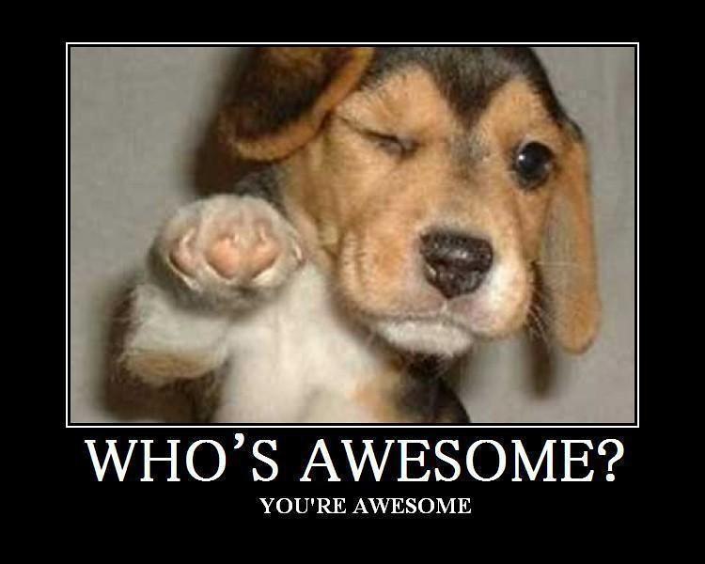
Todays Task:
Please Select one of the following chilli challenges. Read the sentences and correct the punctuation in each. Use what you have learned to enter the correct punctuation marks:
? ! .
And insert capital letters where they are needed.

Slide 10
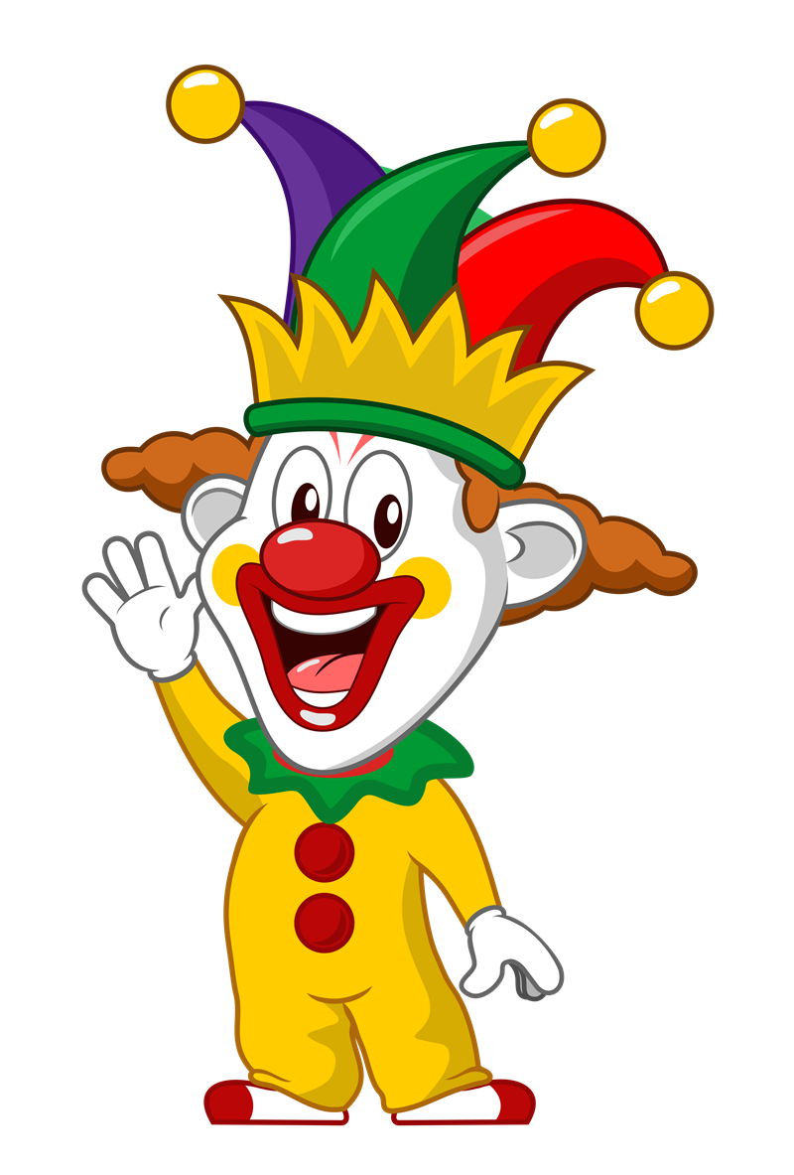
Copy the following sentences into your jotter, adding in any missing capital letters and full stops.
the clown had a red nose
he wore a yellow jacket and baggy trousers
the clown had long legs and big boots
his tall hat had a pink feather in it
the clowns name is coco

Slide 11
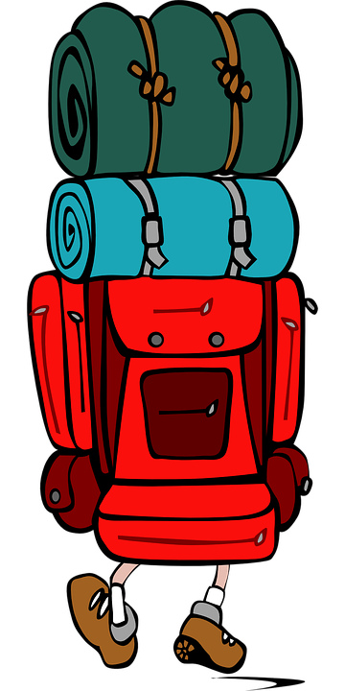
Copy the following sentences into your jotter, adding in any missing capital letters and punctuation marks ( . Or ? ).
anne moore lives in edinburgh
my address is 14 king street in dundee
have you ever been to america or canada
the mountain climber climbed mount Everest
is christmas in november or december

Slide 12
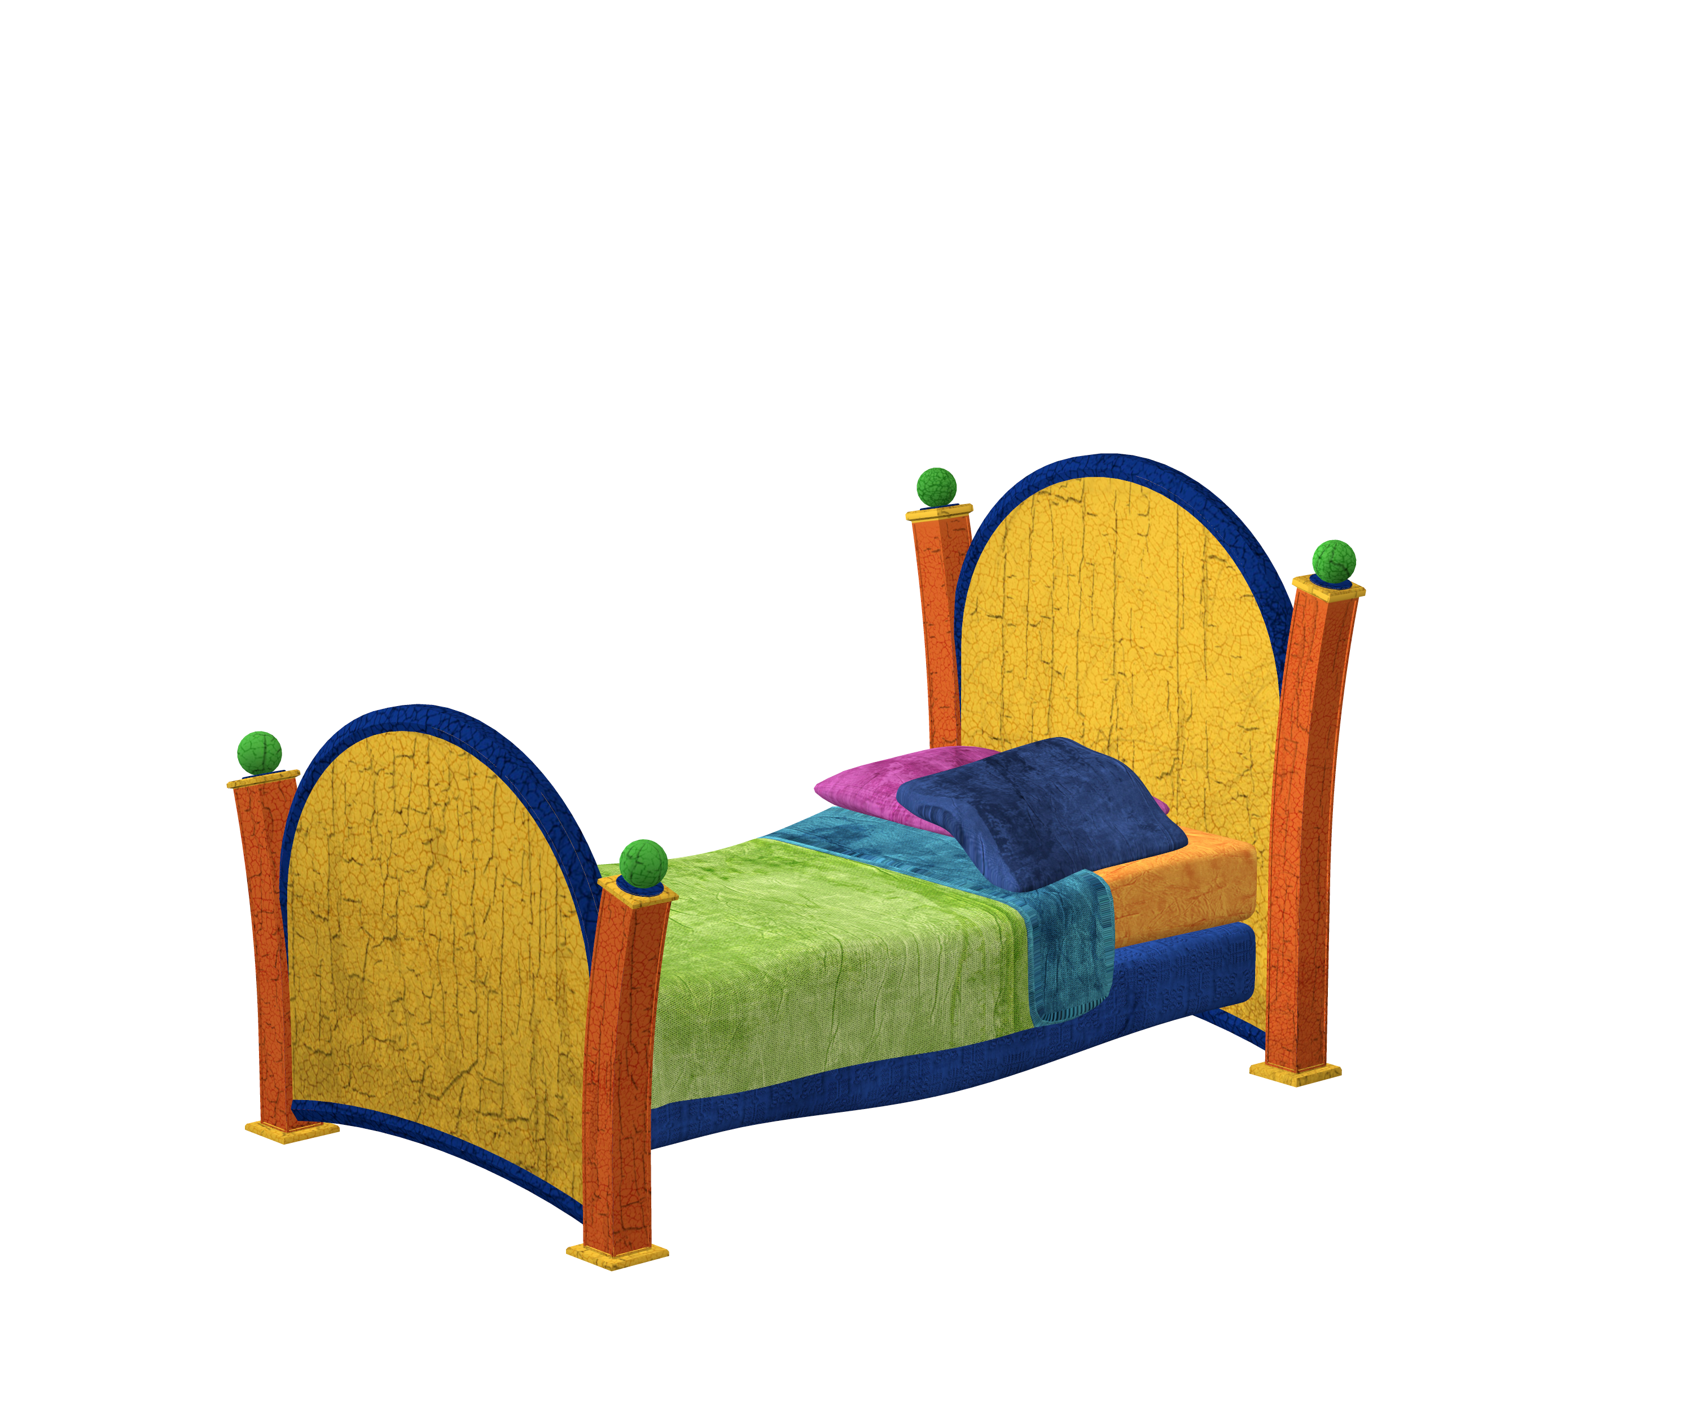
Copy the following sentences into your jotter, adding in any missing capital letters and punctuation marks ( . ? Or ! ).
have you ever felt so tired that you just wanted to stay in bed all day
dan felt happy and contented that he was getting to stay in his bed for an extra hour
help i have locked myself out of the house
edward threw the ball at sue unfortunately it missed and hit the window
it is sara’s 9th birthday and she can invite one friend to her party, do you think she will pick me or john

Slide 13
Numeracy Chimney sums
Learning Intention:
Write chimney sums and complete subtraction problems.
Success Criteria:
- I know that the ones, tens and hundreds must be lined up
I can take the bottom number away from the top number in the correct columns and put the answers under that column
My writing is neat and tidy

Slide 14
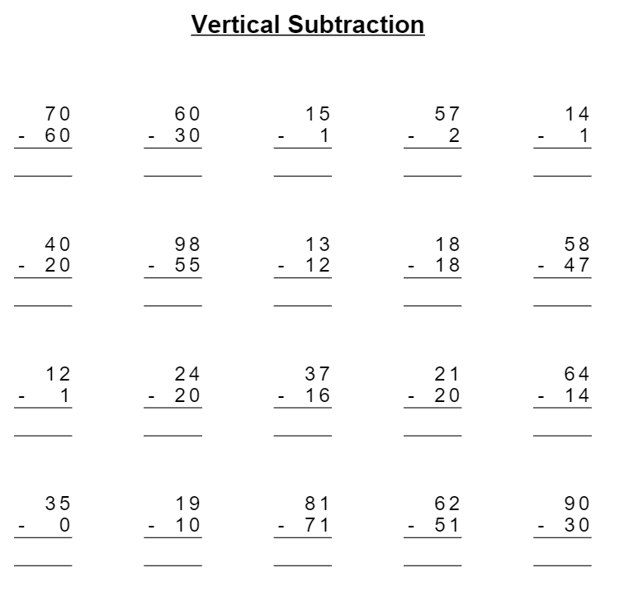
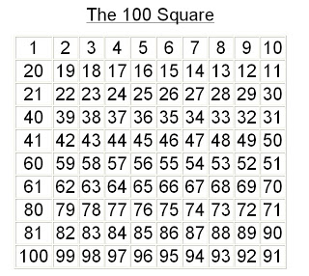
Mild Challenge: No Regrouping
Copy and complete these subtraction sums in your jotter remembering to complete your ones column and then the tens column.

Slide 15
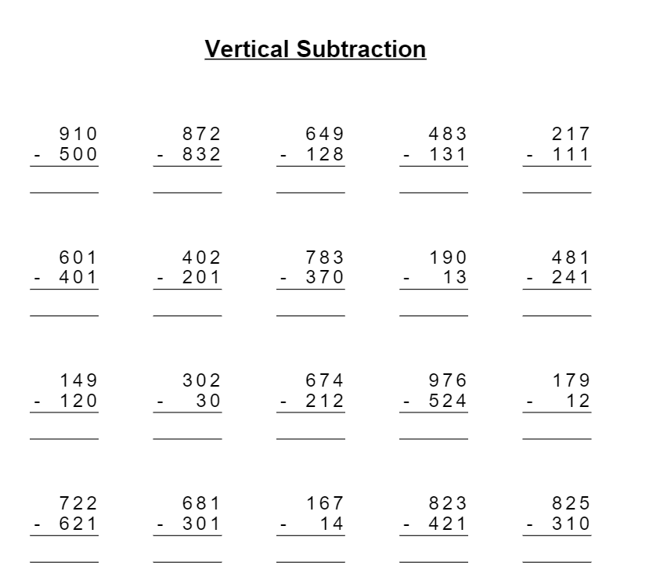
Hot Challenge: No Regrouping
Copy and complete these subtraction sums in your jotter remembering to complete you ones column, then the tens column and finally the hundreds column.

Slide 16
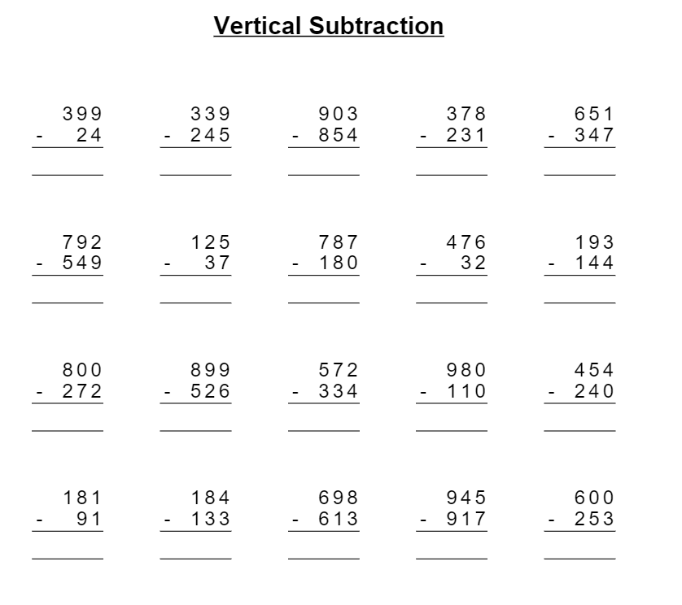
Spicy Challenge: Regrouping
Copy and complete these subtraction sums in your jotter remembering to complete you ones column, then the tens column and finally the hundreds column.

Slide 17
Viking Alphabet
What is the Viking alphabet called?
Runic alphabet
The runic alphabet, or Futhark, gets its name from its first six sounds (f, u, th, a, r, k), much like the word 'alphabet' derives from the first two letters of the Greek alphabet, alpha and beta.

Slide 18
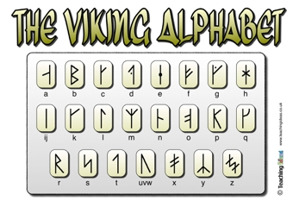

Slide 19
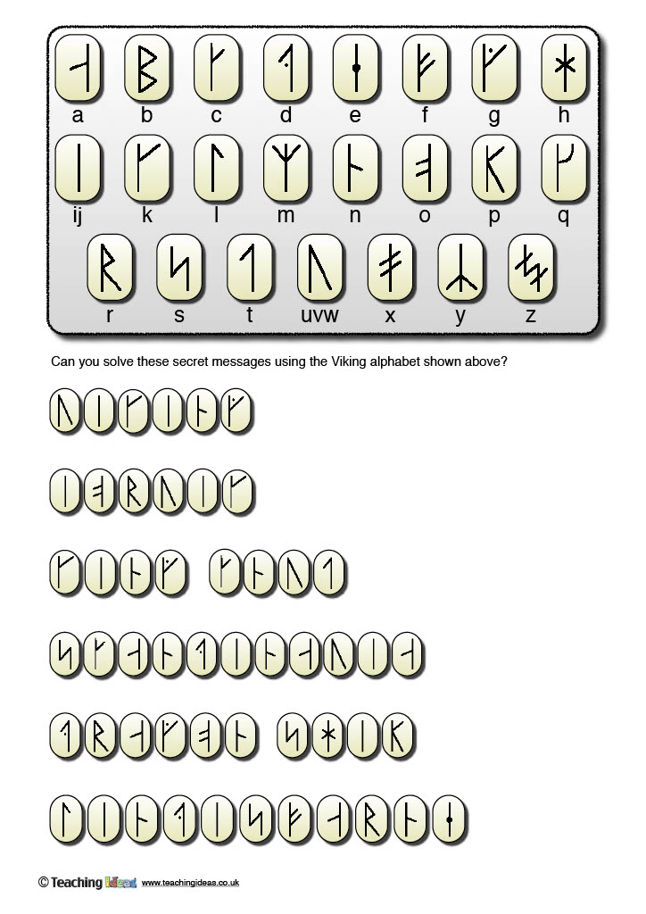
Use the Rune/alphabet guide to solve the following hidden Viking messages.
By finding each rune in the code use the letter underneath to crack the code and reveal the hidden message.
Number one translates into the word
1. Viking

Slide 20
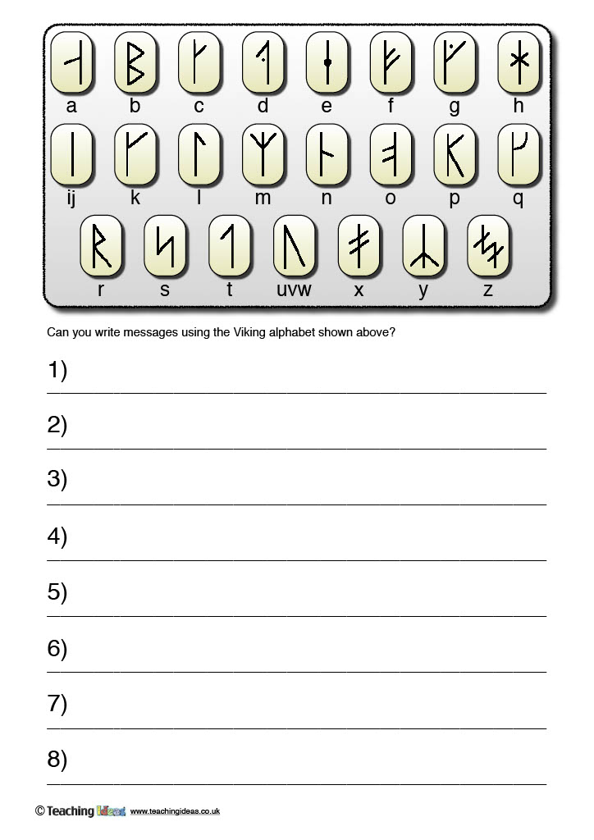
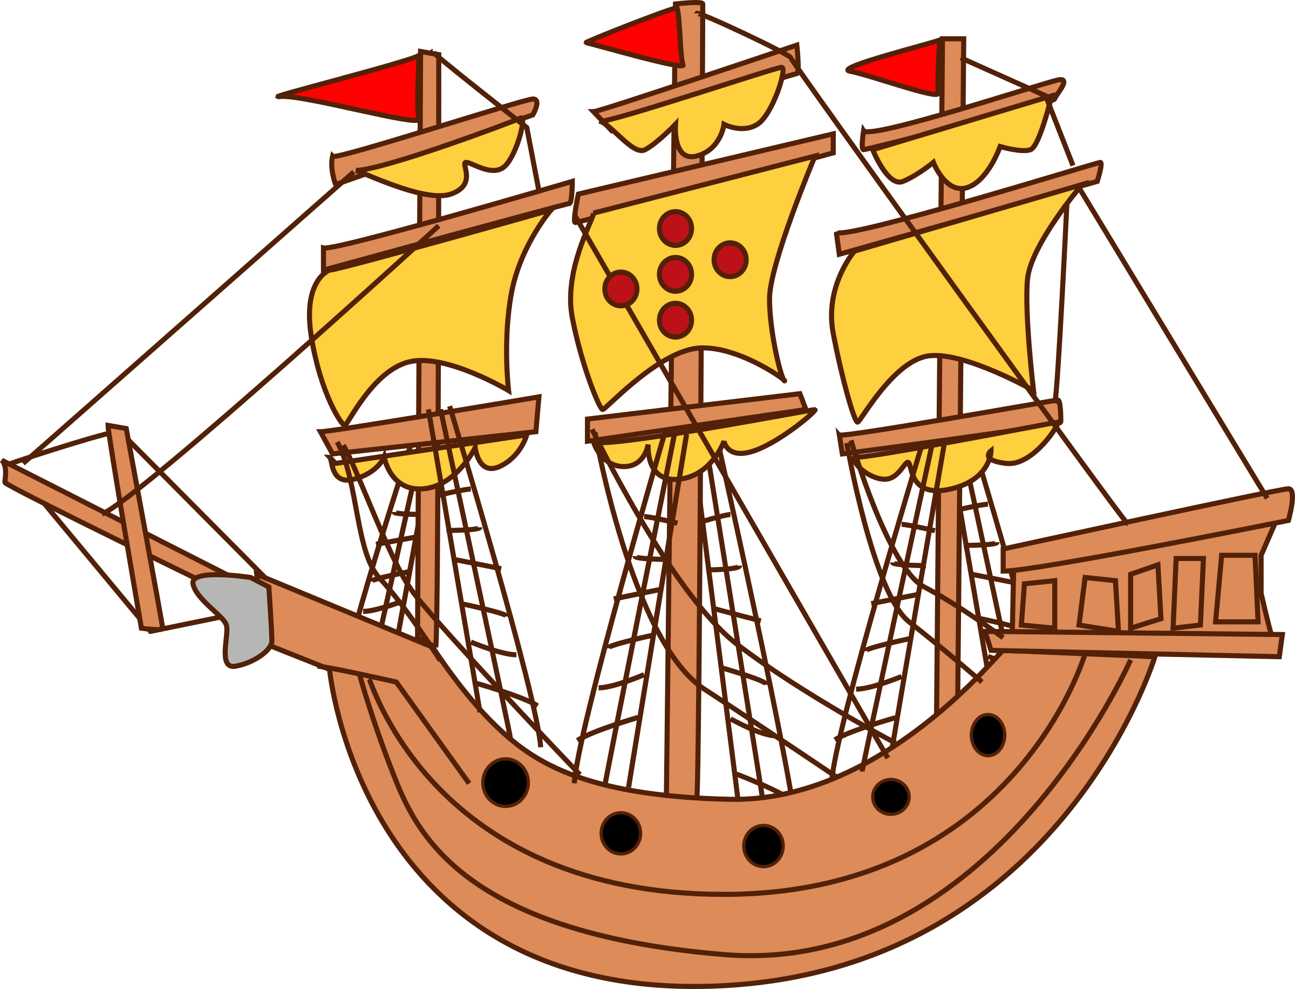
Now try it yourself. Create your own coded messages using Nordic Runes in your jotters.

Slide 21
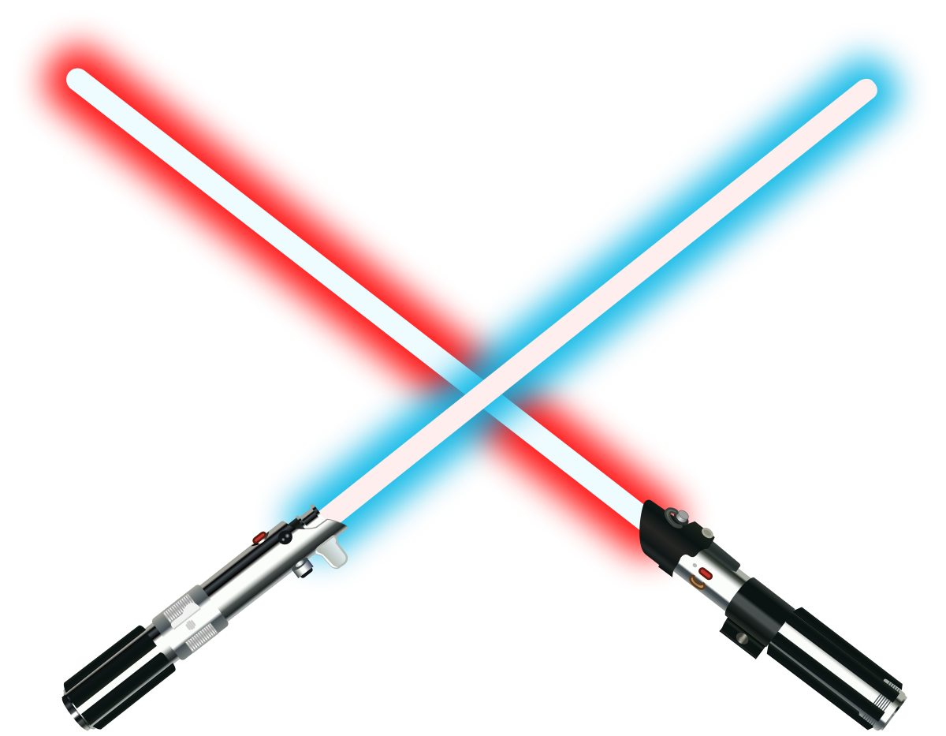
Cosmic Kids Yoga – Star Wars
https://www.youtube.com/watch?v=coC0eUSm-pc

Slide 22
Night time prayer
God our Father, I come to say thank you for your love today.
Thank you for my family and all the friends you give to me.
Guard me in the dark of night and in the morning send your light.Amen.

