Slide 1
St Mary’s Glow Blog
P3 & P4
Monday 8th February
With Mrs Gould

Slide 2
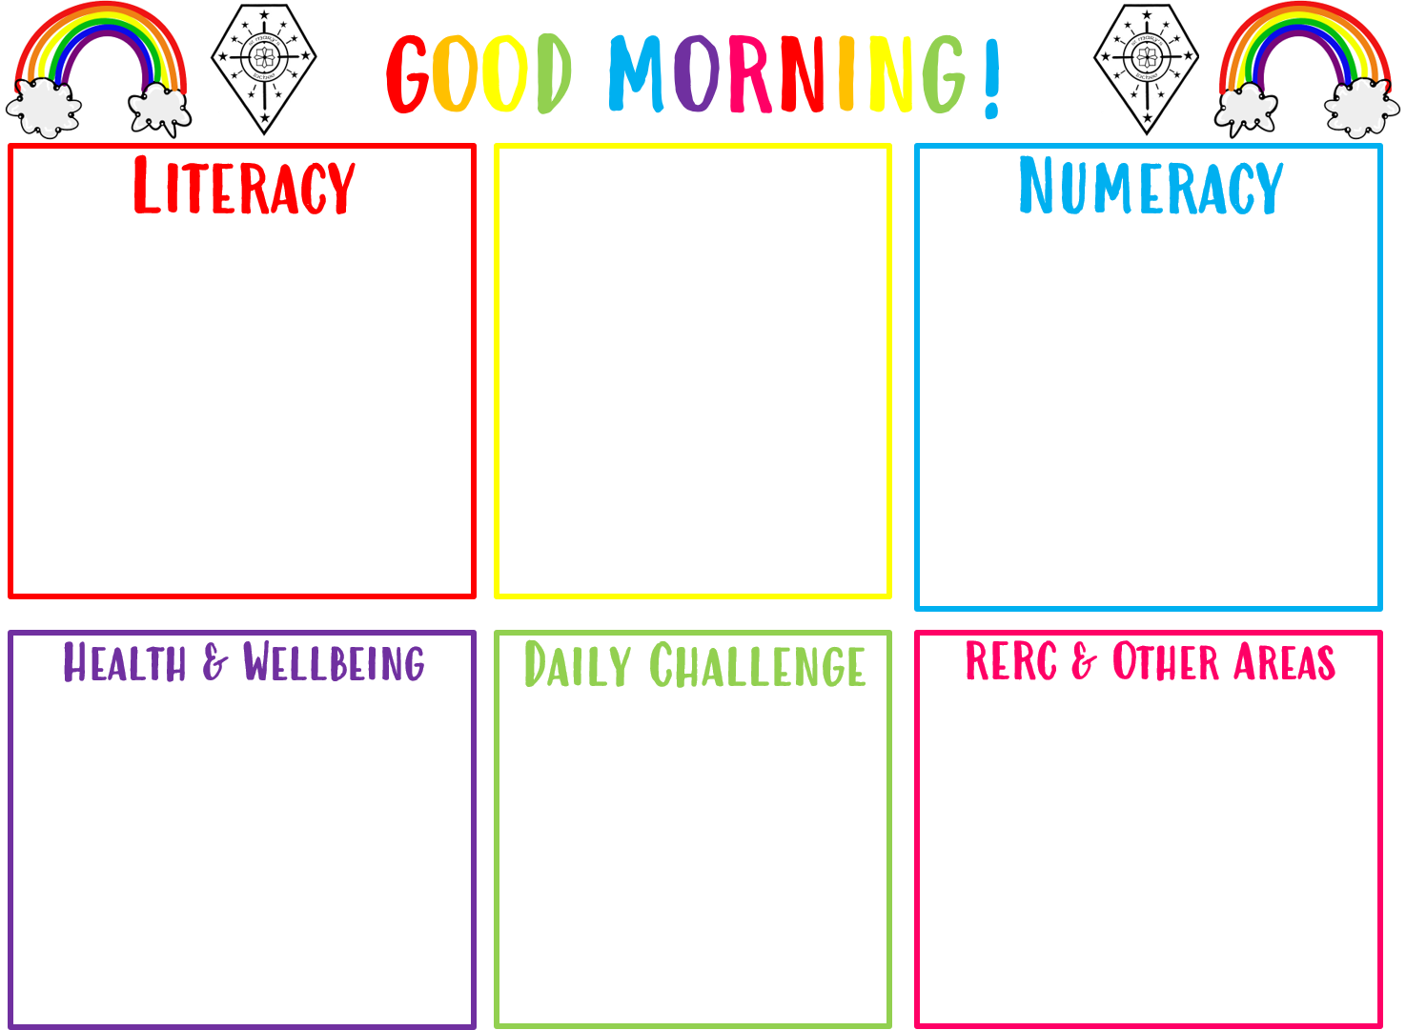
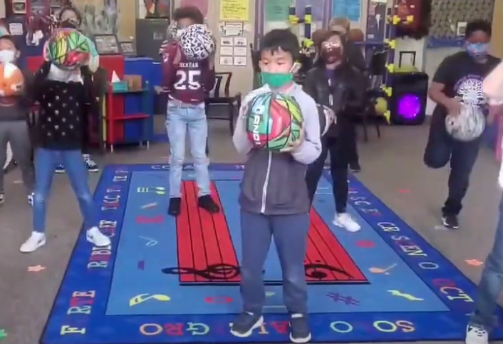
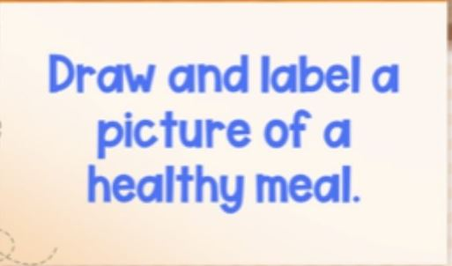
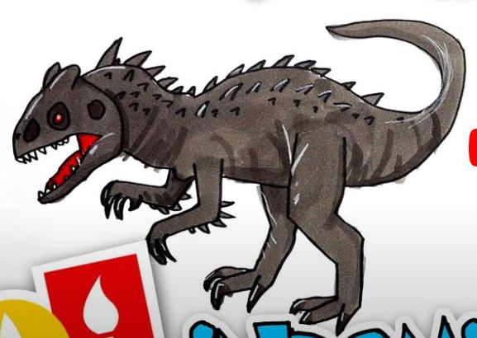
Good morning boys and girls
Monday 8th February
08/02/2021
The in school teacher is
Mrs Gould
All completed work should be sent to Mrs Raeper
ddaraeper726@glow.sch.uk
We are learning our spelling words and using those words in sentences.
Addition and Subtraction today. Take the mild, hot or chilli challenge.
Art – How to draw a dinosaur.

Slide 3
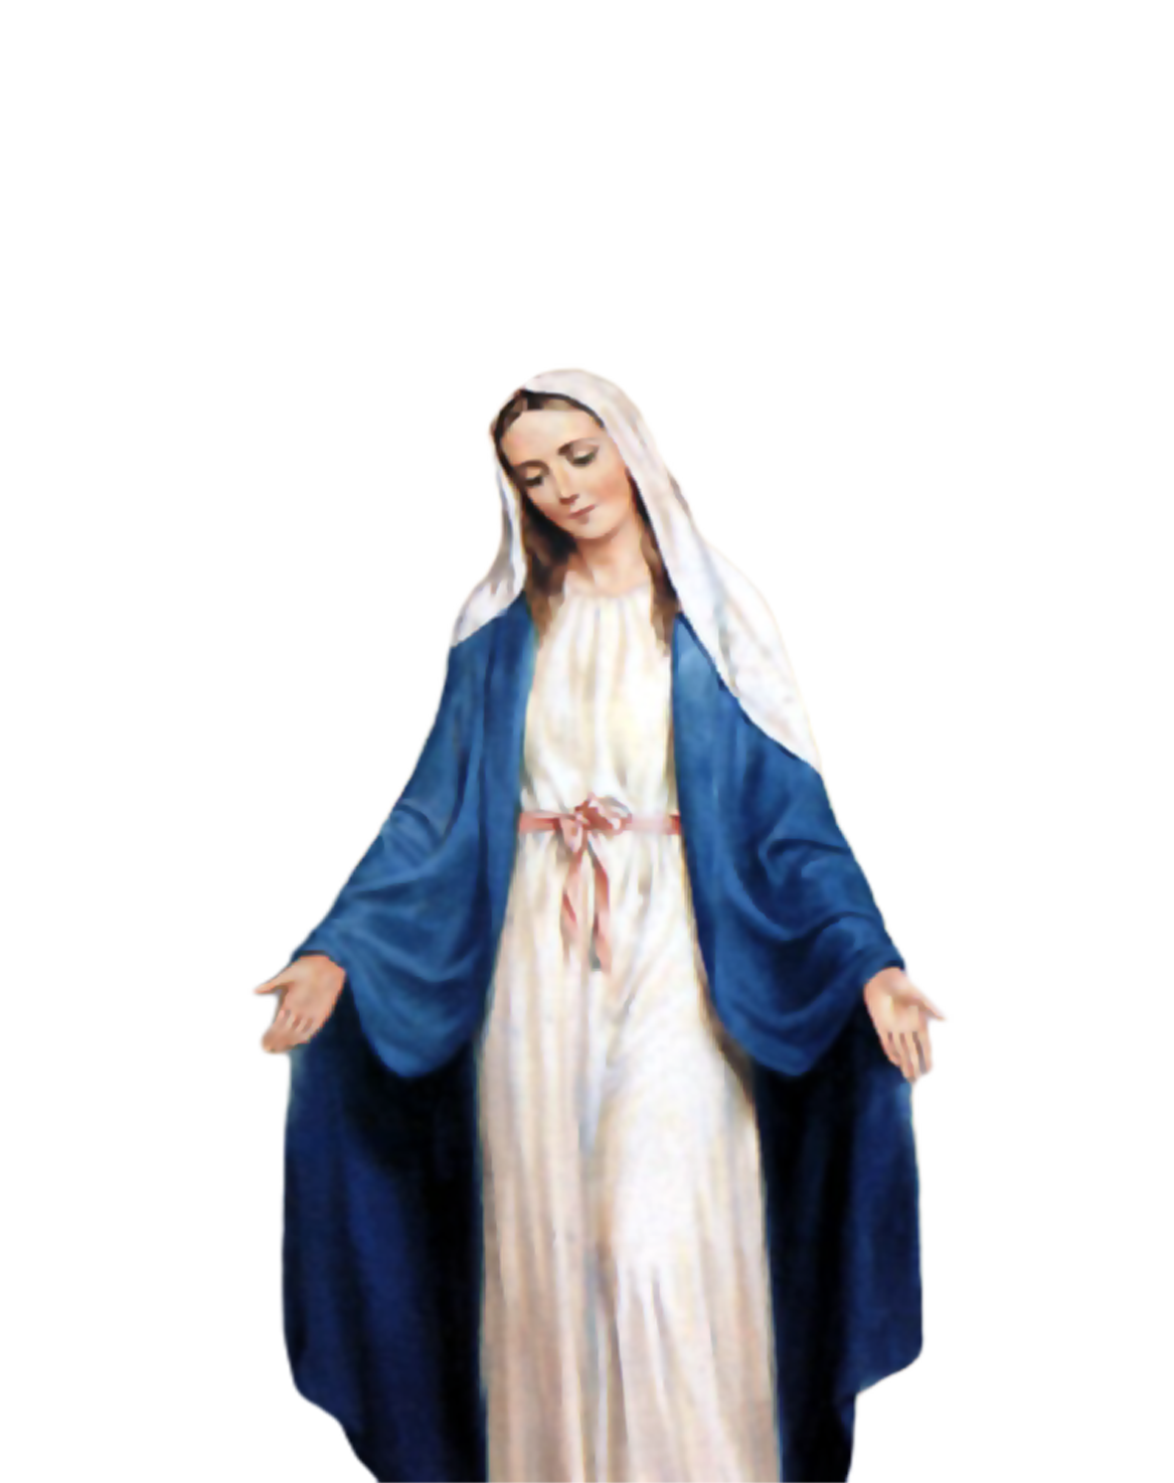
Morning Prayer
Father in heaven you love me
You are with me night and day
I want to love you always
In all I do and say
I’ll try to please you Father
Bless me through this day
Amen

Slide 4
Morning Challenge

Slide 5
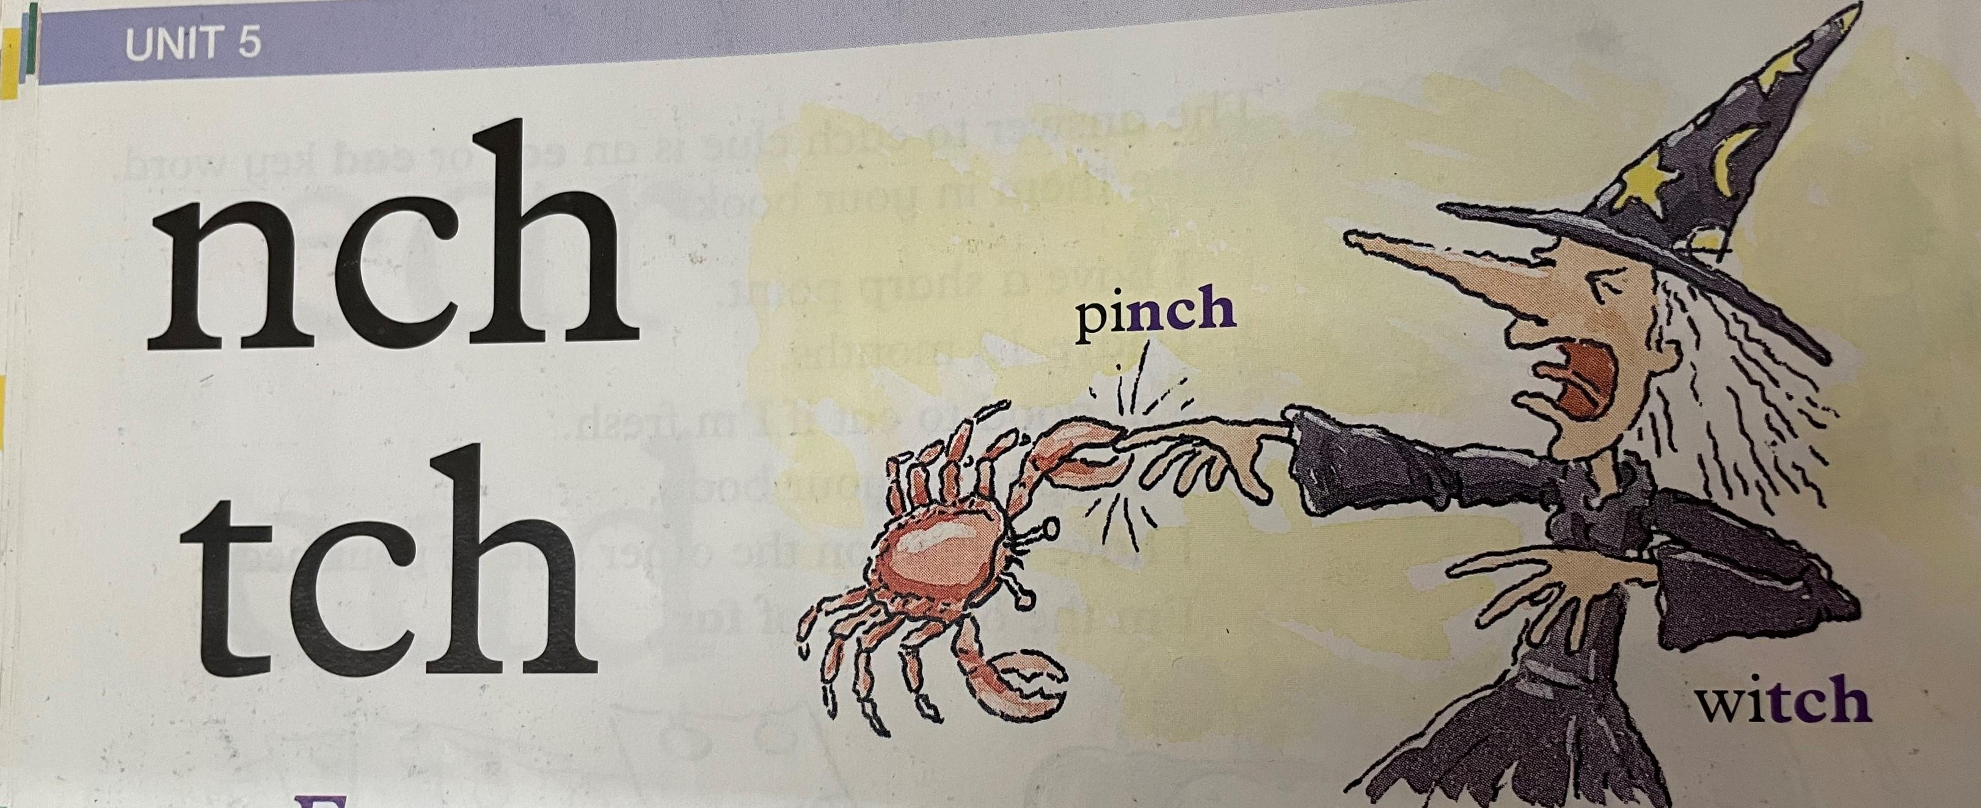
Literacy- Spelling and Sentences
Learning Intention:
We are learning our spelling words and using these
words in sentences.
Success Criteria:
Spend time looking at the spelling words and trying to
remember the new sound in each word.
When you are writing the new words in your sentences,
keep checking your spelling.
Remember, sentences start with a capital letter and end
with a full stop.

Slide 6
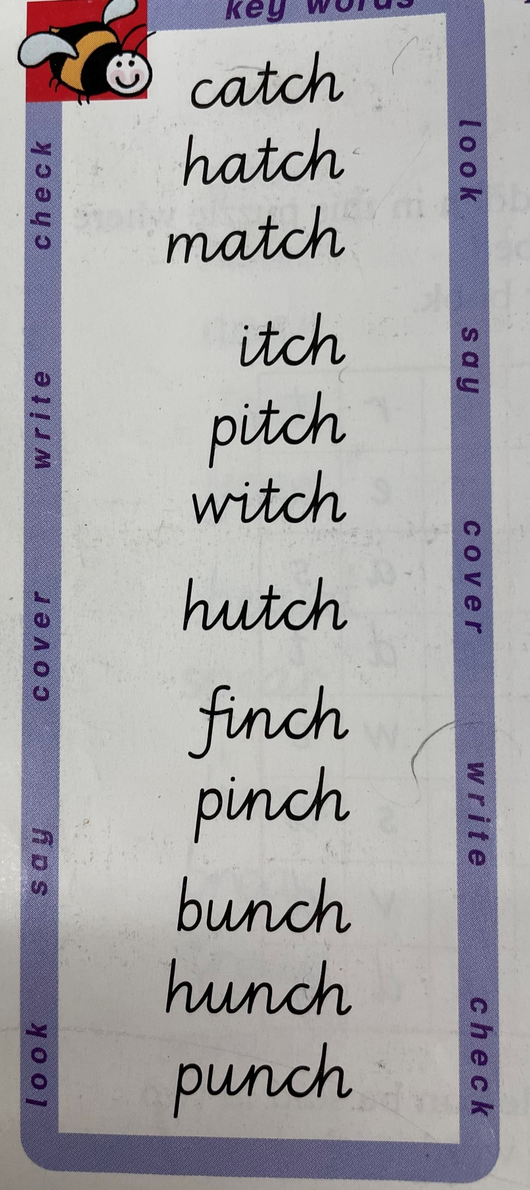
Mild Challenge
Read through the words.
Try to remember the words without looking.
Write the spelling words in your jotter 3 times.

Slide 7
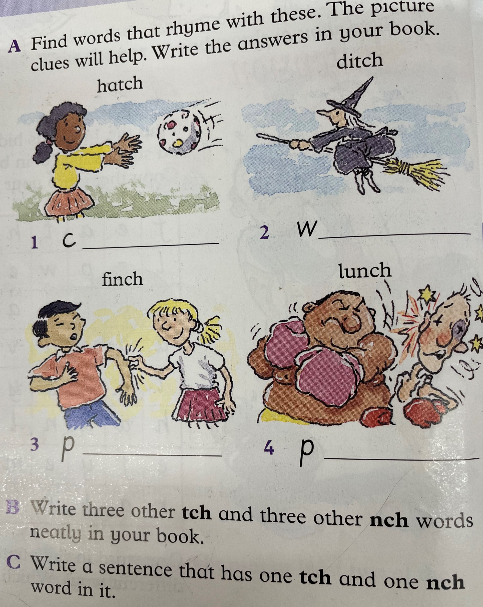
Hot Challenge
Write the spelling list 3 times and complete the challenge below.

Slide 8
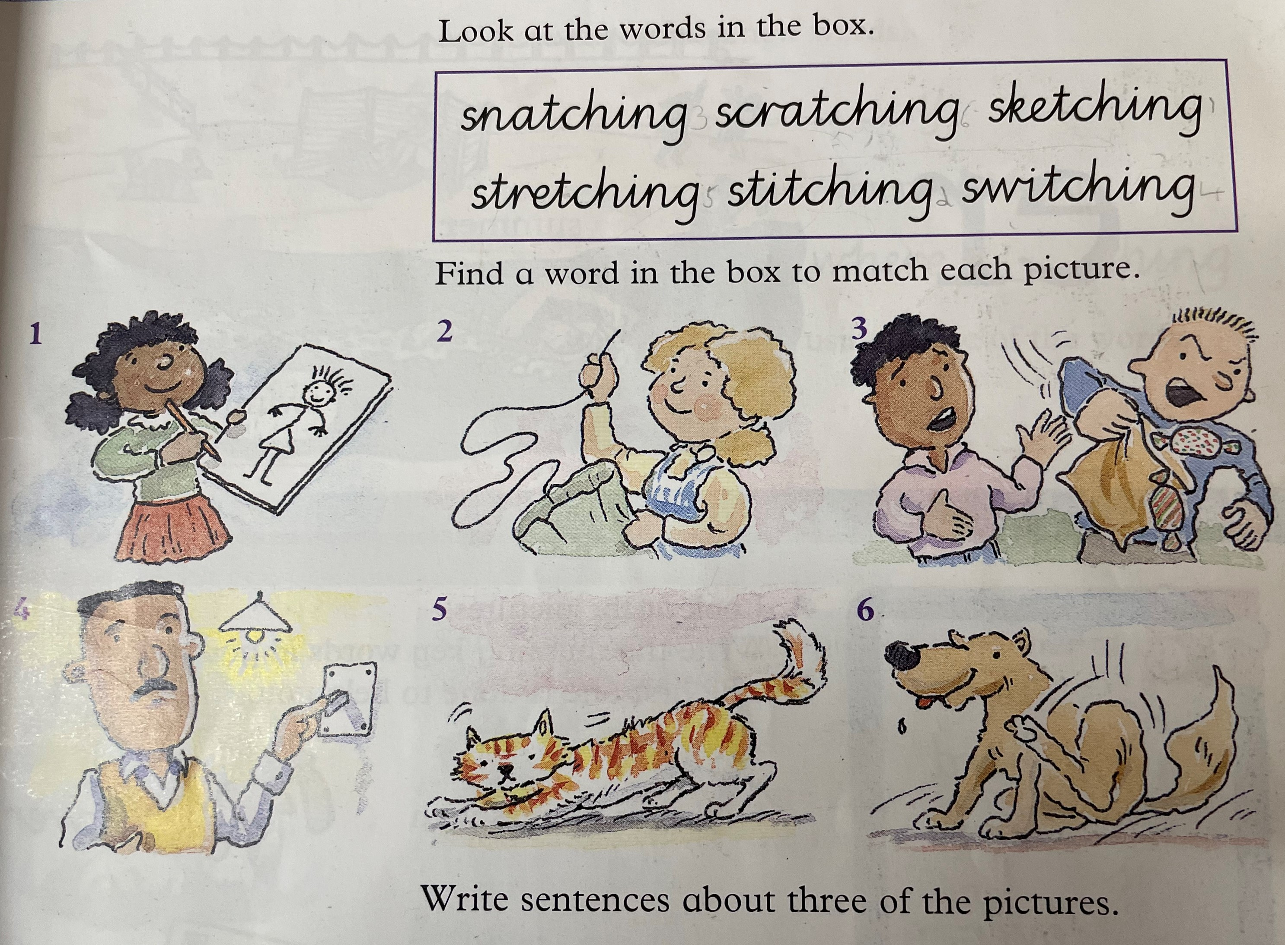
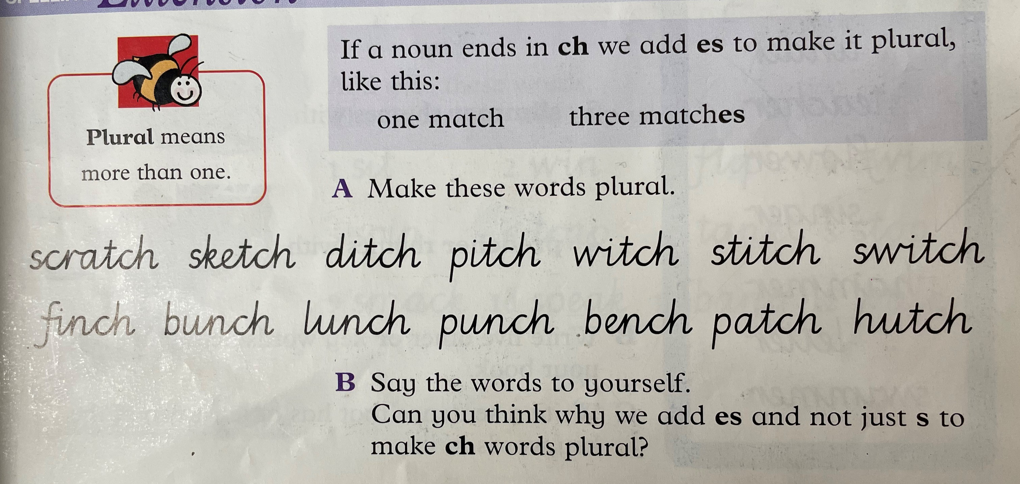
Chilli Challenge
Complete the challenge below.

Slide 9
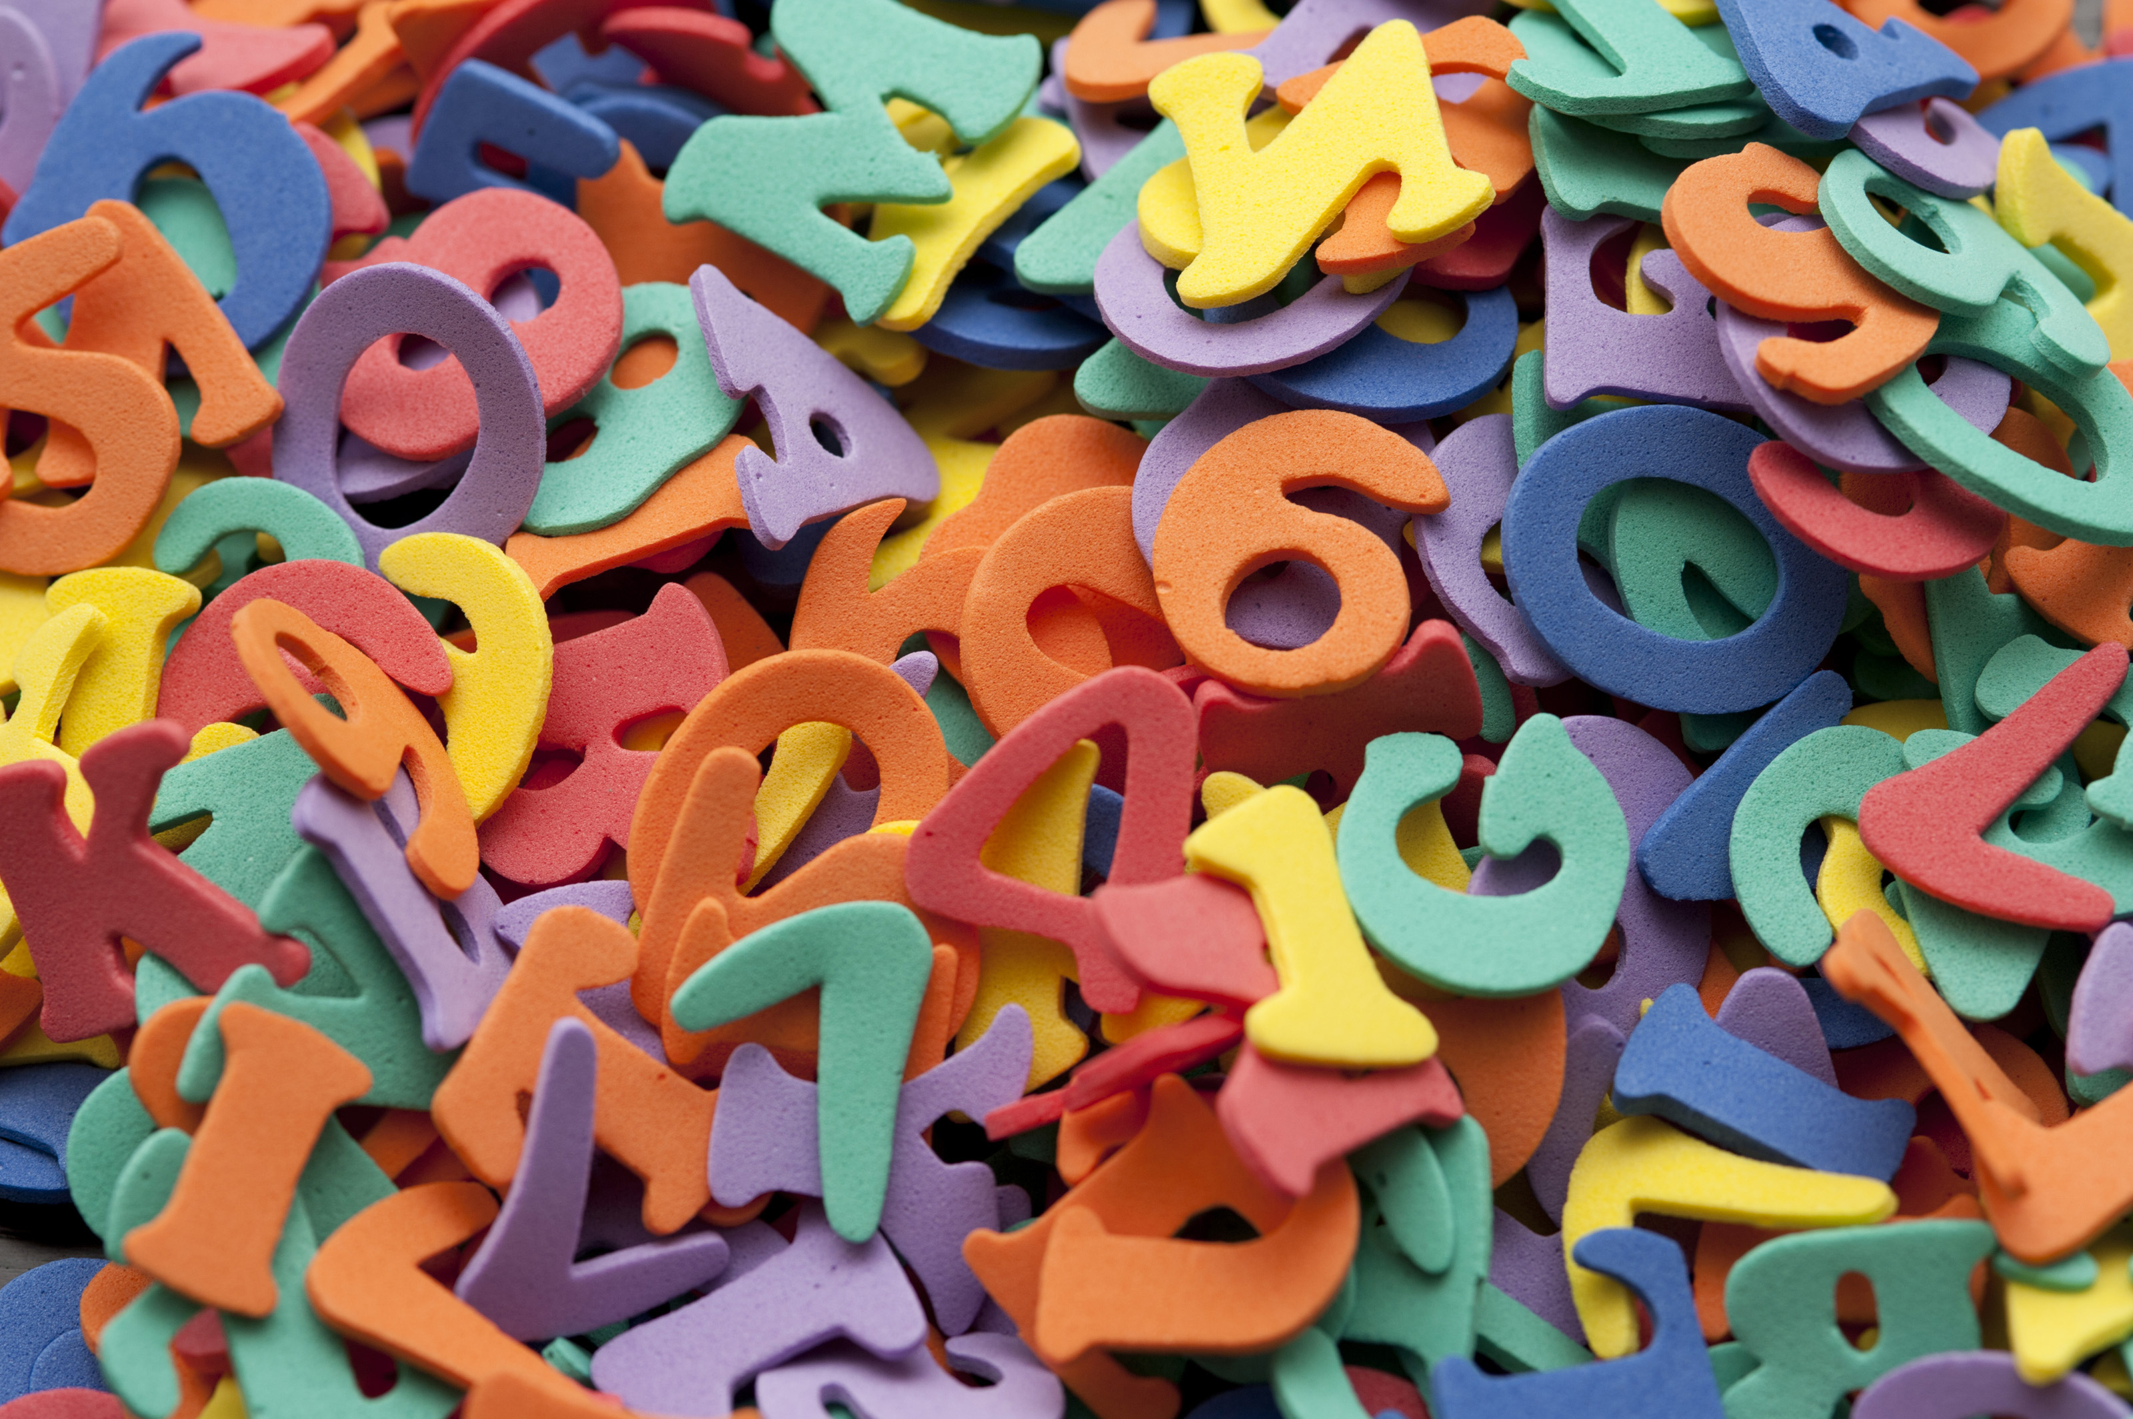
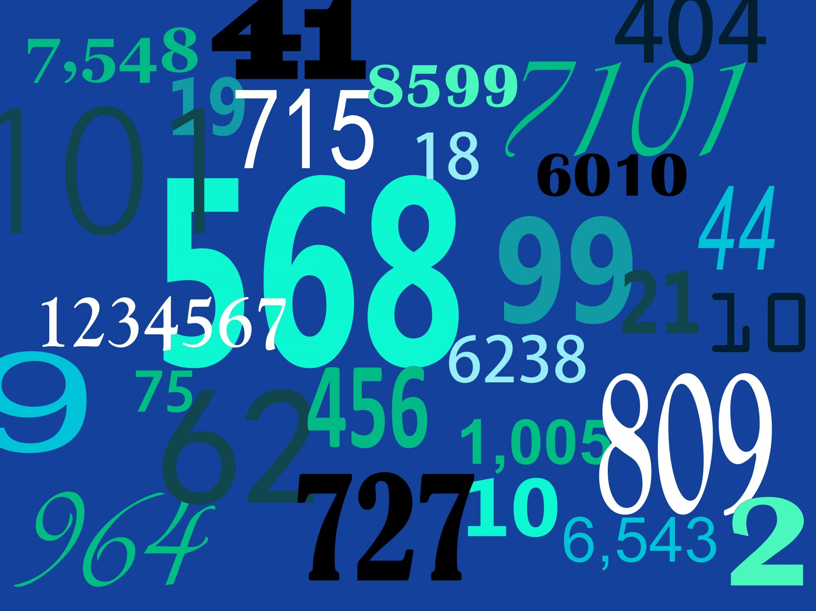
Number 08.02.21 Addition and Subtraction Today we have addition and subtraction challenges. Remember the rules! If you are adding the answer will get bigger. If you are taking away, the answer will get smaller.
This Photo by Unknown Author is licensed under CC BY
This Photo by Unknown Author is licensed under CC BY-NC
This Photo by Unknown Author is licensed under CC BY-NC

Slide 10
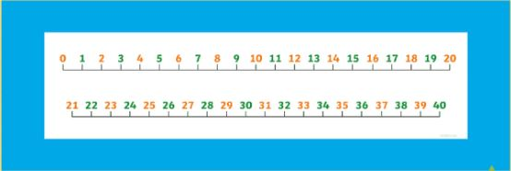
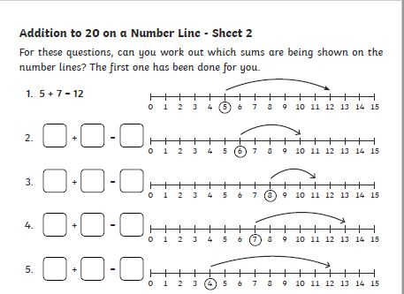
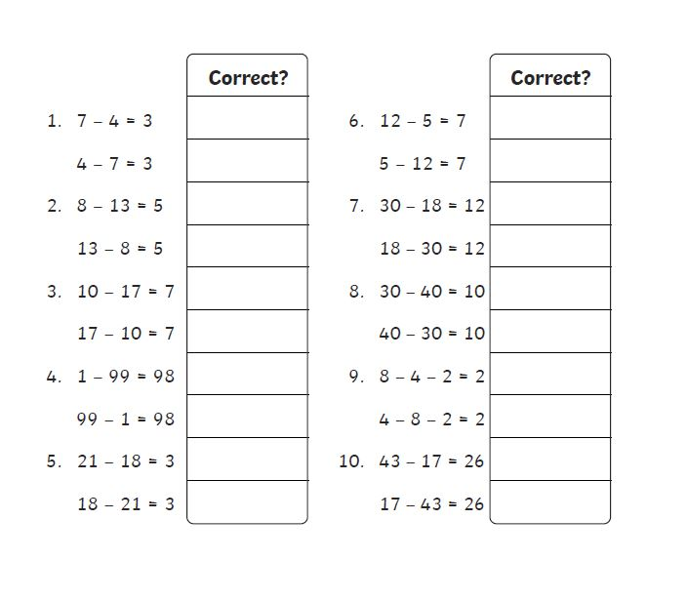
Mild Challenge – Use the number line to help you add and subtract.

Slide 11
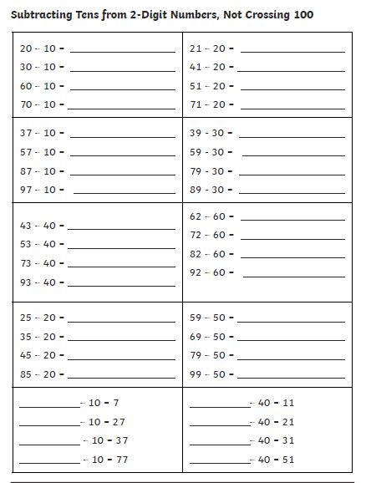
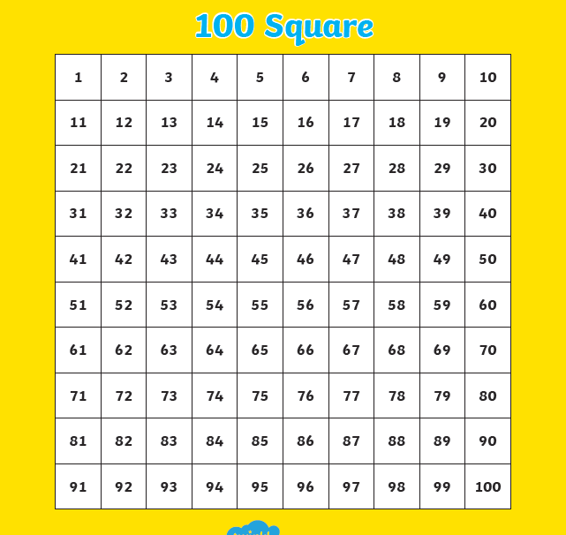
Hot Challenge – use the 100 square to help you add and subtract.

Slide 12
Reminder: for grown ups and children. Take a break if you need to.

Slide 13
Art – How to draw a dinosaur! Follow the link and learn how to draw this cool dinosaur!
How To Draw Indominus Rex From Jurassic Park - YouTube

Slide 14
Health and Wellbeing – You need a ball for this activity. We would love see your recording of this if you take the challenge!
Combining basketball with music by Tchaikovsky, 4th grade music students perform a fun routine! 🏀😍 - YouTube

Slide 15
NIGHT Prayer
God our Father, I come to say thank you for your love today.
Thank you for my family and all the friends you give to me.
Guard me in the dark of night and in the morning send your light.
Amen.

