Slide 1
St Mary’s Glow Blog
P3 & P4
^{Friday 5th} February
With Mrs Gould

Slide 2
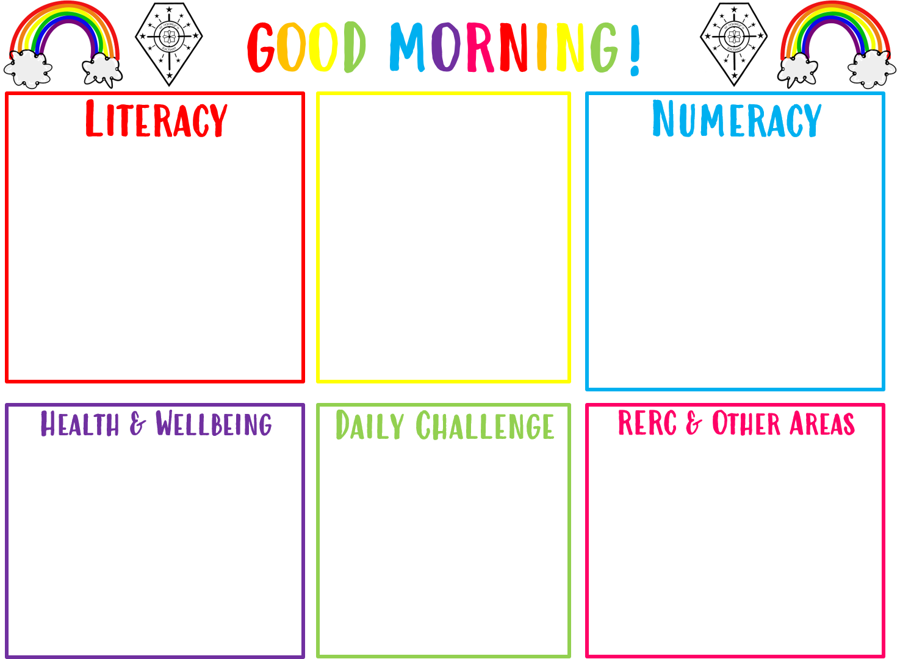
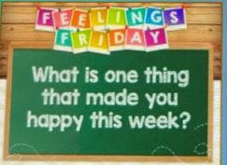
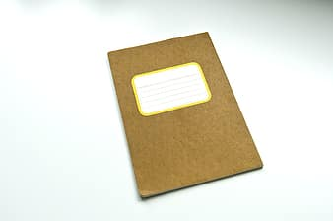
Good morning boys and girls
Friday 5th February
05/02/2021
The in school teacher is
Mrs Gould
All completed work should be sent to Mrs Gould
ddlmurray891@glow.sch.uk
Take the online challenge on Topmarks OR the maths challenge in the pack.
We are practicing our handwriting skills.
Weekly Journal!
If it is nice day, go
outside for a walk
and get some
exercise!

Slide 3
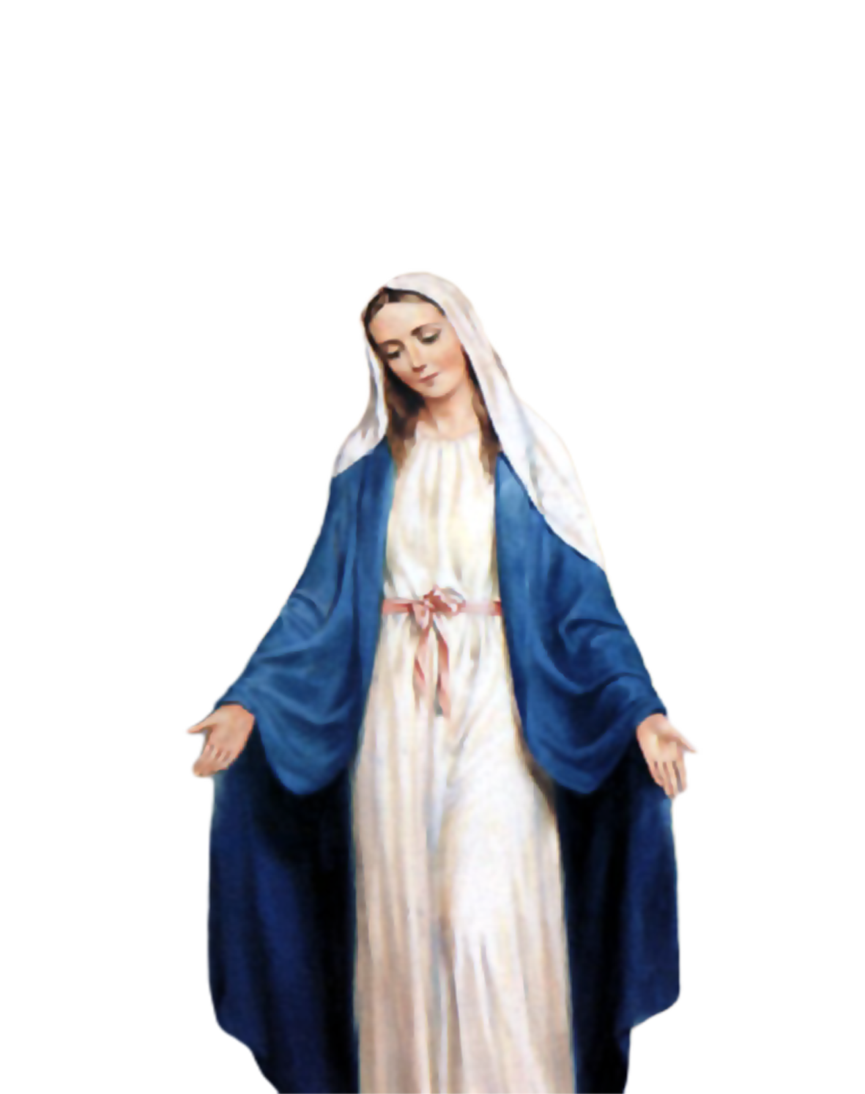
Morning Prayer
Father in heaven you love me
You are with me night and day
I want to love you always
In all I do and say
I’ll try to please you Father
Bless me through this day
Amen

Slide 4
Morning Challenge

Slide 5
Literacy- Handwriting Skills
Learning Intention:
we are learning how to form our letters correctly
Success Criteria:
I am using the correct formation of the letter
I am writing on the line
I am leaving spaces between each letter
I am sitting up straight in my chair with my feet on the floor

Slide 6
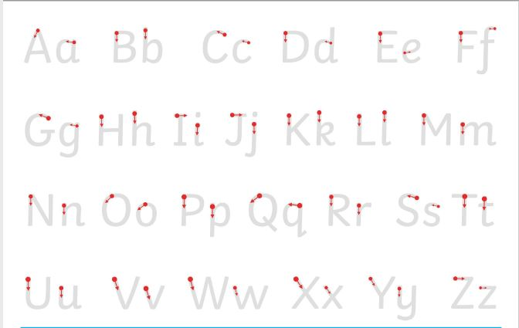
Mild Challenge.
Can you form all the letters of the alphabet correctly?

Slide 7
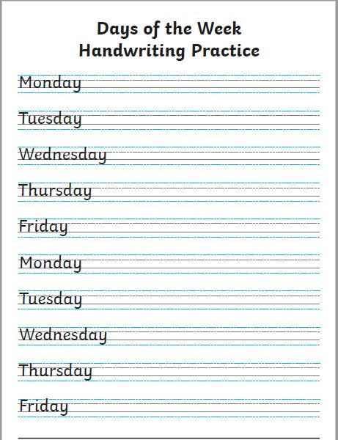
Hot Challenge
Can you write the days
Of the week?
Remember, the capital letters
Touch the top line.
Some letters have tails and go under
The line

Slide 8
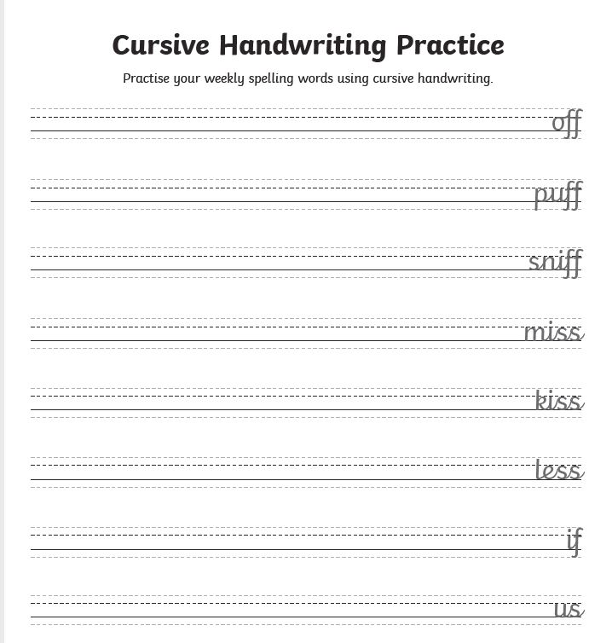
Chilli Challenge Can you join up the letters?

Slide 9
Reminder: for grown ups and children. Take a break if you need to.

Slide 10
Number 05.02.21 Topmarks Paint the Squares
Paint the Squares - Interactive Number Charts (topmarks.co.uk)
This is fun Friday number activity!
Open the link and can you paint the
Square?
Count in 2s, 5s and 10s.
Can you make the patterns of the 2,3,4,5,
6,7 and 8 timestables?
This Photo by Unknown Author is licensed under CC BY-NC
This Photo by Unknown Author is licensed under CC BY-NC

Slide 11
Maths Challenge
Don’t worry if you can’t open the link!
Here is a maths challenge for you to
Complete!
Good luck!

Slide 12
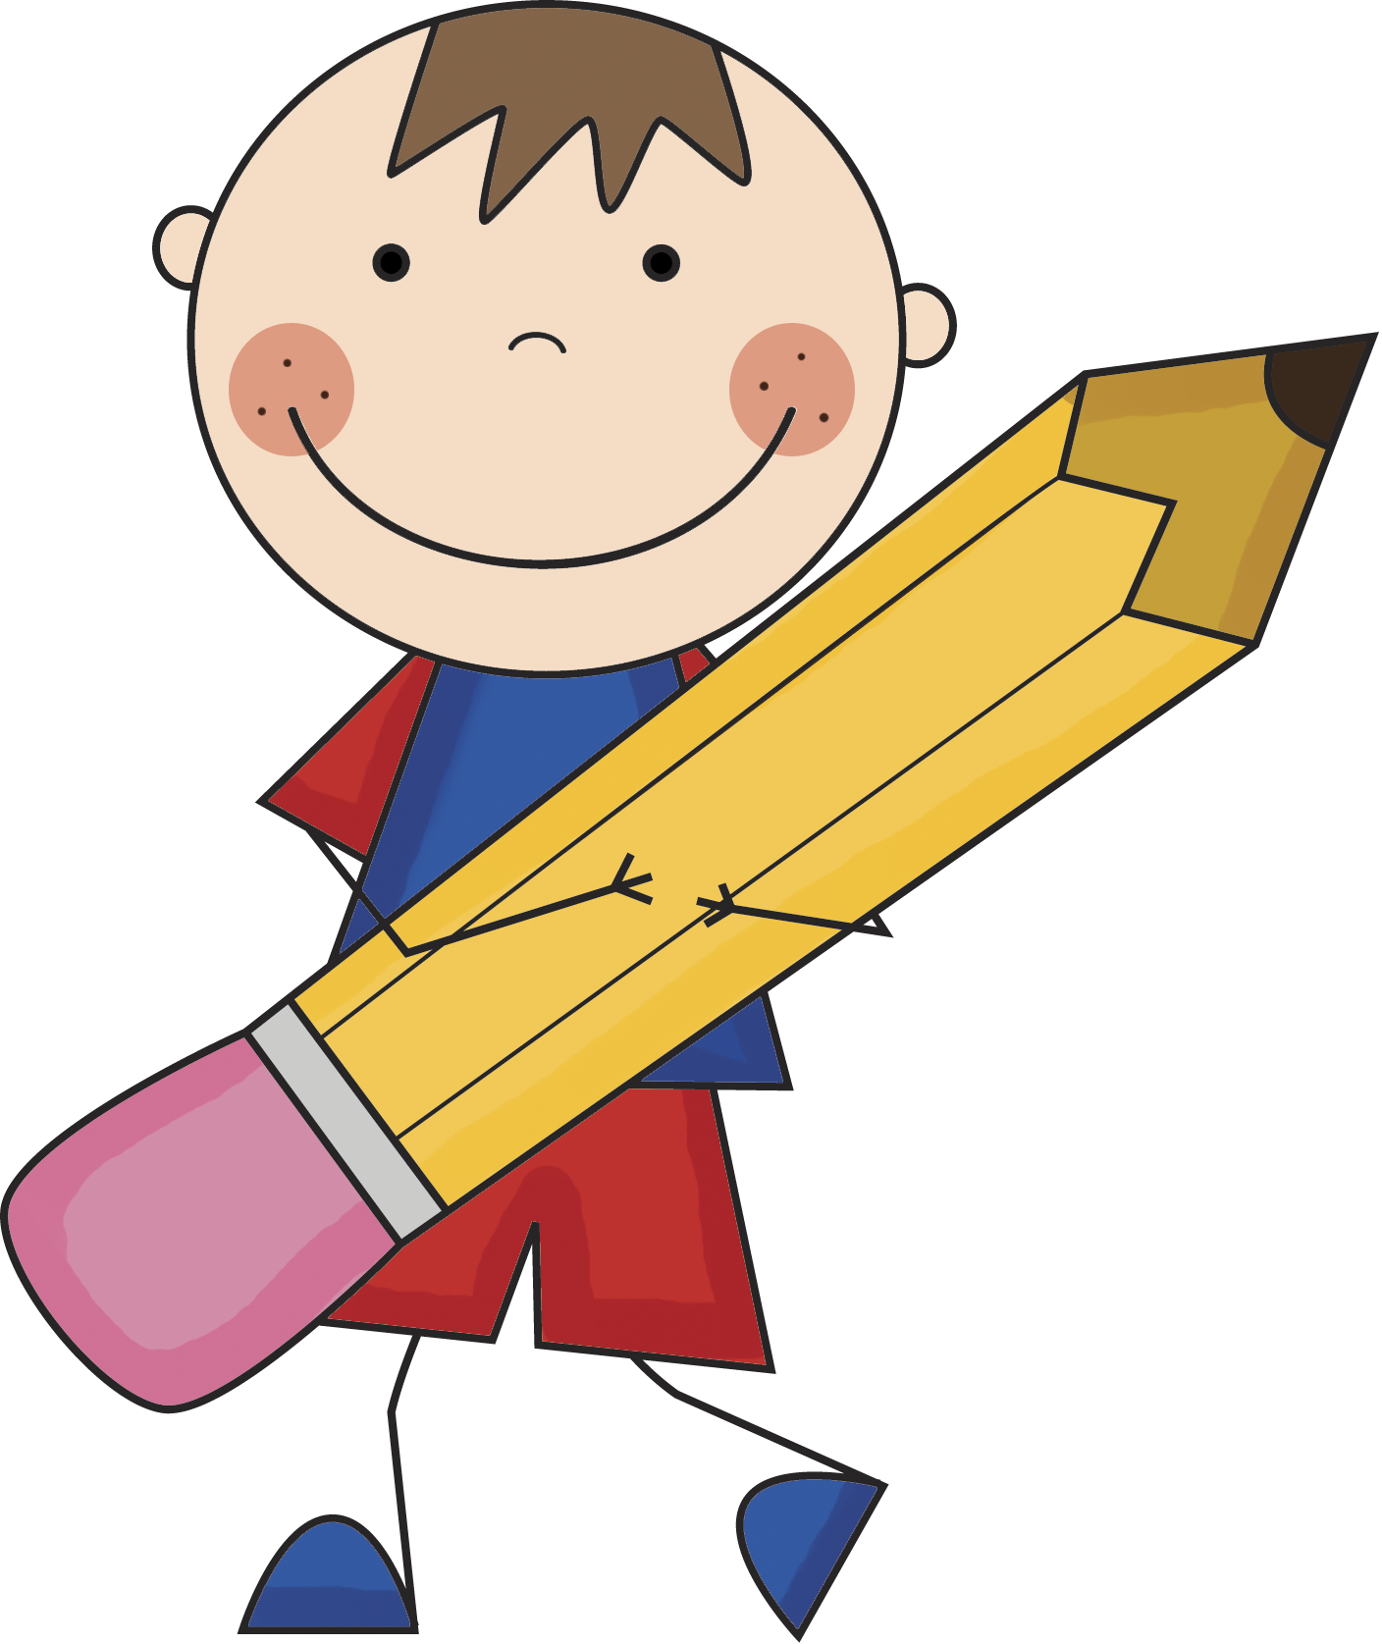
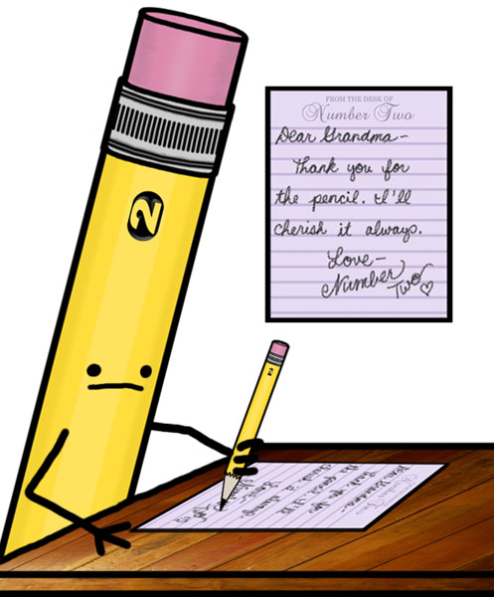
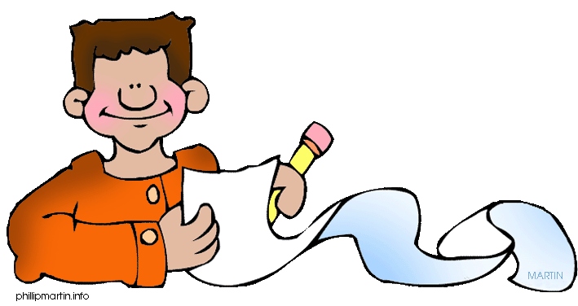
Weekly News!
How has your week been?
What were your favourite activities this week?
Who has been helping you?
Are there some activities you would like to seen online that the teachers could add?
You could also record yourself and send us a message!

Slide 13
NIGHT Prayer
God our Father, I come to say thank you for your love today.
Thank you for my family and all the friends you give to me.
Guard me in the dark of night and in the morning send your light.
Amen.

