Slide 1
St Mary’s Glow Blog
P3 & P4
Thursday 4th February
With Mrs Gould

Slide 2
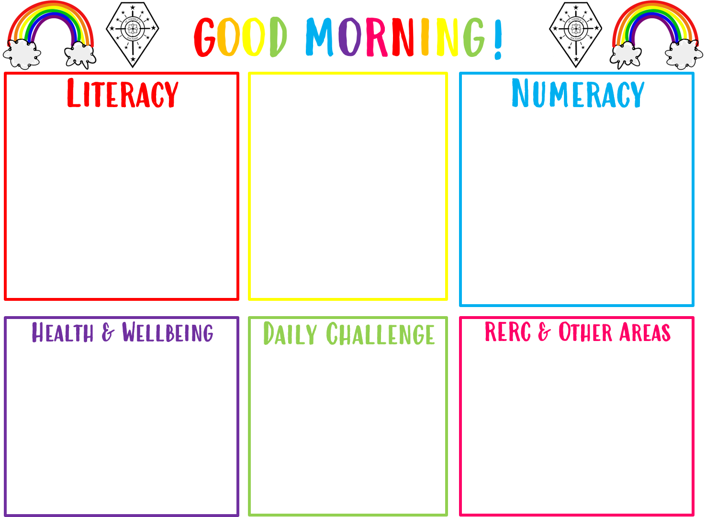
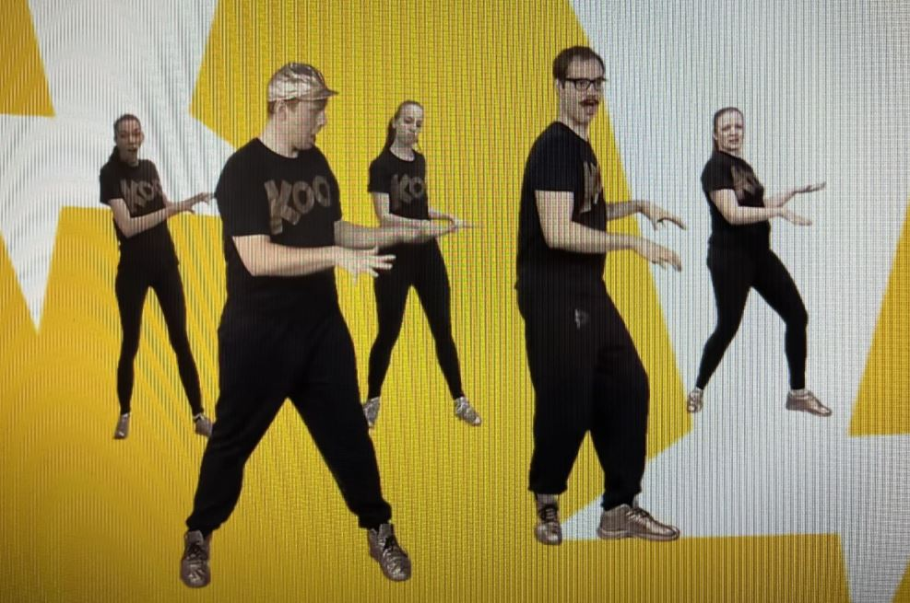
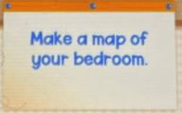
Good morning boys and girls
Thursday 4th February
04/02/2021
The in school teacher is
Mrs Gould
All completed work should be sent to Mrs Raeper
ddaraeper726@glow.sch.uk
We are using our literacy skills to write an imaginative story.
Revision of Time
Take the mild, hot or chilli challenge
The Story of The Good Samaritan

Slide 3
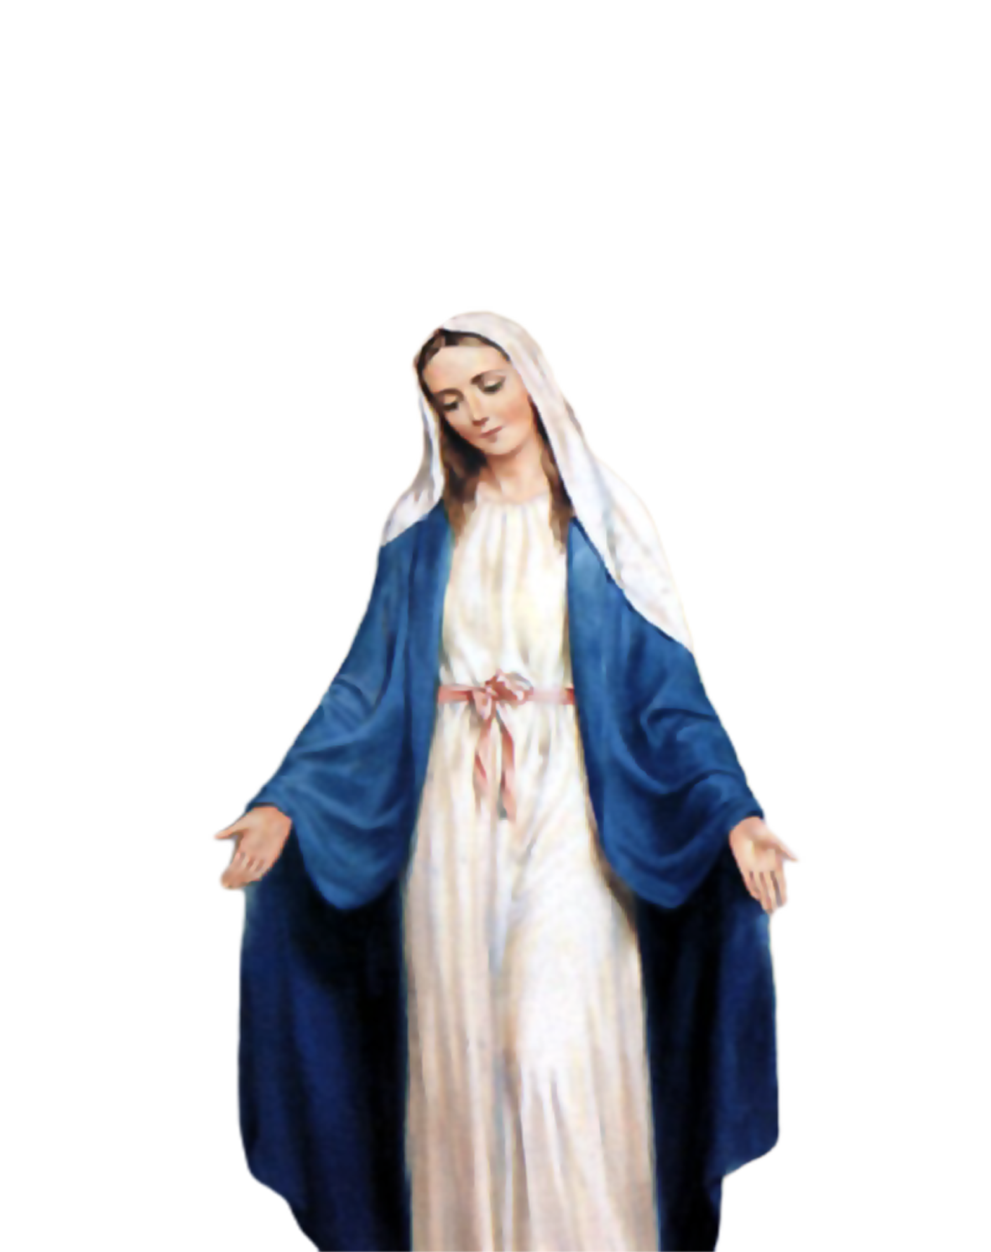
Morning Prayer
Father in heaven you love me
You are with me night and day
I want to love you always
In all I do and say
I’ll try to please you Father
Bless me through this day
Amen

Slide 4
Morning Challenge

Slide 5
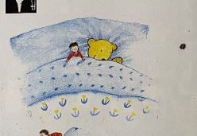
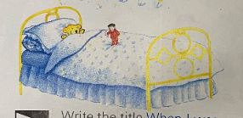
Literacy- Writing Skills
We are learning to write an imaginative story.
A story has a beginning a middle and an end.
In an imaginative story anything can happen!
You can do anything and go anywhere in your story!
In my story I became very small...

Slide 6
Remember!
Give your story an interesting beginning to hook the reader.
Tell us what happens in the story.
Who do you meet?
Do you meet any friends?
How do you feel?
Is it good or bad being so small? Why?

Slide 7
Here is the writing template to help you
Write your story.
Remember to plan your story first.
Think about the beginning, middle and end.
Be as creative as you can and use lots of
describing words.
Show detailed drawings of yourself.

Slide 8
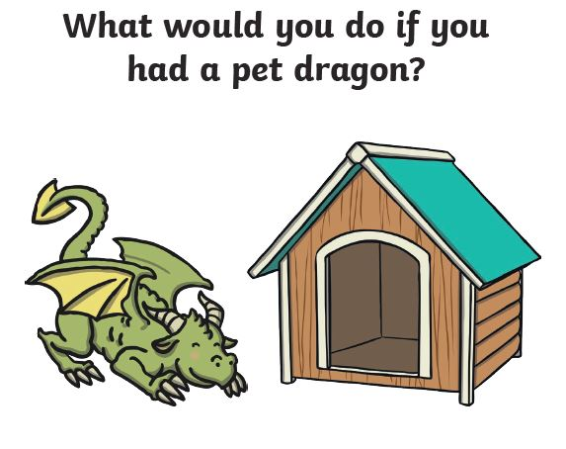
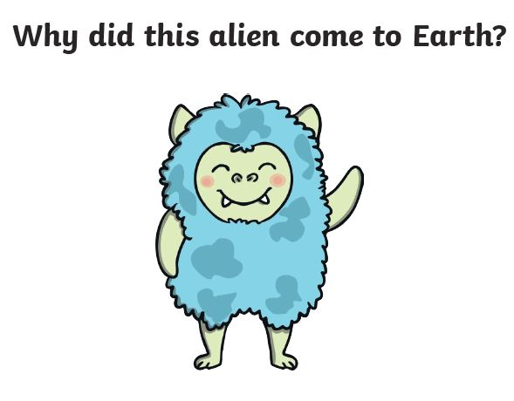
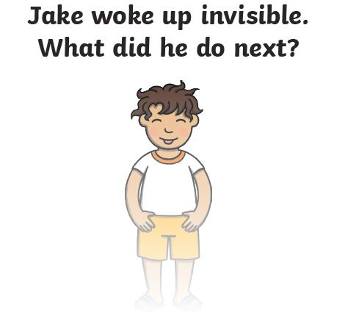
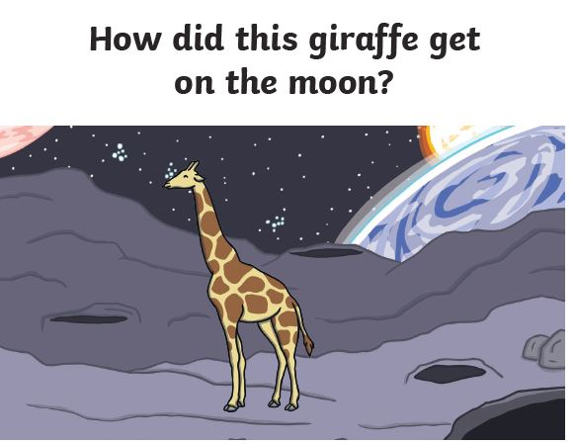
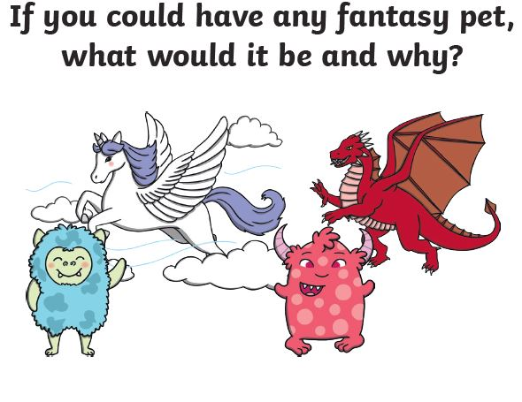
Here are some more imaginative writing ideas!
Can you write a story about any of these pictures?
Send me your finished story!

Slide 9
Number 04.02.21 Revision of time
We have been looking at days of the week, months of the year and seasons.
We have been looking at o’clock and half past the hour.
Today there is a mild, hot and chilli challenge…
…which challenge will you take?
This Photo by Unknown Author is licensed under CC BY-NC
This Photo by Unknown Author is licensed under CC BY-NC

Slide 10
!
Mild Challenge
Write the time on the clock.
All the answers are on the hour –
0’clock.
Tip: when it is o’clock, the minute hand
points to the 12.

Slide 11
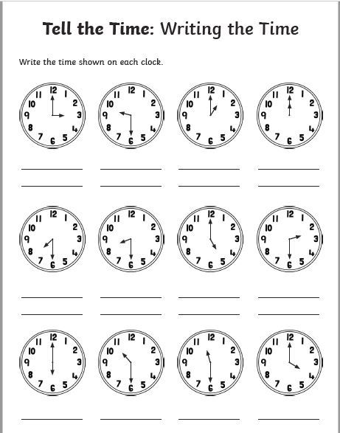
Hot Challenge
All the answers are either o’clock or half past.
Tip: when it is o’clock, the minute hand points
To the 12.
Tip: when it is half past, the minute hand points
To the 6.

Slide 12
Chilli Challenge
The answers can be o’clock
Half past
Quarter past
Quarter to
Tip: when it is quarter past, the minute hands points to the 3
Tip: when it is quarter to, the minute hand points to the 9.

Slide 13
Reminder: for grown ups and children. Take a break if you need to.

Slide 14
Religious Education
The Story of the Good Samaritan

Slide 15
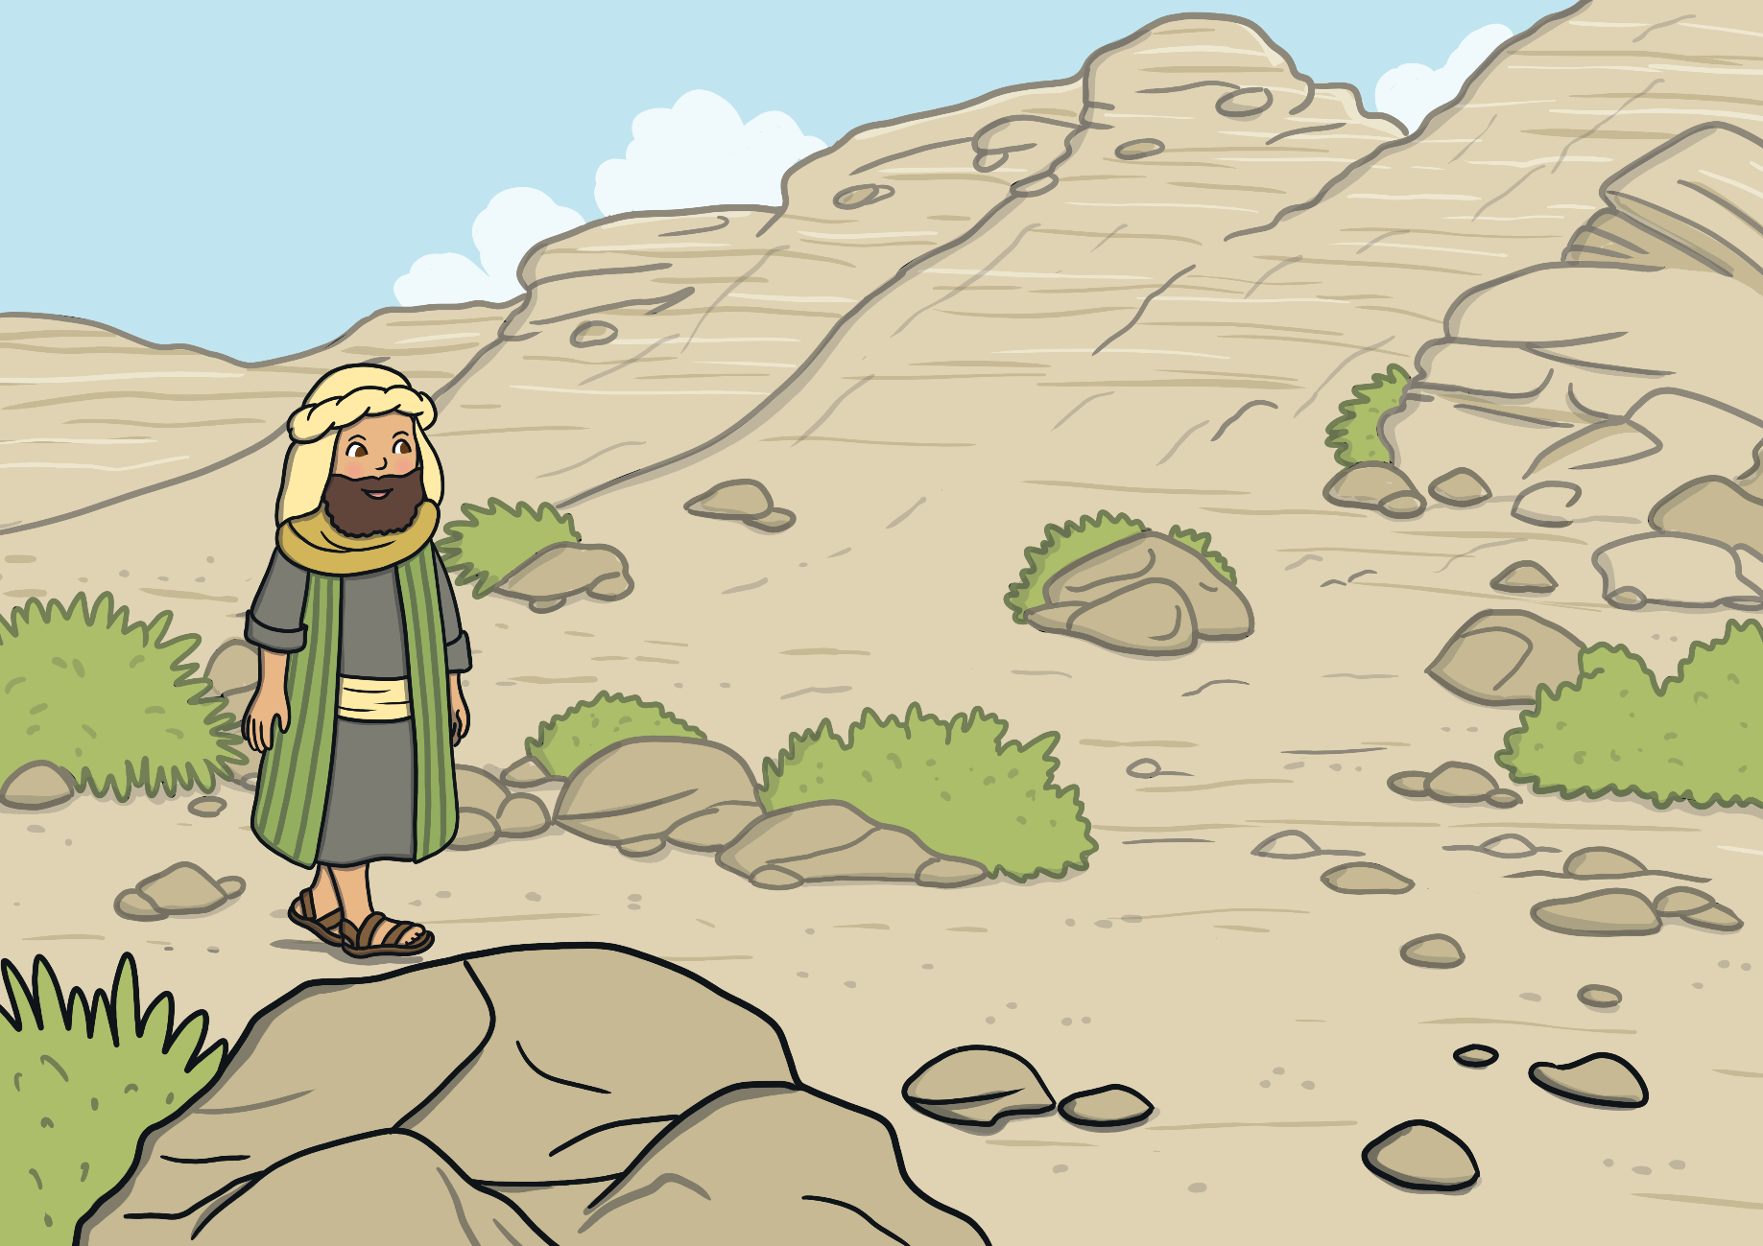
One day, a Jewish man went out for a stroll along the road between Jerusalem and Jericho.

Slide 16
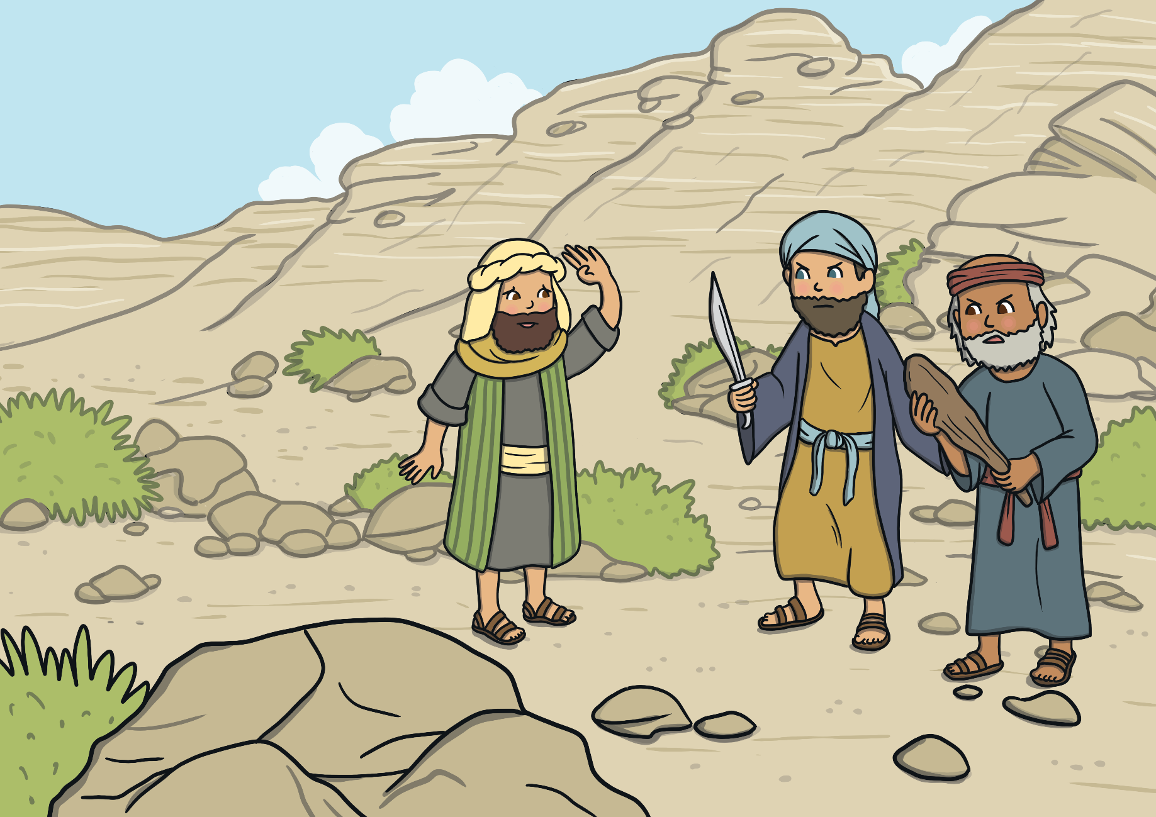
Along the way, two bandits jumped onto the road and stole all of the man’s belongings.

Slide 17
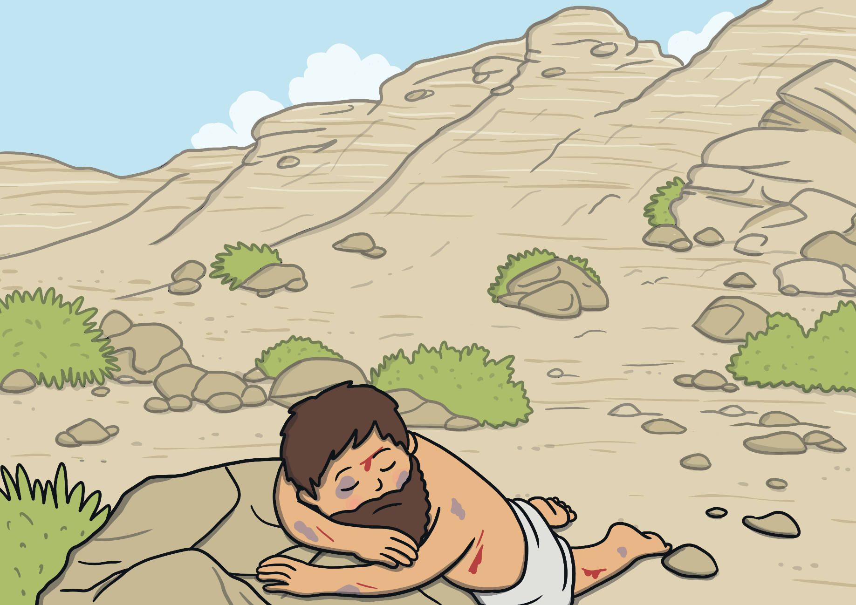
The bandits stole his clothes, beat him and left him for dead at the side of the road.

Slide 18
After a short while, a priest walked by and saw the man lying on the ground.

Slide 19
Did the Priest help? No, he walked away.

Slide 20
The next traveller to walk by was a Levite. The Levite’s job was to help with the duties at the temple in Jerusalem.

Slide 21
Did the Levite help? No, he walked away.

Slide 22
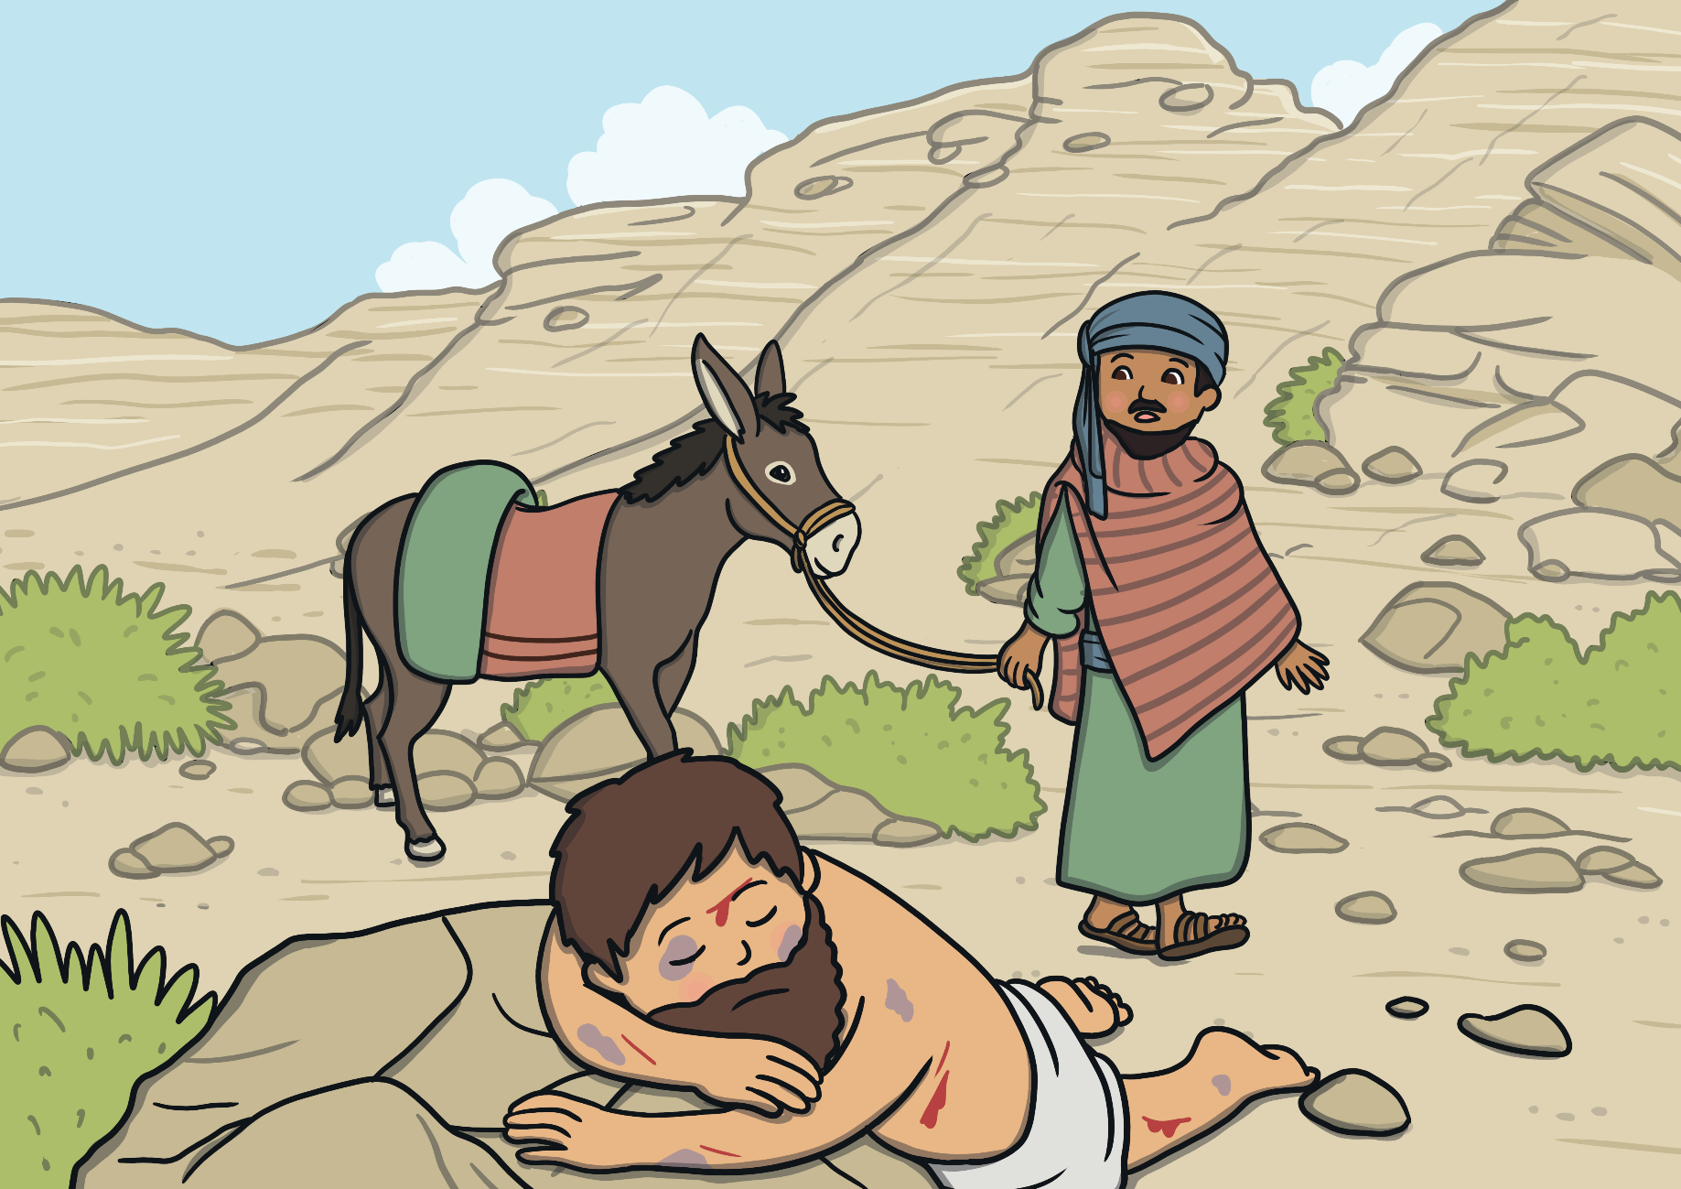
Soon, a Samaritan came along and saw the Jew lying on the ground. Samaritans and Jews usually didn’t get along at all. They had very different beliefs, which made them treat each other badly.

Slide 23
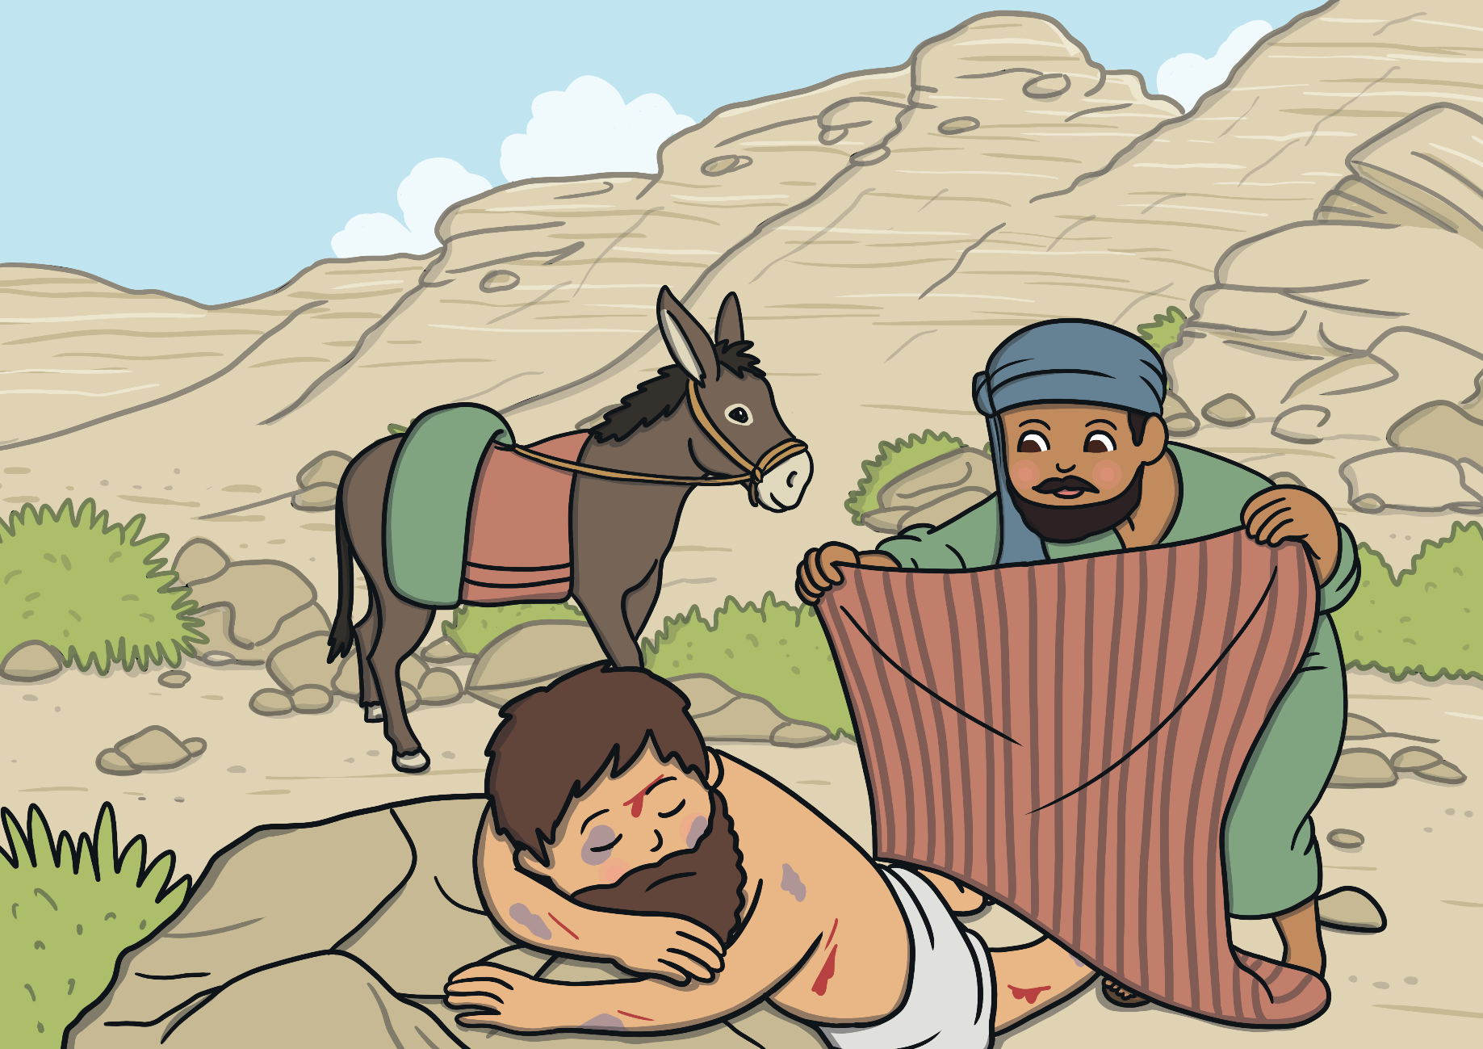
Did the Samaritan help? Yes! The Samaritan couldn’t leave the Jewish man to die.

Slide 24
The Samaritan covered the man with his cloak.

Slide 25
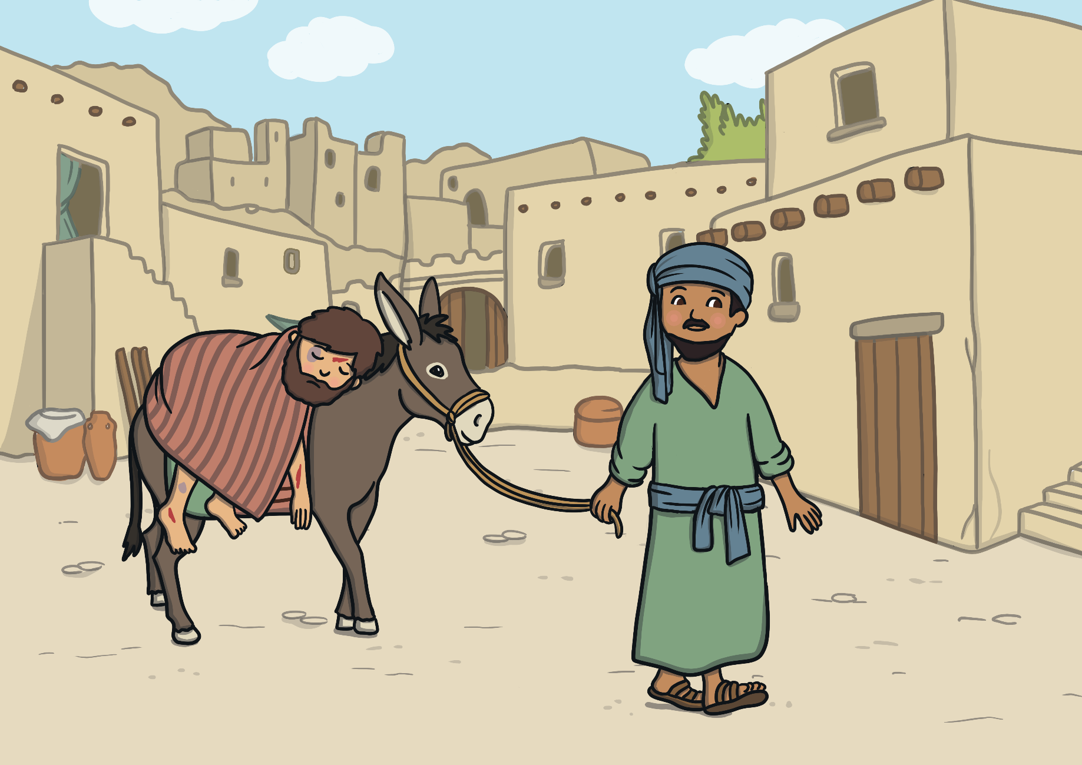
He put the man on his donkey and took him to a nearby inn.

Slide 26
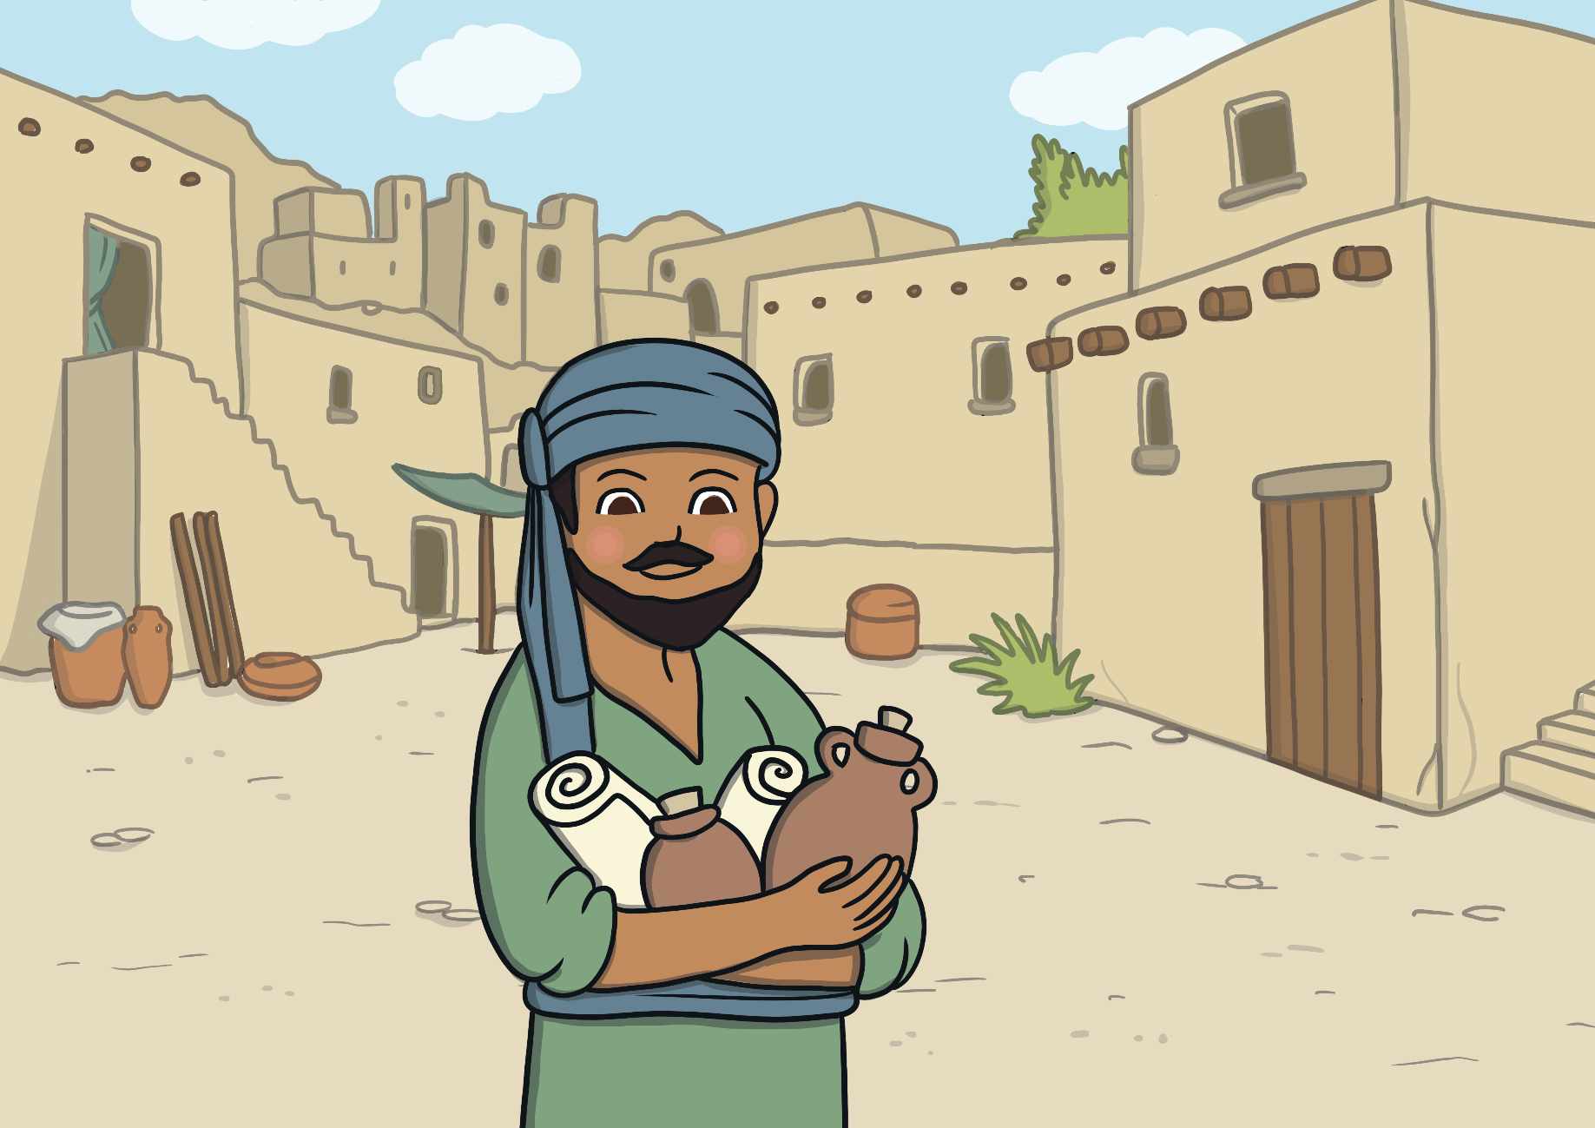
He bought expensive medicine, wine, oil, and bandages to help heal the man.

Slide 27
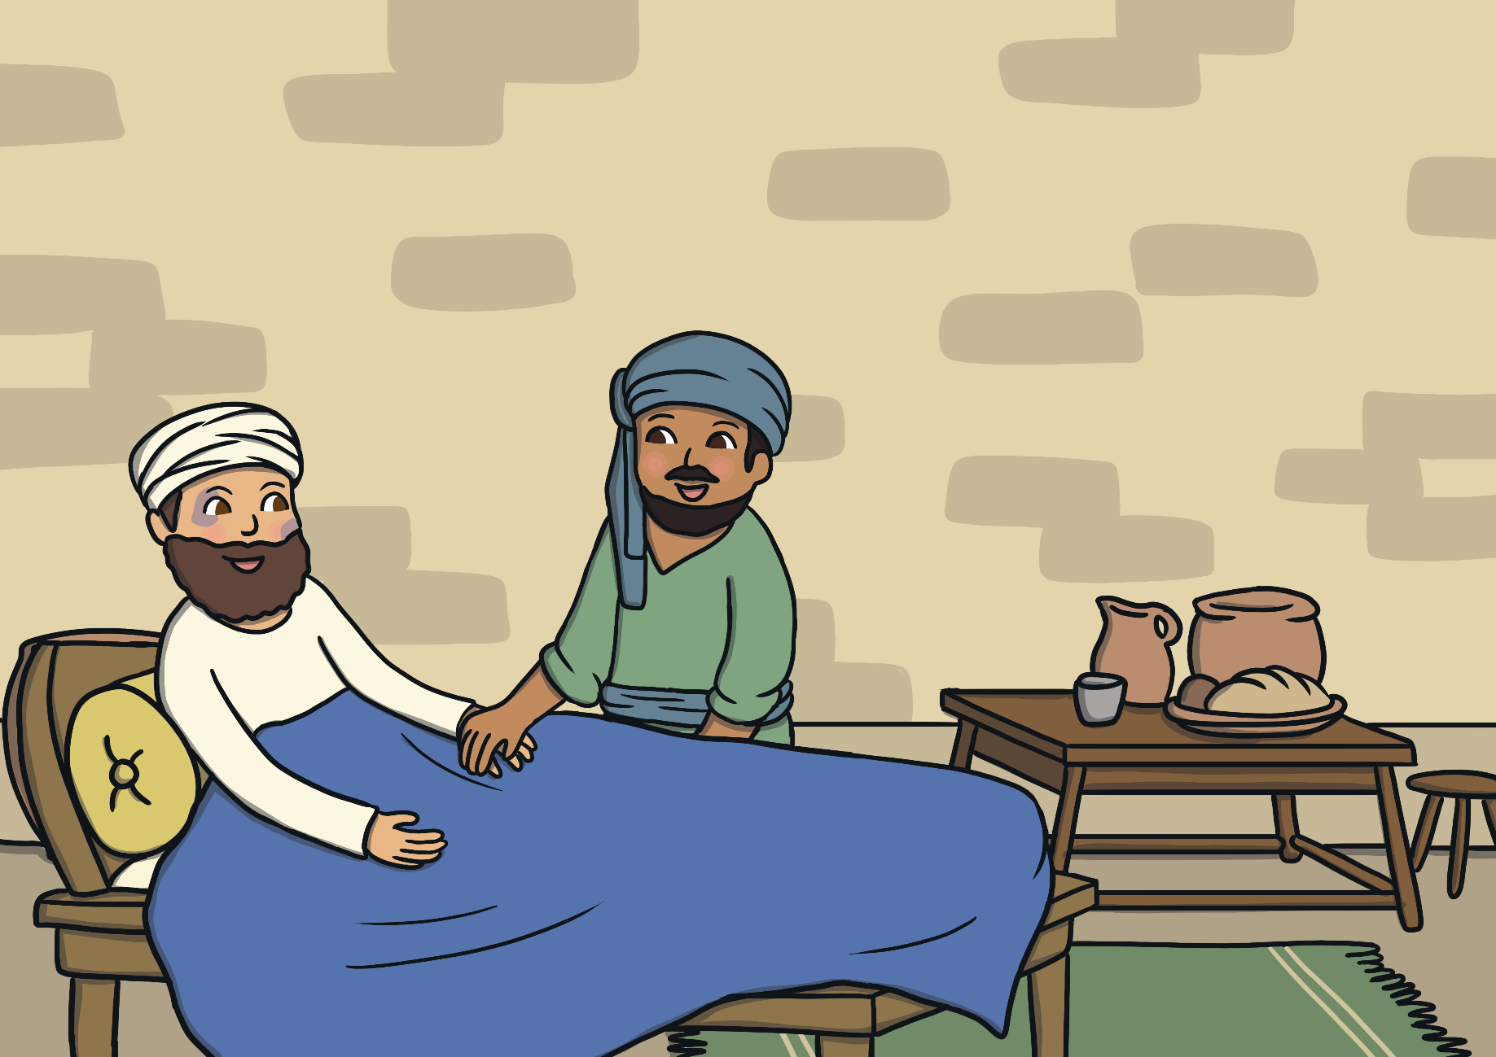
Even though the Samaritans and Jews didn’t often get along, the Samaritan showed the man kindness. He was a true neighbour to this stranger.

Slide 28
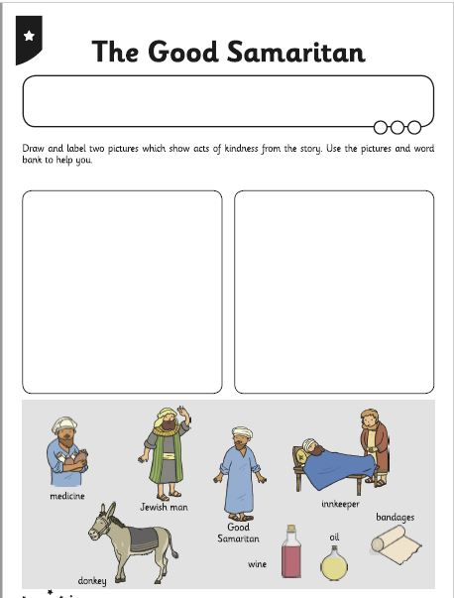
The Good Samaritan
Can you draw and label two
pictures from the story which show
an act of kindness?
Can you tell your grown about a time
when you were kind?

Slide 29
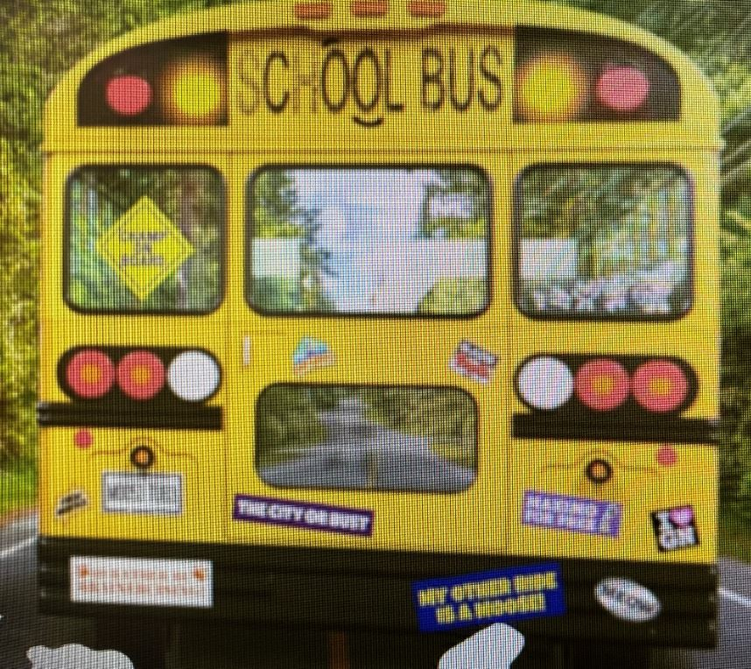
Today’s movement challenges are from Go Noodle.
Have fun! I think you will know them!
Boom Chicka Boom - Moose Tube | GoNoodle - YouTube
Koo Koo Kanga Roo - Dinosaur Stomp (Dance-A-Long) - YouTube

Slide 30
NIGHT Prayer
God our Father, I come to say thank you for your love today.
Thank you for my family and all the friends you give to me.
Guard me in the dark of night and in the morning send your light.
Amen.

