Slide 1

St Mary’s RC primary school
Friday 29.01.21
P3 and P4

Slide 2

Morning Prayer
Father in heaven you love me
You are with me night and day
I want to love you always
In all I do and say
I’ll try to please you Father
Bless me through this day
Amen

Slide 3
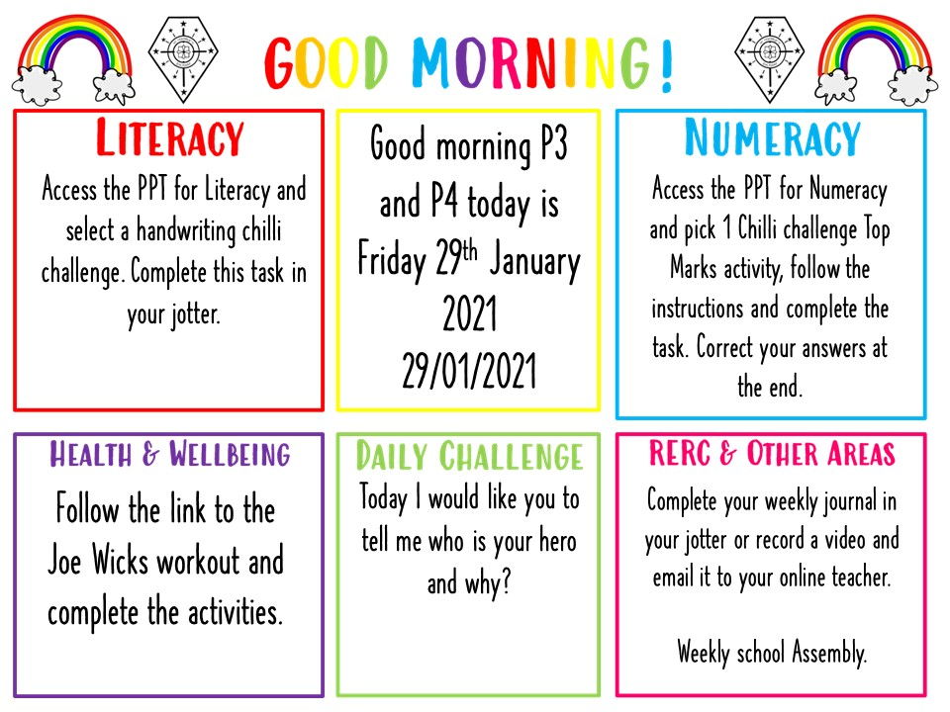

Slide 4

Literacy - Handwriting
Learning Intention:
We are learning to improve our handwriting.
Success Criteria:
Form our letters correctly
I can form my letters on the line.
Write my letters in my jotter.

Slide 5
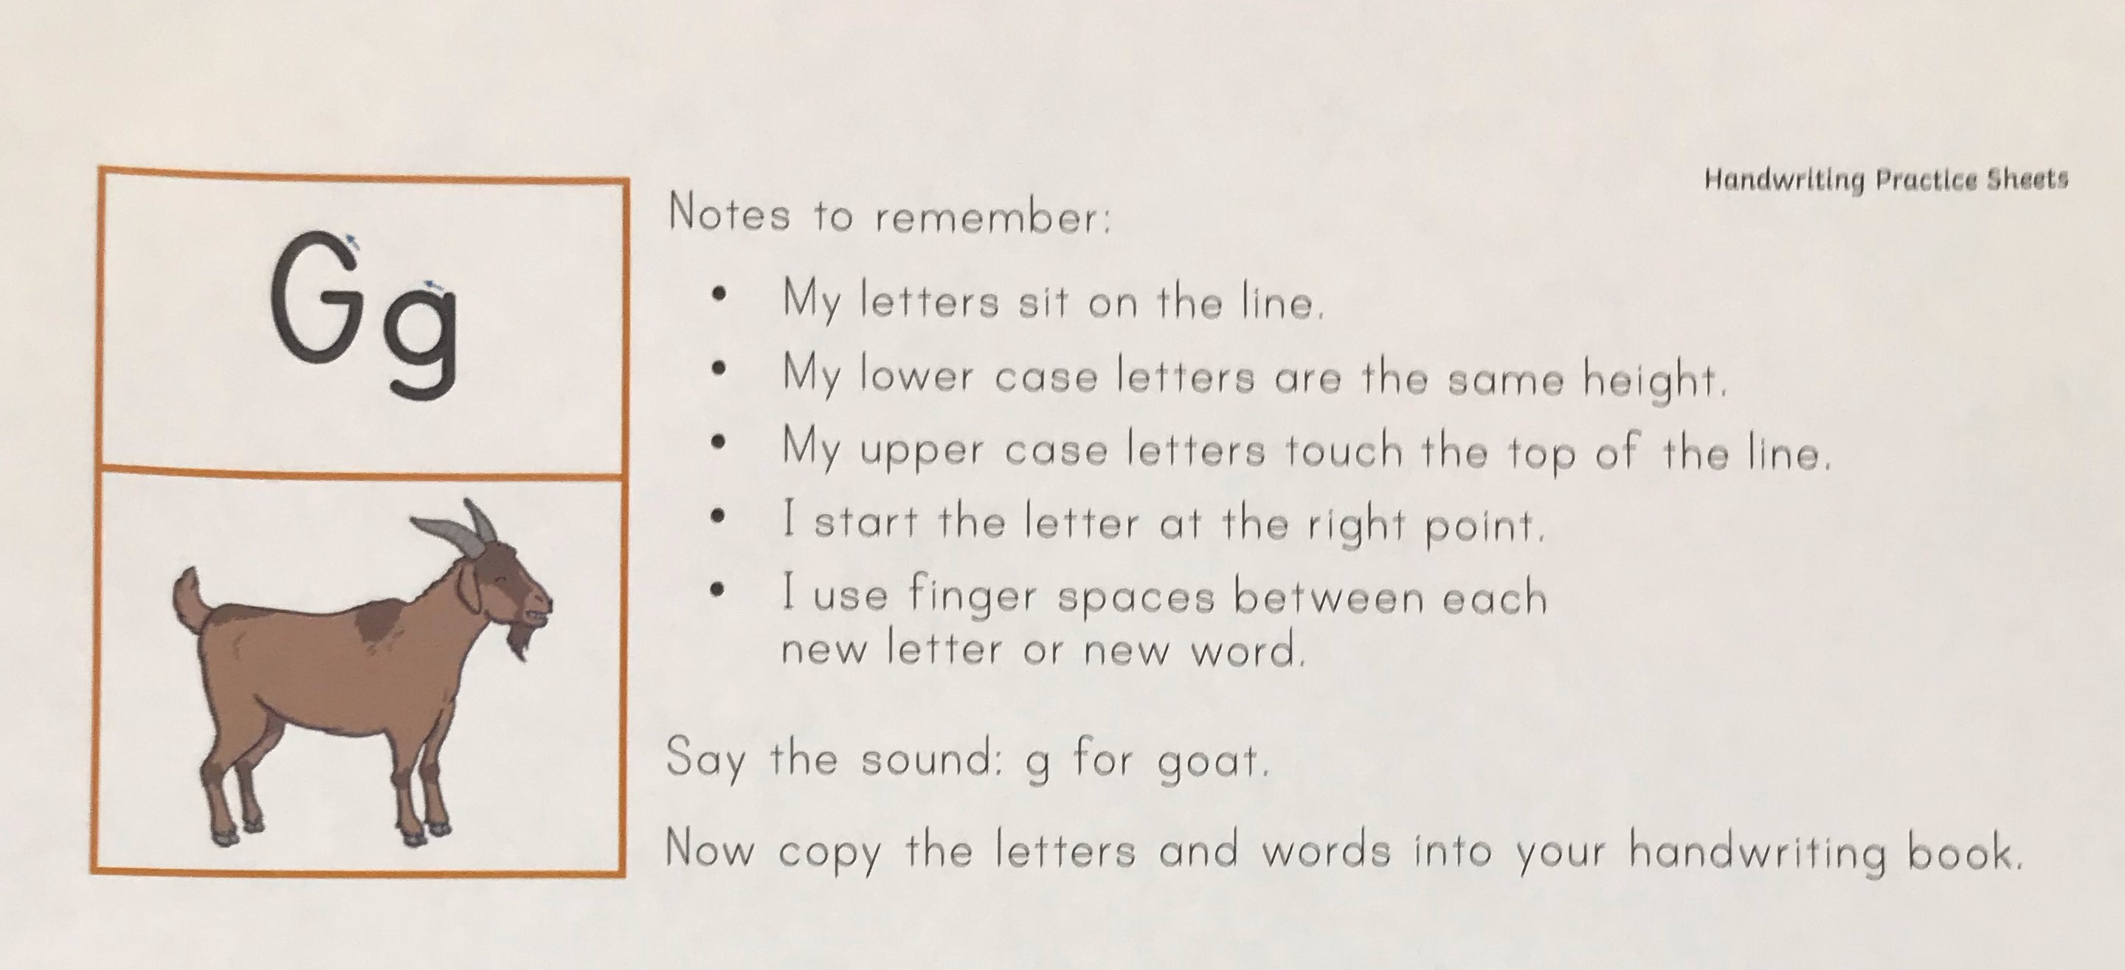

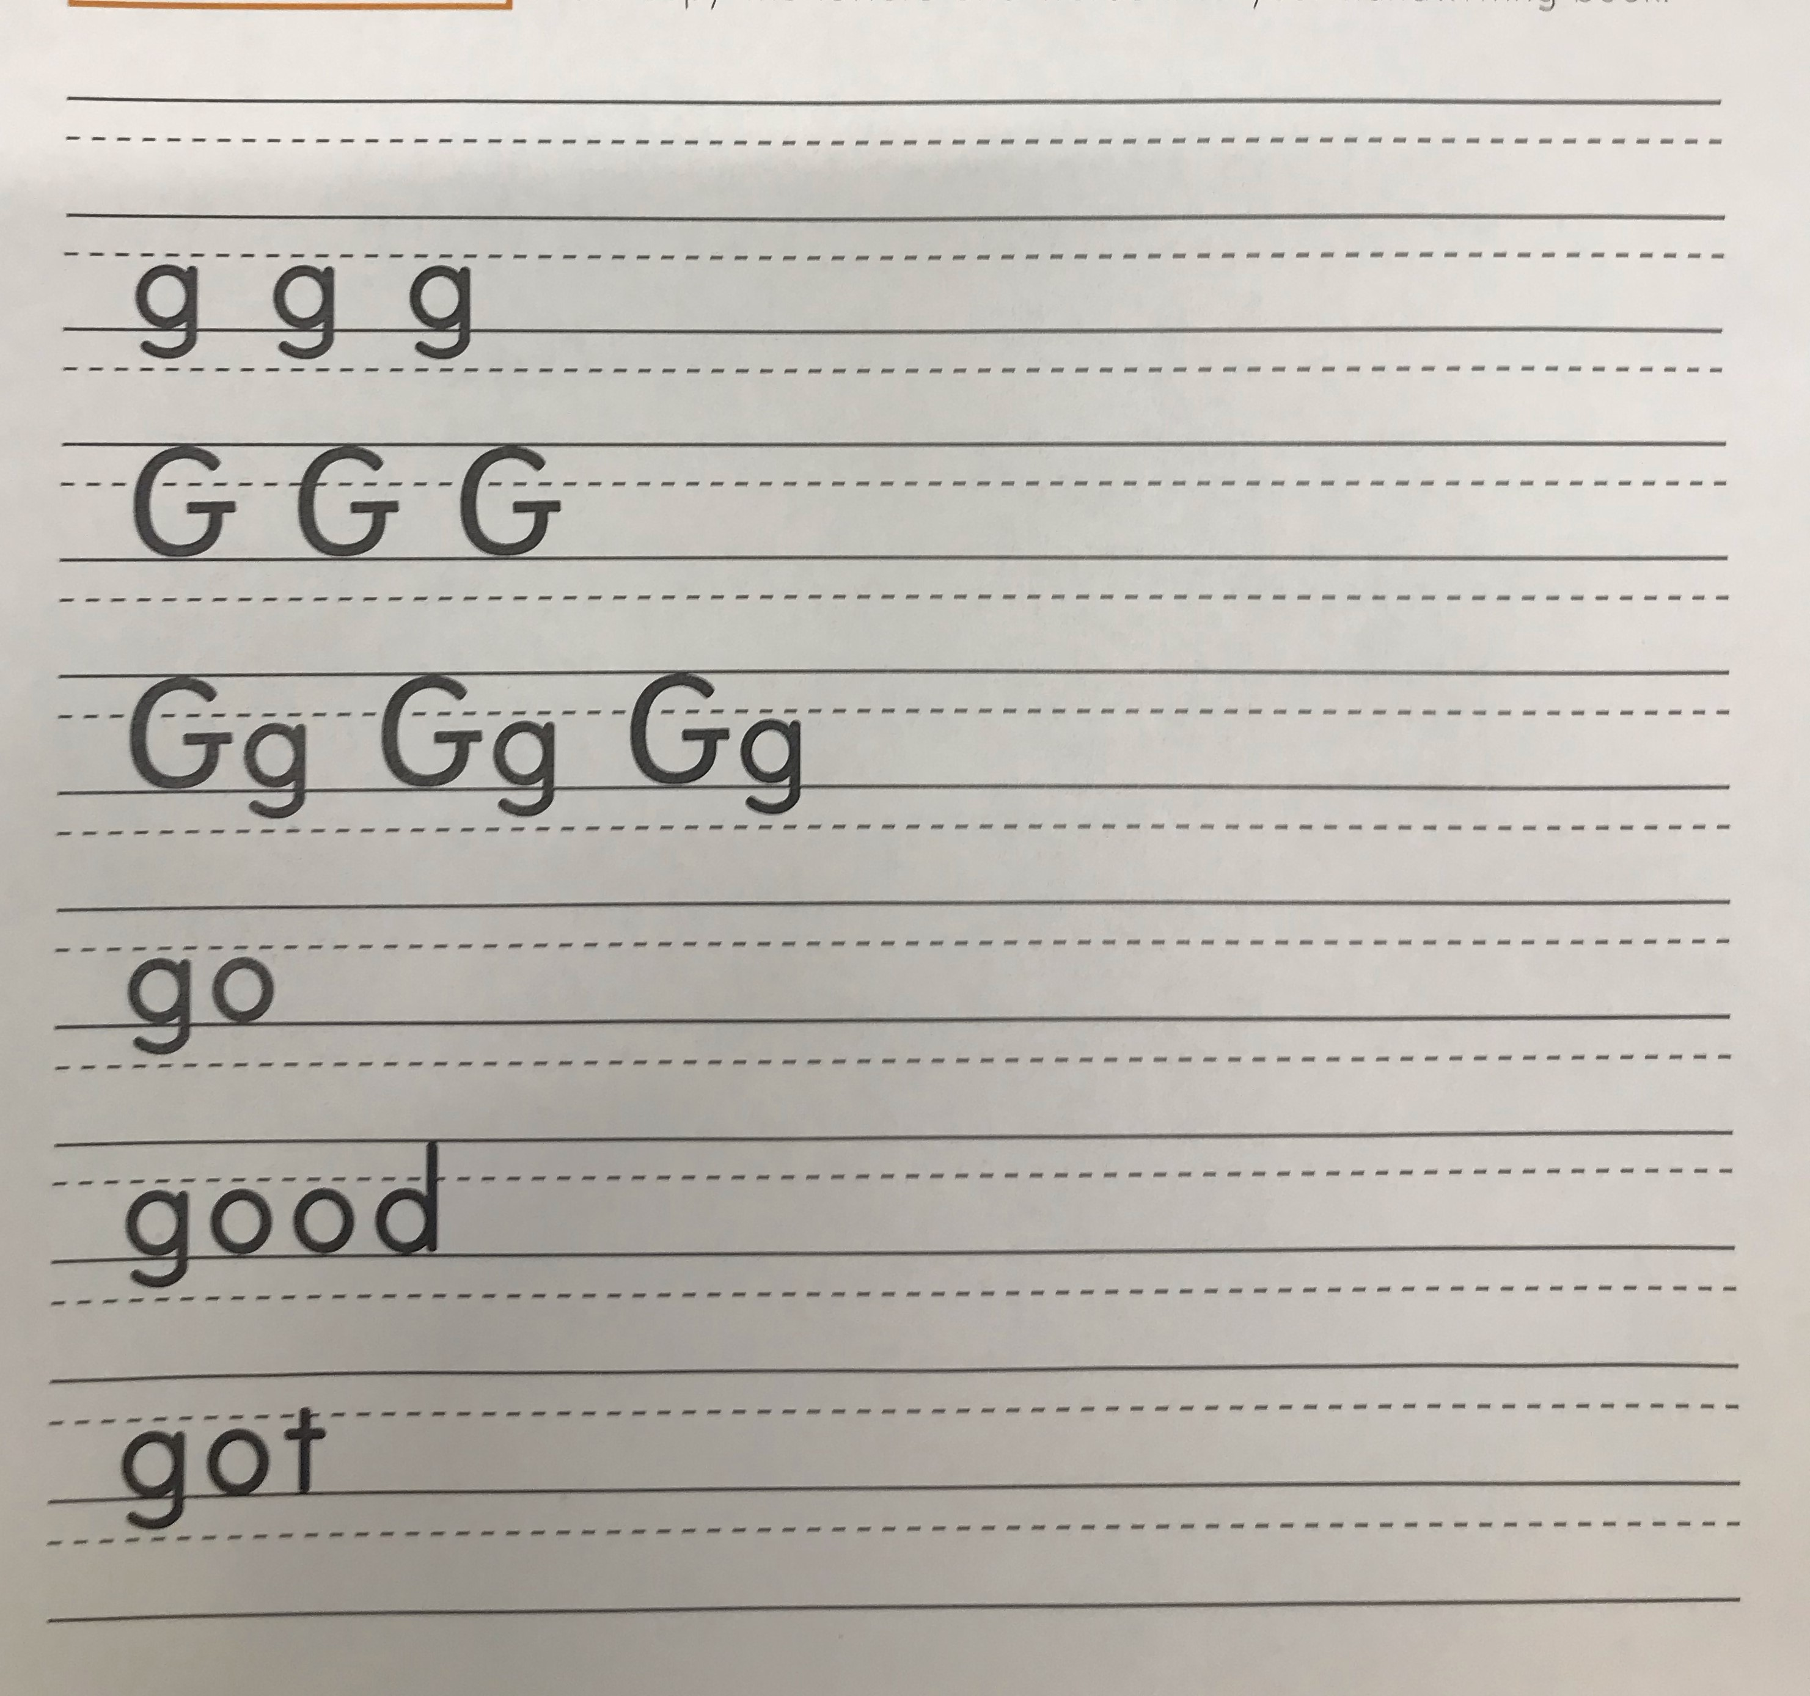
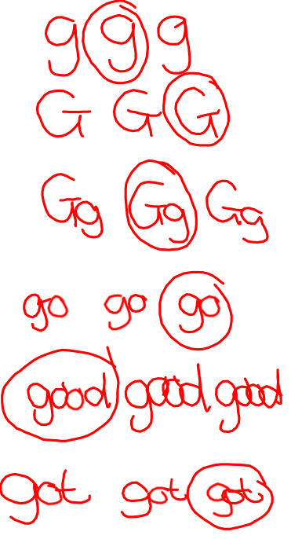
Write 6 version of g and circle your best.
Write 6 versions of G and circle your best.
Write 6 versions of Gg and circle your best.
Write each word 6 times and circle your best.

Slide 6
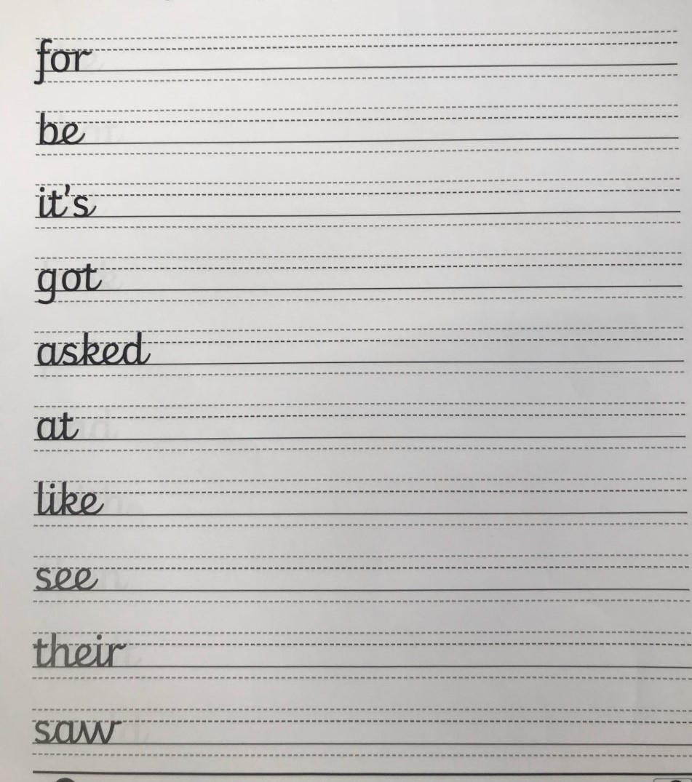
Practise your neat handwriting
By writing each word out 5 times.
Remember finger spaces and write
on the line.
Pick 5 words and write a sentence for each word.

Slide 7
Numeracy
Learning Intention
We are learning to use addition.
Success Criteria
Complete the following number tasks on Topmarks.
Choose the Mild, Hot or Spicy Chilli challenge.
Don’t worry if you do have internet access, complete a number activity in your home learning pack.

Slide 8
Numeracy https://www.topmarks.co.uk/maths-games/daily10
Mild | Hot | Spicy
Choose level 2. Choose Subtraction. Choose Two-Digit Numbers. Choose manual so you can control the time limit. Mark your answers at the end. | Choose level 2. Choose Subtraction. Choose Two-Digit Numbers with Decomposition. Choose manual so you can control the time limit. Mark your answers at the end. | Choose level 3 Choose Subtraction Choose Two-Digit Numbers with Decomposition. Choose manual so you can control the time limit. Mark your answers at the end.

Slide 9

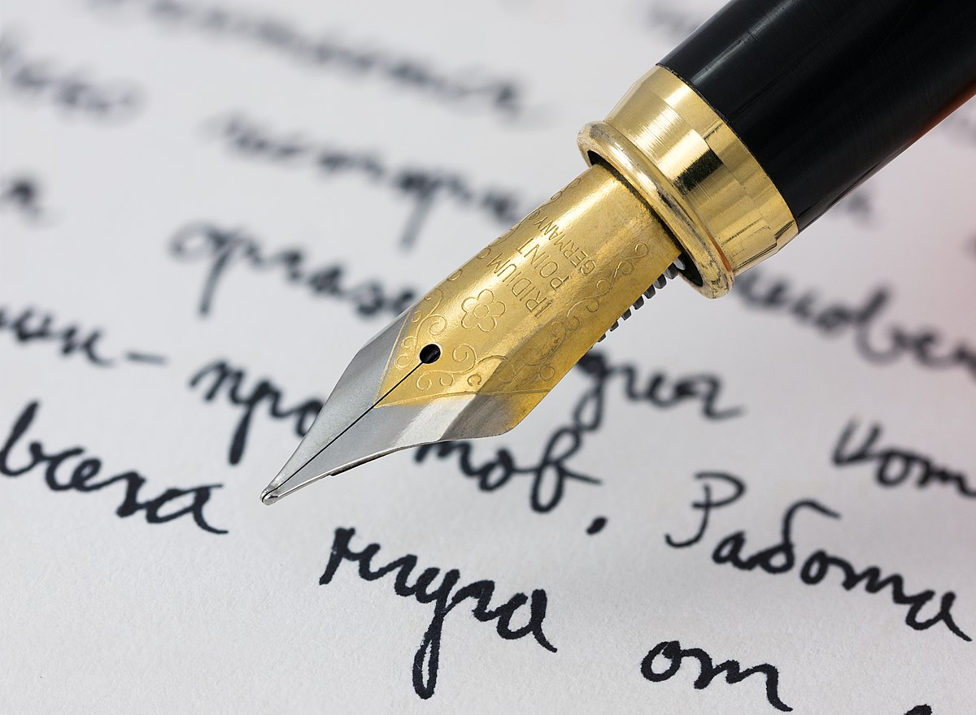
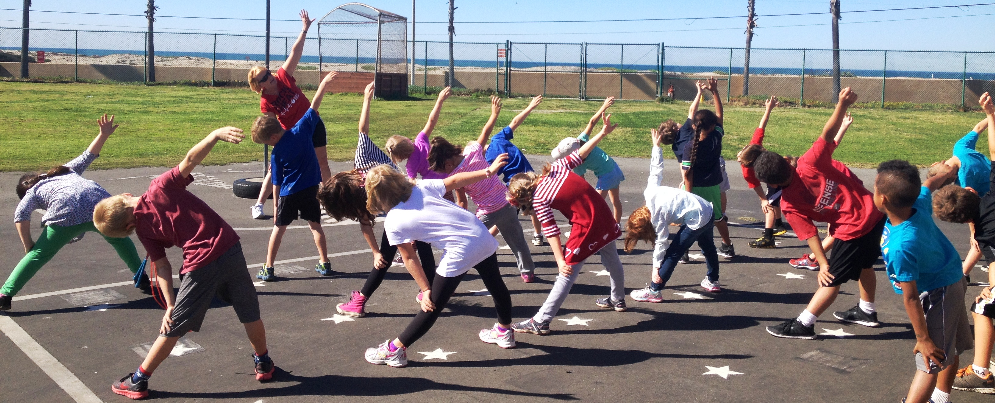

Weekly Journal
For the Weekly Journal we would like to hear about how you are experiencing your learning.
In your jotters please tell us what has been your favourite thing you have done in learning this week and tell us why. Have you enjoyed completing your learning at home with family? Do you enjoy going at your own pace?
We would also like to know if there has been anything you have missed not being in school. Do you miss your friends? Do you miss your teachers?
If you have the know how and would rather make a video of yourself we would be more than happy to receive these to know how you are getting on and see your smiling faces.
This Photo by Unknown Author is licensed under CC BY

Slide 10
Interactive School Assembly
Please follow the link on the P3 and P4 blog for an invite into the school assembly via Microsoft Teams.

Slide 11
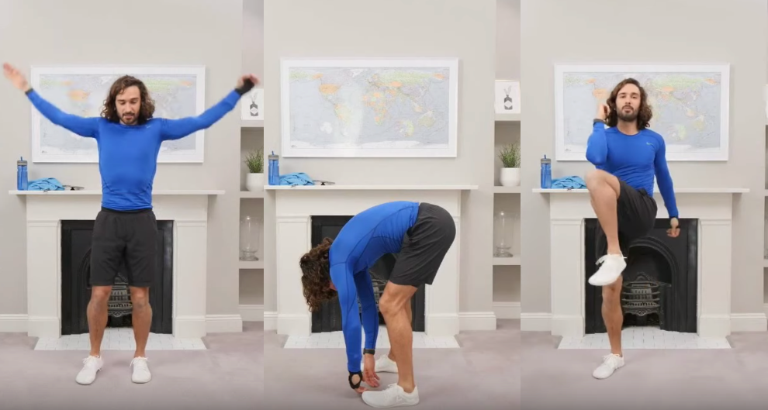
P.E
Follow the link to Joe Wicks P.E Lesson. Watch the video and complete the activities.
https://www.youtube.com/watch?v=l0k6XqfFEUo

Slide 12
Night time prayer
God our Father, I come to say thank you for your love today.
Thank you for my family and all the friends you give to me.
Guard me in the dark of night and in the morning send your light.Amen.

