Slide 1

St Mary’s RC primary school
Thursday 28.01.21
P3 and P4

Slide 2

Morning Prayer
Father in heaven you love me
You are with me night and day
I want to love you always
In all I do and say
I’ll try to please you Father
Bless me through this day
Amen

Slide 3
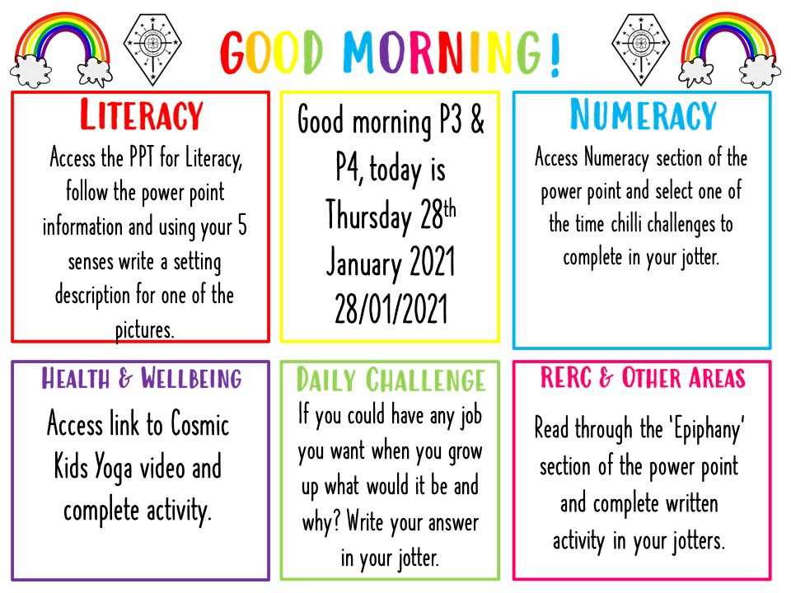

Slide 4

Literacy
Learning Intention:
We are learning to write a setting description.
Success Criteria:
I can use descriptive words in my writing (hot, cold, sticky, smooth).
I can use a variety of openers and connectives in my writing (so, but, because, however).
I can use my senses (hearing, sight, taste, smell and touch) to describe my setting.

Slide 5
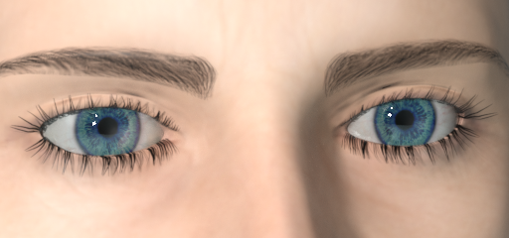
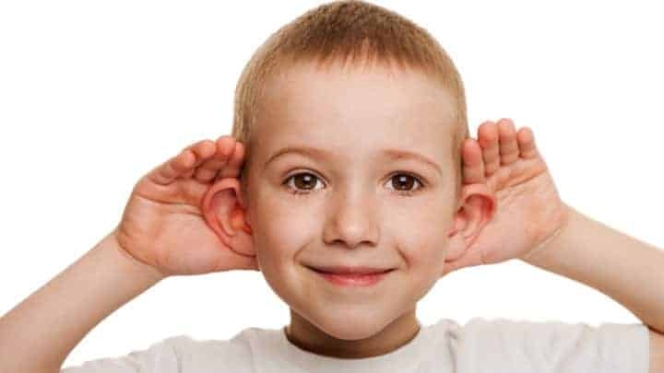
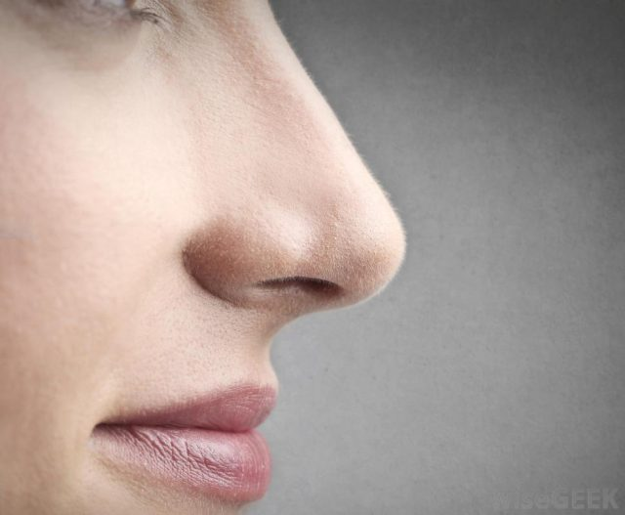
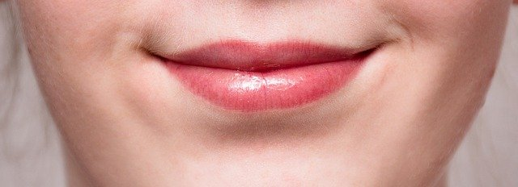
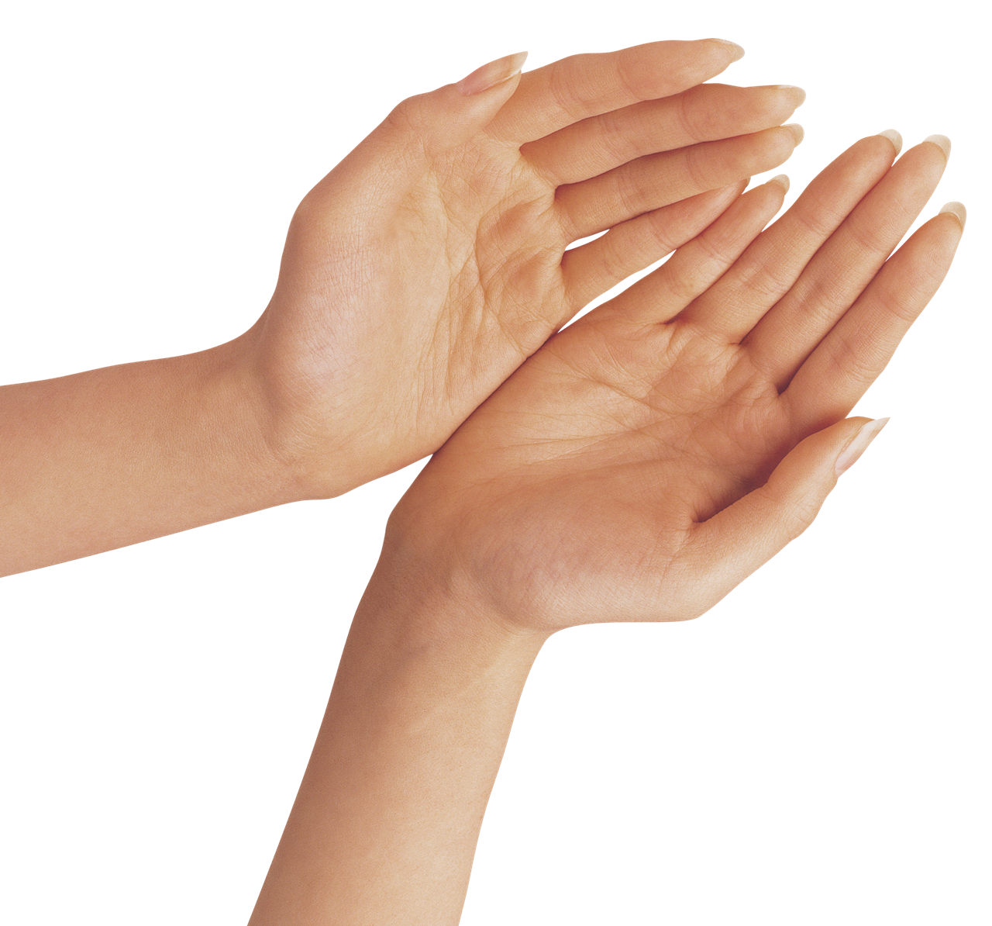
Literacy – Writing a setting description.
5 Senses
Today we will be learning to write a description of a setting. This means describing the place where your story is taking place.
A good way of doing this is to use as many of our 5 senses as we can to describe to the reader what we are experiencing.
Sight
(what we can see)
Sound
(what we can hear)
Smell
(what we can smell)
Taste
(what we can taste)
Touch
(what we can feel)

Slide 6
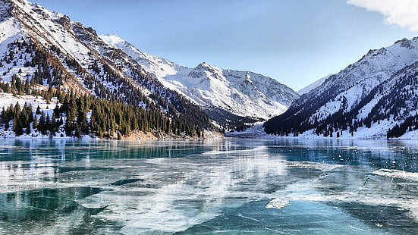
For Example (I have also underlined examples of descriptive vocabulary you could use).
Sight – As I looked out over the frozen lake all I could see were snow covered mountains touching the clear blue sky.
Sound – The only thing I could hear was the faint noise of birds in the distance over the silence.
Smell – The overpowering smell of wet pine needles filled my nostrils.
Taste – I couldn’t taste anything as the cold winter wind had dried my mouth.
Touch – I could feel the ice under my feet crack crisply with every step I took.
By putting all of my sentences together I can write an effective setting description.

Slide 7
As I looked out over the frozen lake all I could see were snow covered mountains touching the clear blue sky. The only thing I could hear was the faint noise of birds in the distance over the silence as the overpowering smell of wet pine needles filled my nostrils. I couldn’t taste anything as the cold winter wind had dried my mouth but I could feel the ice under my feet crack crisply with every step I took.
By adding some connectives to join my sentences together I can write a good visual description of my setting.

Slide 8
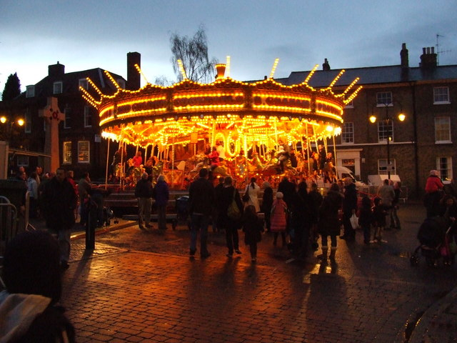
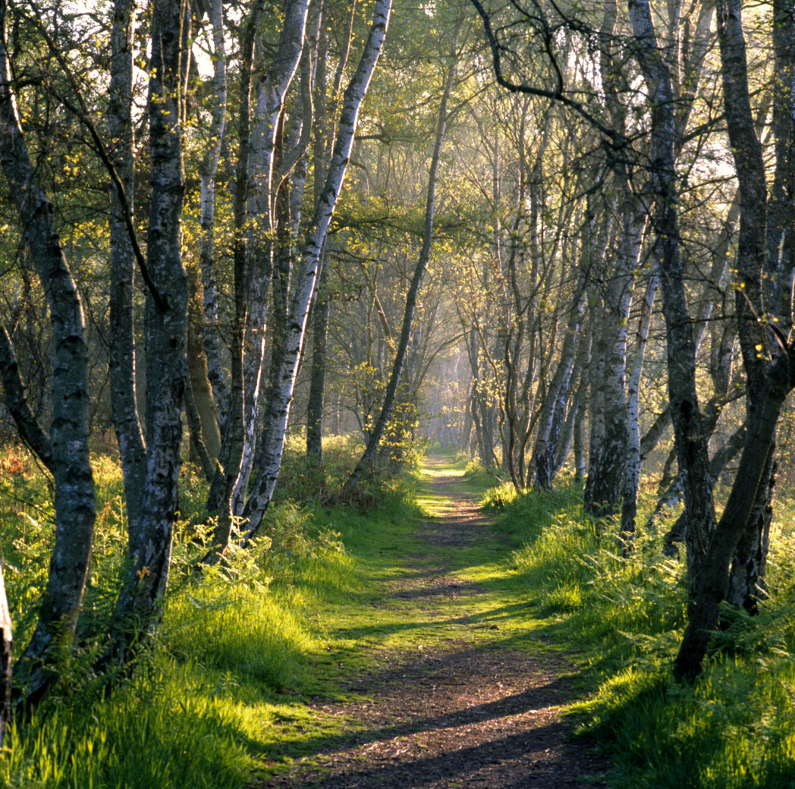
Your Task
Pick one of the following pictures and write 5 sentences to describe the setting. Each sentence should use one of the five senses we have looked at today: Sight, Sound, Smell, Taste and Touch.
Once you have written your 5 sentences put them all together using connectives where you can to for one continuous setting description.
Connectives
and
therefore
because
but
however
so
then

Slide 9
Numeracy
Learning Intention
We are learning to understand time.
Success Criteria
- Pick a mild, hot or spicy chilli challenge from the following slides to complete in you jotter - you can do all three if you wish!
Write the answers in your jotter.
Make sure all spelling is correct.

Slide 10
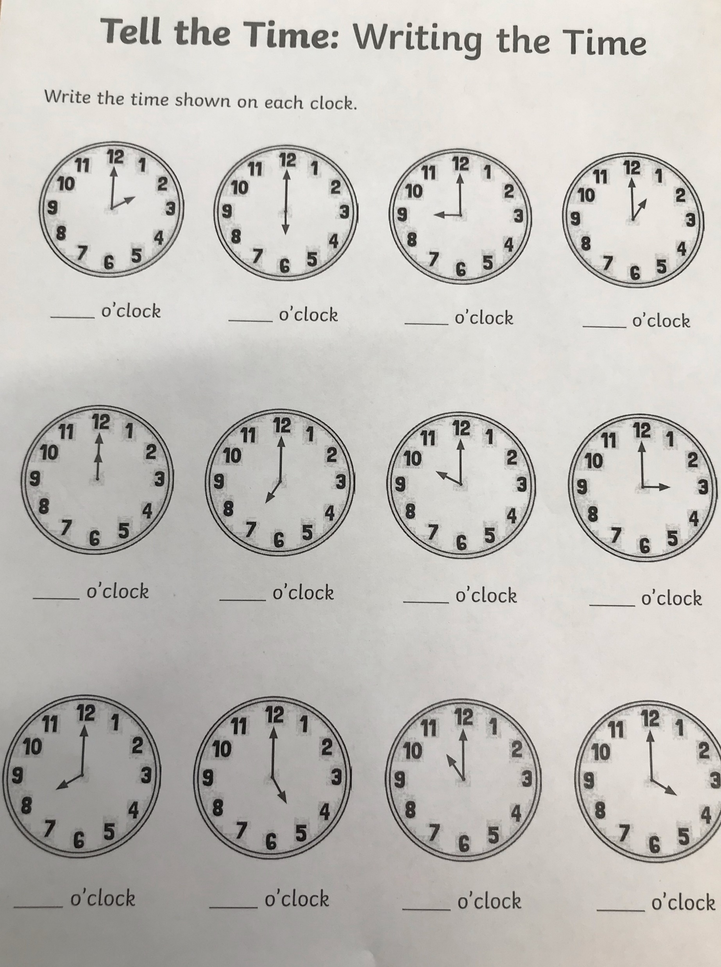



In your jotters please write down the time shown on the clock.

Slide 11
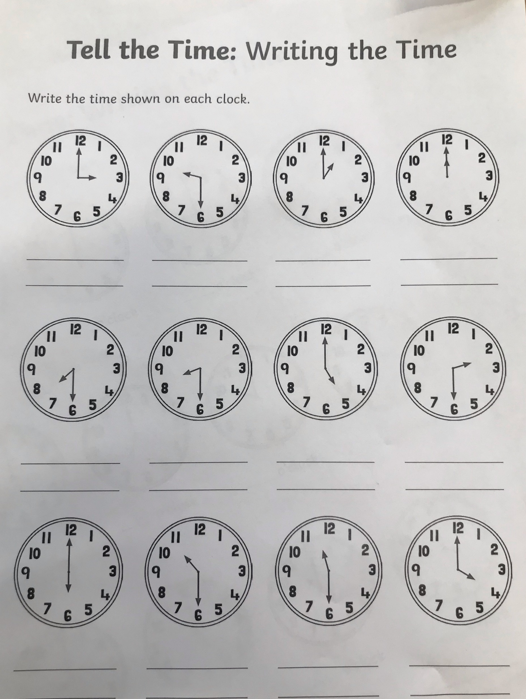

In your jotters please write down the time shown on the clock.

Slide 12
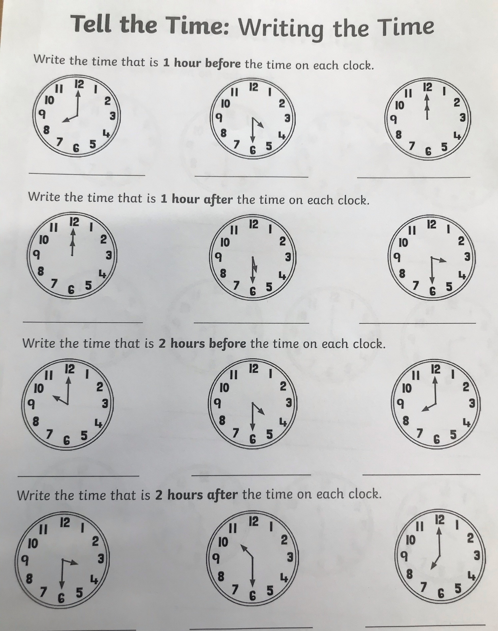

In your jotters please answer the following questions about time.

Slide 13
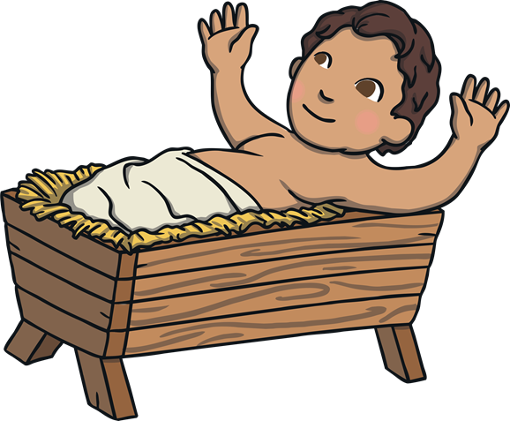
RME
The Following lesson is all about ‘Epiphany’ and this is usually discussed around Christmas time. However, due to our delayed return we never go the chance so we are going to take this time to discuss it.
The Meaning
The feast of Epiphany is celebrating the Baby Jesus being seen or appearing, to the visitors who had travelled to see him.
The word ‘epiphany’ comes from the verb ‘to appear’.

Slide 14
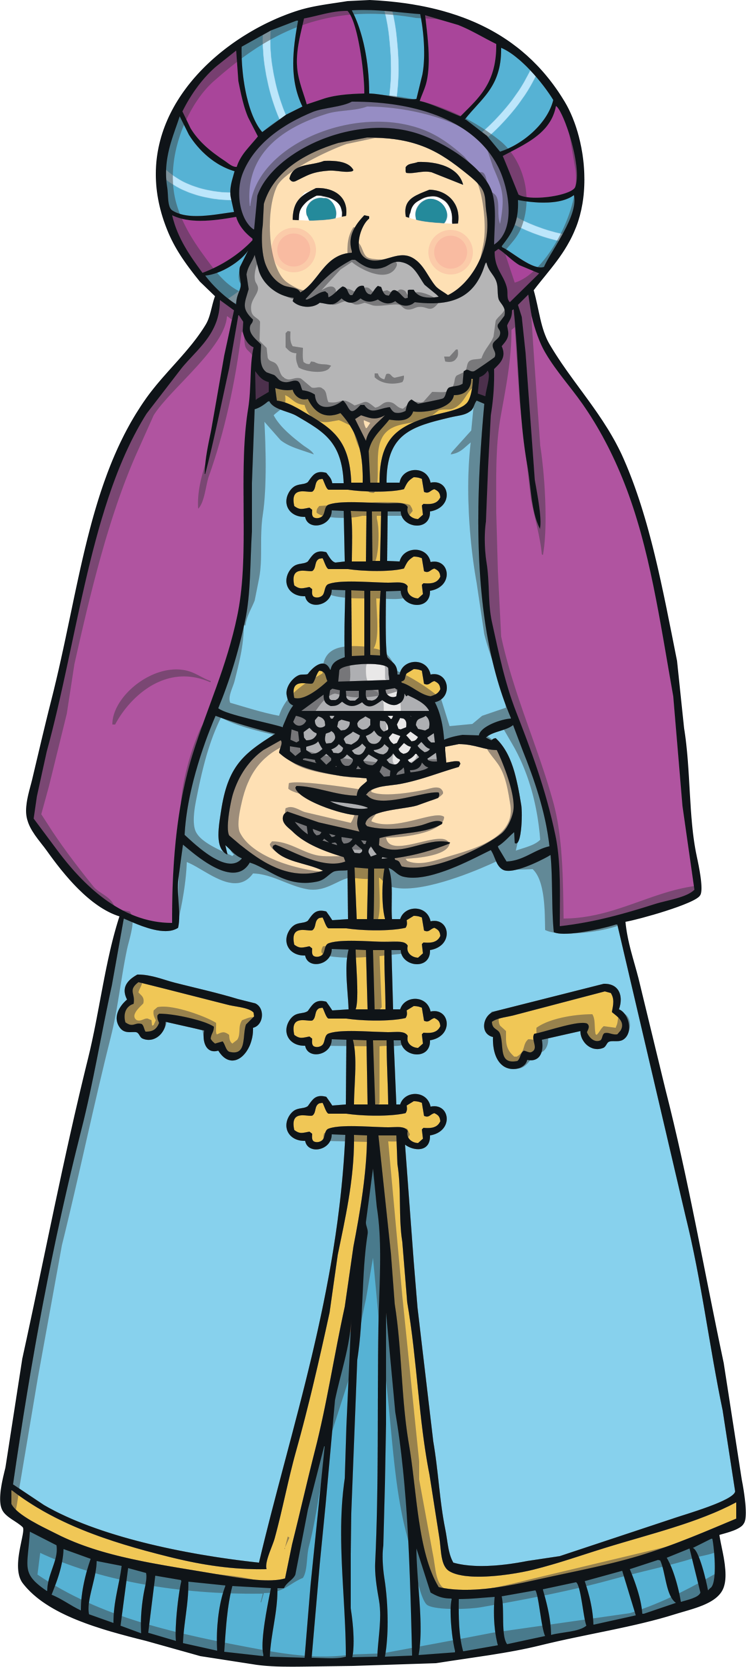
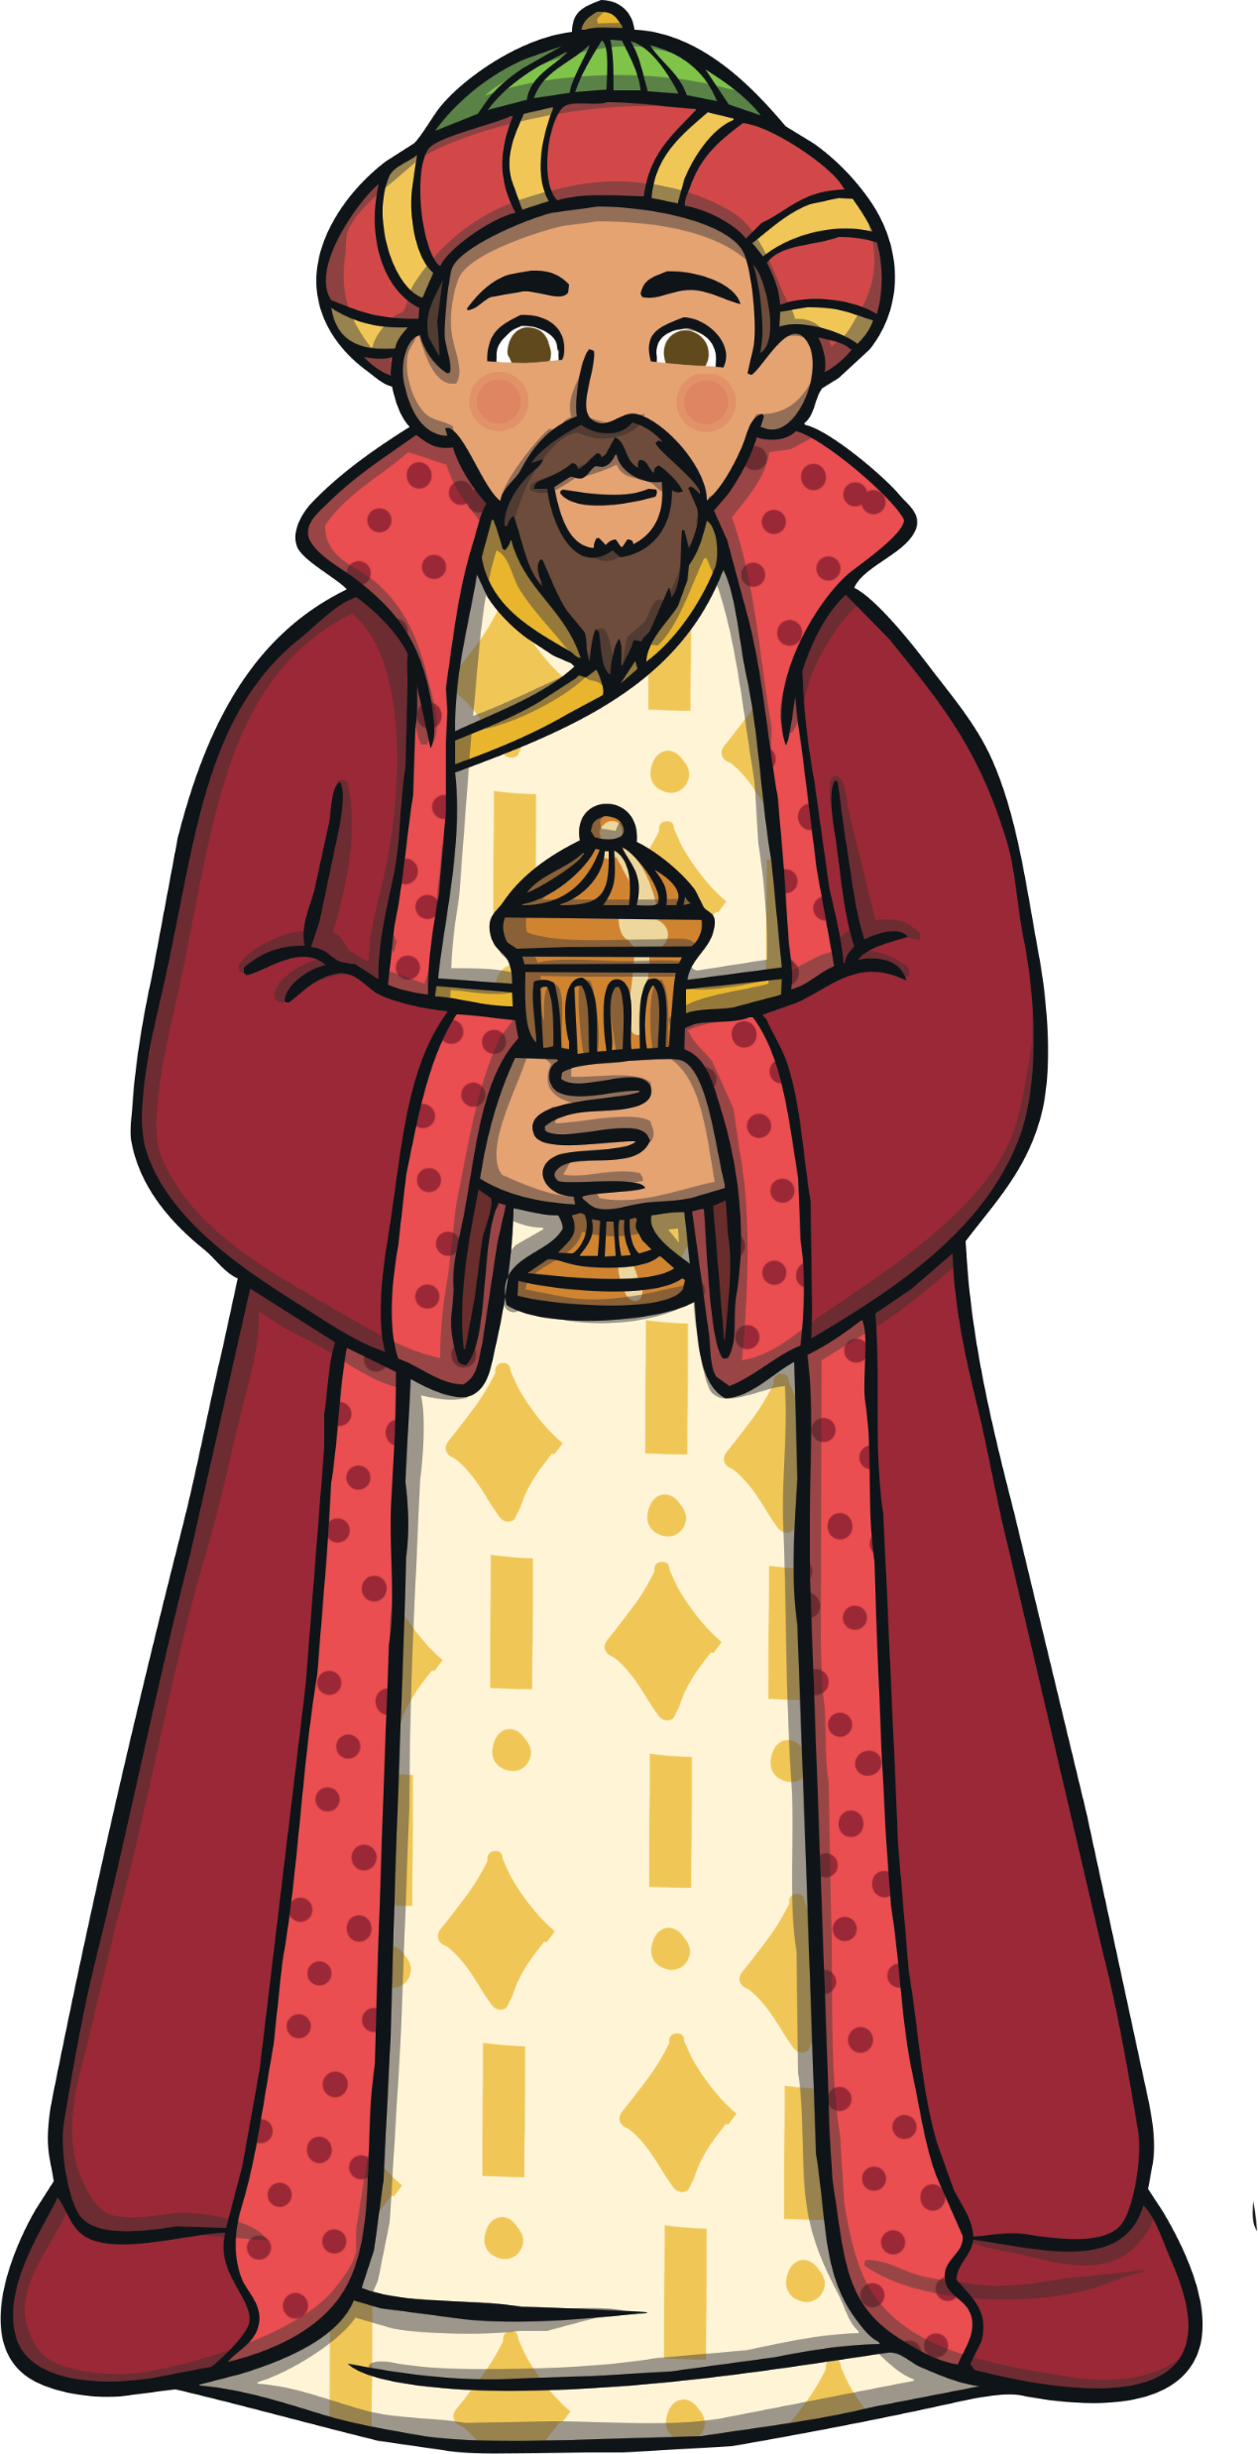
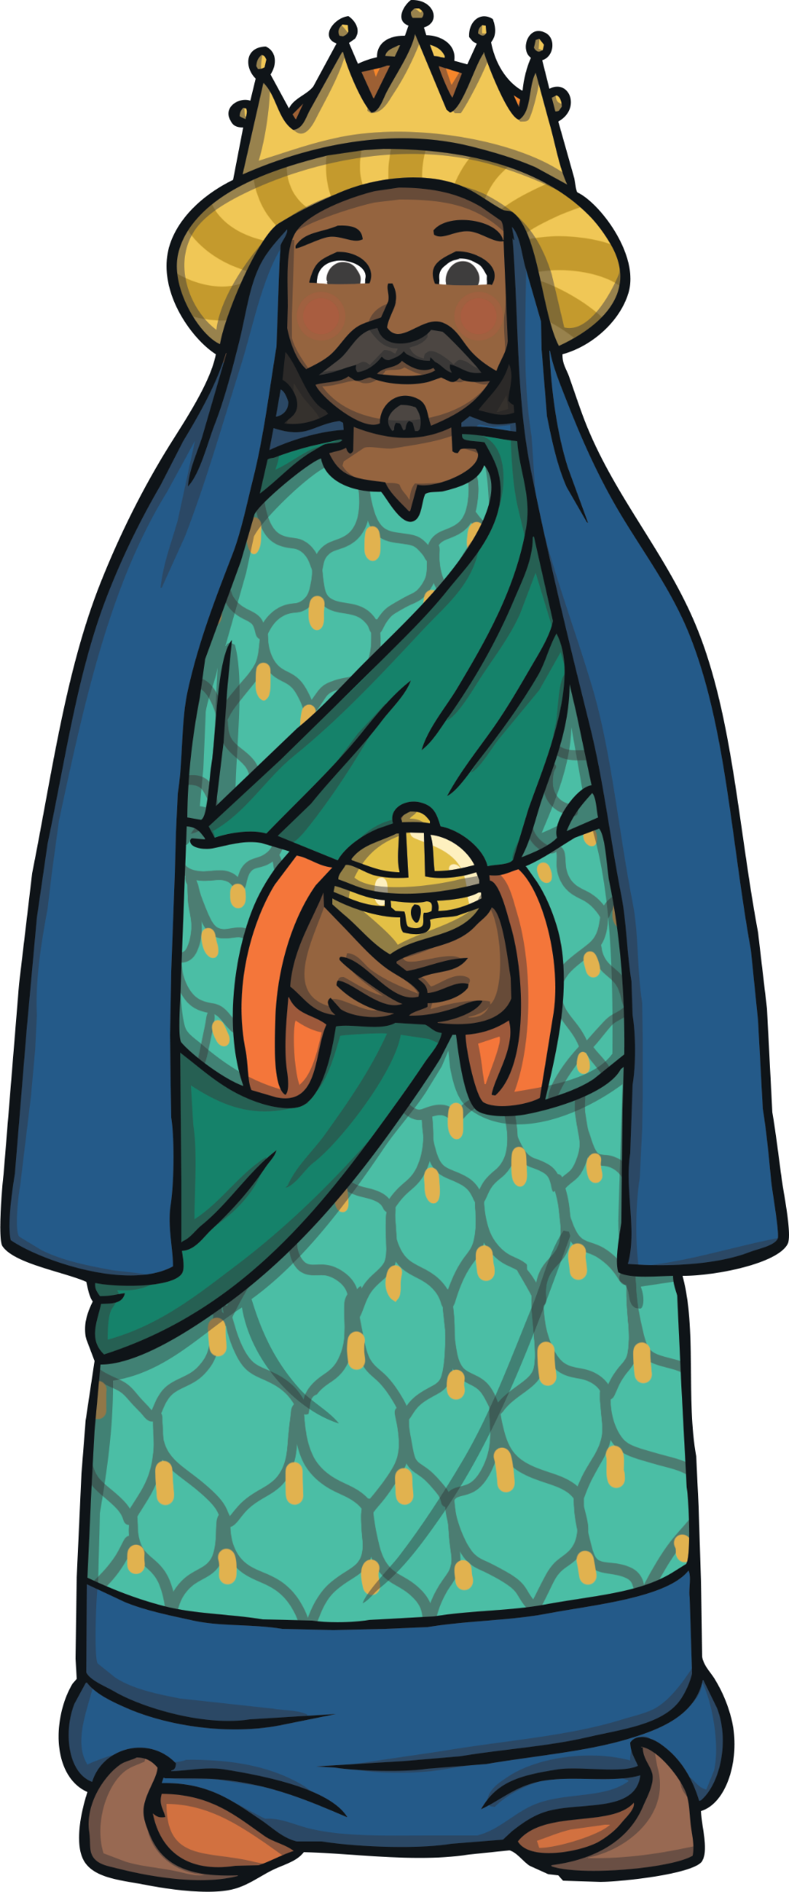
The Visitors
So, who were these visitors?
A long, long way away, there were some wise men studying the stars with their telescopes.
One night, they saw a very interesting star. Very interesting indeed!
These men lived in the east, and were possibly from Persia, which is now called Iran.
Did you know?
The Wise Men are often called Magi, which was a word given to describe priests and clever men.

Slide 15

The Star
The Wise Men were very clever, and understood the religious writings that had been written many years before.
The writings told them that one day there would be a great star and the star would mean that a new king had been born.
So, the men decided to pack up their belongings, and follow the star to wherever it led them.

Slide 16
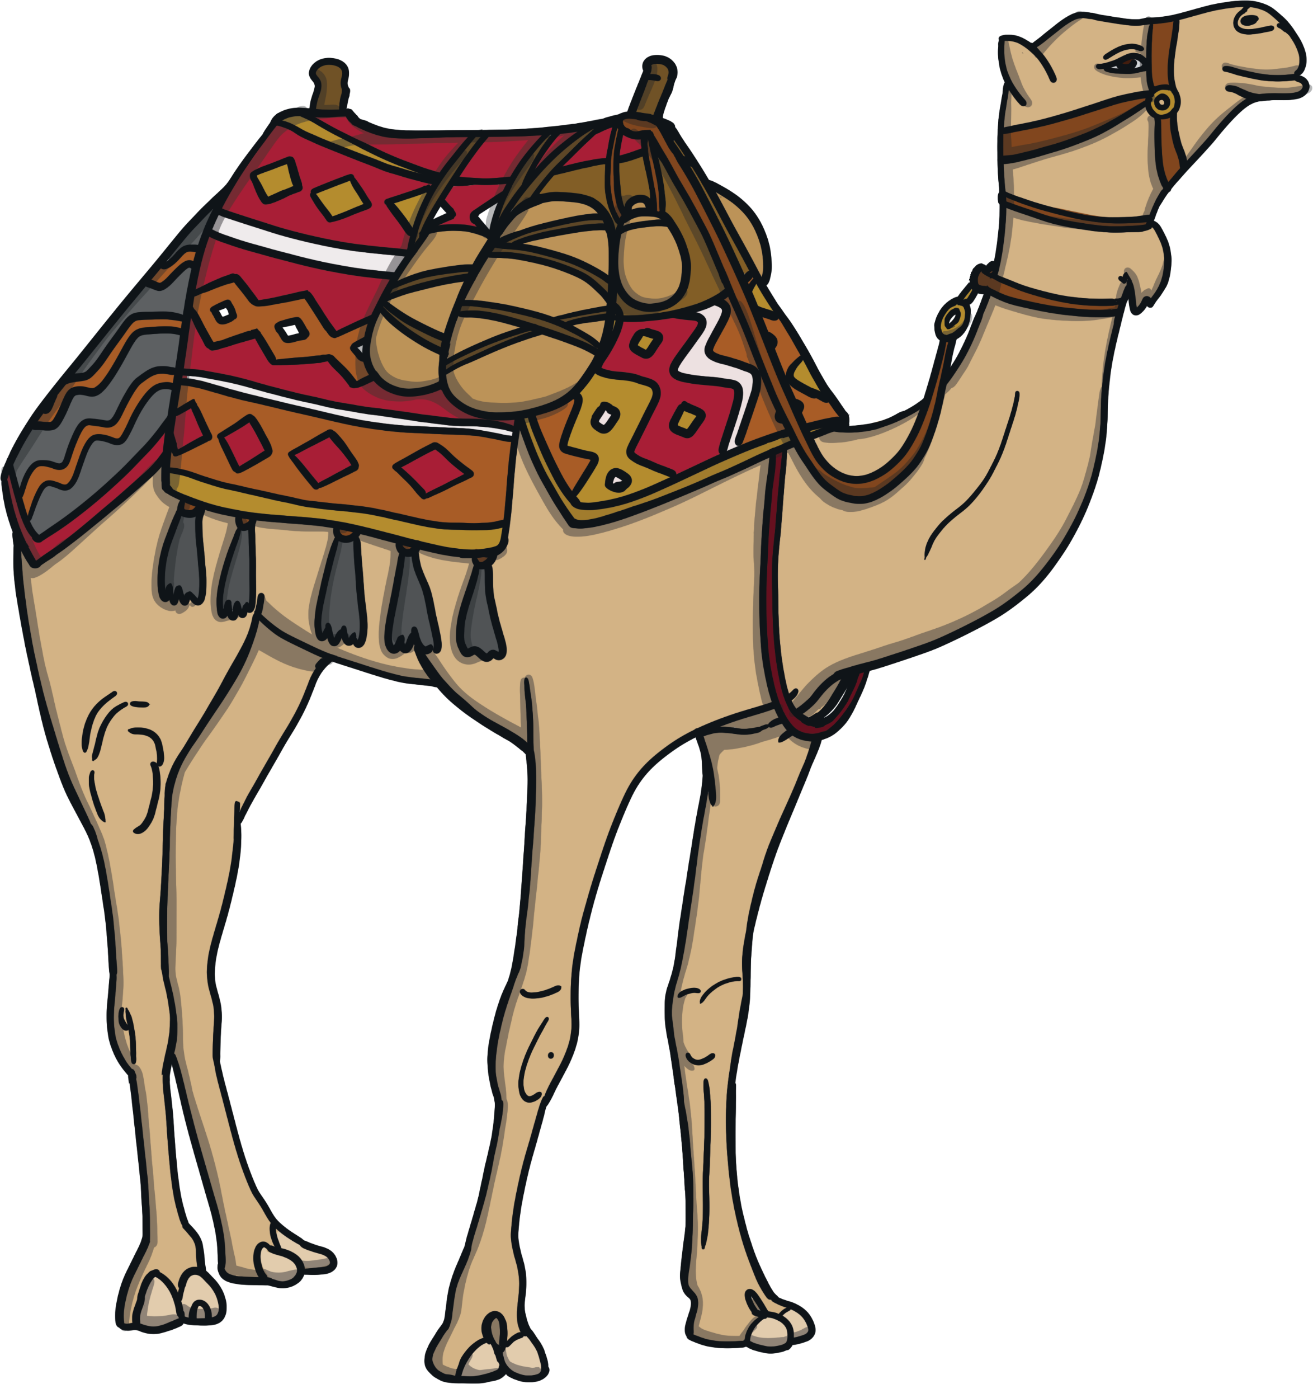
The Journey
The journey would have been very long.
They probably travelled on camels, across deserts and over mountains.
The star led them to the town of Bethlehem
in Israel.

Slide 17
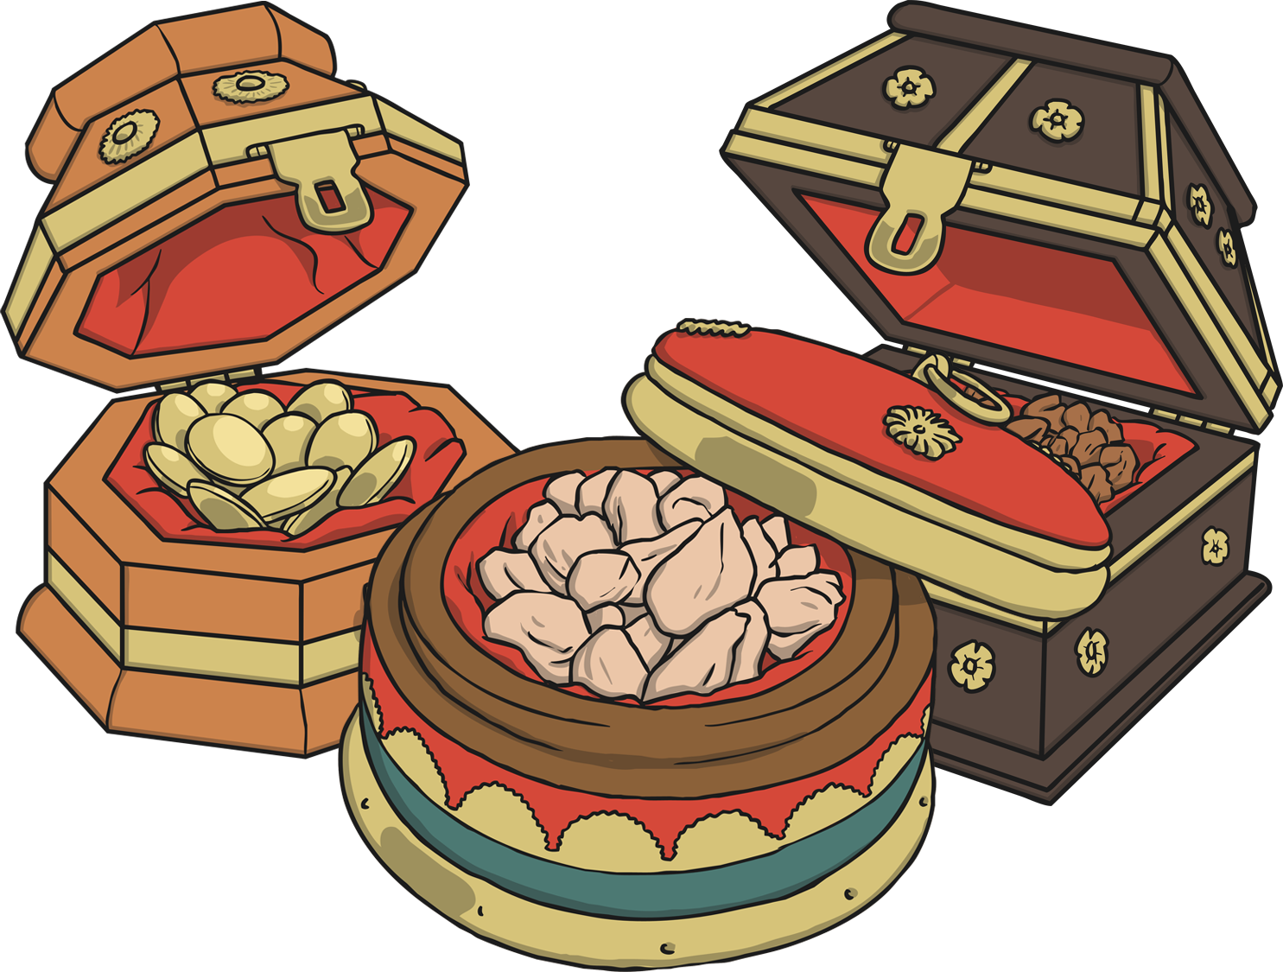
The Gifts
The star came to rest over the place where Jesus was, and the Wise Men brought expensive gifts for him and worshipped the new king.
The Bible never mentions how many wise men there were, but because there were three gifts, people often think there must have been three wise men.
Did you know?
The Wise Men are sometimes called the Three Kings because of the expensive gifts they brought.
The gifts were gold, frankincense and myrrh.

Slide 18
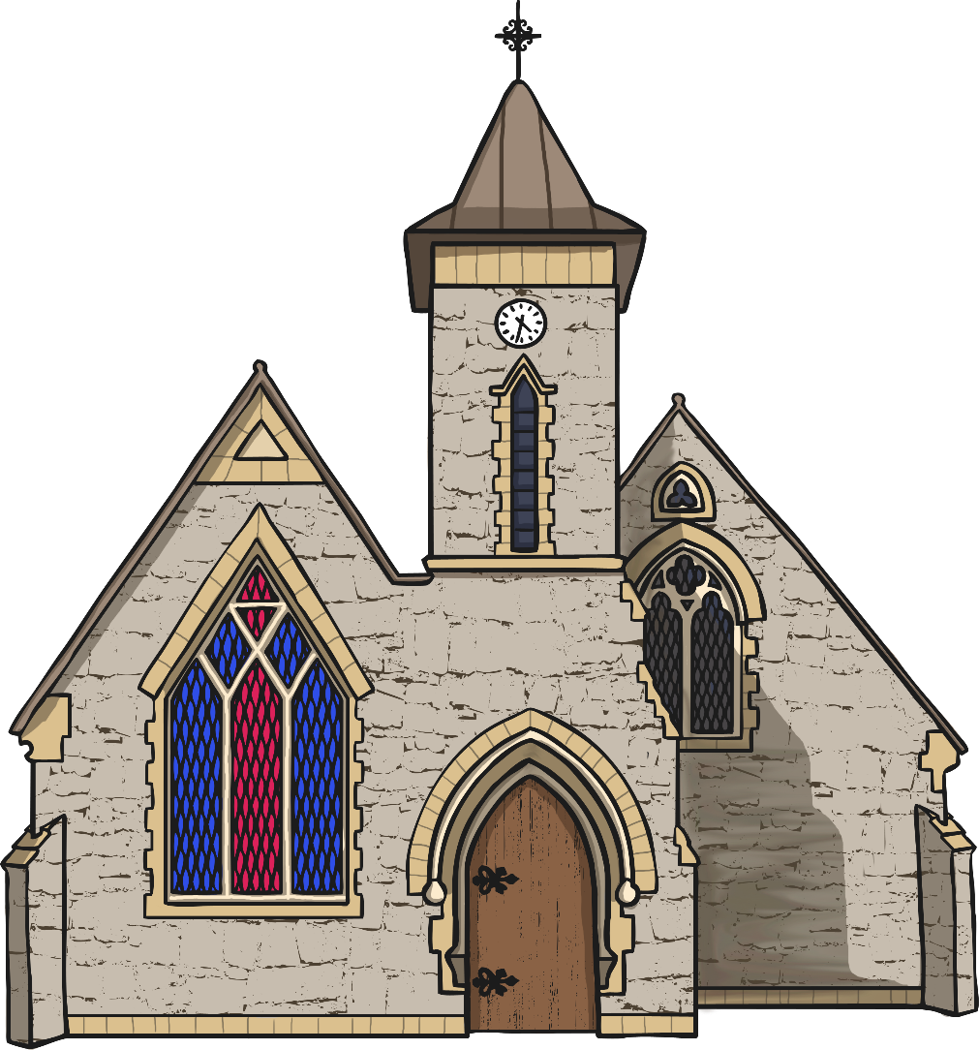
The Feast of Epiphany
The Feast of Epiphany is celebrated in churches, usually on the 6th January.
Epiphany is also known as Three Kings’ Day.

Slide 19
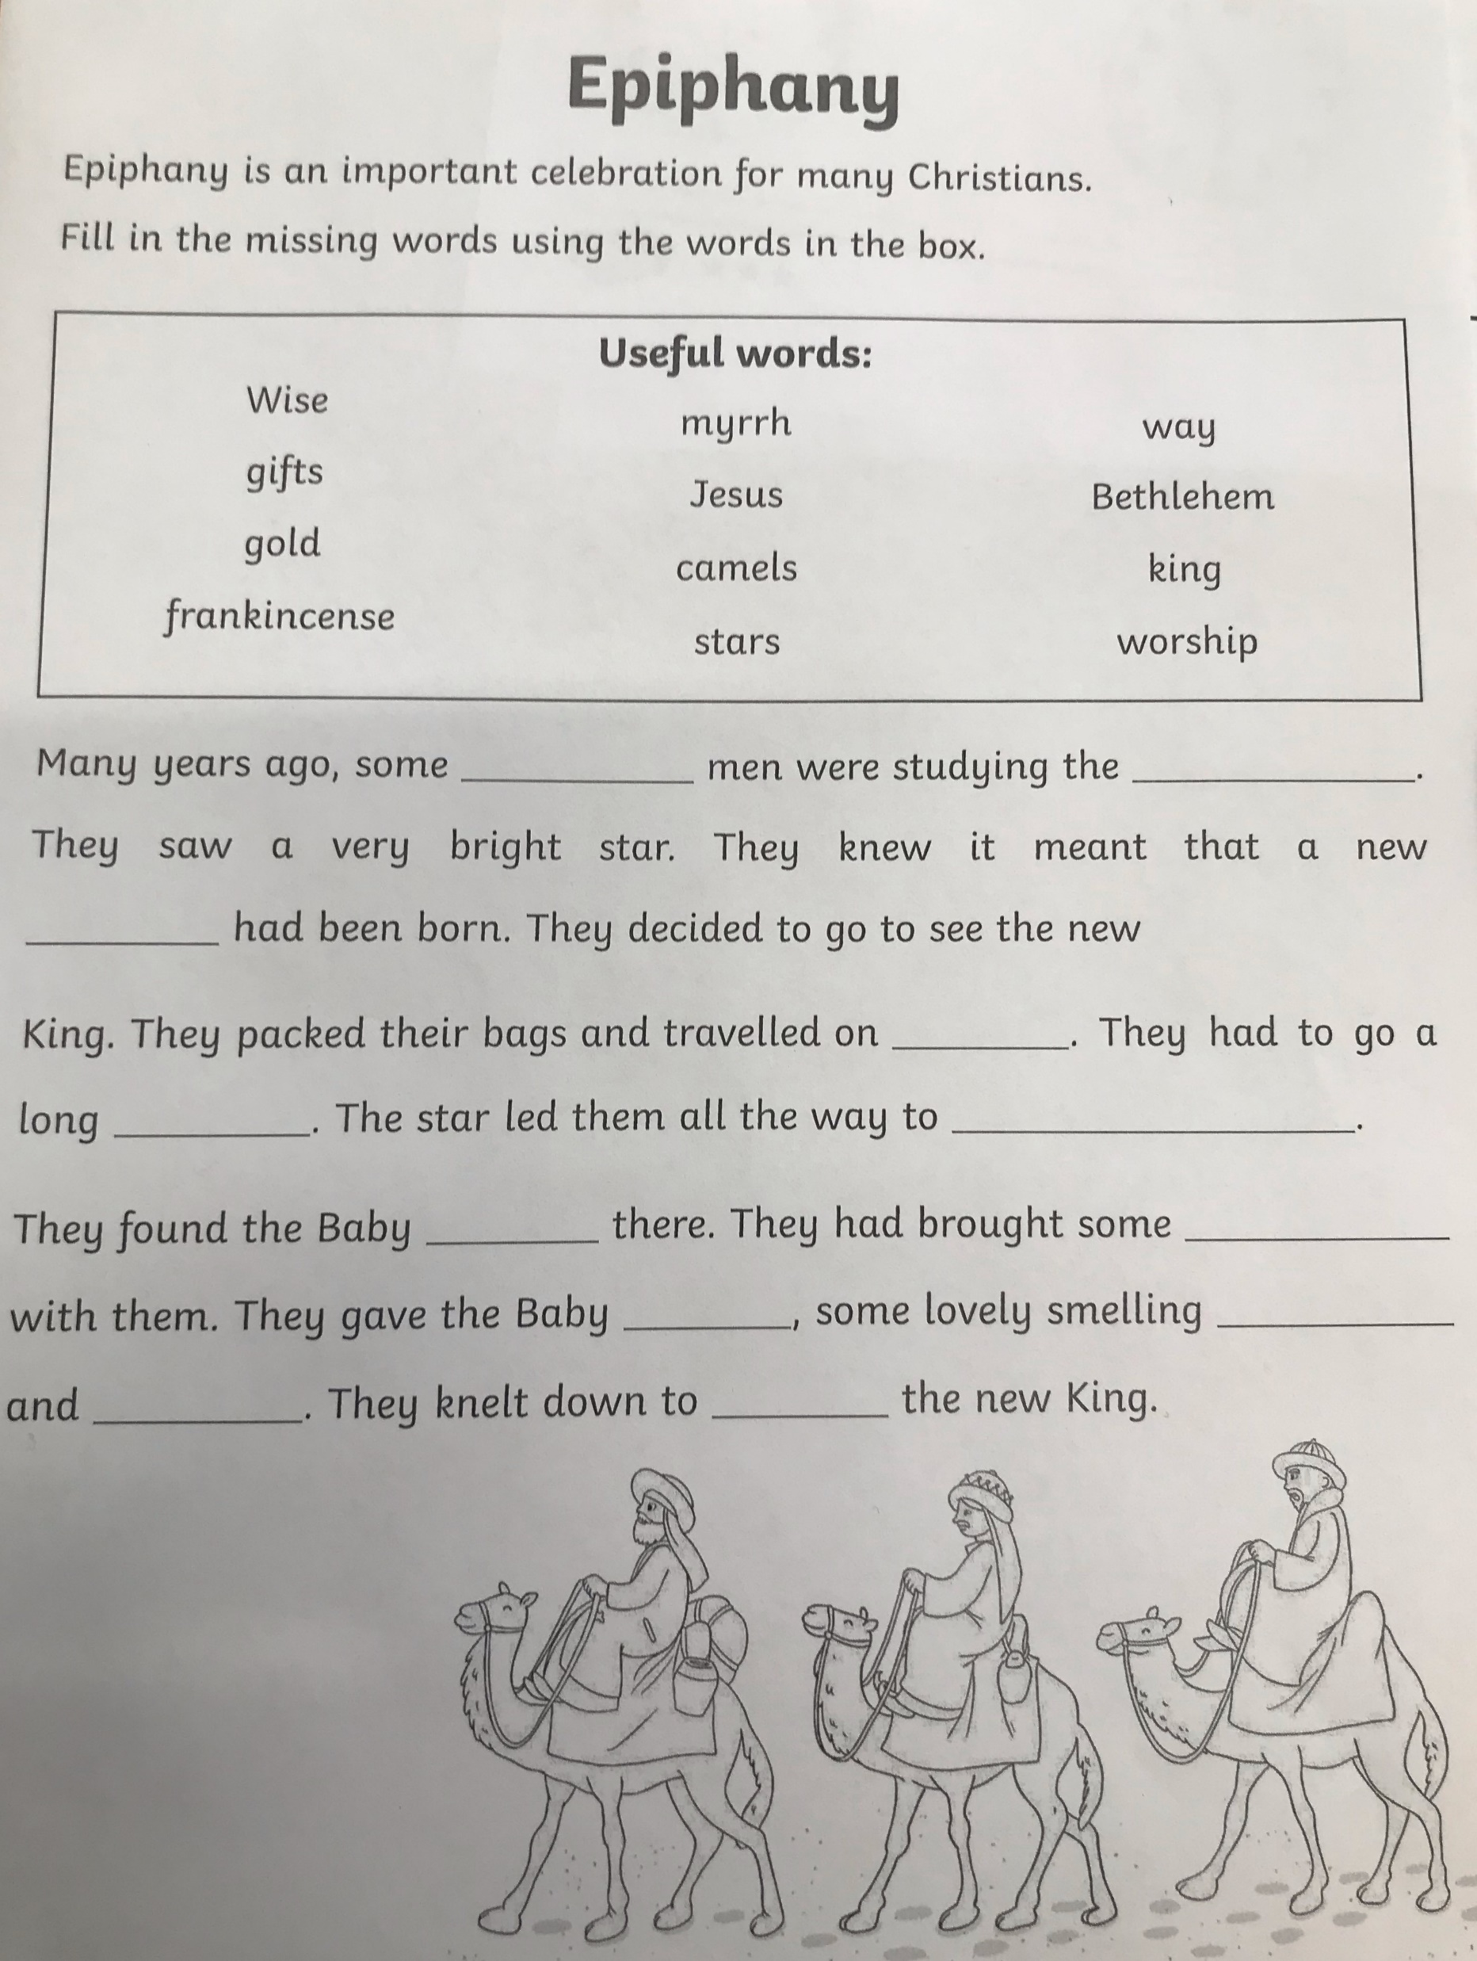
Using all of the information you have just learned please use the word bank to fill in the blanks to tell us all about ‘Epiphany’.
Copy the paragraph into your jotter filling in the missing words.

Slide 20

P.E
Follow the link to Harry Potter – Cosmic Yoga and complete the activities.
https://www.youtube.com/watch?v=R-BS87NTV5I

Slide 21
Night time prayer
God our Father, I come to say thank you for your love today.
Thank you for my family and all the friends you give to me.
Guard me in the dark of night and in the morning send your light.Amen.

