Slide 1
St Mary’s Glow Blog
P3 & P4
Tuesday 26th January 2021
With Mrs Gould

Slide 2
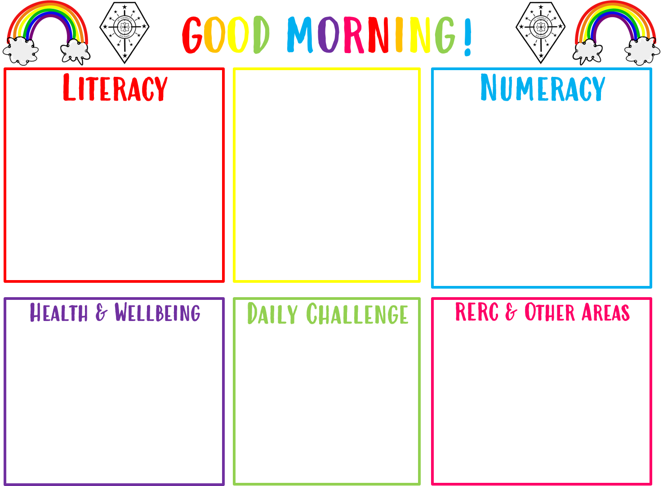
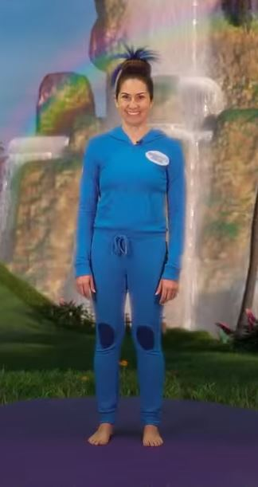
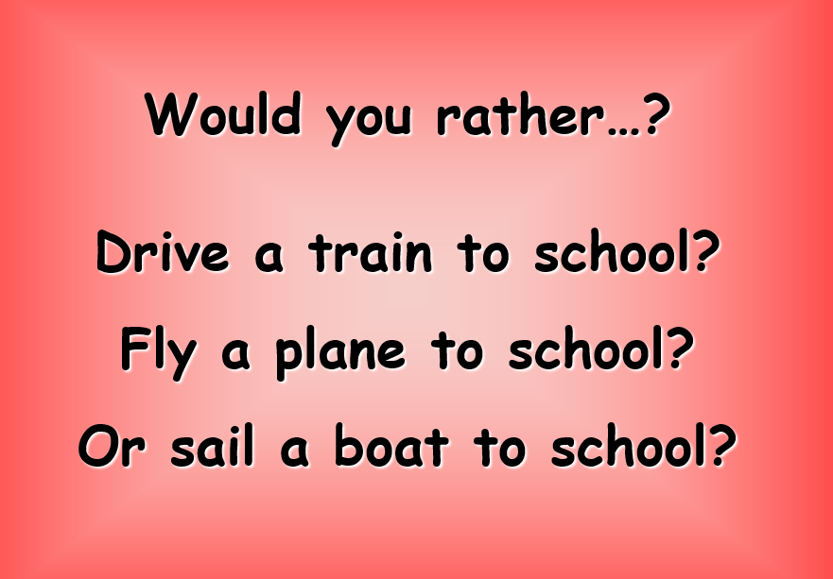
Good morning boys and girls
Tuesday 26 th of January 2021
26/01/2021
The in school teacher is
Mrs Gould
All completed work should be sent to Mrs Raeper
ddaraeper726@glow.sch.uk
Grammar and Punctuation
We are learning to recognise verbs which are DOING words.
Revision of Subtraction
Take the mild, hot or chilli challenge
Art and Design – design your own tartan!

Slide 3
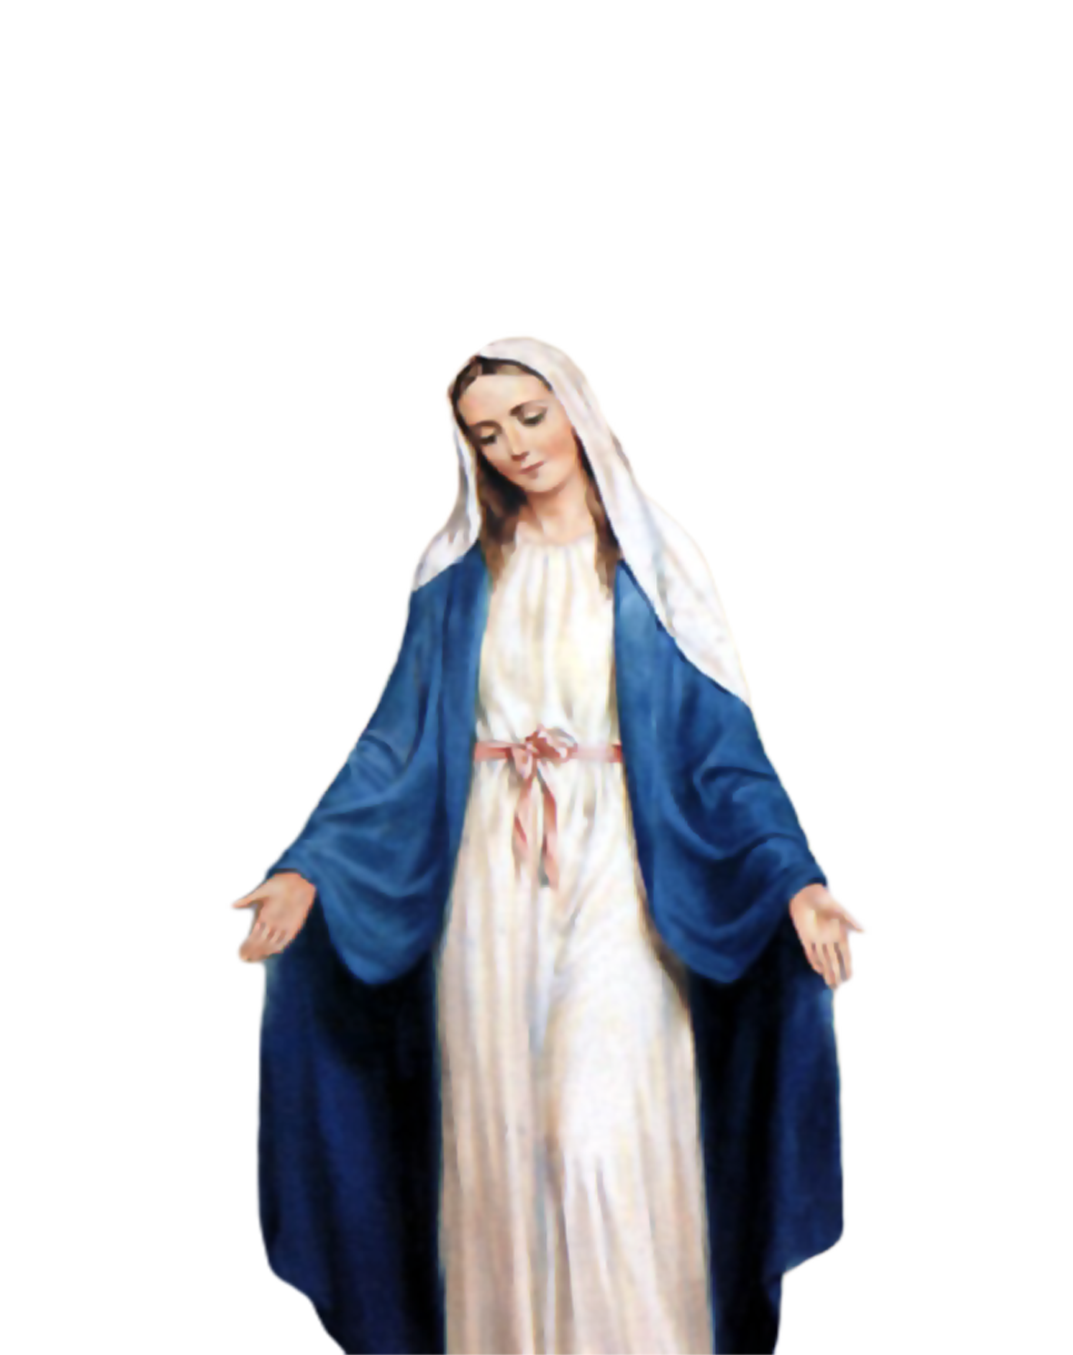
Morning Prayer
Father in heaven you love me
You are with me night and day
I want to love you always
In all I do and say
I’ll try to please you Father
Bless me through this day
Amen

Slide 4
Morning Challenge

Slide 5
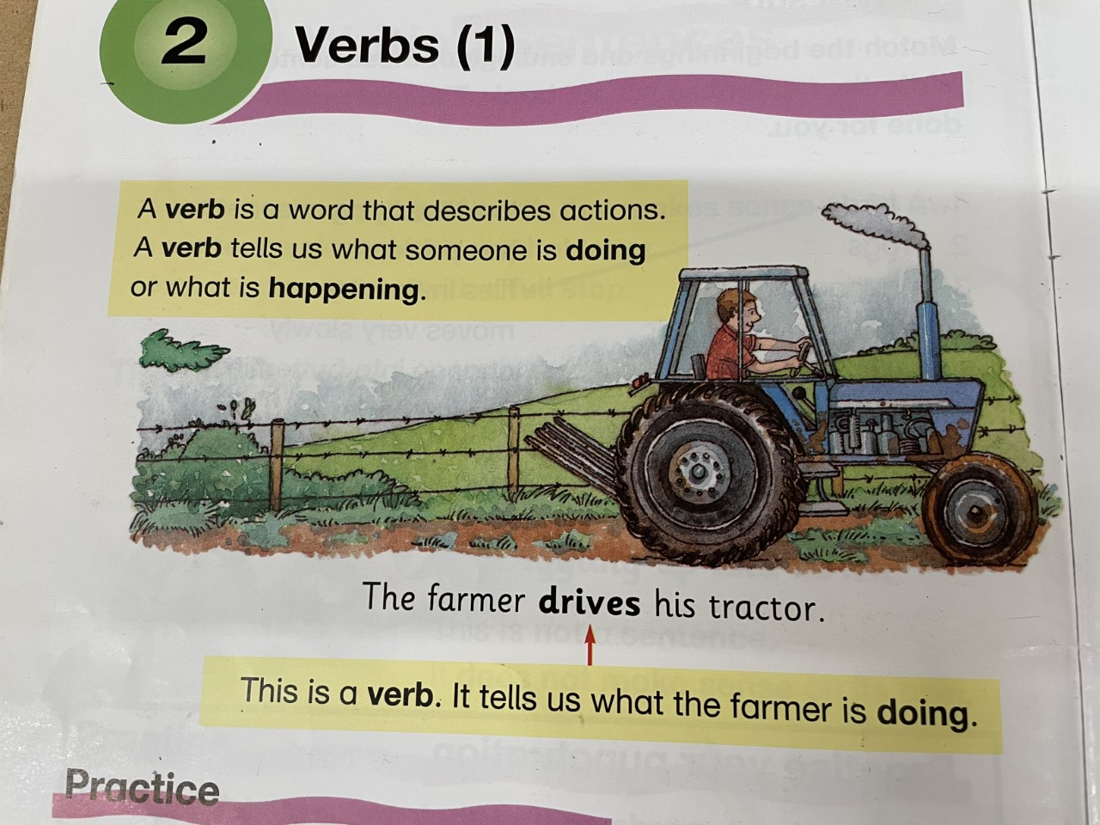
Literacy- Verbs Tuesday 26th January 2021
We are learning to recognise verbs.
A verb is a doing word like dig, sing, run walk hop.

Slide 6
!
Mild Challenge
We are learning to recognise Verbs. Verbs are doing words.
Copy the sentences below and write them in your jotter.
If it’s too tricky for you to write the sentences, then write down the verb from each sentence.

Slide 7
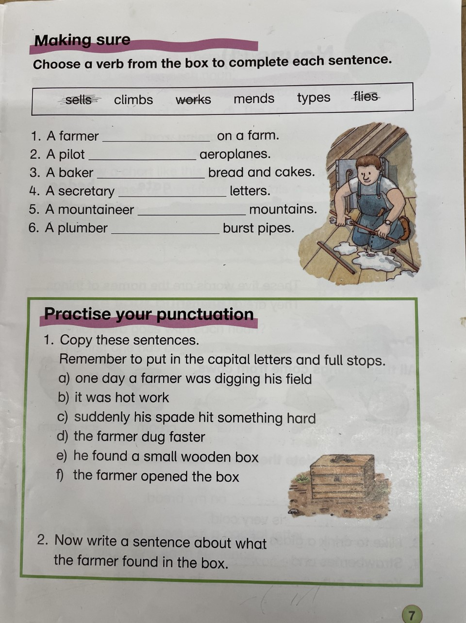
Hot Challenge
We are learning to recognise verbs.
We are choosing the correct verb for each
sentence.
We are practising our punctuation. Can you write full
stops and capital letters in each sentence?
What did the farmer find in the box? This is your chance
to use adjectives too!

Slide 8
Chilli Challenge
Nouns are names of people, places or things. Examples of nouns are dog, table, jelly, Lochee.
Match the nouns and the verbs together. The first one has been done for you.
Practice your punctuation. Write the sentences with full stops and capital letters and underline the verbs.

Slide 9
Reminder: for grown ups and children. Do not panic… just do the challenge you are able to do. Take a break if you need to.

Slide 10
Numeracy for Tuesday 26th January– Subtraction Learning Intention: We are learning to take away Success Criteria: We are using a number line or hundred square to count back to find the answer. We know that when we are taking away, the number gets smaller.

Slide 11
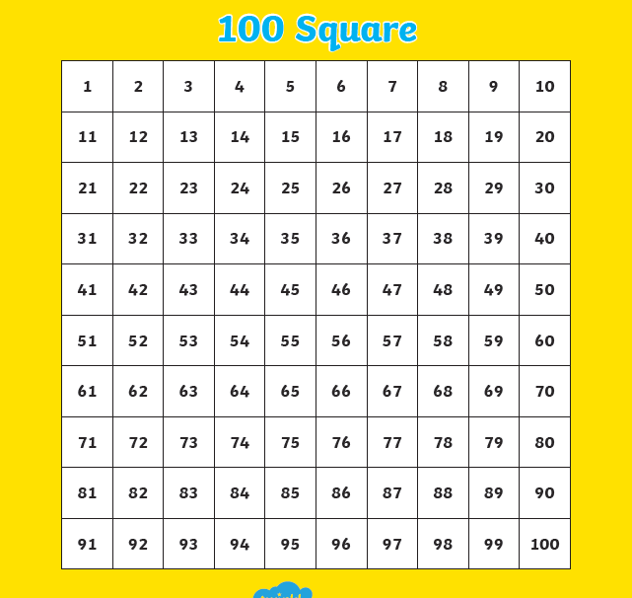
Use the hundred square to help you with your taking away.

Slide 12
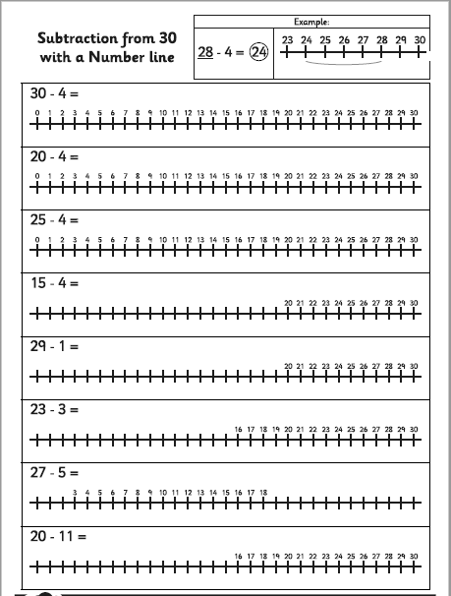
Mild Challenge
Use the number line to help you take away.
Remember – when you take away the numbers get smaller.
If the sum is 30 – 4 start on 30 and hop back 4. The number you land on is the answer.
The one at the top of the page has been done for you.

Slide 13
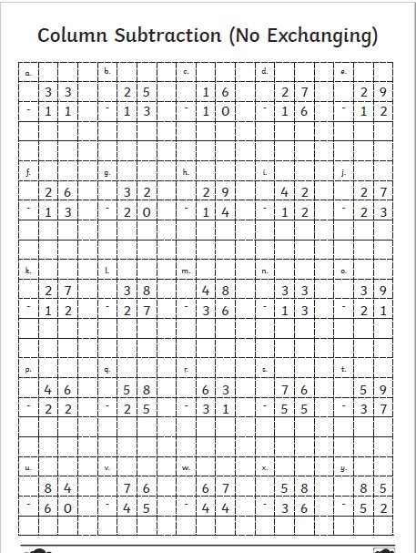
Hot Challenge
We are learning to take away using chimney sums.
Remember to line up your tens and ones.
Take away from the top number first.
Remember – when you take away the answer is smaller.

Slide 14
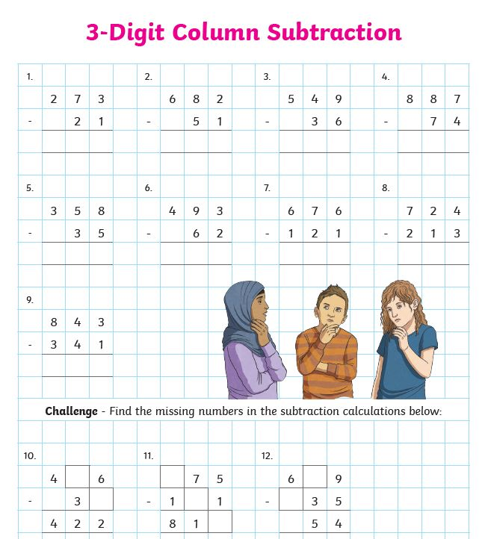
Chilli Challenge
- We are learning to take away using chimney sums.
Remember to line up your tens and ones.
Take away from the top number first.
Remember – when you take away the answer is smaller.

Slide 15
Read through the next few slides on tartan and choose
and then design your own tartan. Which colours will you
Use? Send it back to school to let the teachers look at your design!

Slide 25
Sonic The Hedgehog | A Cosmic Kids Yoga Adventure! - YouTube
It’s been a busy day…if you have
Enough energy try soe Cosmic yoga!

Slide 26
Keep practising your Scot’s poem. The links are below. You can take part in the Burn’s competition!
P3 Poem and activity.pptx (sharepoint.com)
P4 Poem and activity.pptx (sharepoint.com)

Slide 27
NIGHT Prayer
God our Father, I come to say thank you for your love today.
Thank you for my family and all the friends you give to me.
Guard me in the dark of night and in the morning send your light.
Amen.

