Slide 1
St Mary’s Glow Blog
P3 & P4
Monday 25th January 2021
With Mrs Gould

Slide 2
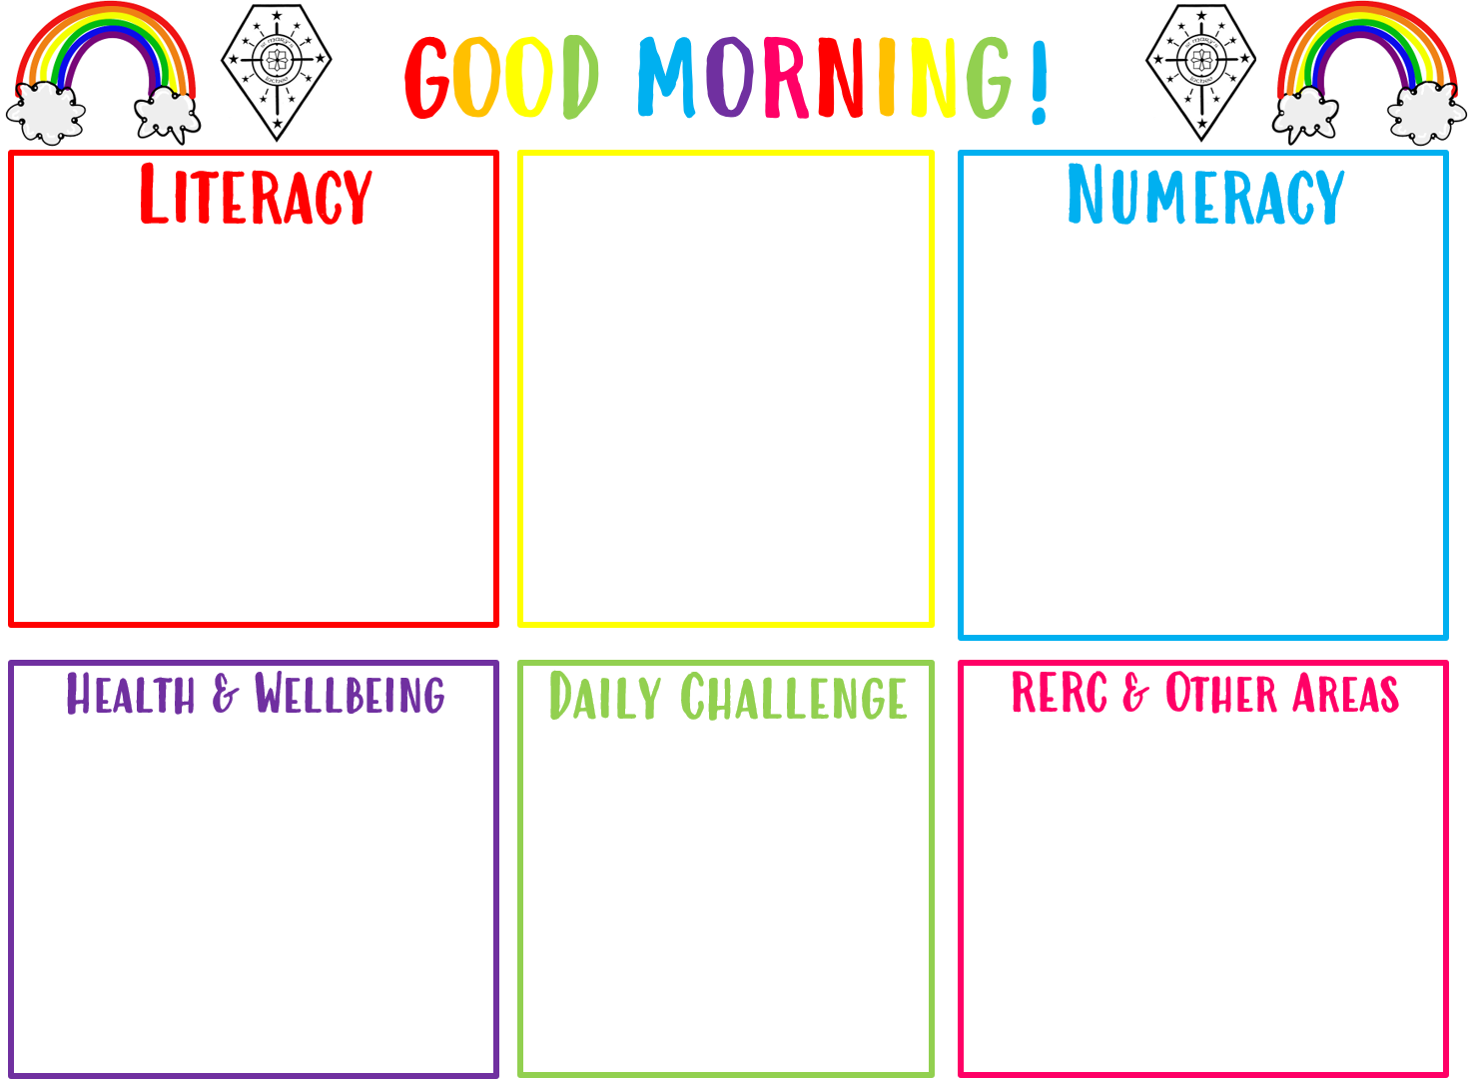
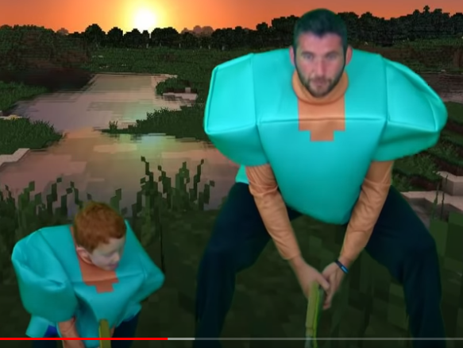
Good morning boys and girls
Monday 25th of January 2021
22/01/2021
The in school teacher is
Mrs Gould
All completed work should be sent to Mrs Raeper
ddaraeper726@glow.sch.uk
Addition
Take the mild, hot or chilli challenge
Spelling
The sound ‘wh’.
Take the mild, hot or chilli challenge
Burn’s Poem and Activity
Learn the poem that Miss McPherson has uploaded to the blog and complete the acrostic poem.

Slide 3
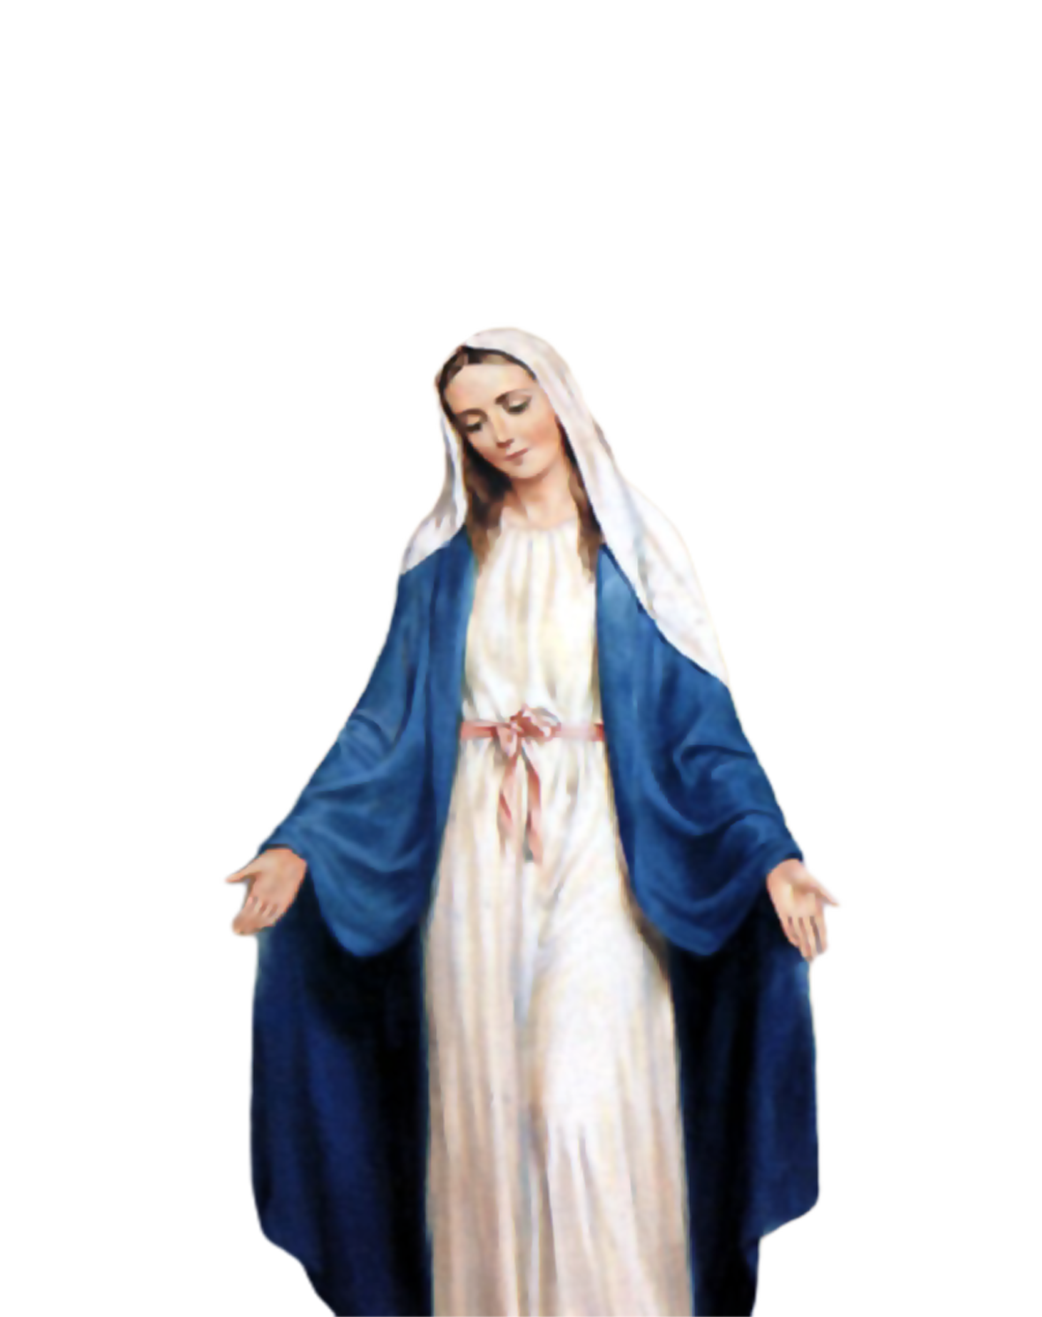
Morning Prayer
Father in heaven you love me
You are with me night and day
I want to love you always
In all I do and say
I’ll try to please you Father
Bless me through this day
Amen

Slide 4
Morning Challenge

Slide 5
Literacy- Spelling Monday 25th January 2021
We are learning the ‘wh’ sound today.
Look at the wordlist.
Read through the words.
Say the words.
Cover them and try and remember how to spell them.

Slide 6
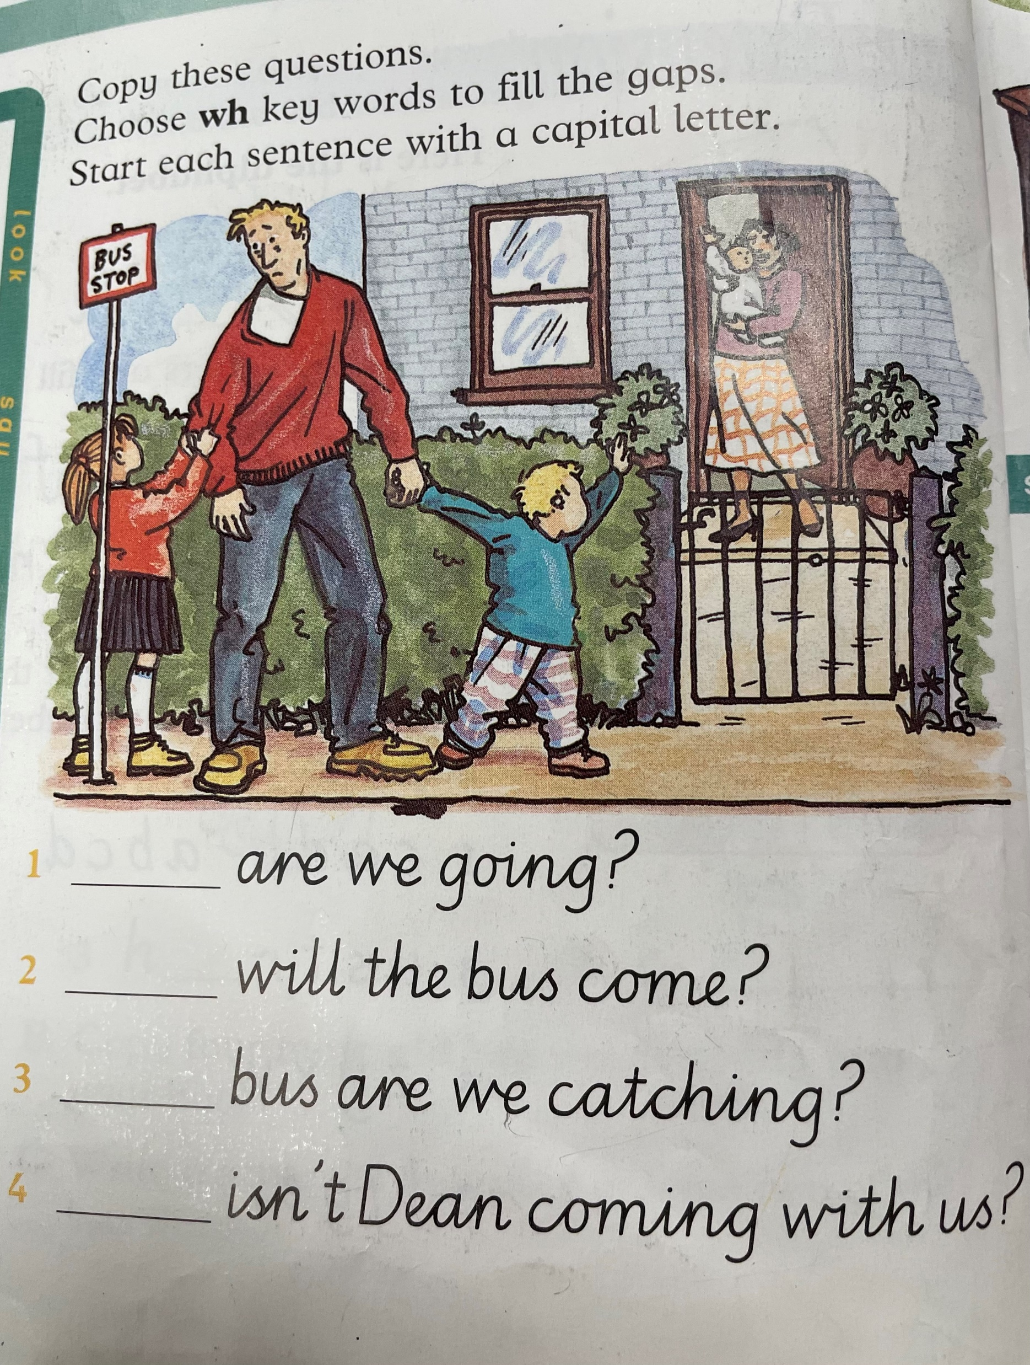
!
Look at the spelling list again.
Can you copy the questions into your jotter and choose the correct word from the spelling list.

Slide 7
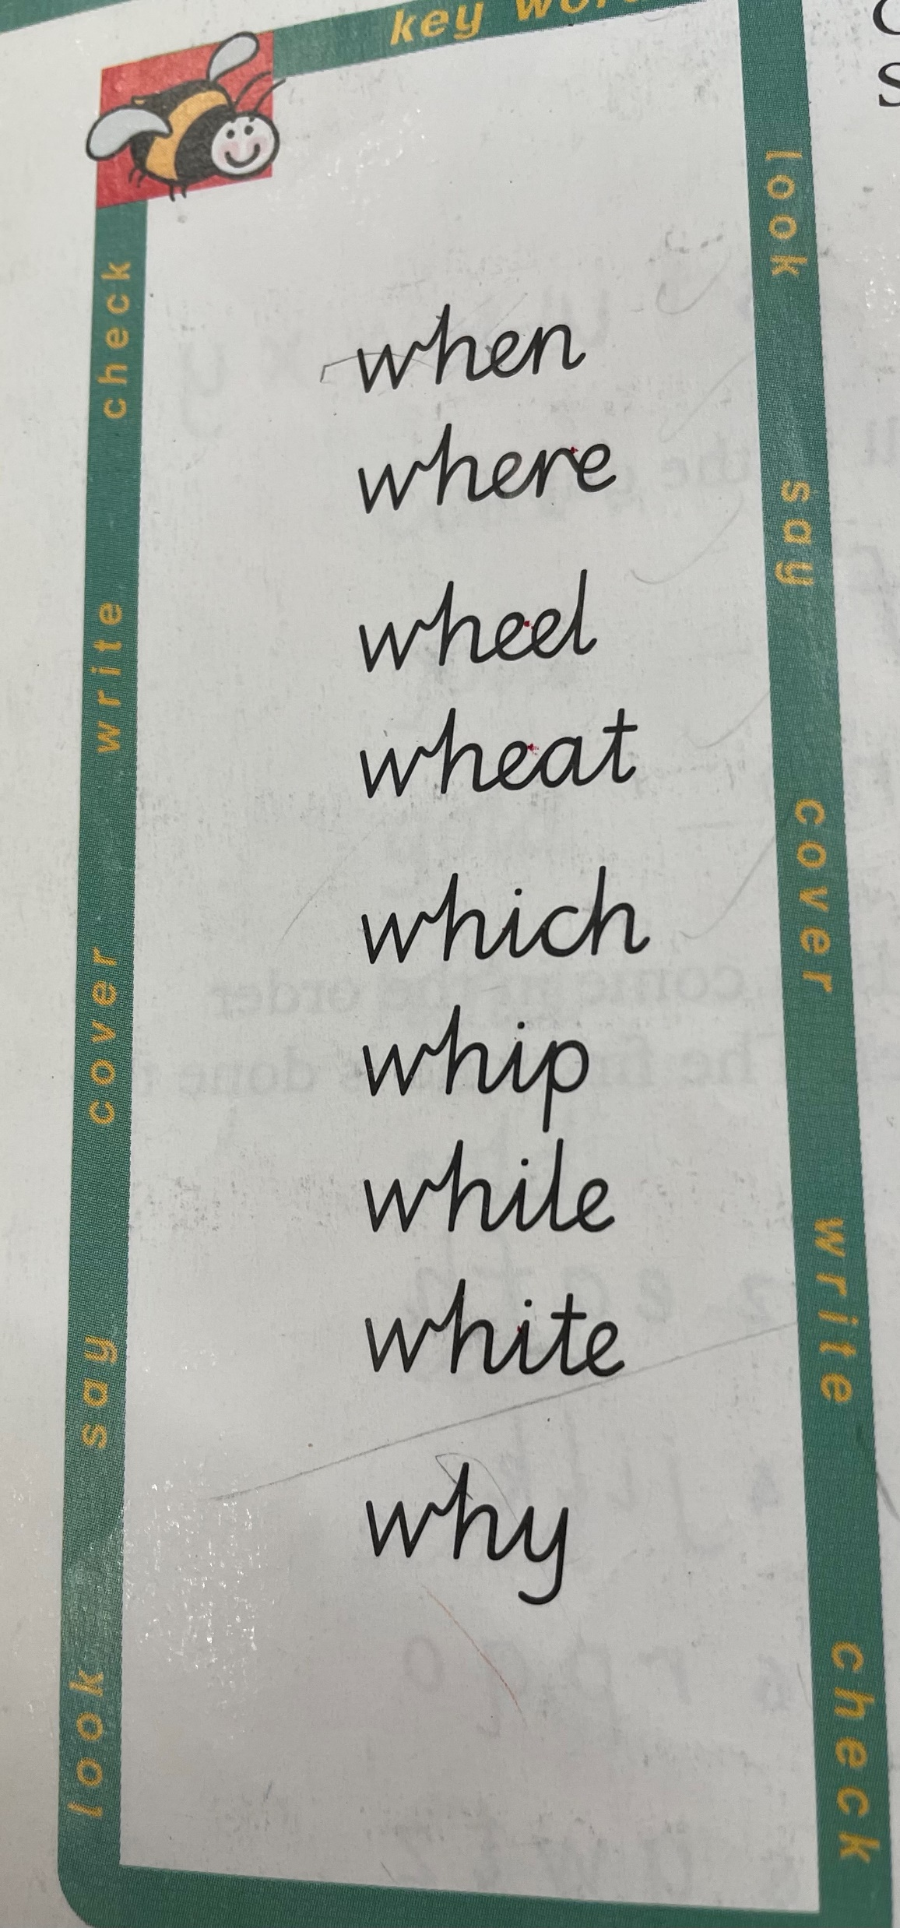
Follow the instructions on the worksheet

Slide 9
Reminder: for grown ups and children. Do not panic… just do the challenge you are able to do. Take a break if you need to.

Slide 10
Numeracy for Monday 25th January– Addition Learning Intention: We are learning to add whole numbers together. Success Criteria: We are using a number or hundred square to add numbers together. We know that when we are adding, the number will be bigger.

Slide 11
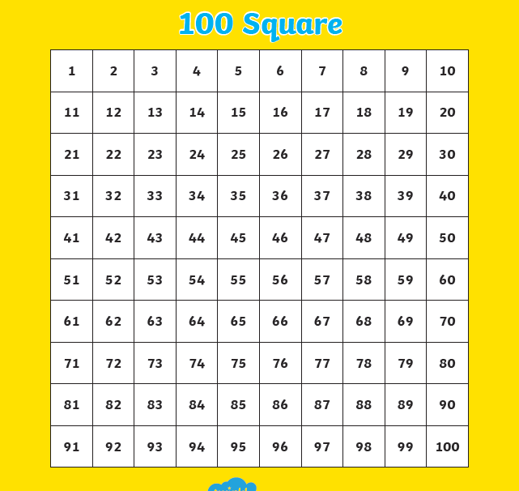
Use the hundred square to help you with your adding.

Slide 12
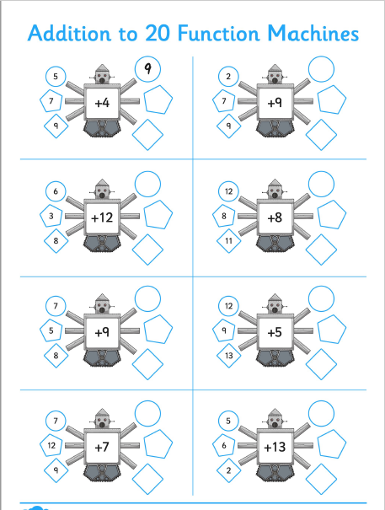
Adding to 20 Function Machine.
- Use your 100 square to help you add.
Remember – when you add the numbers get bigger.
The first one has been done for you.

Slide 13
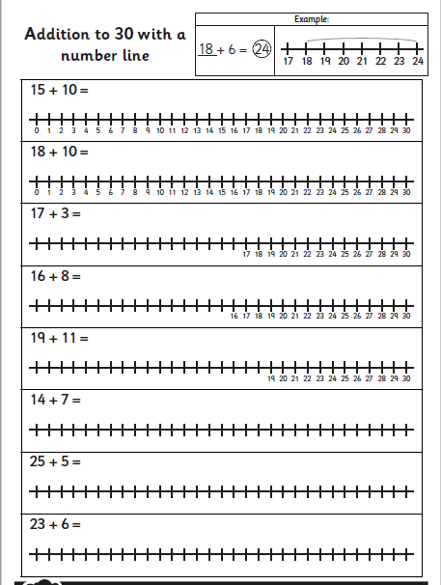
Addition on a number line.
Remember to start at the first number.
The second number tells you the number of hops.
The number you land on is the answer.

Slide 14
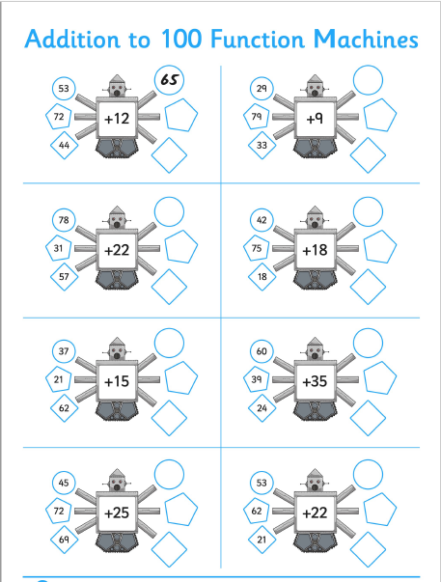
Adding to 100 Function Machine.
- Use your 100 square to help you add.
Remember – when you add the numbers get bigger.
The first one has been done for you.

Slide 15
Click on the link to find the minecraft workout!
Kids Workout! MINECRAFT GYM CLASS! Real-Life VIDEO GAME! Kids Workout Videos, DANCE, & P.E. FUN! - YouTube

Slide 16
Follow the link in the Blog to see the Scot’s Poem activities uploaded by Miss McPherson. You can also click on the links here.
P3 Poem and activity.pptx (sharepoint.com)
P4 Poem and activity.pptx (sharepoint.com)

Slide 17
NIGHT Prayer
God our Father, I come to say thank you for your love today.
Thank you for my family and all the friends you give to me.
Guard me in the dark of night and in the morning send your light.
Amen.

