Slide 1
St Mary’s Glow blog
P3 & P4
Friday 22nd January 2021
With Mrs Gould

Slide 2
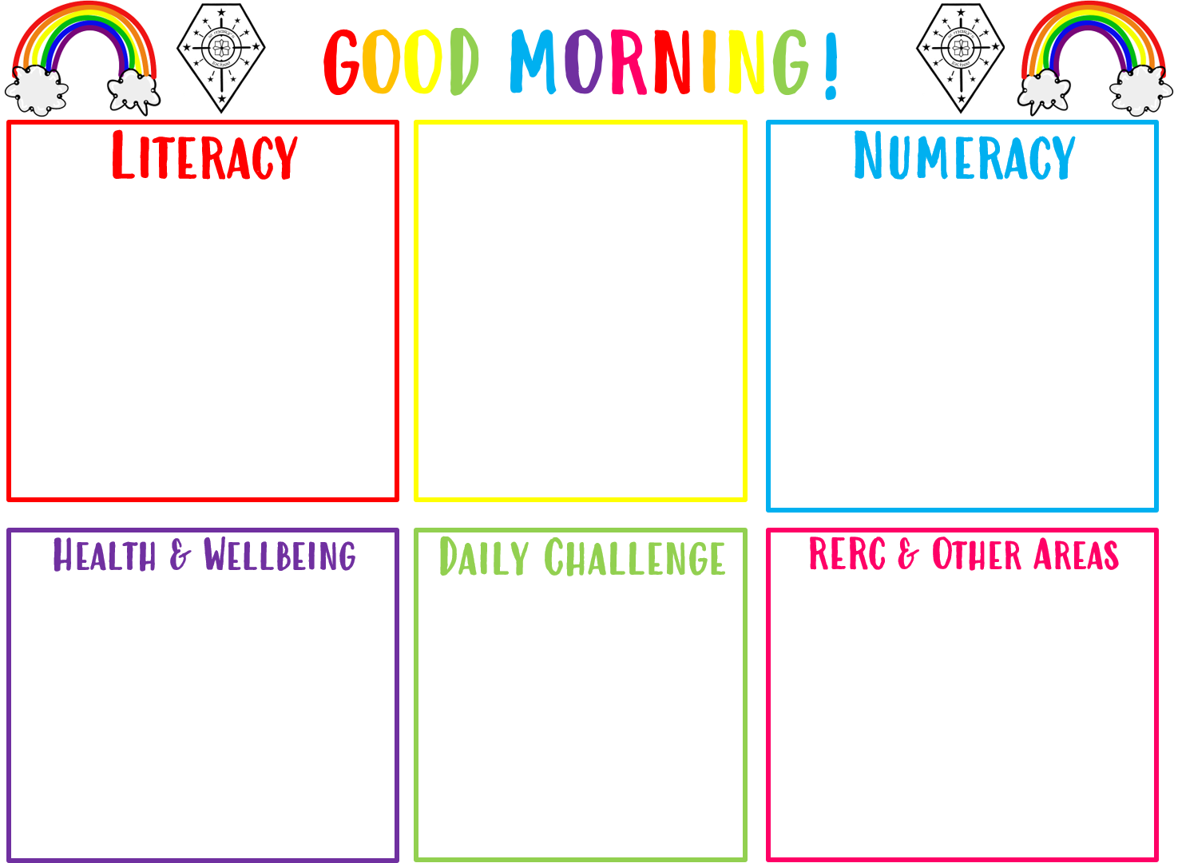
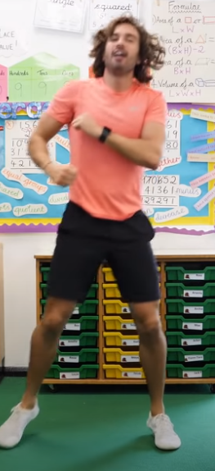
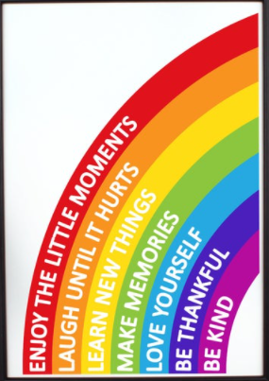
Good morning boys and girls
Friday22nd of January 2021
22/01/2021
The in school teacher is
Mrs Gould
All completed work should be sent to Mrs Gould
ddlmurray891@glow.sch.uk
Handwriting.
Practice in your jotter or on the worksheet in your pack.
Can you take the times table challenge?
Follow the link in the power point to ‘Hit the Button’
Weekly Journal
Fitness with Joe Wicks

Slide 3
Morning Prayer
Father in heaven you love me
You are with me night and day
I want to love you always
In all I do and say
I’ll try to please you Father
Bless me through this day
Amen

Slide 4
Literacy- Handwriting Friday 22nd January 2021
Learning Intention:
we are learning how to form our letters correctly
Success Criteria:
I am using the correct formation of the letter
I am writing on the line
I am leaving spaces between each letter
I am sitting up straight in my chair with my feet on the floor

Slide 5
Handwriting Phrases – to help you when you are writing!

Slide 6
Handwriting Friday 22nd January 2021 Mild Challenge

Slide 7
Handwriting 22nd January 2021 Hot Challenge

Slide 8
Handwriting Friday 22nd January Chilli Challenge

Slide 9
Numeracy Friday 22nd January 2021 - Mental maths and times table practice
Follow
Follow the link to ‘Hit the Button’.
Choose
Choose the mild, hot or chilli challenge!
Try and beat
Try and beat your personal best.
Ask
Ask your grown up to take the challenge!

Slide 10
Numeracy Friday 22nd January 2021 Can you beat your personal best?
Hit the Button - Quick fire maths practice for 5-11 year olds (topmarks.co.uk)
mild | hot | chilli
Choose the 3 times table. | Choose the 4 times table. | Choose the 5 or 6 times table.

Slide 11
Fitness with Joe Wicks Follow the link to complete this workout!
Active 8 Minute Workout 1 | The Body Coach TV - YouTube

Slide 12
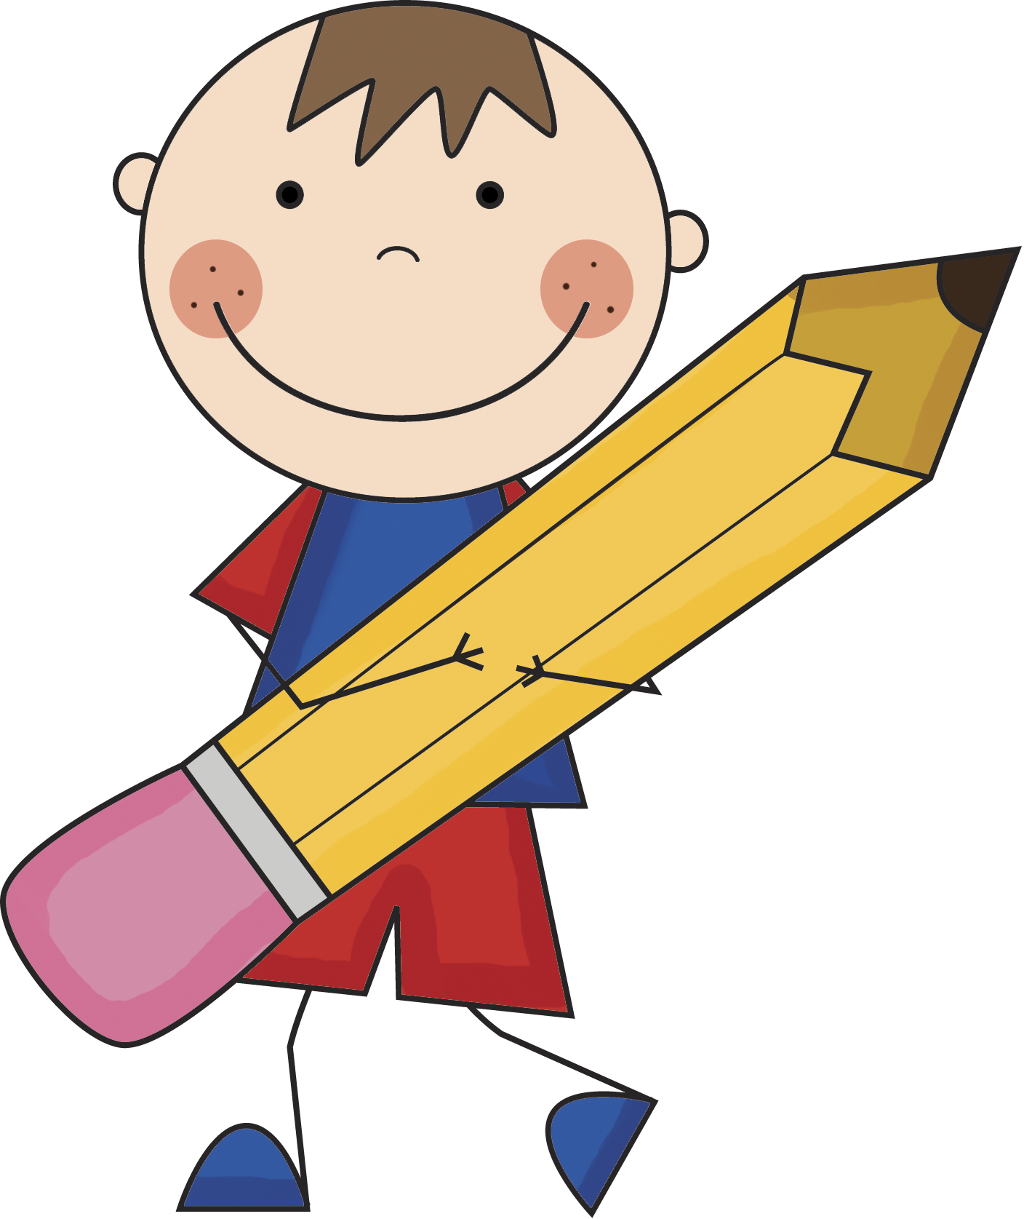
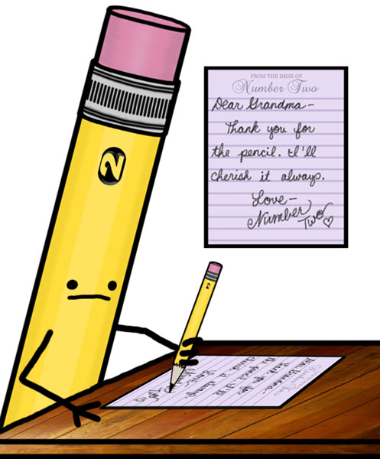
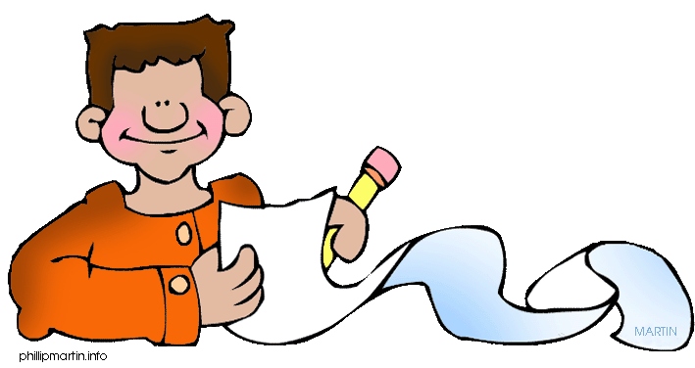
Weekly News!
How has your week been?
What were your favourite activities this week?
Who has been helping you?
Are there some activities you would like to see online that the teachers could add?
You could also record yourself and send us a message!

Slide 13
NIGHT Prayer
God our Father, I come to say thank you for your love today.
Thank you for my family and all the friends you give to me.
Guard me in the dark of night and in the morning send your light.
Amen.

Slide 14
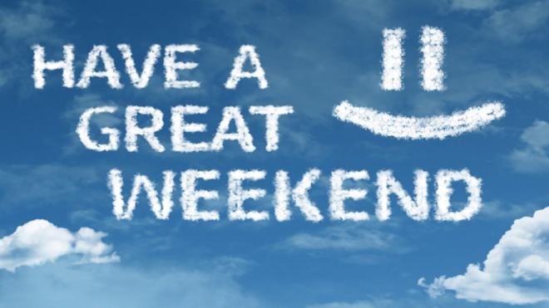
Opera performed by animals | "Maestro" - CG short film by Illogic collective - YouTube
This Photo by Unknown Author is licensed under CC BY-SA-NC

