Slide 1
St Mary’s RC primary school Monday 18.01.21
P3 and P4

Slide 2
Morning Prayer
Father in heaven you love me
You are with me night and day
I want to love you always
In all I do and say
I’ll try to please you Father
Bless me through this day
Amen

Slide 3
Morning Challenge
Would you rather?
Be able to breathe under water?
Be able to talk to animals?
Be able to fly like a bird?
Draw your favourite in your jotter. Remember to write the date at the top of the page.

Slide 4
Literacy
Learning Intention:
We are learning to spell common words.
Success Criteria:
Pick a Mild, Hot or Spicy chilli challenge.
Copy the words neatly into your jotter.
Try to remember how to spell the words.
Pick 5 words and write a sentence for each word.
This Photo by Unknown Author is licensed under CC BY

Slide 5
spelling
Mild | Hot | Spicy
mum pin dad sit lid pig rat had sad sat | sweet street knee sleep three speed keep green feed cheer | heater scream healer dreamer cheaper pheasant clearer release reason cream

Slide 6
Numeracy
Learning Intention
We are learning to use subtraction.
Success Criteria
Choose the Mild, Hot or Spic Chilli challenge.
Copy the questions into your jotters.
Answer the questions and double check your answers.

Slide 7
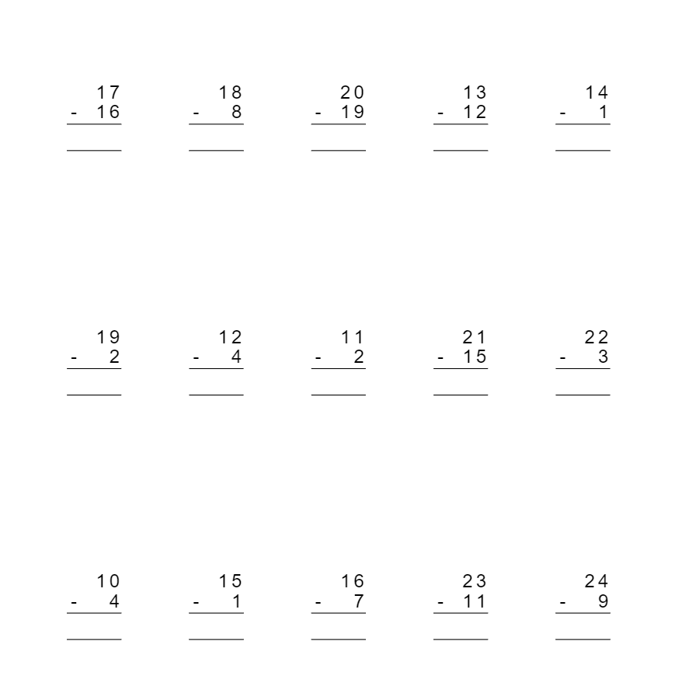

Slide 8
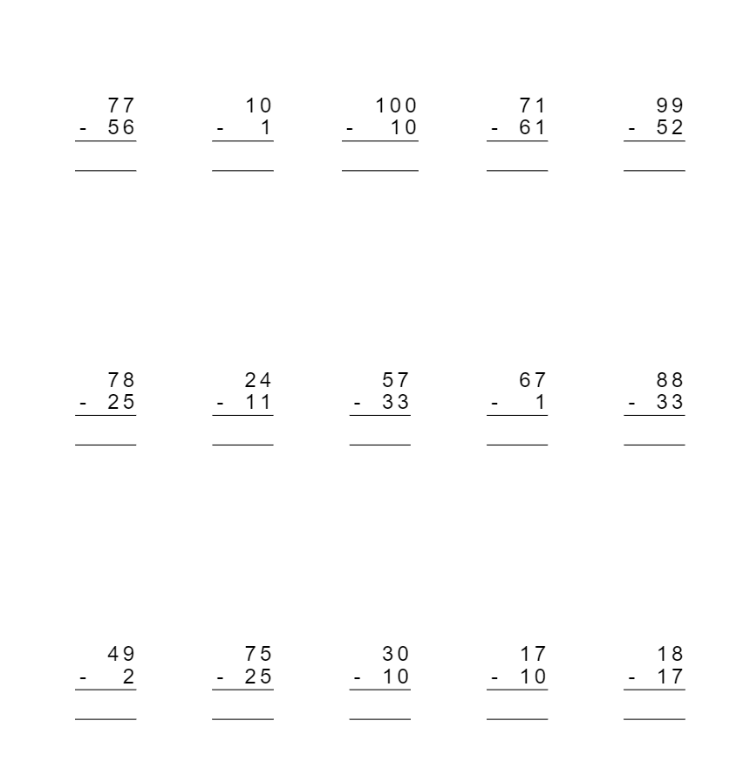

Slide 9
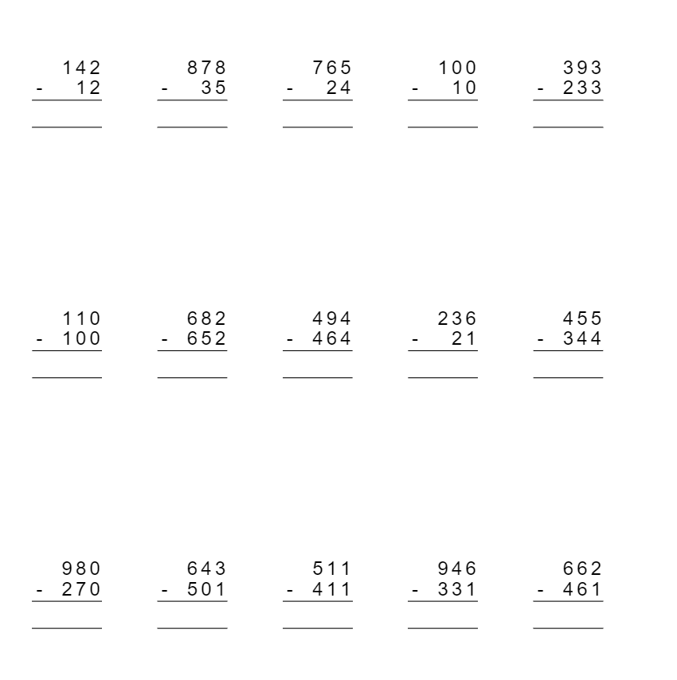

Slide 10
Cosmic Yoga
Follow the link to Cosmic Yoga – Wizard of Oz Lesson. Watch the video and complete the activities.
https://www.youtube.com/watch?v=j_3weVPH0-U

Slide 11
Night time prayer
God our Father, I come to say thank you for your love today.
Thank you for my family and all the friends you give to me.
Guard me in the dark of night and in the morning send your light.Amen.

