Slide 1
St Mary’s RC primary school Thursday 14.01.21
P3 and P4

Slide 2
Morning Prayer
Father in heaven you love me
You are with me night and day
I want to love you always
In all I do and say
I’ll try to please you Father
Bless me through this day
Amen

Slide 3
Literacy
Learning Intention:
We are learning to write a character description.
Success Criteria:
Listen to the story
Take notes of the descriptive words used to describe the Gruffalo.
Use these notes to draw your own image of the Gruffalo in your jotters.

Slide 4
Literacy – Character Description
Close your eyes and listen to the story of The Gruffalo
Using the description given draw a picture of how you think the Gruffalo would look.
https://www.youtube.com/watch?v=n0jdae32TF0
This Photo by Unknown Author is licensed under CC BY-NC

Slide 5
Gruffalo Word Bank
Terrible claws Terrible tusks Terrible jaws Knobbly knees Turned-out toes Poisonous wart at the end of its nose
Eyes are orange Tongue is black Poisonous prickles all over his back.
?

Slide 6
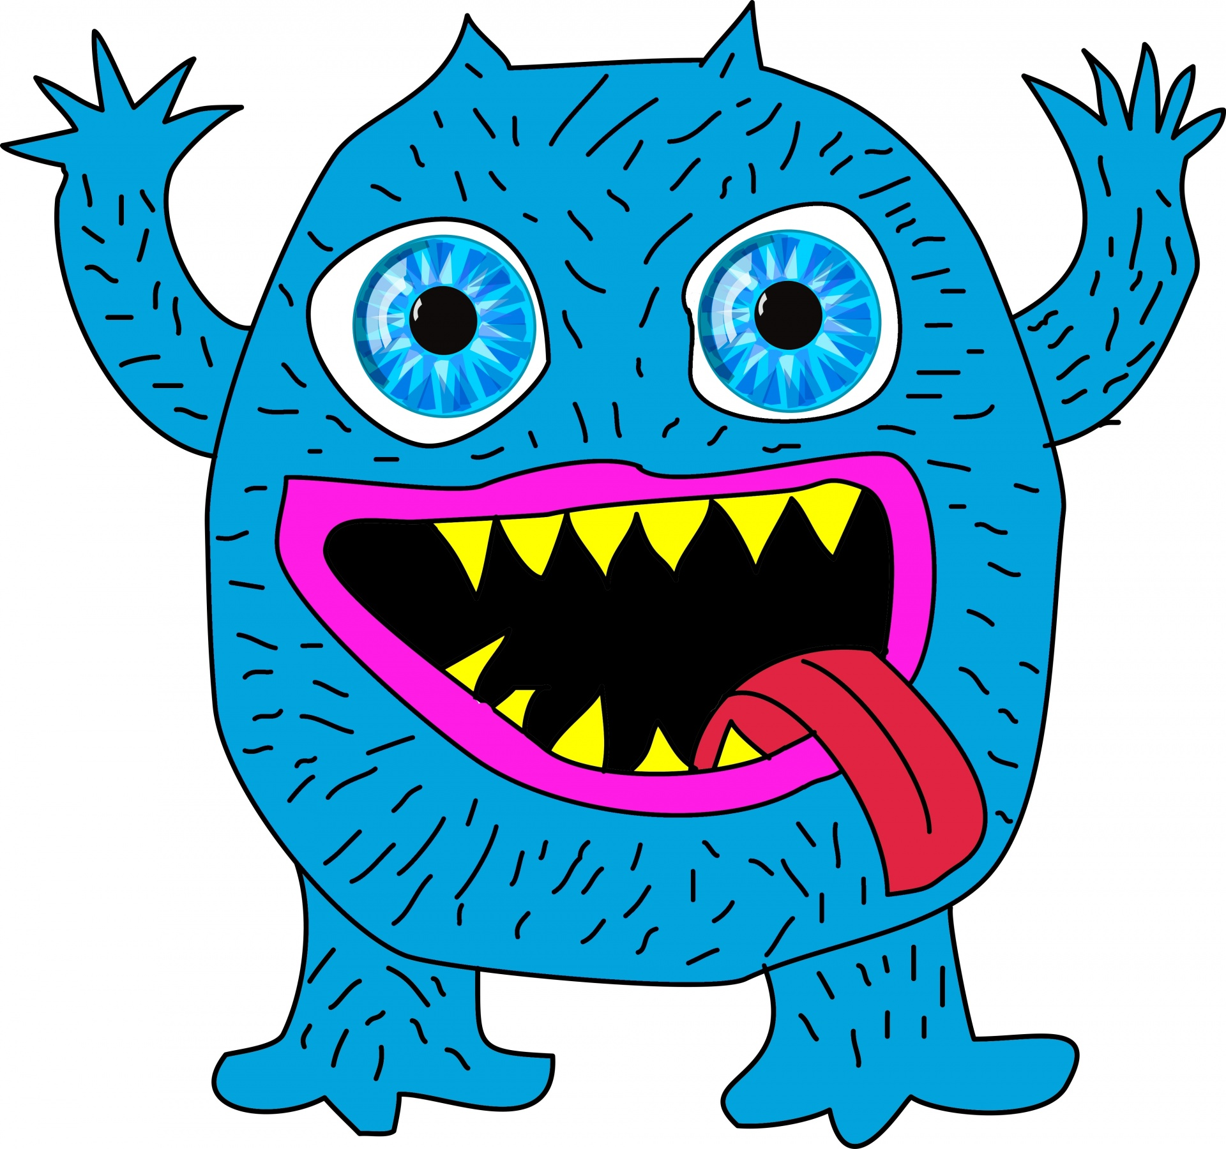
Can you think of the words you could use to describe your own imaginary monster?
Write your own description or a description of your own monster using some wow words.
Write 5 sentences that best describe your monster using descriptive vocabulary and draw a picture to show what you have written.

Slide 7
Numeracy
Learning Intention
We are learning to understand time.
Success Criteria
- Pick a mild, hot or spicy chilli challenge from the following slides to complete in you jotter - you can do all three if you wish!
Write the answers in your jotter.
Make sure all spelling is correct.

Slide 8
SUMMER
WINTER
AUTUMN
SPRING
There are four seasons in every year. I want you to organise them in order starting with Spring, then answer the following questions:
1. Which season comes After Winter?
2. Which season comes Before Autumn?
3. Which season comes After Autumn?
4. Which season comes Before Spring?
5. Which season is your favourite and why?
What is the weather like?
What activities do you do during this season?
Are there any special holidays in this season you enjoy?

Slide 9
There are seven days in a week. I want you to organise them in order starting with Monday, then answer the following questions:
Monday Saturday Thursday Tuesday Friday Sunday Wednesday
Which day comes before Wednesday?
Which day is 2 days after Friday?
Which day is 3 days before Friday?
Which day is 7 days after Monday?
Which day is your favourite day of the week and why?
Is it a day you have no school?
Is it the day you come to school?
Is it a day you do an out of school activity?

Slide 10
There are twelve months in a year. I want you to organise them in order starting with January, then answer the following questions:
January November May June April October December March August July September February
Which month is 2 months after June?
Which month is 4 months before December?
Which month is the 10th month of the year?
Which month the 4th month of the year?
Which month is your favourite month of the year and why?
Is it because of the type of weather you get in this month?
Is there a special holiday in this month?
Is your birthday in this month?

Slide 11
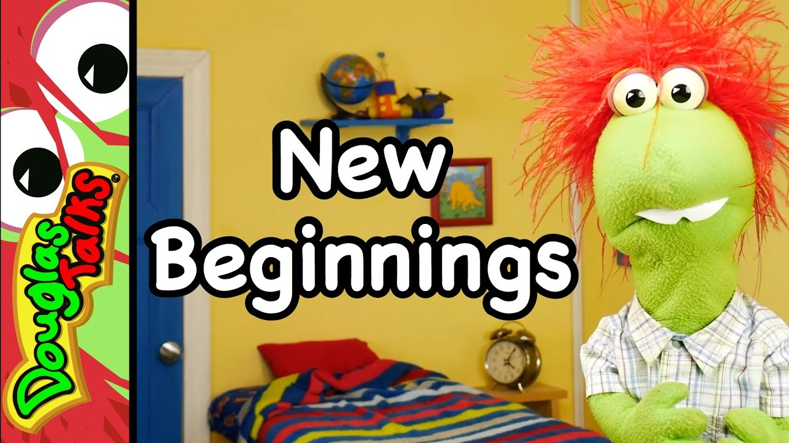
RME
Please watch the following video which is about new beginnings. Douglas discusses with us how through God we can become better people and be forgiven for the things we have done wrong.
As this is the start of a new year there might be some things you think you might want to do differently this year and we call those this a New Years Resolution.
Your task will be to watch the clip of Douglas the in your jotters write down three things you will try to do differently this year.
This could be something that helps your parents/carers and home, something that helps your teachers at school or something that will help you be the best you can be .
https://www.youtube.com/watch?v=Rb__4XB3AOg

Slide 12
P.E
Follow the link to Minecraft – Cosmic Yoga and complete the activities.
https://www.youtube.com/watch?v=02E1468SdHg

Slide 13
Night time prayer
God our Father, I come to say thank you for your love today.
Thank you for my family and all the friends you give to me.
Guard me in the dark of night and in the morning send your light.Amen.

