Slide 1
St Mary’s RC primary school Wednesday 13.01.21
P3 and P4

Slide 2
Morning Prayer
Father in heaven you love me
You are with me night and day
I want to love you always
In all I do and say
I’ll try to please you Father
Bless me through this day
Amen

Slide 3
Literacy
Learning Intention:
We are learning to write a book report
Success Criteria:
Listen to the story
Read the book review and think about your answers for each section
Remember to explain your answer.
Don’t worry if you don’t have internet access, you can choose one of your favourite books from home. The worksheet is in your home learning pack.

Slide 4
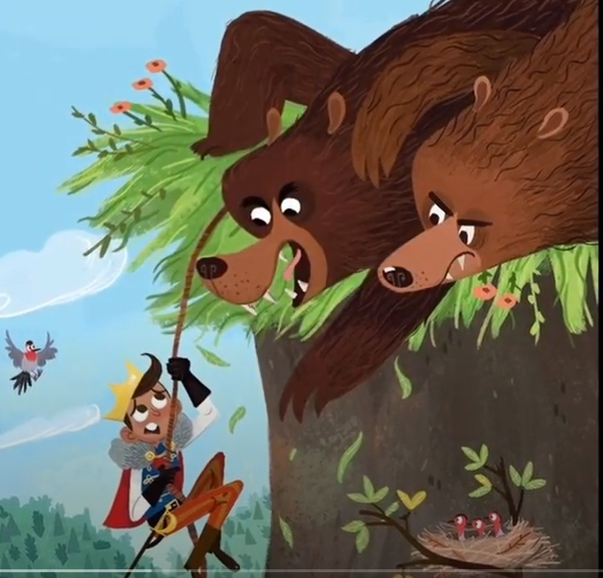
Literacy – Book review
Listen to the story of The Prince and the Witch and the Thief and the Bears by Alastair Chisholm
Write a book review using the sheet on the next slide.
Alastair Chisholm reads The Prince and the Witch and the. . . | Bookbug Picture Book Prize - YouTube

Slide 5
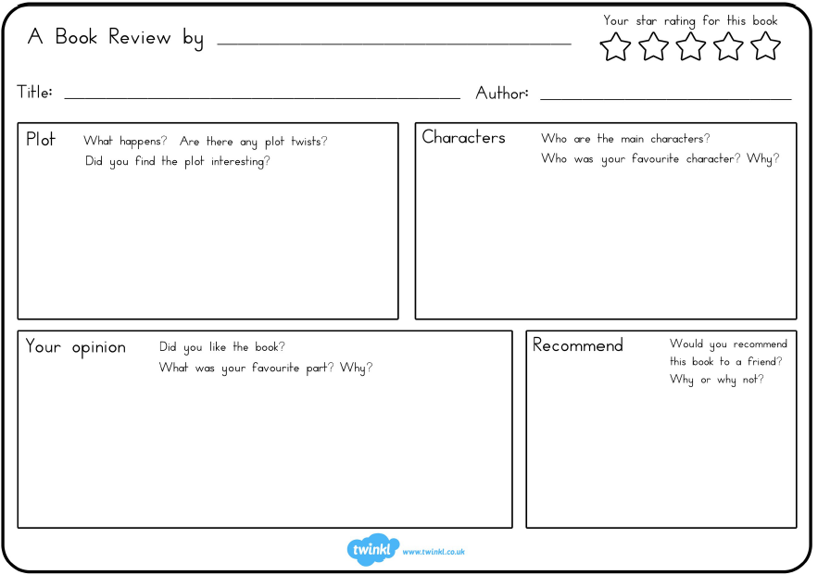

Slide 6
Numeracy Chimney sums Let’s see how much you remember from yesterday!!!!
Learning Intention:
Add and write chimney sums
Success Criteria:
- I know that the ones, tens and hundreds must be lined up
I add the columns together and put the answers under that column
My writing is neat and tidy

Slide 9
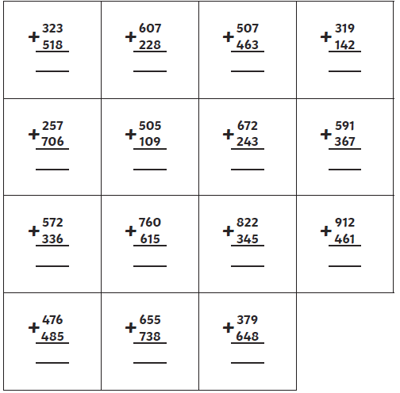

Slide 10
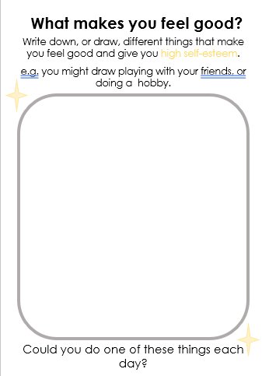
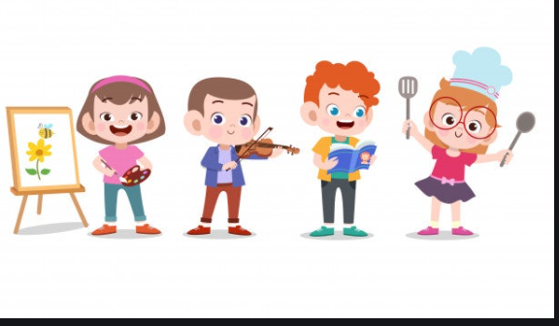

Slide 11
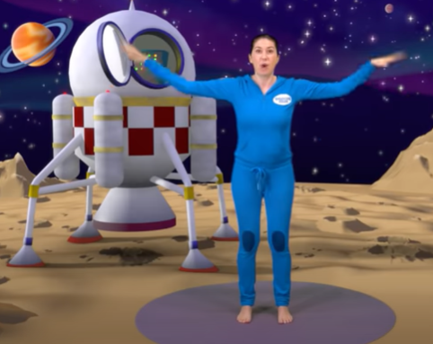
Mike and Muttnik on The Moon | A Cosmic Kids Yoga Adventure! – YouTube
Follow the link to Cosmic Yoga!

Slide 12
Night time prayer
God our Father, I come to say thank you for your love today.
Thank you for my family and all the friends you give to me.
Guard me in the dark of night and in the morning send your light.Amen.

