Slide 1
St Mary’s RC primary school Tuesday 12th January 2021
P3 and P4

Slide 2
Morning Prayer
Father in heaven You love me
You are with me night and day
I want to love you always
In all I do and say
I’ll try to please you Father
Bless me through this day
Amen

Slide 3
Morning Challenge
Would you rather?
Have piano keys for teeth?
Wear an invisibility cloak?
Have wheels for feet?
Write your favourite in your jotter and draw a picture.

Slide 4
Handwriting
Learning Intention:
We are learning to write neatly
Success Criteria:
I can write on the line.
I can form my letters correctly
Practice your writing in your home learning jotter

Slide 6
Practise your neat handwriting
By writing each word out 5 times.
Remember finger spaces and write
on the line.

Slide 7
Numeracy Chimney sums
Learning Intention:
Add and write chimney sums
Success Criteria:
- I know that the ones, tens and hundreds must be lined up
I add the columns together and put the answers under that column
My writing is neat and tidy

Slide 8
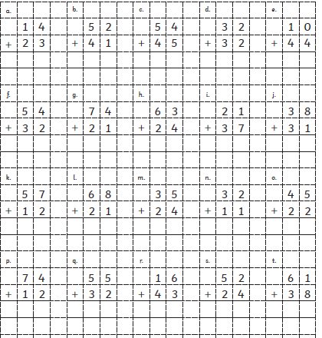

Slide 9
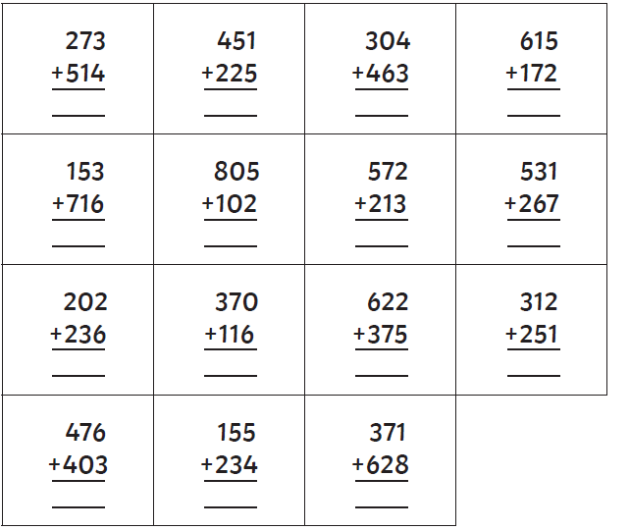

Slide 10
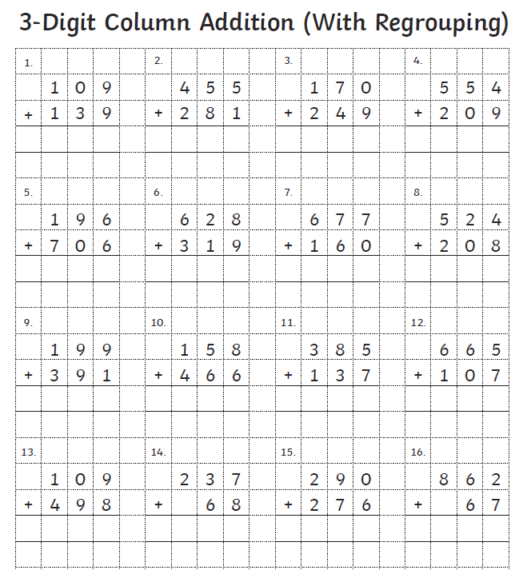

Slide 11
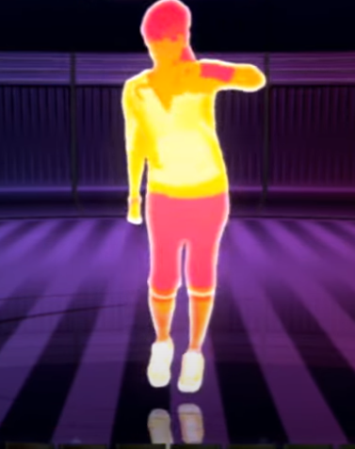
Pe – Zumba dance party!
Zumba Fitness 20 Minutes Beginners Routine - YouTube

Slide 12
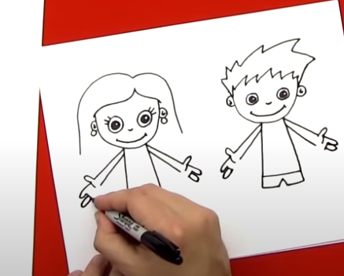
Art – learn how to draw a person
Follow this tutorial and learn how to draw a person!
Colour it in once you have finished your drawing!
How To Draw A Boy And A Girl - YouTube

Slide 13
Night time prayer
God our Father, I come to say thank you for your love today.
Thank you for my family and all the friends you give to me.
Guard me in the dark of night and in the morning send your light.Amen.

