Slide 1
Andy Warhol Popart!
Learning intention
to understand and apply the art style of Andy Warhol
Success Criteria –
I understand what popart is
I can make a repeated image in the style of Andy Warhol.

Slide 2
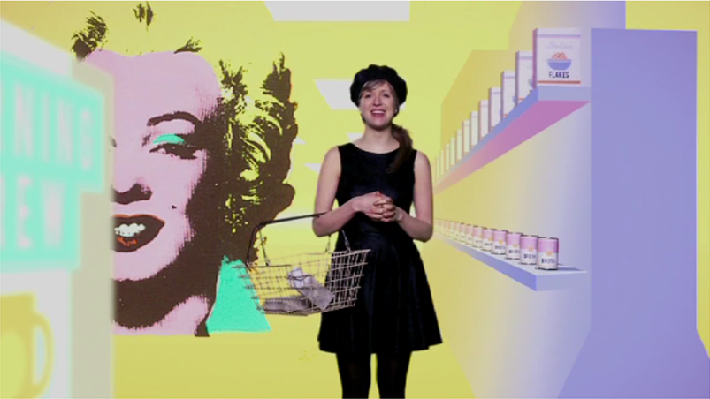
Pop Art
Today we are learning about Pop Art.
In this video, we are going to find out about a famous artist called Andy Warhol.
If the link isn't working, copy and paste this URL into your internet browser: https://www.youtube.com/watch?v=QUoqetH1iJo

Slide 3
Andy Warhol
Andy Warhol was a Pop Artist.
He used a technique called screen printing to create lots of prints that look the same.
He often changed the colours of the pictures.

Slide 4
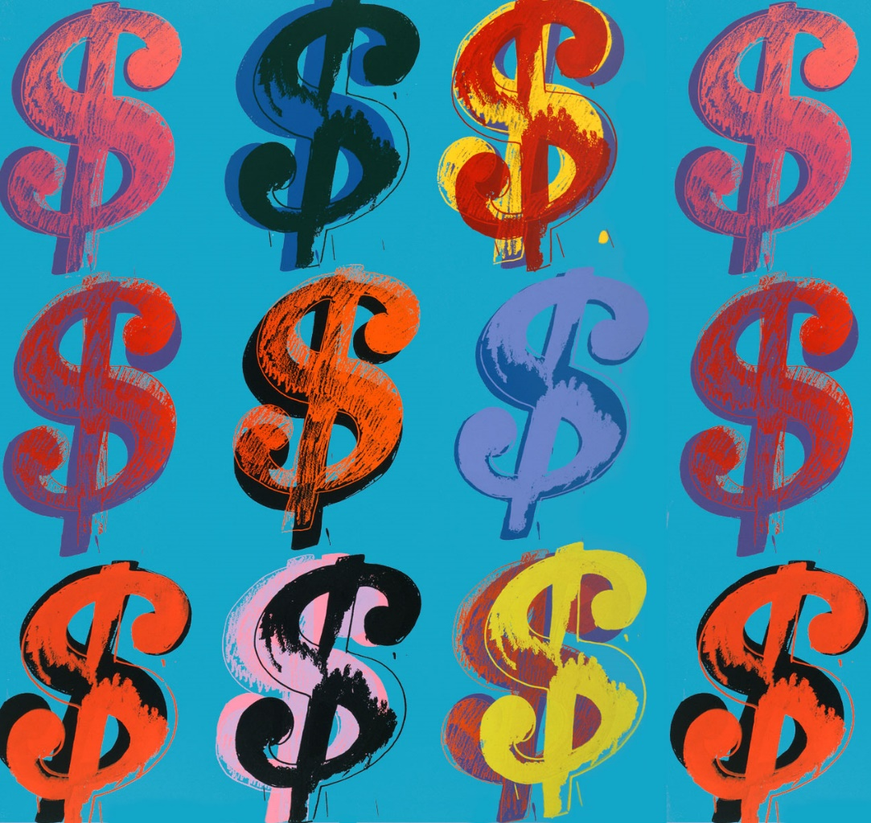
Making Patterns
Andy Warhol often used very bright colours in his work.
He used repeated images to make patterns.

Slide 5
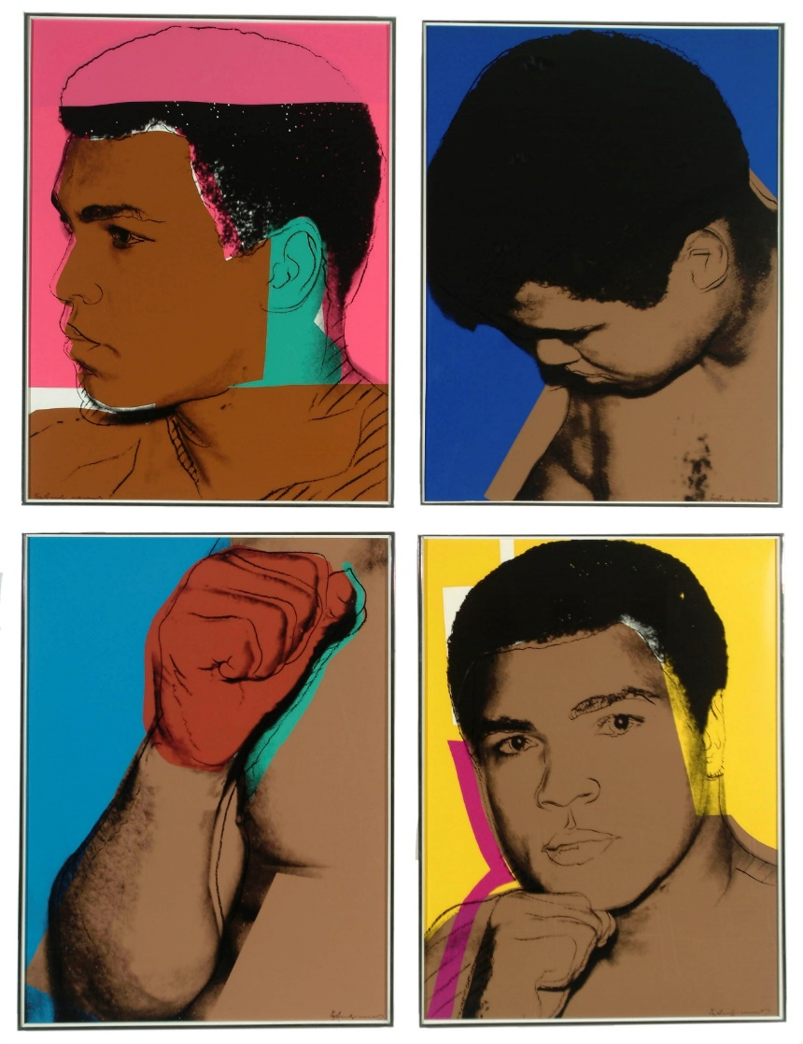
Famous Portraits
Warhol made lots of portraits of iconic people.
Do you know who this is?

Slide 6
He also used everyday objects in his artwork.

Slide 8
Todays task is to design your own Andy Warhol Pop art! You can choose to do the cupcakes or donut template

Slide 9
Try to use lots of bright colours for the background and picture in each box.

