Slide 1
Diary Writing
Li: We are learning to write a diary

Slide 2
Li: We are learning to write a diary
I can write in sentences and use capital letters, fingers spaces and full stops.
I can form my letters correctly.
I can use the word ‘and’ to make my sentences longer.
I can use some of the features of diary writing.

Slide 3
Writing a Diary Entry
When you write a diary entry, you are writing about a day in the life of a real person or character.

Slide 4
Writing a Diary Entry
The diary entry needs to sound as if the person or character has written it, so it needs to be written from their point of view.

Slide 5
Writing a Diary Entry
It also needs to be exciting and interesting to read.
To get this right, just follow a few easy steps...

Slide 6
include the date and/or time

Slide 7
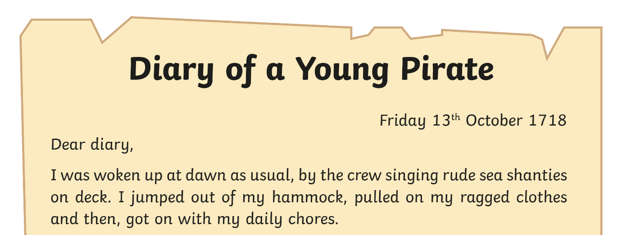
Diary Writing Must...
include the date and/or time
The date or time can be written at the top of the page like this...
or it can be included in the first few sentences of a diary entry like this...
‘It is past midnight but I am still wide awake because my day has been so exciting.’
This is important because it tells the reader exactly when the diary is being written.

Slide 8
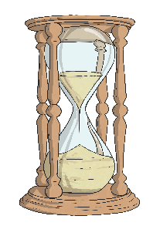
Diary Writing Must...
be written in the past tense
When we write a diary, we write in the past tense. This is because we are writing about something that has already happened.

Slide 9
Be Written in the past tense

Slide 10
Diary Writing Must...
be written in the past tense
Look at the sentence below. How would you change it into the past tense?
I am so excited and I cannot sleep!

Slide 11
Diary Writing Must...
be written in the past tense
Look at the sentence below. How would you change it into the past tense?
I am so excited and I cannot sleep! I was so excited and I could not sleep.

Slide 12
Diary Writing Must...
use the words ‘I’, ‘my’, ‘we’ and ‘our’

Slide 13
Diary Writing Must...
use the words ‘I’, ‘my’, ‘we’ and ‘our’
These words are special because they tell us the diary is being written by someone and they are talking about themselves.
We call this kind of writing ‘first person’. Look at these two examples. Which one uses the correct words to be written in ‘first person’?

Slide 14
Diary Writing Must...
use the words ‘I’, ‘my’, ‘we’ and ‘our’
I played with the new football I got for my birthday. When my brother came home, we went inside our house. First person!
First person!
She played with the new football she got for her birthday. When her brother got home, they went inside their house. Not first person!
Not first person!

Slide 15
Diary Writing Must...
write as if you were there
When we write a diary, we have to make the reader think we were really there.
We can do this by including lots of detail and description.

Slide 16
Diary Writing Must...
put the most important events in order
In a diary, we usually write about the events of our day in the order they happened, starting with what we did first when we woke up
and finishing with the end of our day.
We only include the most important or interesting events.

Slide 17
Diary Writing Must...
put the most important events in order
We can help to do this using words such as ‘first’, ‘next’ and ‘then’.

Slide 18
Diary Writing Must...
put the most important events in order
We can help to do this using words such as ‘first’, ‘next’ and ‘then’.
If we just use one word, such as ‘and’ to link the events in our diary it can get very boring!

Slide 19
Diary Writing Must...
describe feelings
A diary is usually a secret place to write how you feel about what has happened to you in the day.
In a diary, you might include feelings, hopes or fears that you wouldn’t want anyone to know about.

Slide 20
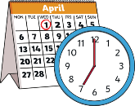
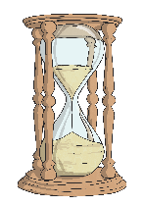
Diary Writing Checklist
Can you remember all the things you need to do to write a fantastic diary entry?
Diary writing must...
write the date and/or time;
be written in the past tense
write as if I was there: ‘I’, ‘my’, ‘we’ and ‘our’;
write about the most important events in order;
describe feelings;

Slide 21
Li: We are learning to write a diary
I can write in sentences.
I can use capital letters, fingers spaces and full stops.
I can form my letters correctly.
I can use the word ‘and’ to make my sentences longer.

