Slide 1
Multiplying
Multiplication is counting equal sets.
Practise counting in 2’s
2 4 6 8 10 12 14 16 18 20
Can you count in 10’s?

Slide 2
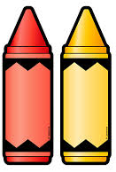
Multiplying
Using objects from your home such as lego pieces, cereal hoops, crayons. Can you split them into equal groups. For example 3 sets of 2
Continue with more examples and complete the worksheet.

