Slide 1
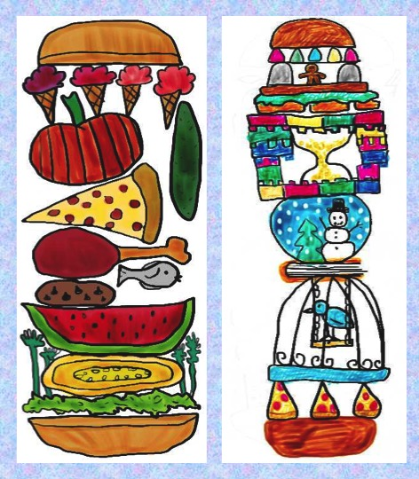
Silly Sandwich
Art lesson

Slide 5
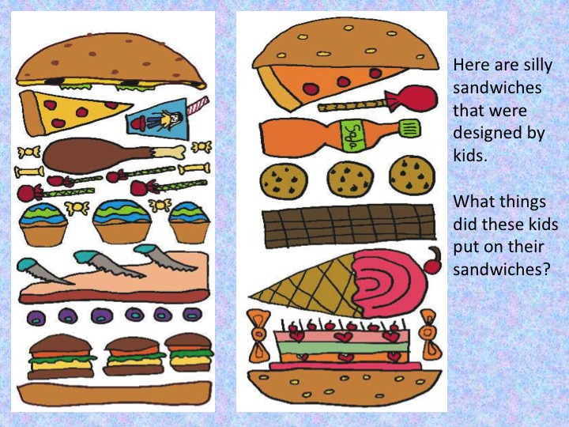

Slide 6
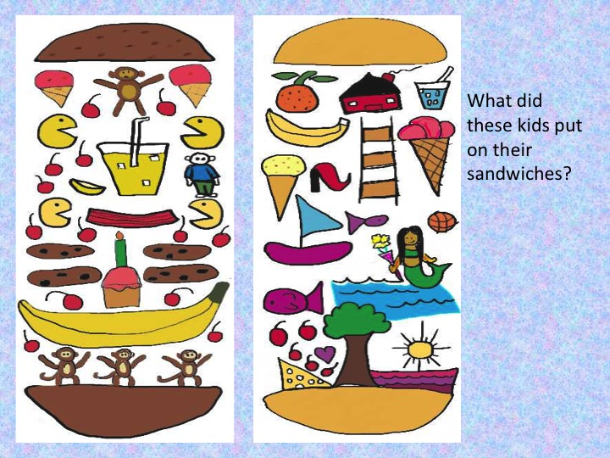

Slide 7
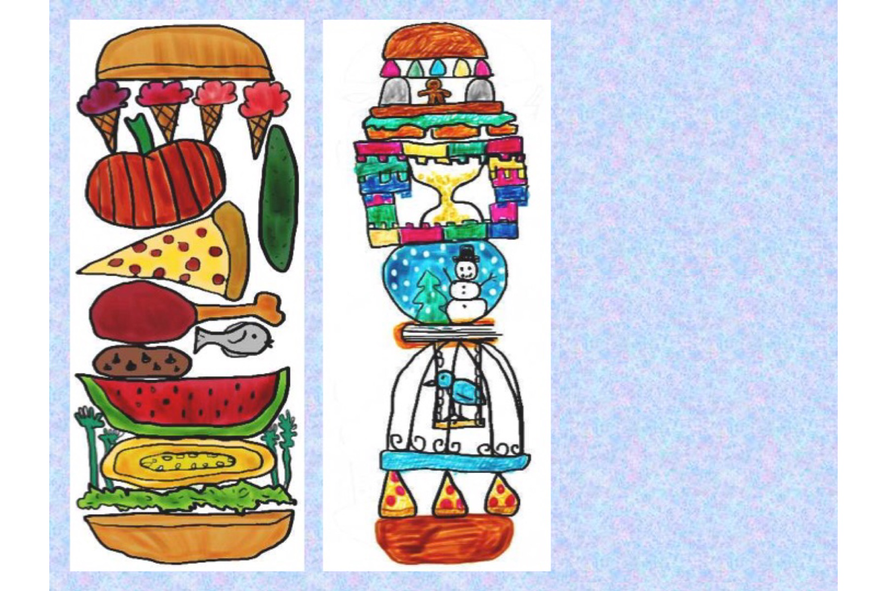
One of these sandwiches has things on it you might want to eat. The other has things you definitely do not want to eat. That would be a very silly sandwich!
Notes:
©Janet Johnson

Slide 8
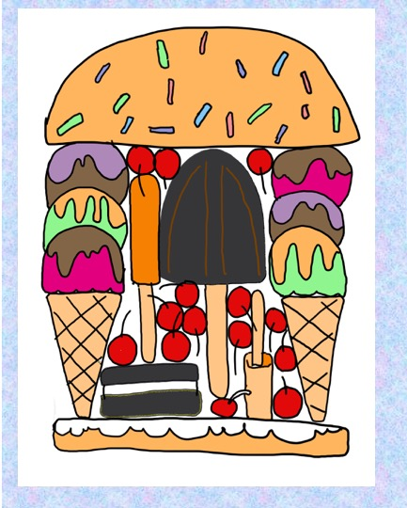
This is an ice cream sandwich!
Notes:
©Janet Johnson

Slide 10
Notes:
©Janet Johnson

Slide 11
Notes:
©Janet Johnson

Slide 12
Notes:
©Janet Johnson

Slide 13
Notes:
©Janet Johnson

Slide 14
Notes:
©Janet Johnson

