Slide 1
Today is Monday 18th January 18.01.2020 Today we are revising our days of the week and months of the year before we learn more about telling the time.

Slide 2
https://www.youtube.com/watch?v=mXMofxtDPUQ Watch this video then answer these questions: What day comes after Saturday? What day comes before Tuesday? What day comes after Wednesday? What day comes before Saturday? What days are the weekend?

Slide 3
We also need to know our months of the year! Watch this video: https://www.youtube.com/watch?v=Fe9bnYRzFvk Which month is your birthday in?

Slide 4
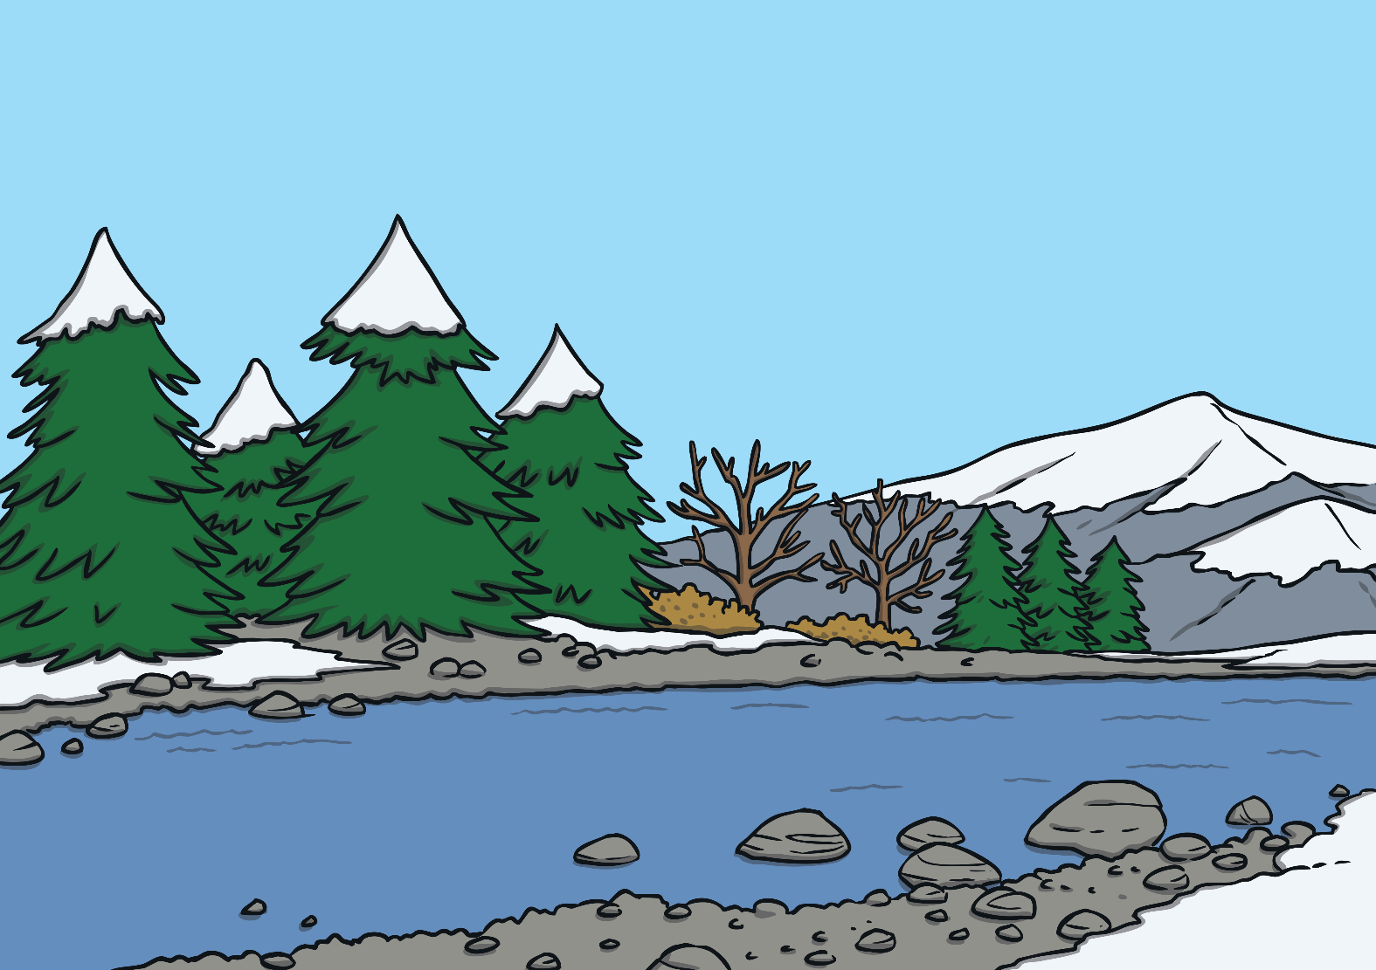
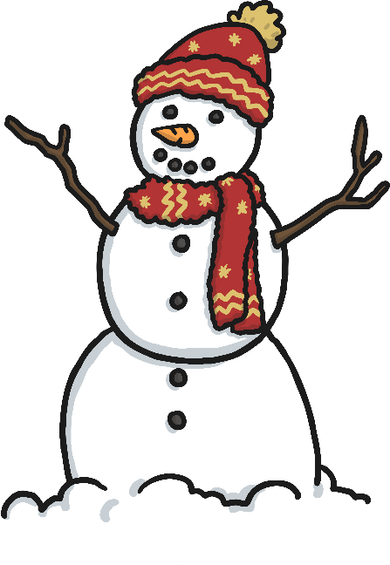
January

Slide 5
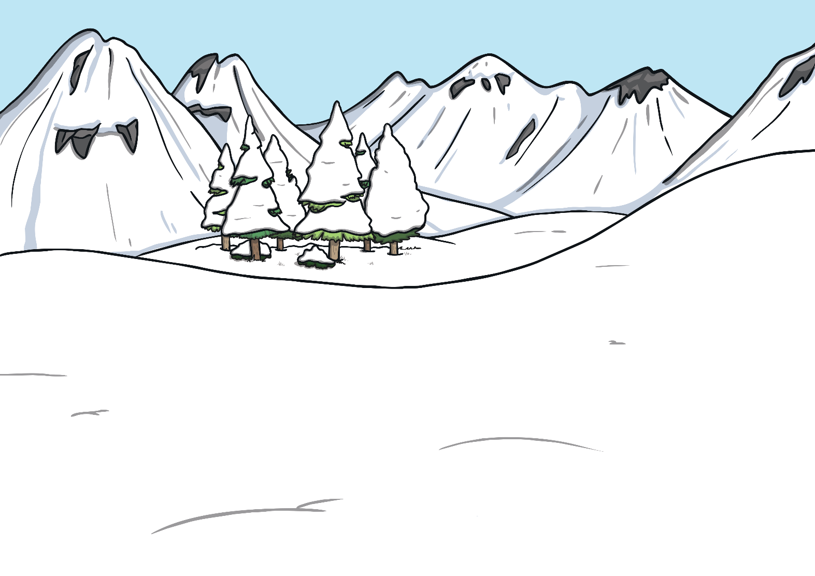
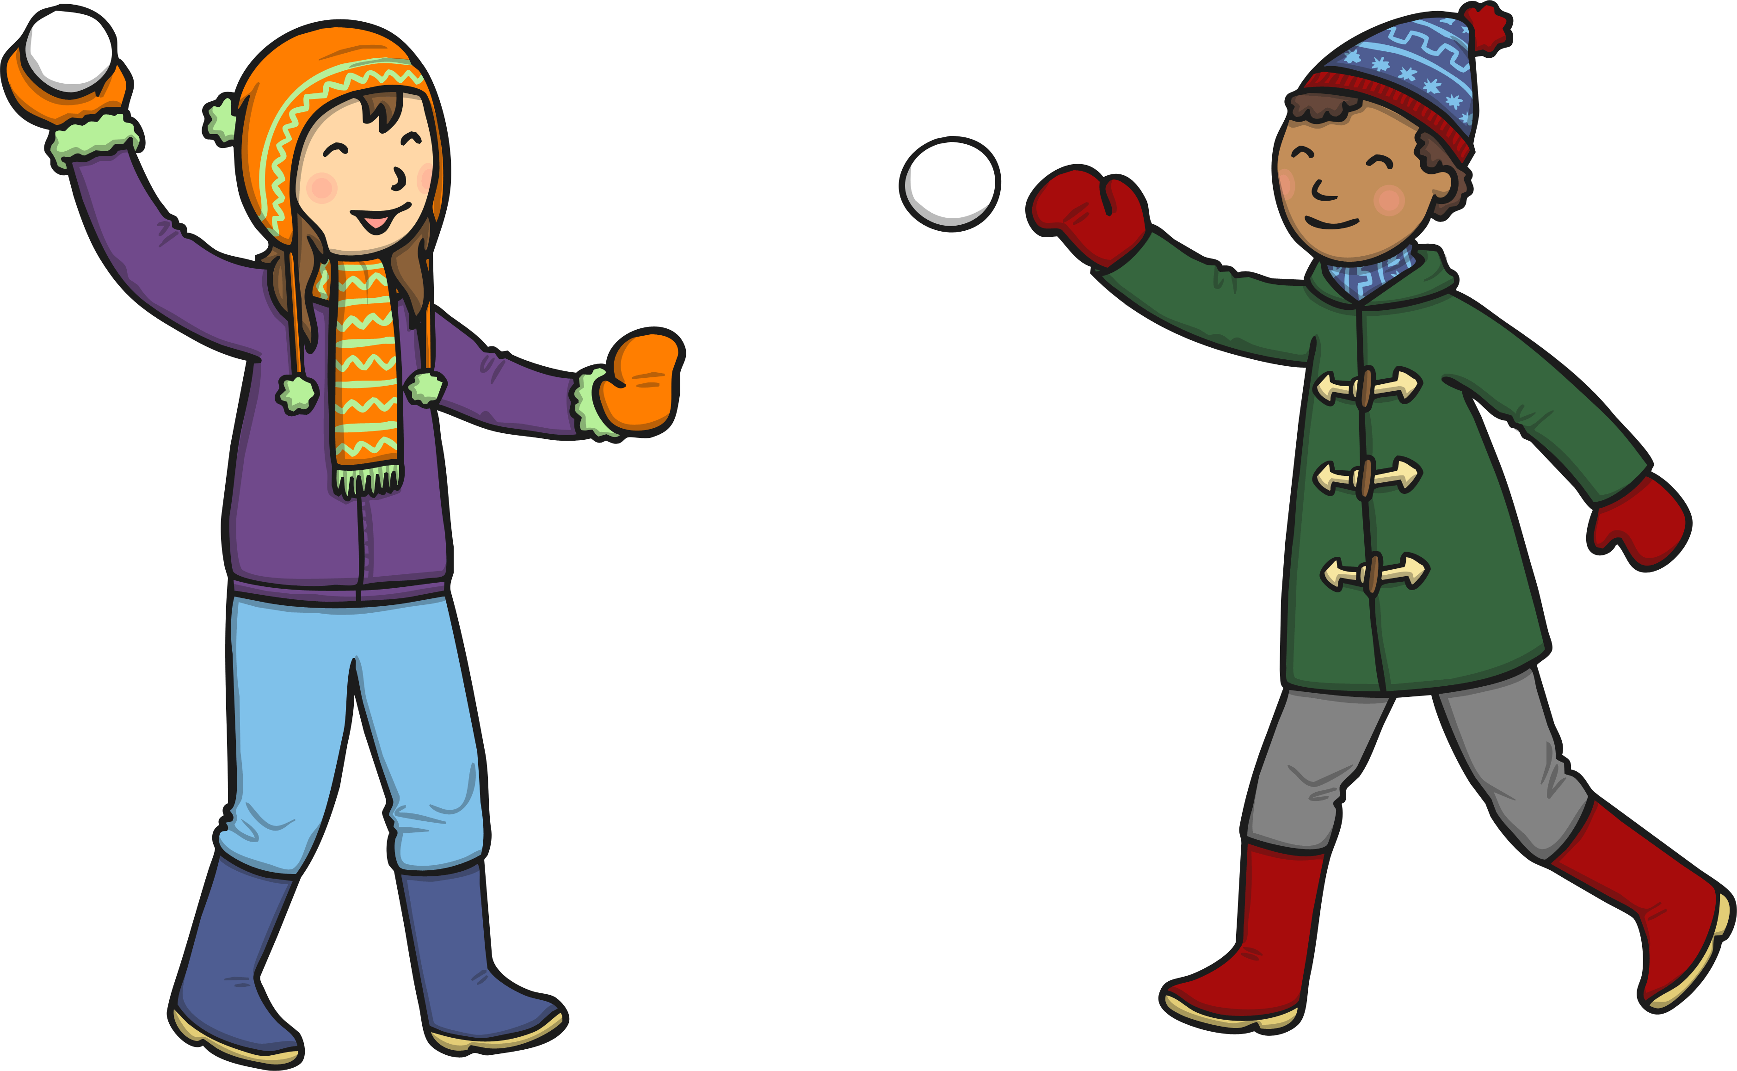
February

Slide 6
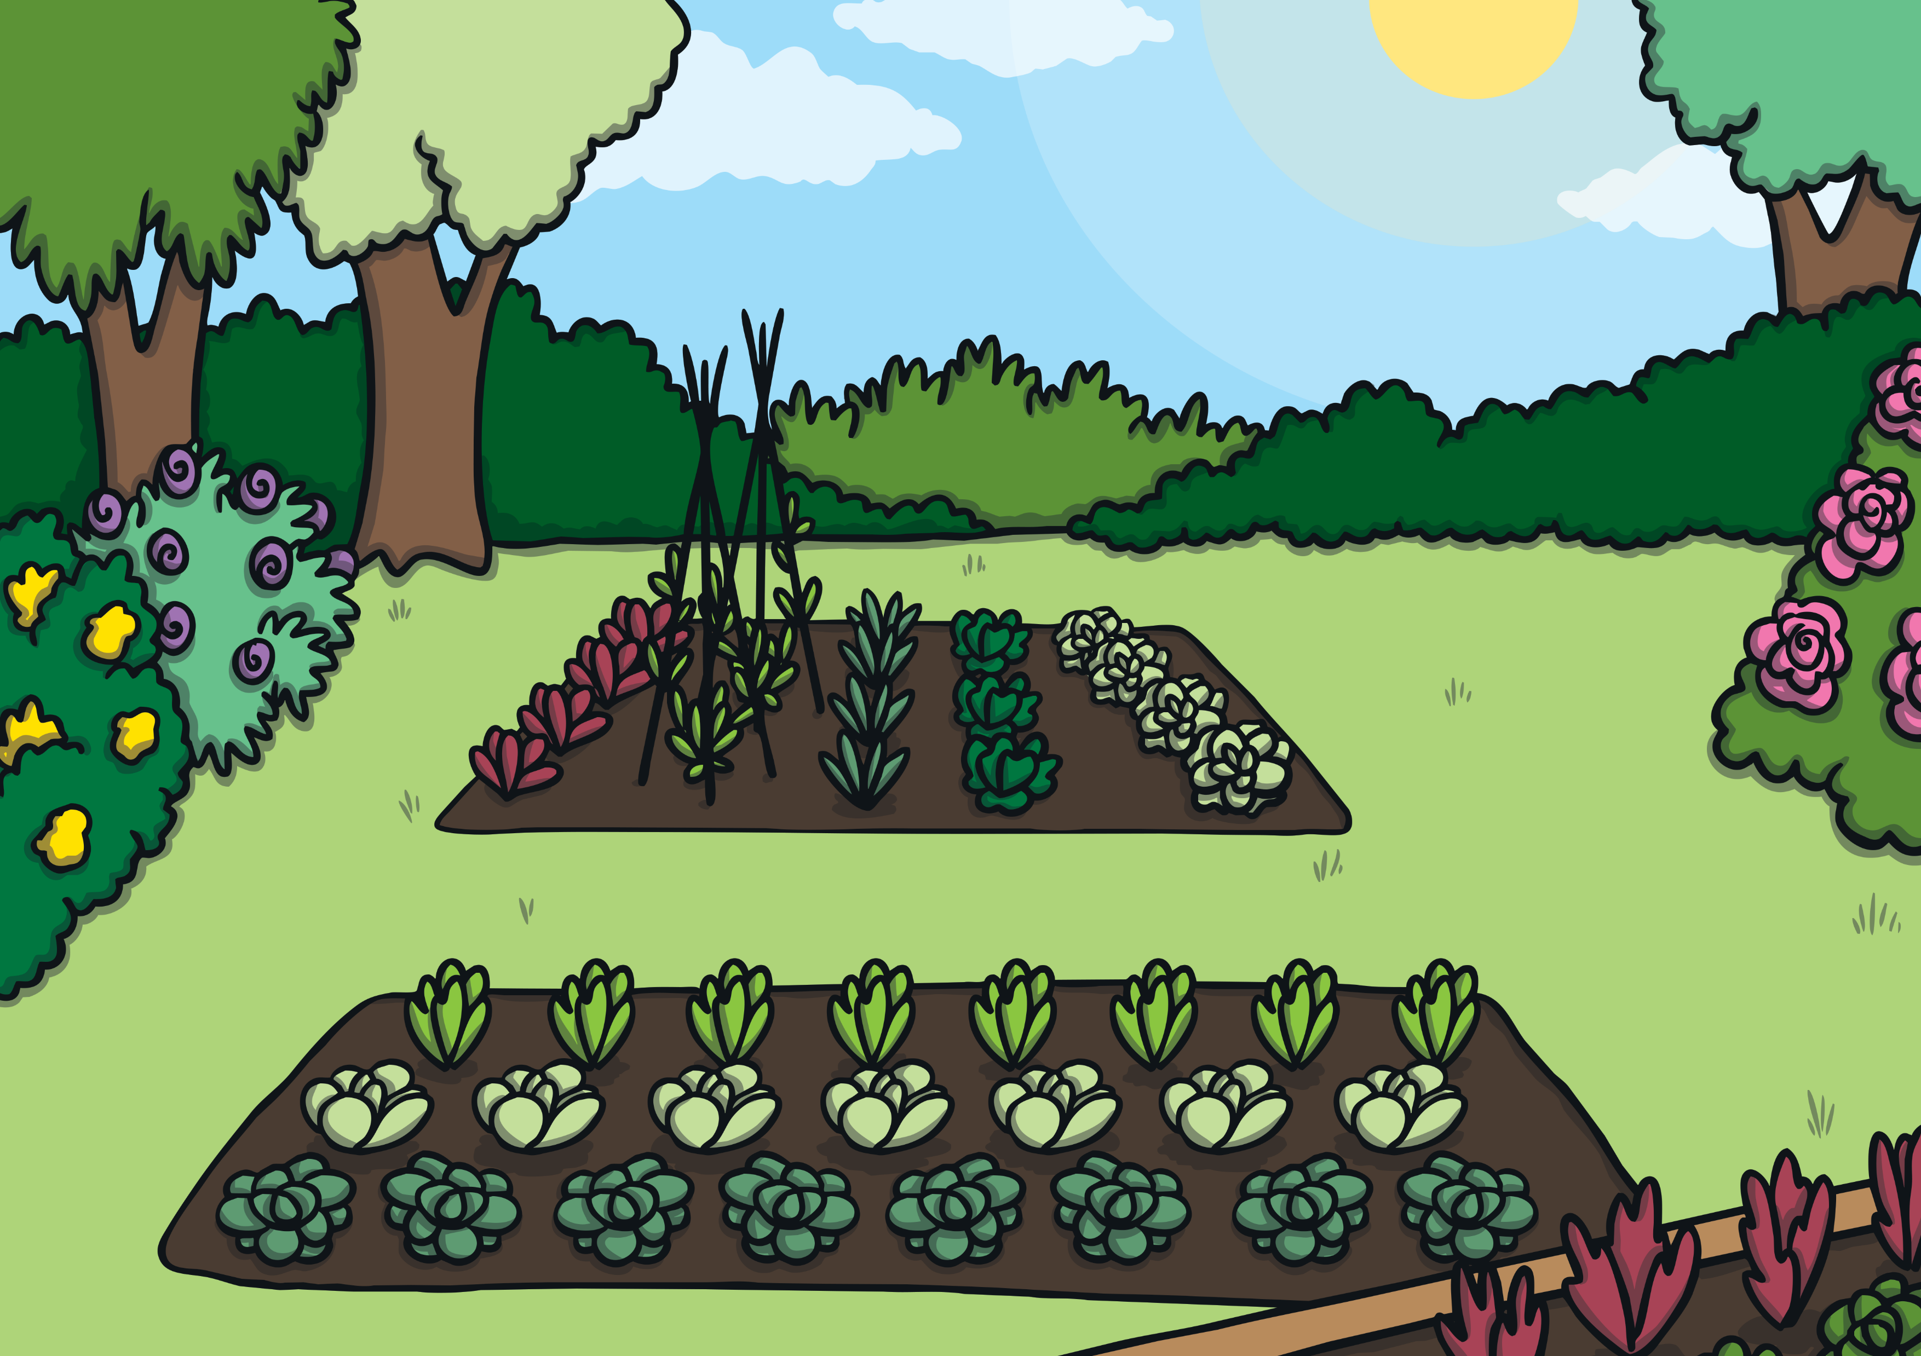
March

Slide 7
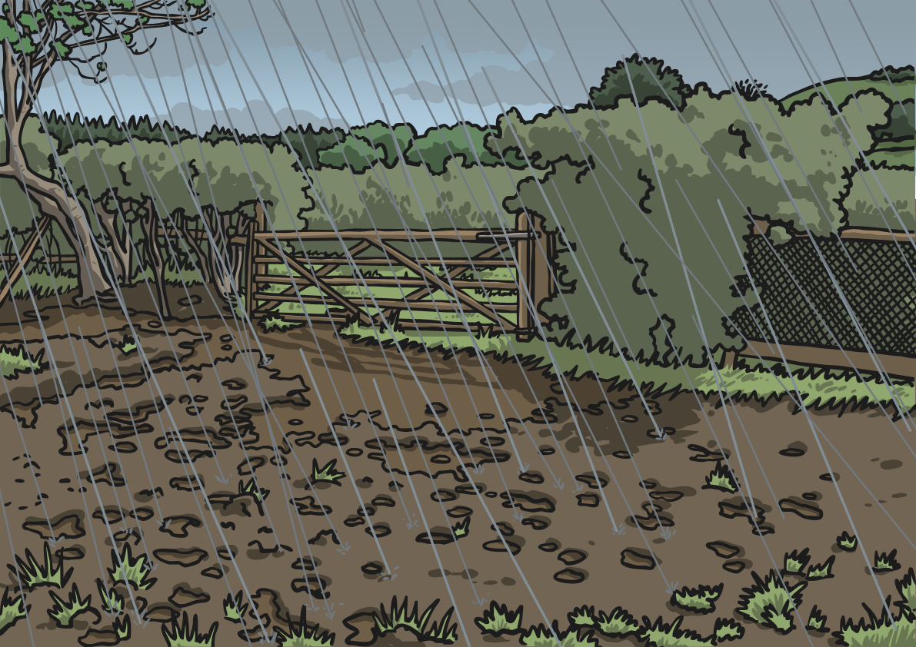
April

Slide 8
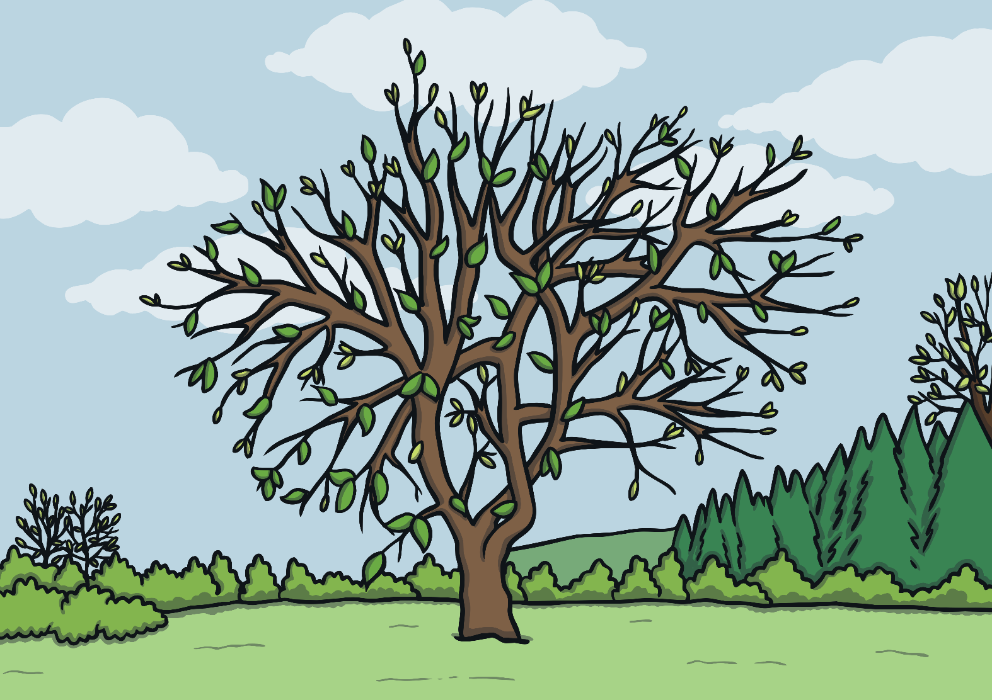
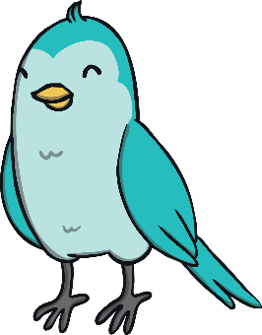
May

Slide 9
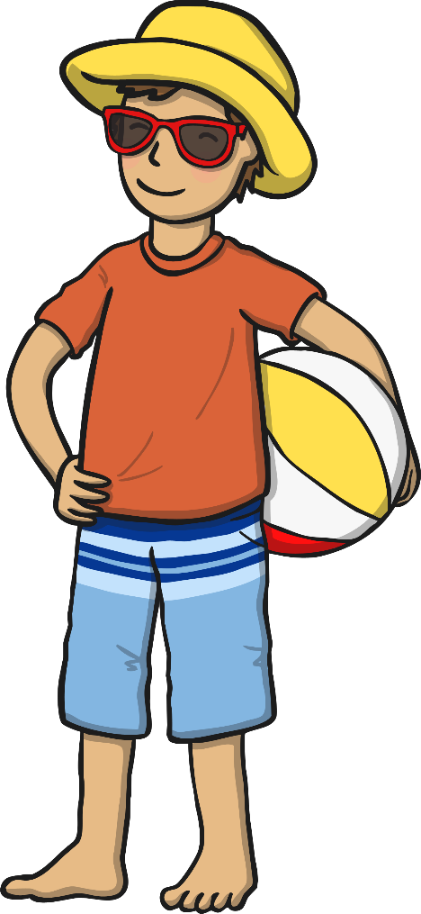
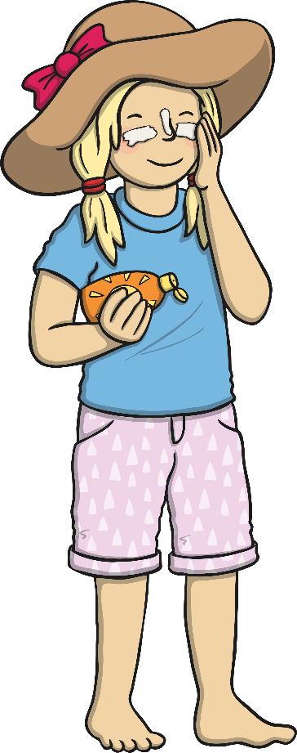
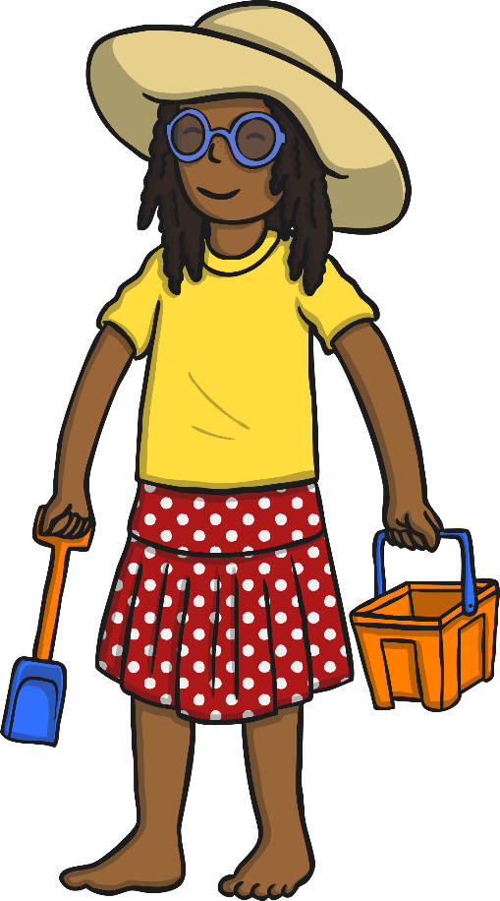
June

Slide 10
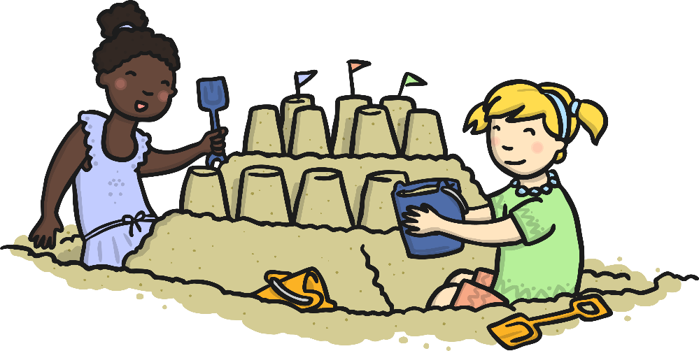
July

Slide 11
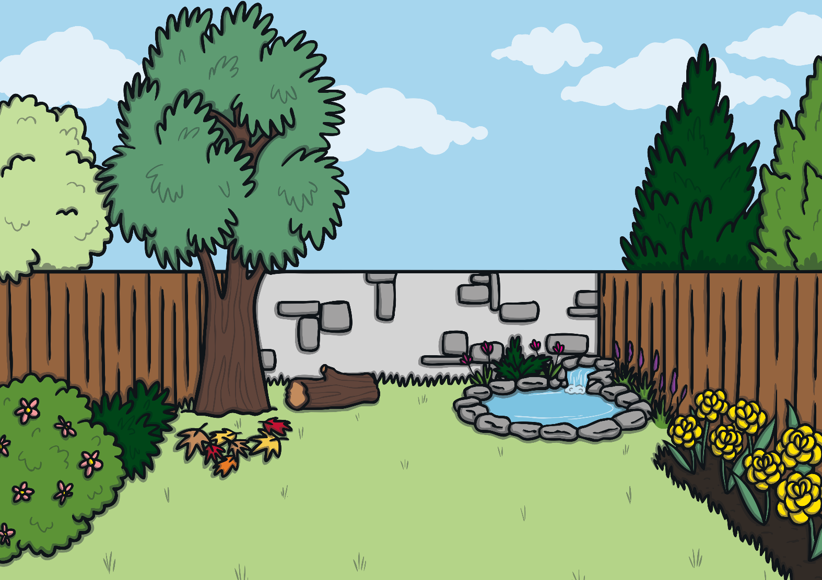
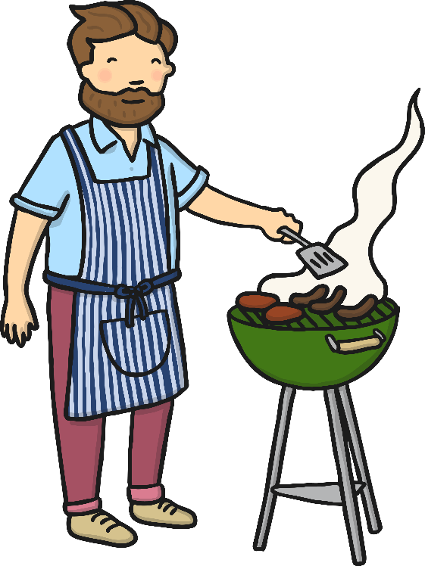
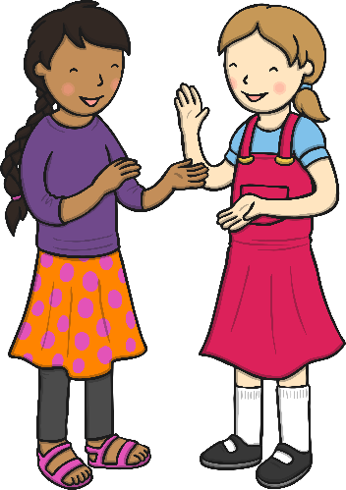
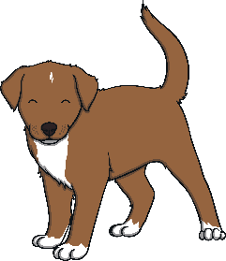
August

Slide 12
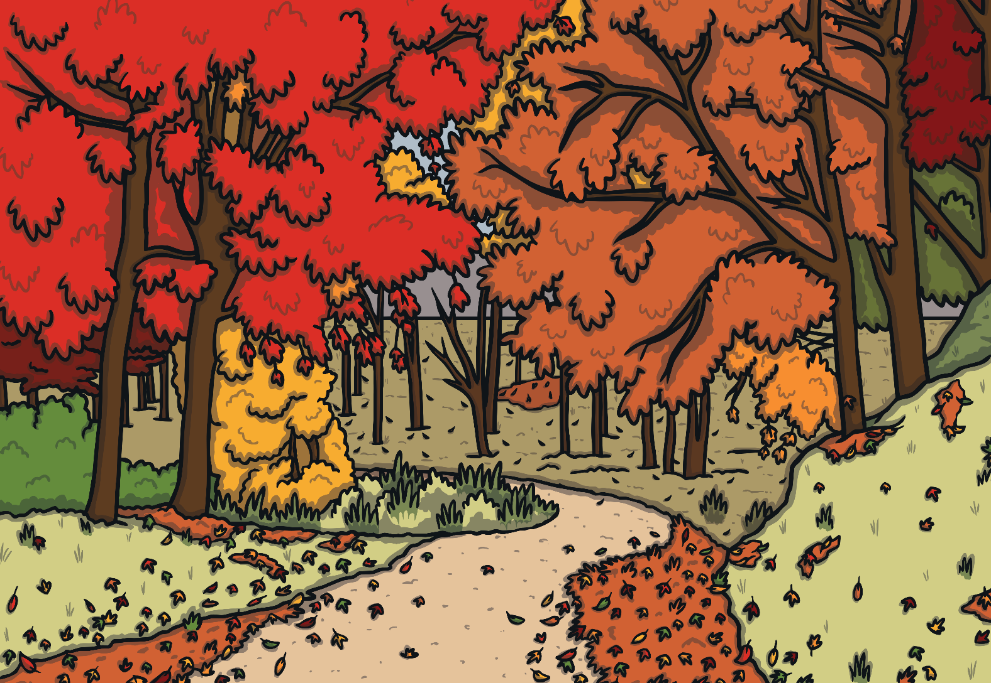
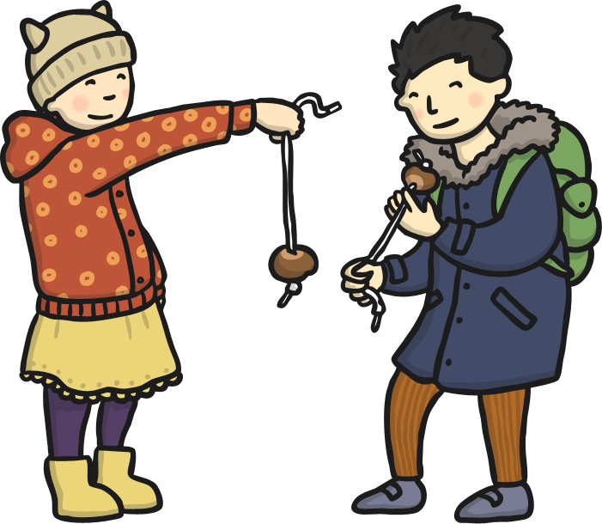
September

Slide 13
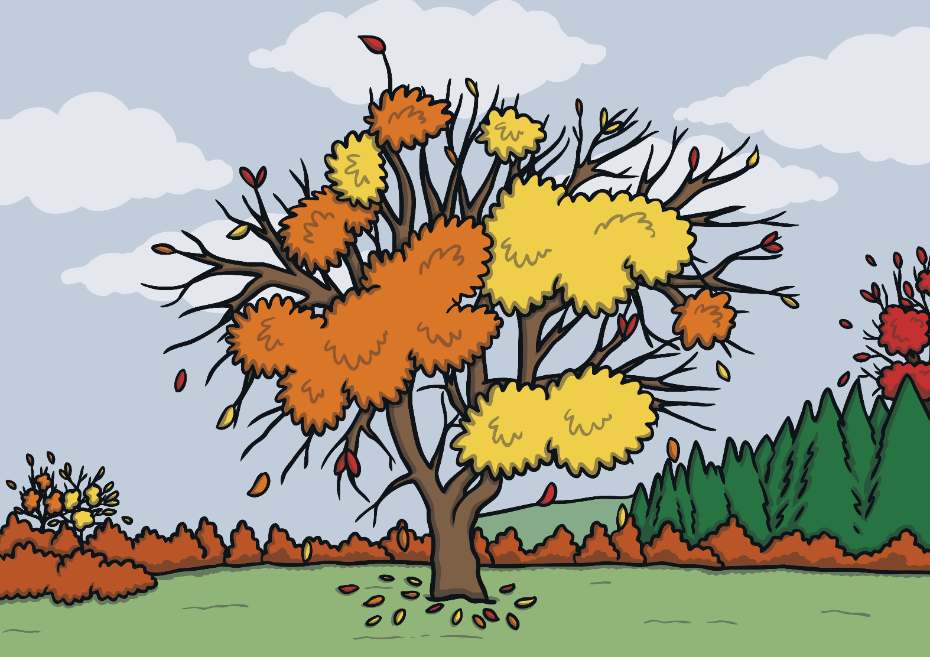
October

Slide 14
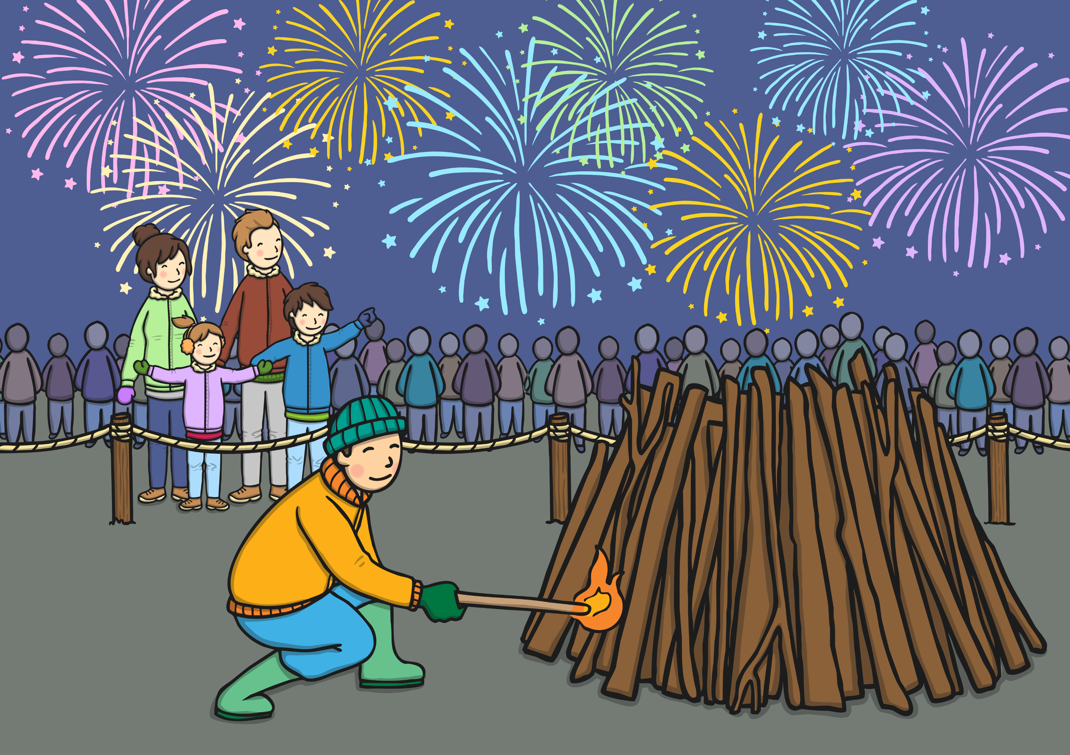
November

Slide 15
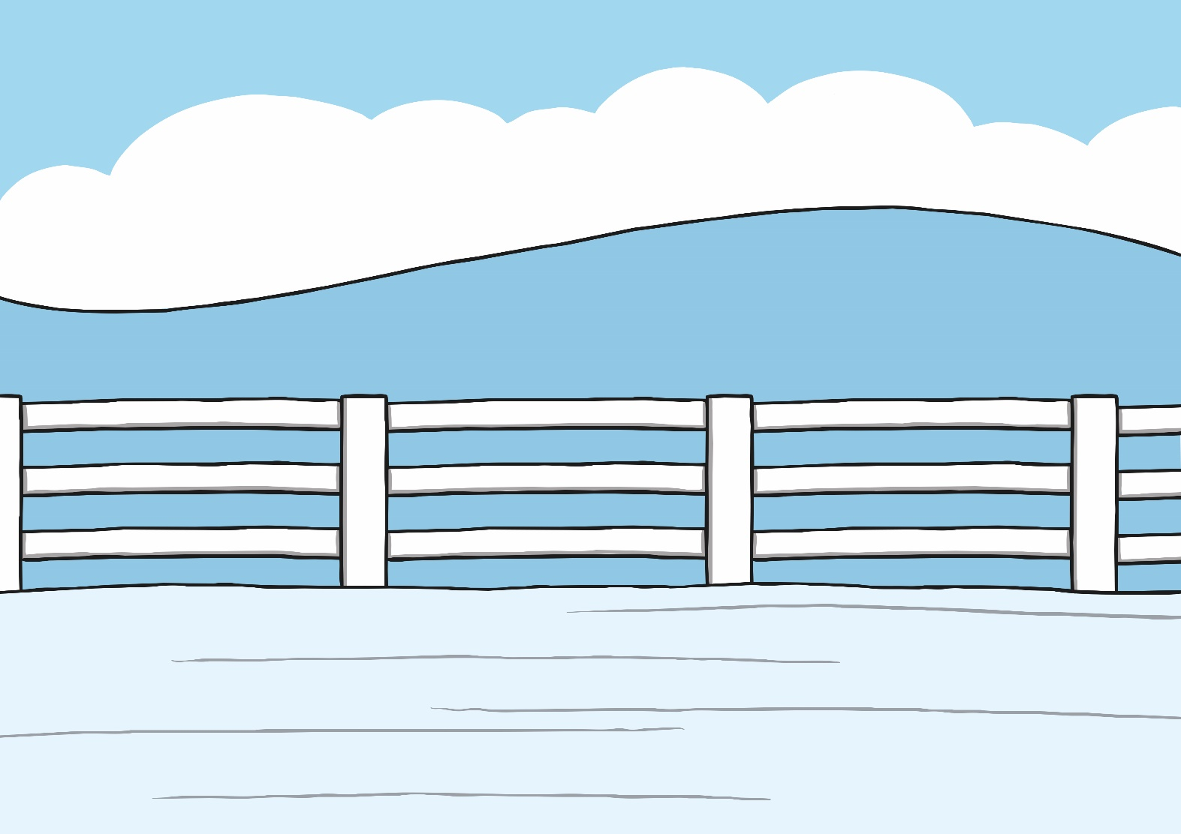
December

Slide 16
Now complete the worksheet putting the months of the year in the correct order. You will find the worksheet on our glow blog.

