Slide 1
Subtracting 4 digit numbers

Slide 2
9247 – 6125 =
Remember with subtraction we always start with the number that is greater.
Thousands | Hundreds | Tens | Ones
Create a place value chart and use concrete materials or drawings to represent the bigger number.

Slide 3
9247 – 6125 =
Remember with subtraction we always start with the number that is greater.
Thousands | Hundreds | Tens | Ones
Take away the smaller number from the greater number. Remember to always start with the ones. Then subtract the tens. Subtract the hundreds. Then subtract the thousdands.

Slide 4
9247 – 6125 =
Thousands | Hundreds | Tens | Ones
If you are using drawings, cross out the materials like above. Or, if you are using concrete materials, remove the correct number for each place value.

Slide 5
9247 – 6125 = 3122
Thousands | Hundreds | Tens | Ones
See the next slide to see how to solve this problem using the column subtraction method.

Slide 6
Th H T O 9 2 4 7 - 6 1 2 5
3 1 2 2
Remember, when subtracting, the greater number always goes on the top!
Set out the problem as a column subtraction. Start by subtracting the ones. Then subtract the tens. Subtract the hundreds. Then subtract the thousands. You could do this mentally or use your concrete materials and place value chart.

Slide 7
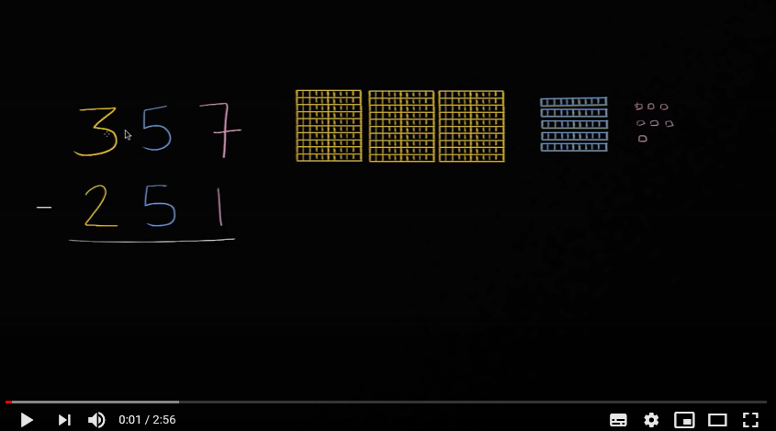
Watch the video below for a further reminder.
This video shows subtraction with 3 digit numbers but the method is the same.

Slide 8
Remember with column subtraction, we cannot subtract a greater number from a number that is smaller. We will not have enough.
Let’s explore this further..

Slide 9
6893 - 1527 =
Remember with subtraction we always start with the number that is greater.
Thousands | Hundreds | Tens | Ones
Create a place value chart and use concrete materials or drawings to represent the bigger number.

Slide 10
6893 - 1527 =
Remember with subtraction we always start with the number that is greater.
Thousands | Hundreds | Tens | Ones
Remember to always start with the ones. We CANNOT subtract 7 from 3, as there is not enough materials. What do we need to do? We need to carry a ten from the tens column.

Slide 11
Subtracting with carrying
Remember the base 10 rule:
1 ten = 10 ones
1 hundred = 10 tens
1 thousand = 10 hundreds
When we have to carry from the column to the left, we must remember the base ten rule when changing the place value.

Slide 12
6893 - 1527 =
Thousands | Hundreds | Tens | Ones
We do not have enough to subtract 7 ones from the ones column. We need to carry a ten from the tens column. Remember the 1 ten will change into 10 ones.

Slide 13
6893 - 1527 =
Thousands | Hundreds | Tens | Ones
Remember to remove the 1 ten you carried over from the tens column. Now we have enough ones to subtract 7 ones from the ones column.

Slide 14
6893 - 1527 = 5366
If you are using drawings, cross out number you are subtracting. Or, if you are using concrete materials, remove the correct number from each place value.
Thousands | Hundreds | Tens | Ones
Now we can begin the subtraction. Start with the ones. Then subtract the tens. Subtract the hundreds. Then subtract the thousands.

Slide 15
6893 - 1527 = 5366
Thousands | Hundreds | Tens | Ones
See the next slide for how this would look using the column subtraction method.

Slide 16
1 ten = 10 ones
10 ones + 3 ones= 13 ones
Th H T O
Remember, when subtracting, the greater number always goes on the top!
8
13
6 8 9 3 - 1 5 2 7
5 3 6 6
Set out the problem as a column subtraction. There is not enough ones to subtract 7 so carry over a ten. Remember to show you have taken 1 ten from the tens column. Change the 1 ten into 10 ones. Add the extra 10 ones to the 3 ones to make 13 ones. Now we can subtract 7 ones from the 13 ones. Then subtract the tens. Subtract the hundreds. Then subtract the thousands. It is very helpful to use concrete materials and a place value chart when subtracting with carrying.

Slide 17
Let’s try another one…

Slide 18
3274 – 2018 =
Remember with subtraction we always start with the number that is greater.
Thousands | Hundreds | Tens | Ones
Create a place value chart and use concrete materials or drawings to represent the bigger number.

Slide 19
3274 – 2018 =
Remember with subtraction we always start with the number that is greater.
Thousands | Hundreds | Tens | Ones
Remember to always start with the ones. We CANNOT subtract 8 from 4, as there is not enough materials. What do we need to do? We need to carry a ten from the tens column.

Slide 20
3274 – 2018 =
Thousands | Hundreds | Tens | Ones
We do not have enough to subtract 8 ones from the ones column. We need to carry a ten from the tens column. Remember the 1 ten will change into 10 ones.

Slide 21
3274 – 2018 =
Thousands | Hundreds | Tens | Ones
Remember to remove the 1 ten you carried over from the tens column. Now we have enough ones to subtract 8 ones from the ones column.

Slide 22
3274 – 2018 =
If you are using drawings, cross out number you are subtracting. Or, if you are using concrete materials, remove the correct number from each place value.
Thousands | Hundreds | Tens | Ones
Now we can begin the subtraction. Start with the ones. Then subtract the tens. Subtract the hundreds- in this problem, we do not have to subtract any hundreds. Then subtract the thousands.

Slide 23
3274 – 2018 = 1256
Thousands | Hundreds | Tens | Ones
See the next slide for how this would look using the column subtraction method.

Slide 24
1 ten = 10 ones
10 ones + 4 ones= 14 ones
Th H T O
Remember, when subtracting, the greater number always goes on the top!
6
14
3 2 7 4
- 2 0 1 8
1 2 5 6
Set out the problem as a column subtraction. There is not enough ones to subtract 8 ones so carry over a ten. Remember to show you have taken 1 ten from the tens column. Change the 1 ten into 10 ones. Add the extra 10 ones to the 4 ones to make 14 ones. Now we can subtract 8 ones from the 14 ones. Then subtract the tens. Subtract the hundreds. Then subtract the thousands. It is very helpful to use concrete materials and a place value chart when subtracting with carrying.

Slide 25
Let’s try one more…
Sometimes we need to carry over from 2 different place values. This can be tricky. Let’s have a look.

Slide 26
7942- 4156 =
Remember with subtraction we always start with the number that is greater.
Thousands | Hundreds | Tens | Ones
Create a place value chart and use concrete materials or drawings to represent the bigger number.

Slide 27
7942- 4156 =
Thousands | Hundreds | Tens | Ones
Remember to always start with the ones. We CANNOT subtract 6 from 2, as there is not enough materials. What do we need to do? We need to carry a ten from the tens column.

Slide 28
7942- 4156 =
Thousands | Hundreds | Tens | Ones
We do not have enough to subtract 6 ones from the ones column. We need to carry a ten from the tens column. Remember the 1 ten will change into 10 ones.

Slide 29
7942- 4156 =
Thousands | Hundreds | Tens | Ones
Remember to remove the 1 ten you carried over from the tens column. Now we have enough ones to subtract 6 ones from the ones column.

Slide 30
7942- 4156 =
If you are using drawings, cross out number you are subtracting. Or, if you are using concrete materials, remove the correct number from each place value.
Thousands | Hundreds | Tens | Ones
Now we can begin the subtraction. Subtract 6 ones from the new amount of 12 ones. Then subtract the tens… but let’s look… we do not have enough tens to subtract 5 tens. We need to carry 1 hundred into the tens column.

Slide 31
7942- 4156 =
Thousands | Hundreds | Tens | Ones
Carry 1 hundred into the tens column. Remember this will change to 10 tens because 1 hundred= 10 tens.

Slide 32
7942- 4156 =
Thousands | Hundreds | Tens | Ones
Now, remember to remove the 1 hundred you carried into the tens column.

Slide 33
7942- 4156 =
If you are using drawings, cross out number you are subtracting. Or, if you are using concrete materials, remove the correct number from each place value.
Thousands | Hundreds | Tens | Ones
Let’s continue with the subtraction. We need to subtract 5 tens from our new amount of 13 tens.

Slide 34
7942- 4156 =
If you are using drawings, cross out number you are subtracting. Or, if you are using concrete materials, remove the correct number from each place value.
Thousands | Hundreds | Tens | Ones
Now we need to subtract the hundreds, then subtract the thousands.

Slide 35
7942- 4156 = 3786
Thousands | Hundreds | Tens | Ones
See the next slide to see how this would look using the column subtraction method.

Slide 36
Cross out the 3 tens and carry 1 hundred.
1 hundred = 10 tens
10 tens + 3 tens = 13 tens
Th H T O
1 ten = 10 ones
10 ones + 2 ones= 12 ones
13
8
3
12
7 9 4 2
- 4 1 5 6
3 7 8 6
Remember, when subtracting, the greater number always goes on the top!
Set out the problem as a column subtraction. Remember to show each time you have carried a number and changed it into another place value. Start with the ones, then subtract the tens, then the hundreds and finally subtract the thousands. Use your place value chart and concrete materials as you go. Remember the base 10 rule.

Slide 37
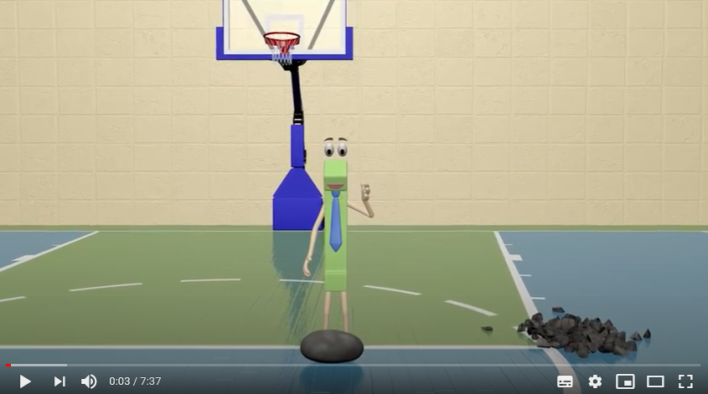
Watch the video below for a further reminder.

Slide 38
Subtraction with carrying (or renaming) can be tricky. Top tips:
Watch the videos on this PowerPoint (as many times as you need to!)
Check these slides (read them as many times as you need to)
Remember the steps (especially removing a number when you have carried it over)
Use concrete materials and a place value chart!
Remember we have learned this in class. Take your time. You can do this! (Remember our Learning Pit!)
If you find the written column method too tricky for now, just complete the question using your concrete materials and place value chart.
I am always here to help you. Ask questions on our Teams page.

