Slide 1
Adding 4 digit numbers

Slide 2
5181 + 3716 =
Thousands | Hundreds | Tens | Ones
Create a place value chart and use concrete materials or drawings to represent each number.

Slide 3
Th H T O 5 1 8 1 + 3 7 1 6
8 8 9 7
Remember, when we are adding, it doesn’t matter which number is on the top and bottom.
Set out the problem as a column addition. Start by adding the ones. Then add the tens. Add the hundreds. Then add the thousands. You could do this mentally or use your concrete materials and place value chart.

Slide 4
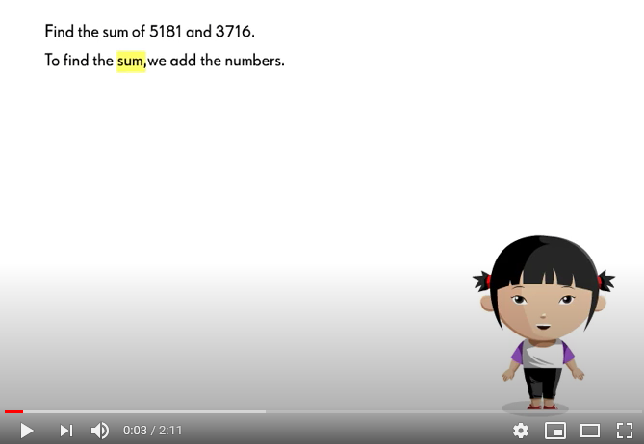
Watch the video below for a further reminder.

Slide 5
Adding with renaming
Remember the base 10 rule:
10 ones = 1 ten
10 tens = 1 hundred
10 hundreds = 1 thousand
We cannot have more than 9 ones in the ones column. If we have 10 ones, we have to change these into 1 ten.
We cannot have more than 9 tens in the tens column. If we have 10 tens, we have to change these into 1 hundred.
We cannot have more than 9 hundreds in the hundreds column. If we have 10 hundreds, we have to change these into 1 thousand.

Slide 6
4357 + 1625 =
Thousands | Hundreds | Tens | Ones
Create a place value chart and use concrete materials or drawings to represent each number.

Slide 7
4357 + 1625 =
Thousands | Hundreds | Tens | Ones
There are more than 10 ones in the ones column, we need to rename these as 1 ten. Remember 10 ones = 1 ten.

Slide 8
4357 + 1625 =
Thousands | Hundreds | Tens | Ones
There are more than 10 ones in the ones column, we need to rename these as 1 ten. Remember 10 ones = 1 ten.

Slide 9
4357 + 1625 = 5982
Thousands | Hundreds | Tens | Ones
Now we can add our numbers together. See the next slide for how this would look using the column addition method.

Slide 10
Remember to add the extra ten.
Th H T O
1
7 ones + 5 ones = 12 ones.
As there are more than 10 ones we need to rename.
12 ones = 1 ten and 2 ones.
We write the 2 ones in the ones column and write the 1 ten in the tens column.
4 3 5 7 + 1 6 2 5
5 9 8 2
Set out the problem as a column addition. Start by adding the ones. If there are more than 9 ones, we need to rename. Then add the tens. Remember to add the extra ten. Add the hundreds. Then add the thousands. It is really helpful to use concrete materials when renaming.

Slide 11
Let’s try another one…

Slide 12
4016 + 2439 =
Thousands | Hundreds | Tens | Ones
Create a place value chart and use concrete materials or drawings to represent each number.

Slide 13
4016 + 2439 =
Thousands | Hundreds | Tens | Ones
There are more than 10 ones in the ones column, we need to rename these as 1 ten. Remember 10 ones = 1 ten.

Slide 14
4016 + 2439 =
Thousands | Hundreds | Tens | Ones
There are more than 10 ones in the ones column, we need to rename these as 1 ten. Remember 10 ones = 1 ten.

Slide 15
4016 + 2439 = 6455
Thousands | Hundreds | Tens | Ones
Now we can add our numbers together. See the next slide for how this would look using the column addition method.

Slide 16
Remember to add the extra ten.
Th H T O
1
6 ones + 9 ones = 15 ones.
As there are more than 10 ones we need to rename.
15 ones = 1 ten and 5 ones.
We write the 5 ones in the ones column and write the 1 ten in the tens column.
4 0 1 6 + 2 4 3 9
6 4 5 5
Set out the problem as a column addition. Start by adding the ones. If there are more than 9 ones, we need to rename. Then add the tens. Remember to add the extra ten. Add the hundreds. Then add the thousands. It is really helpful to use concrete materials when renaming.

Slide 17
Let’s try one more…

Slide 18
5175 + 3248 =
Thousands | Hundreds | Tens | Ones
Create a place value chart and use concrete materials or drawings to represent each number.

Slide 19
5175 + 3248 =
Thousands | Hundreds | Tens | Ones
There are more than 10 ones in the ones column, we need to rename these as 1 ten. Remember 10 ones = 1 ten.

Slide 20
5175 + 3248 =
Thousands | Hundreds | Tens | Ones
There are more than 10 ones in the ones column, we need to rename these as 1 ten. Remember 10 ones = 1 ten.

Slide 21
5175 + 3248 =
Thousands | Hundreds | Tens | Ones
This problem is a little trickier. We also need to rename the tens as there are more than 9 tens in the tens column. Remember 10 tens = 1 hundred.

Slide 22
5175 + 3248 =
Thousands | Hundreds | Tens | Ones
This problem is a little trickier. We also need to rename the tens as there are more than 9 tens in the tens column. Remember 10 tens = 1 hundred.

Slide 23
5175 + 3248 = 8423
Thousands | Hundreds | Tens | Ones
Now we can add our numbers together. See the next slide for how this would look using the column addition method.

Slide 24
Remember to add the extra ten and extra hundred.
Th H T O
1. 5 ones + 8 ones = 13 ones.
As there are more than 10 ones we need to rename.
13 ones = 1 ten and 3 ones.
We write the 3 ones in the ones column and write the 1 ten in the tens column.
1
1
5 1 7 5 + 3 2 4 8
8 4 2 3
2. 1 ten + 7 tens + 4 tens = 12 tens.
As there are more than 10 tens we need to rename.
12 tens = 1 hundred and 2 tens.
We write the 2 tens in the tens column and write the 1 hundred in the hundreds column.
3. Then add the hundreds and thousands.

Slide 25
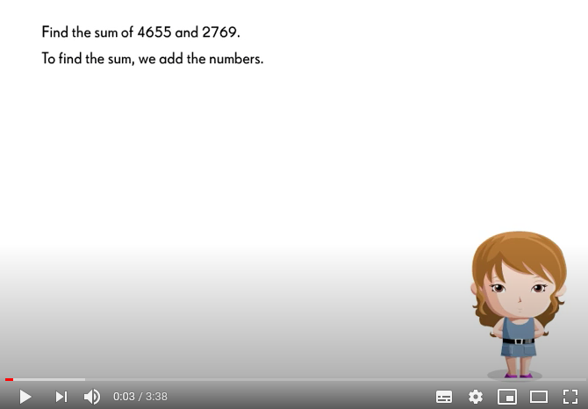
Watch the video below for a further reminder.

Slide 26
Remember to use concrete materials and a place value chart, especially for problems when you need to rename as these can be tricky!
Although you do not have Numicon or Dienes at home, you may have counters. Or you can use anything in your house! You could use Lego, pasta, board game pieces, jigsaw pieces, crayons or you could draw.
You can also simply draw a place value chart on paper.

