Slide 2
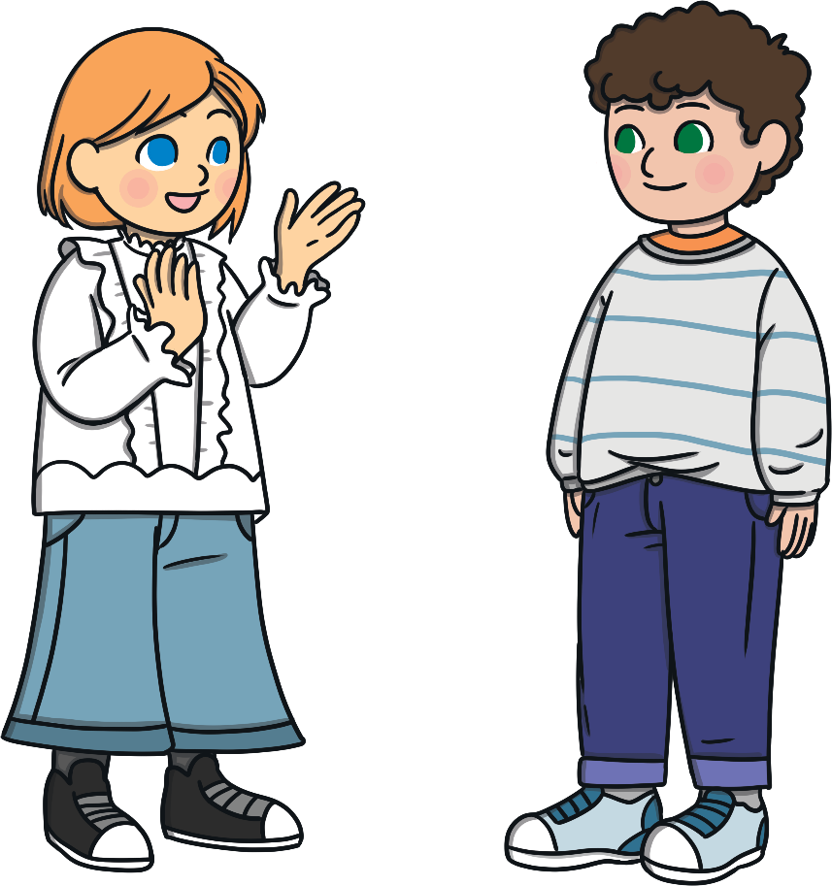
Why do we celebrate Mary during May?
Have some thinking time.
- Discuss with someone at home or write down some ideas.

Slide 3
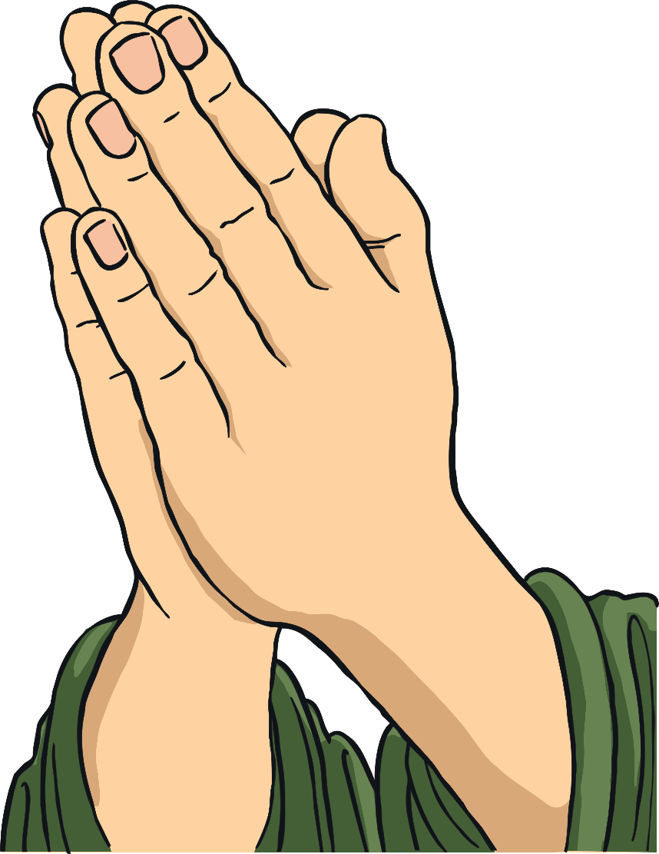
Did You Know…?
We have been celebrating Mary for about 700 years.

Slide 4
Important Events in Mary’s Life
Presentation of Mary in the Temple
Betrothal to Joseph
Annunciation of Jesus’ birth
Jesus’ birth
Jesus is lost in the Temple
Wedding feast at Cana
Assumption of Mary

Slide 5
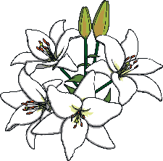
Celebrating Mary
Mary is honoured all over the world by Catholic Christians.
She is the Mother of Jesus.
She is the Mother of the Church and our Mother too.

Slide 6
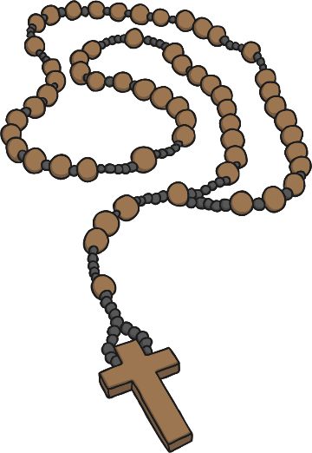
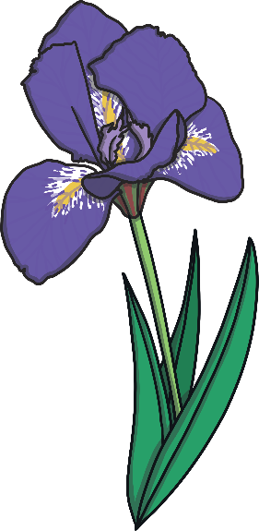
Mary’s life is celebrated through:
May Devotions
May Crowning
Click the buttons to find out more
May Processions
The
Rosary

Slide 7
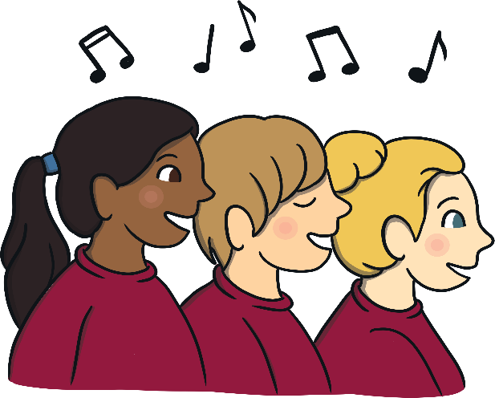
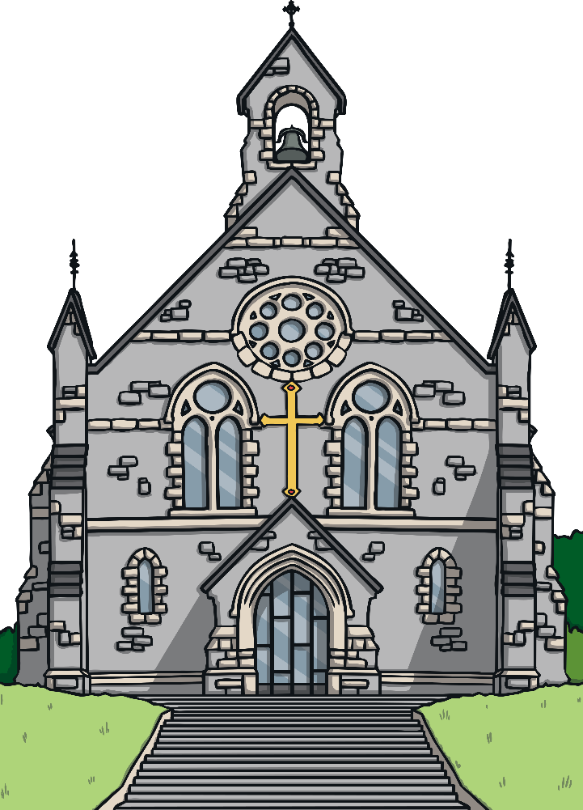
May Devotions
The Catholic Church celebrates Mary during Mass.
Special hymns are sung.
People lay out flowers to bring nature into church.
Many festivals are held during May to celebrate Mary’s life. These are called ‘Marian Festivals’.
Back

Slide 8
May Crowning
A May Crowning is when we crown a statue of Mary with flowers.
On the May altar, Mary is offered a crown of flowers or blossoms and other handmade items to represent her queenship as the Mother of Jesus Christ.
We honour her during May as it is a time of growth.
Back

Slide 9
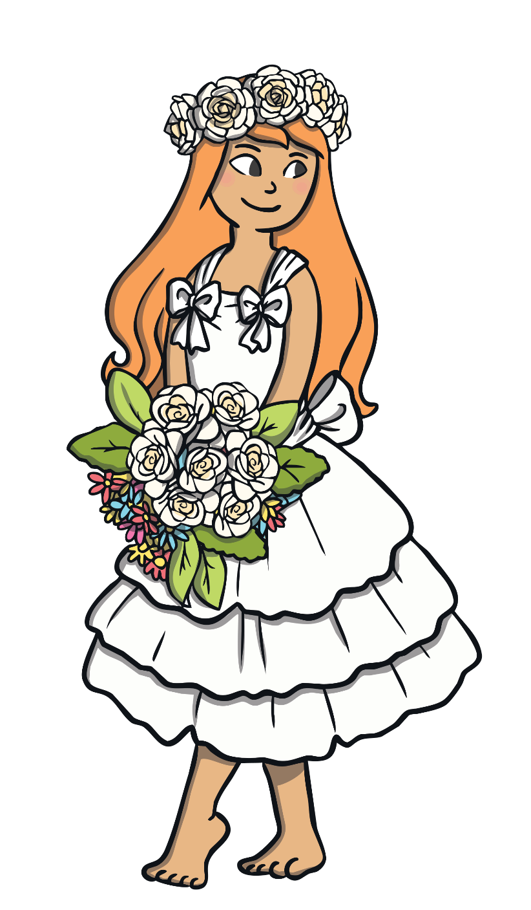
May Procession
Long ago, May processions were very popular.
Boys and girls would walk through the streets carrying flowers.
People would sing hymns and say prayers.
When people reached the shrine or the church, they would crown Mary.

Slide 10
May Procession
Then, they would put their flowers at her feet.
Some people decorated their homes with pictures or statues of Mary.
Back

Slide 11
The Holy Rosary
The Holy Rosary is a type of Catholic prayer using beads.
It is composed of five decades.
Each decade consists of the Our Father, ten Hail Marys and a Glory Be to the Father.
Each decade has a story or Mystery, which remembers the life of Jesus Christ and of his Blessed Mother, Mary.

Slide 12
The Holy Rosary
There are four types of Mysteries:
The Joyful Mysteries
The Luminous Mysteries
The Sorrowful Mysteries
The Glorious Mysteries
Back

Slide 13
Discussion Time
Reflect on what Mary did for Jesus, and us all. What does your Mother or carer do for you?
Why is the month of May important? Explain to someone at home.
Activities
Create a Marian month prayer thanking Mary for what she has done for you.
Why do you think we should celebrate Mary? Write or draw some ideas.
What would you like to say to Mary? Write her a letter.

Slide 14
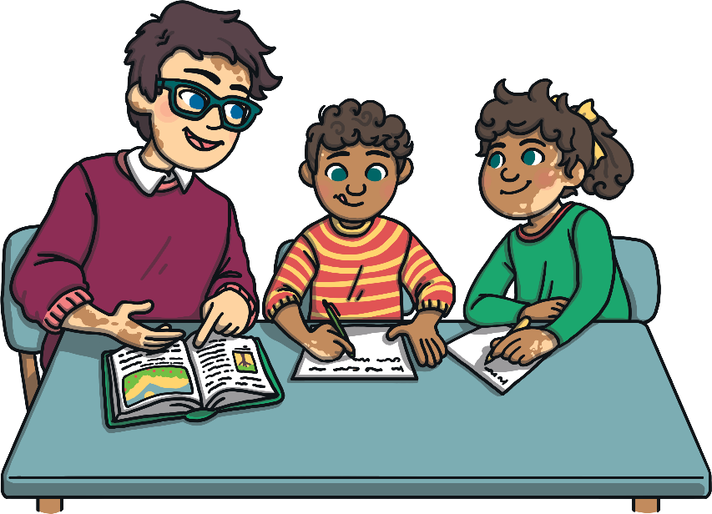
Suggested starters for your prayer:
Dear Mary,
I thank you for…
Dear Mary,
I just wanted to say…

