Slide 1
Place Value Activities
Complete the activities on the following slides. If possible, complete the activities on paper and then check your answers.

Slide 2
Estimating Numbers
Estimate the number.
2000
3000

Slide 3
Estimating Numbers
Estimate the number.
2850
2000
3000
Answer

Slide 4
Estimating Numbers
Estimate the number.
4000
6000

Slide 5
Estimating Numbers
Estimate the number.
5200
4000
6000
Answer

Slide 6
Estimating Numbers
Estimate the number.
0
10000

Slide 7
Estimating Numbers
Estimate the number.
2000
0
10000
Answer

Slide 8
Estimating Numbers
Estimate the number.
0
10000

Slide 9
Estimating Numbers
Estimate the number.
9550
0
10000
Answer

Slide 10
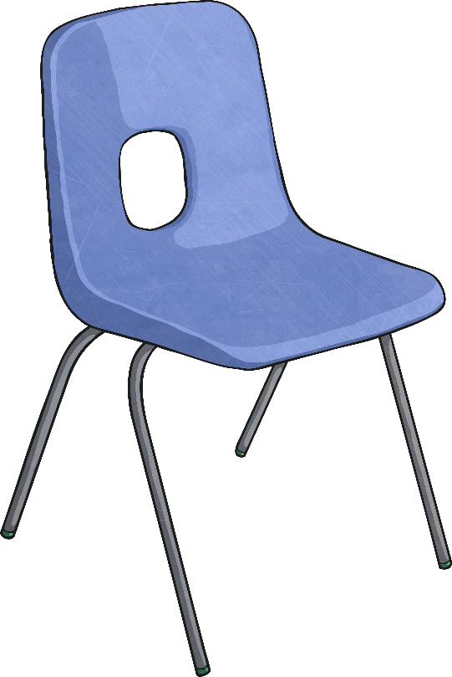
Estimating Measures
Estimate the height of the chair.
1000mm
0mm

Slide 11
Estimating Measures
Estimate the width of the bag.
0mm
1000mm

Slide 12
Estimating Measures
Estimate how many millilitres of water remain in these 5 litre bottles.

Slide 13
Round numbers to the nearest 10, 100 and 1000
Complete the table. Remember the Rounding Rhyme. Remember all the digits after the place value you are rounding to are 0. See the example below.
Look at the ones digit.
Look at the tens digit.
Look at the hundreds digit.
 | Round to nearest 10 | Round to nearest 100 | Round to nearest 1000
3265 | 3270 | 3300 | 3000
1307
2547
4683
5889
7056
Click on the next slide to reveal the answers.

Slide 14
Round numbers to the nearest 10, 100 and 1000
Complete the table.
Click to reveal the answers.
 | Round to nearest 10 | Round to nearest 100 | Round to nearest 1000
1307
2547
4683
5889
7056
1310
1300
1000
2550
2500
3000
4680
4700
5000
5890
5900
6000
7060
7100
7000

Slide 15
Solve Number and Practical Problems
I have these digits:
8 1 3 9
The smallest number I can make with these digits is:
3198
Am I right?

