Slide 2
Aim
I can identify areas of the world containing rainforests.
I can use maps and atlases to locate rainforests.
Success Criteria
I can name some countries where rainforests are found.
I can tell you more about one country where rainforests are found.
I can use an atlas to find countries of the world where rainforests are found.
I can label a map to show countries where rainforests are found.

Slide 3
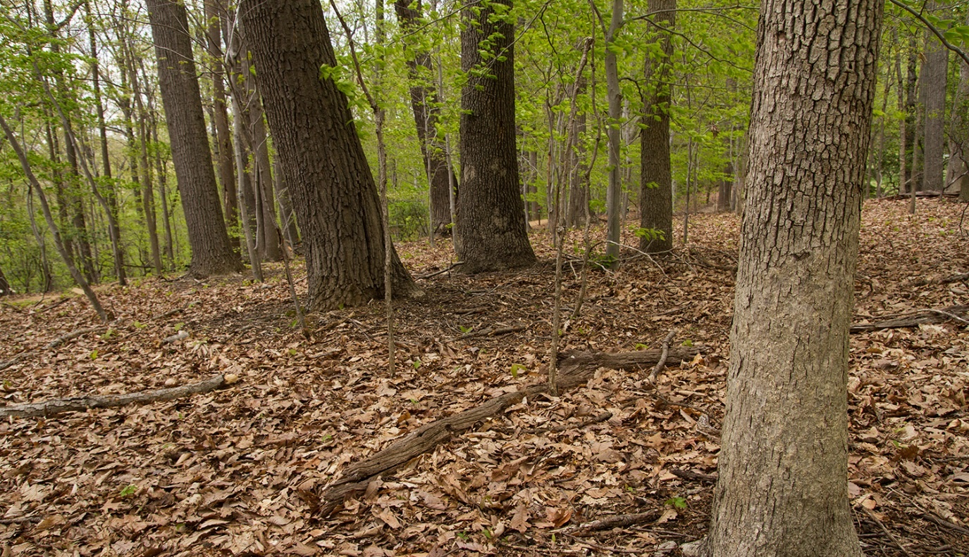
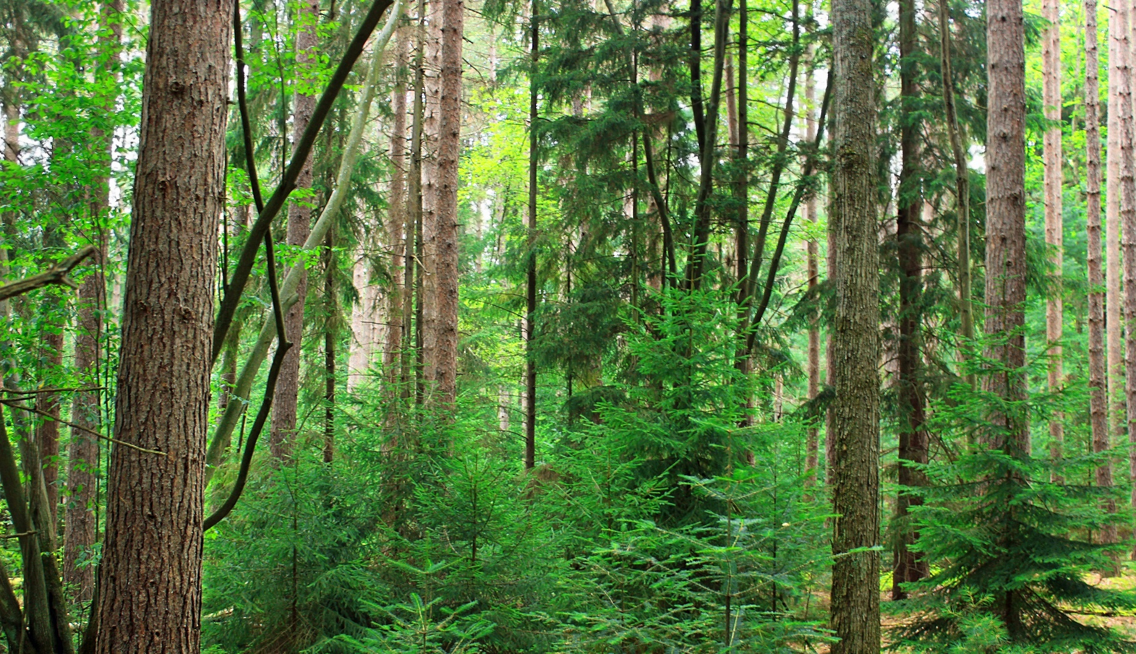
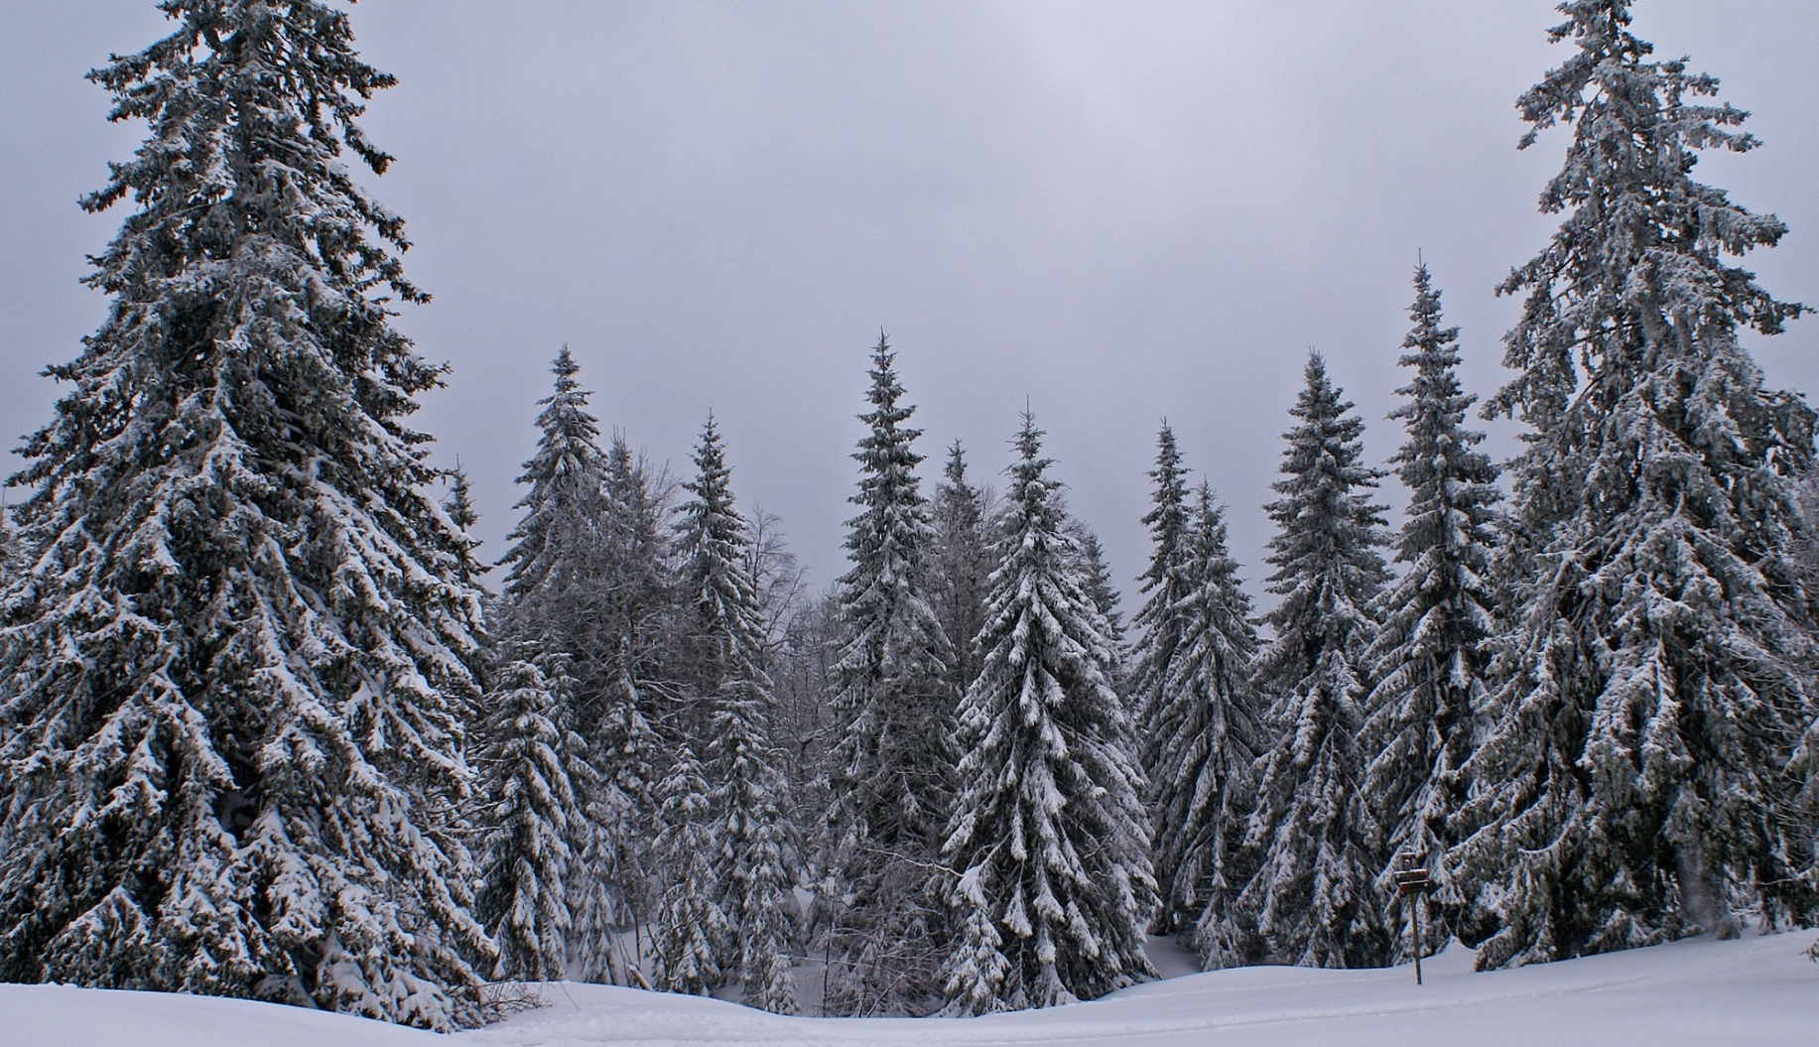
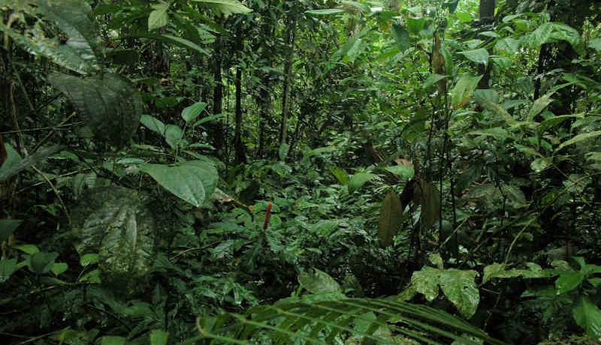
Types of Forests
There are four main types of forests around the world:
temperate coniferous forest
temperate deciduous forest
boreal forest
tropical rainforest

Slide 4
Types of Forests
Which kinds of forest do we find in the UK? Which ones are not found in the UK?
temperate deciduous forest
temperate coniferous forest
boreal forest
tropical rainforest

Slide 5
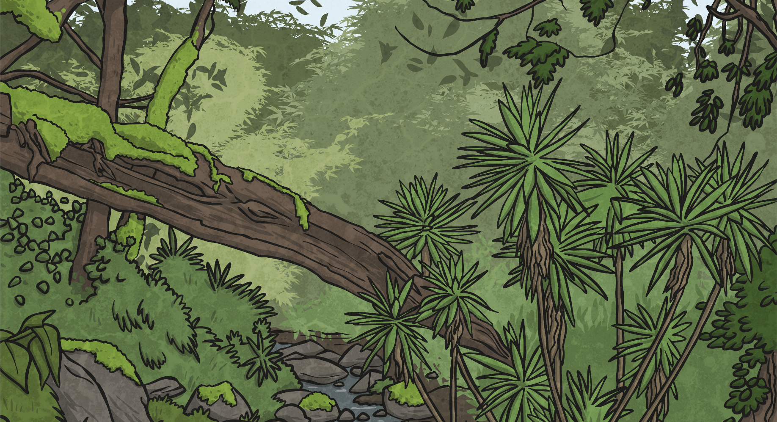
Types of Forests
Have you heard of rainforests before?
What do you know about them?

Slide 6
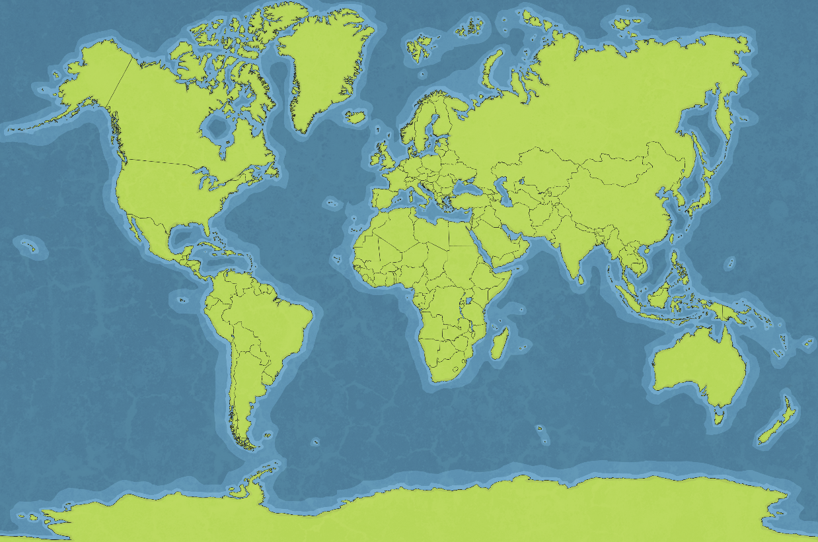
Where Are Rainforests Found?
Rainforests are found in many countries, such as:
Brazil
Peru
Australia
Indonesia
Bolivia
Ecuador
Guyana
India
Malaysia
Mexico
Venezuela
Do you recognise any of these country names?
Do you know where they are located on the map?

Slide 7
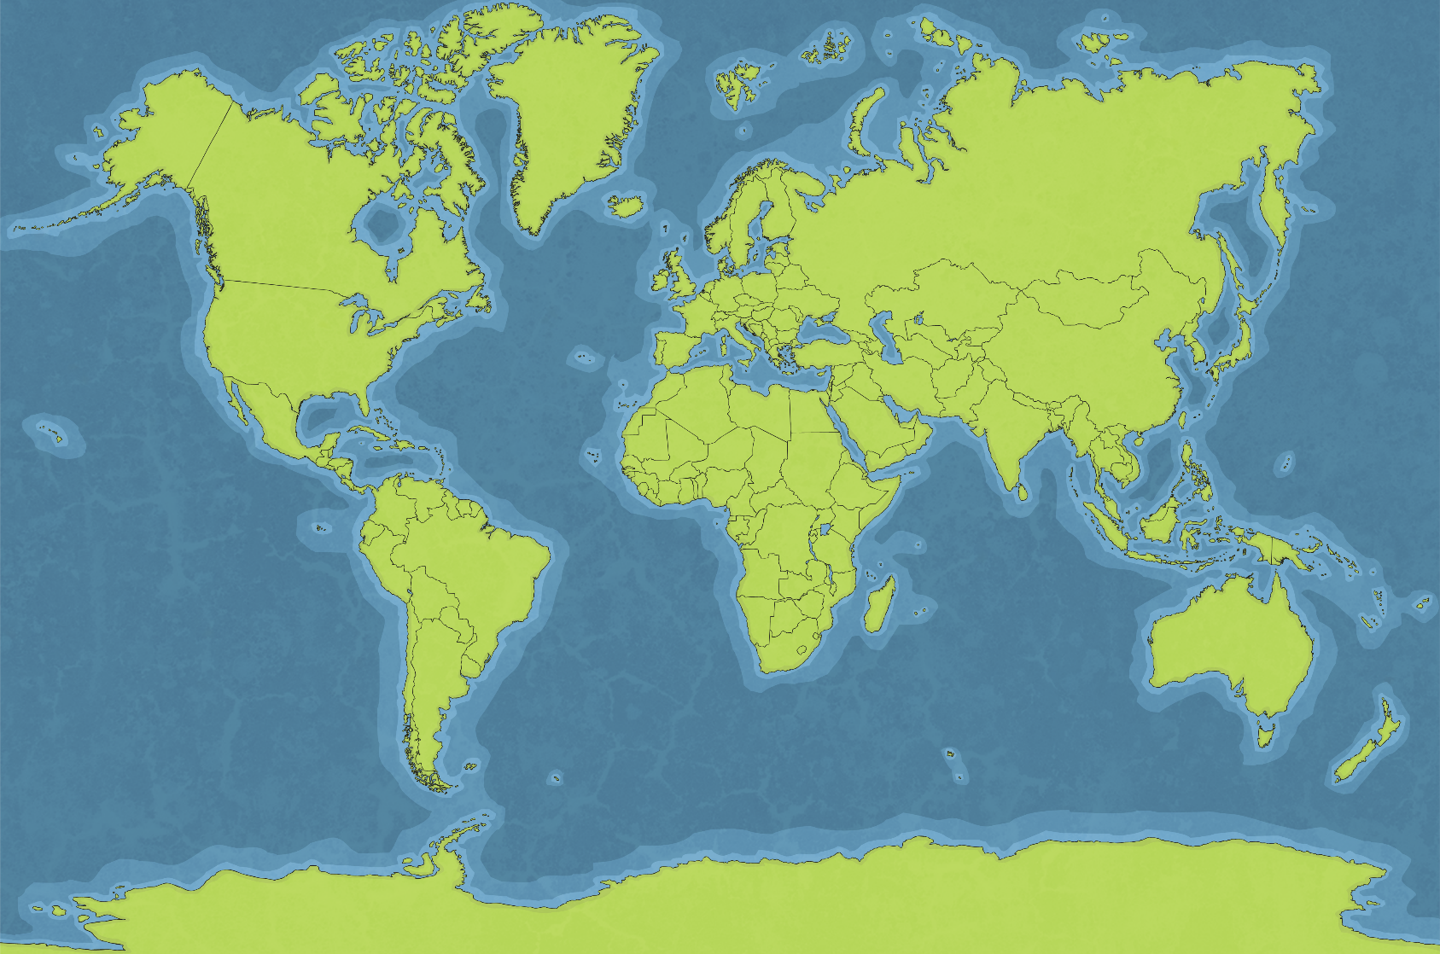
Where Are Rainforests Found?
Brazil
Peru
Australia
Indonesia
Bolivia
Ecuador
Guyana
India
Malaysia
Mexico
Venezuela
India
Guyana
Ecuador
Bolivia
Malaysia
Mexico
Venezuela
Indonesia
Peru
Brazil
Australia

Slide 8
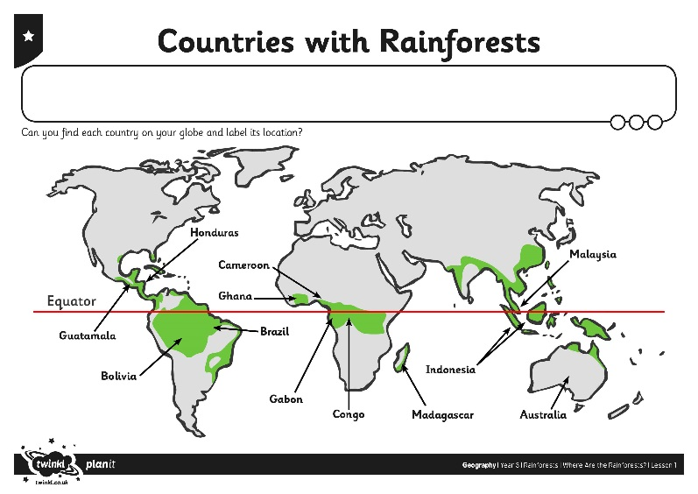
Which Countries Have Rainforests?
Find out the names and locations of more countries with rainforests.
Label your map with the country names.
Remember to use a capital letter to start each name.
Use this PowerPoint, a globe, a world map or a world map online to help you.
Open the Countries with Rainforests Map Activity.

Slide 9
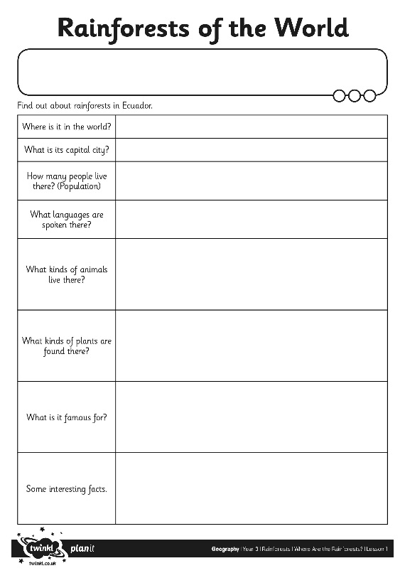
Extra Challenge: Lets Find Out More
Read Romel’s Rainforest Home at this website.
What did you find out about Ecuador? How is it different to Scotland?
Try to complete the Rainforests of the World Information Activity using the information you read about Ecuador from Romel.

Slide 10
Well done! I hope you learned the location of rainforests across the world. Next week we will learn about rainforests in more detail.

