Slide 1
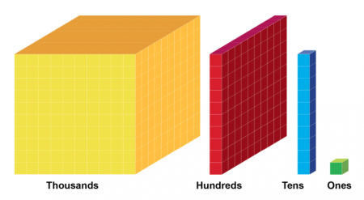
Place Value Activities
Complete the activities on the following slides. If possible, complete the activities on paper and then check your answers.

Slide 2
Identify Numbers
Which number is represented here?

Slide 3
Identify Numbers
Which number is represented here?
5371
Answer

Slide 4
Identify Numbers
Which number is represented here?

Slide 5
Identify Numbers
Which number is represented here?
3006
Answer

Slide 6
Identify Numbers
Which number is represented here?

Slide 7
Identify Numbers
Which number is represented here?
9200
Answer

Slide 8
Representing Numbers Using Base 10
Use Base 10 (Dienes) drawings to represent the following numbers.
Click to the next slide to see the answers.
1038
2115
3516
4388
5402

Slide 9
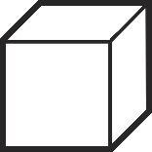
Representing Numbers Using Base 10
Use Base 10 drawings to represent the following numbers.
Click to reveal each answer.
1038
2115
3516
4388
5402

