Slide 1
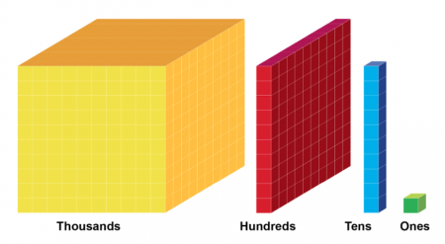
Place Value Activities
Complete the activities on the following slides. If possible, complete the activities on paper and then check your answers.

Slide 2
Comparing Numbers Reasoning Challenge
Convince me that I’ve made a mistake.
2887 < 2557

Slide 3
Comparing Numbers Reasoning Challenge
Convince me that I’ve made a mistake.
4329 > 4929

Slide 4
Comparing Numbers Reasoning Challenge
Convince me that I’ve made a mistake.
9076 < 8006

Slide 5
Order Numbers Beyond 1000
Order these numbers from smallest to largest.
What is the best way to start ordering numbers?
7506
6605
6550
5646
6534
6641
Answers

Slide 6
Order Numbers Beyond 1000
Order these numbers from greatest to smallest.
8709
8899
8599
8919
8891
8198
8909
Answers

Slide 7
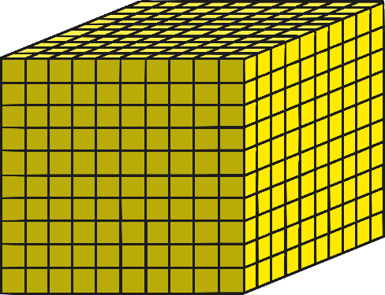
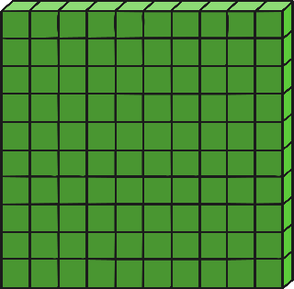
Identify Numbers
What number is represented below?
3111
Answer

Slide 8
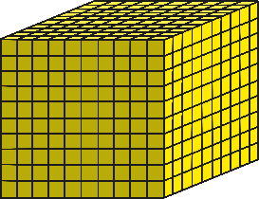
Identify Numbers
What number is represented below?
7086
Answer

Slide 9
Identify Numbers
What number is represented below?
2020
Answer

