Slide 1
The Story of Chocolate
By Primary 2/3F
St Clements

Slide 2
Cocoa Plant
This is the start of our chocolate story.
Here is a picture of a cocoa plant grown by the farmer.
It needs a lot of sun and water.

Slide 3
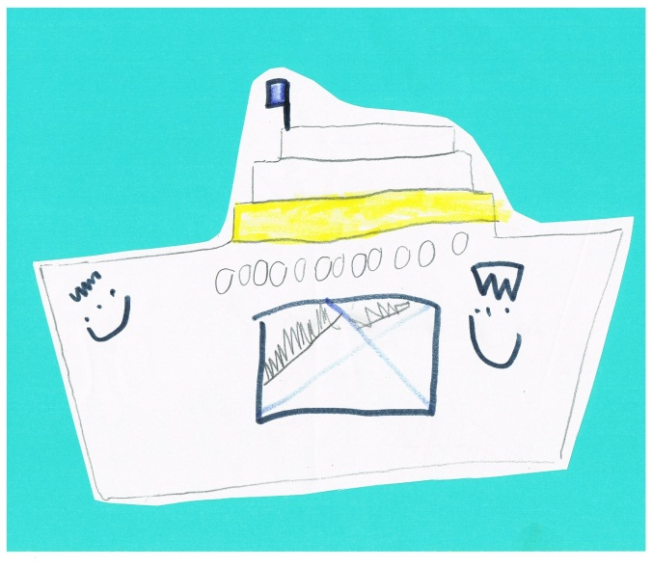
Here are the boats that bring the cocoa to the factories.

Slide 4
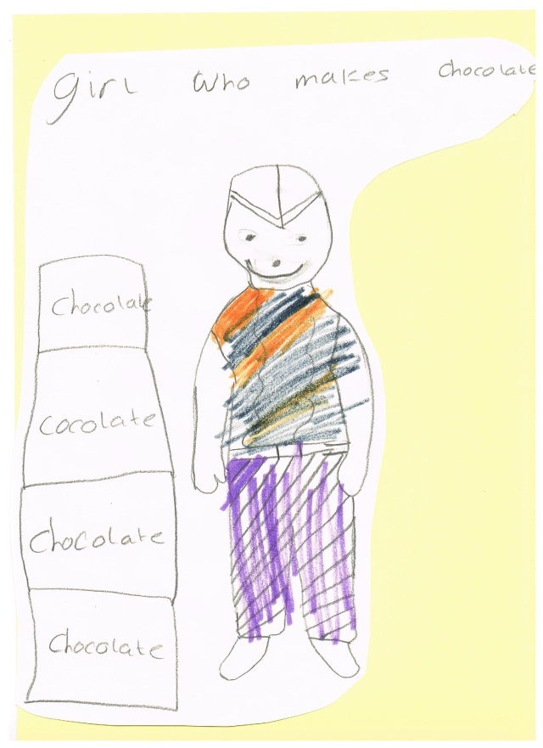
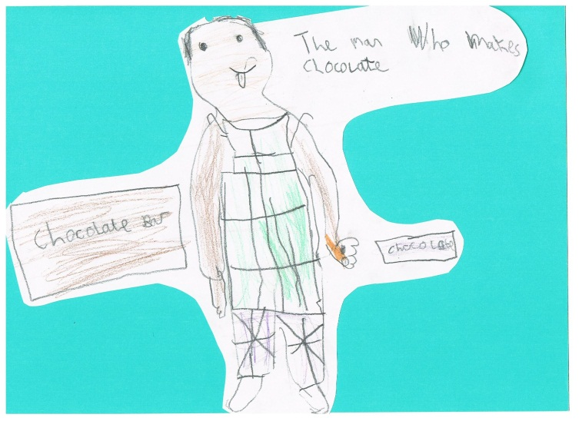
Here are the people who make chocolate out of the cocoa

Slide 5
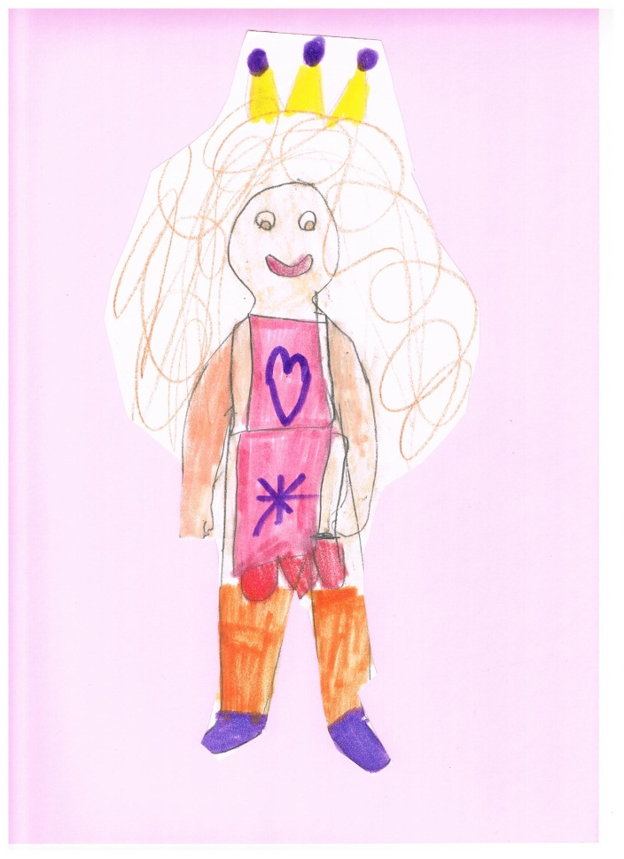
Here is the girl who works in the shop that sells the chocolate.

Slide 6
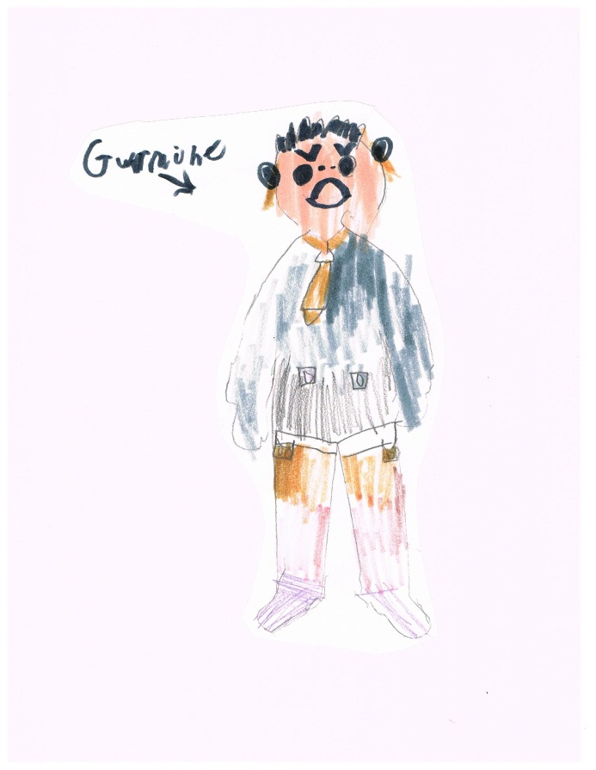
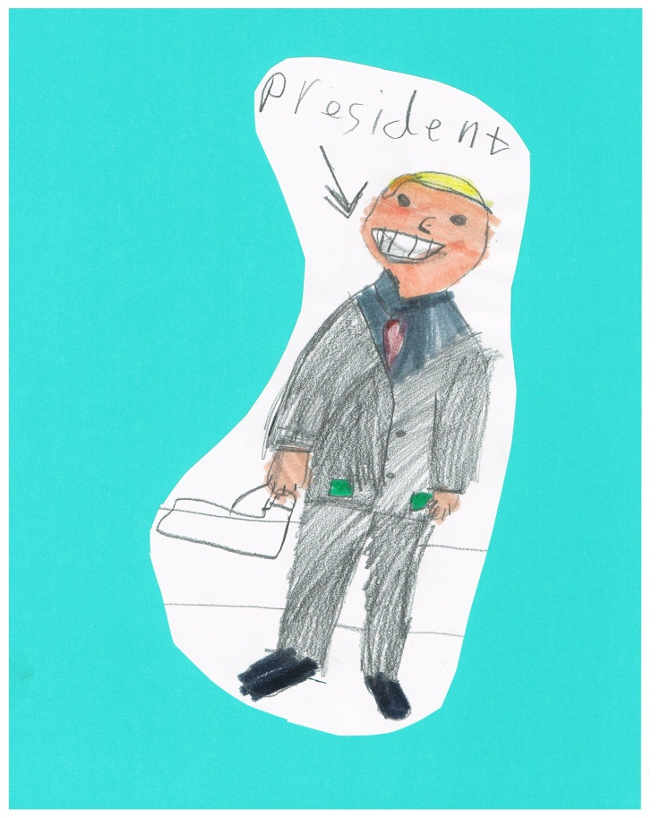
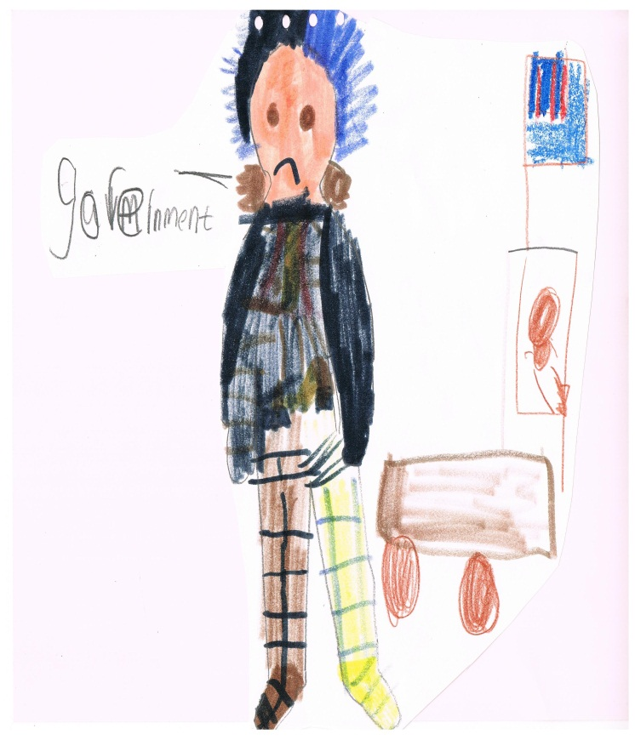
Here are the government people who make the most money from selling chocolate.

Slide 7
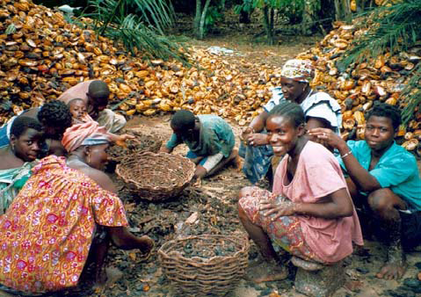
Here is a picture of the cocoa farmers who make the least amount of money from the sale of chocolate.

Slide 8
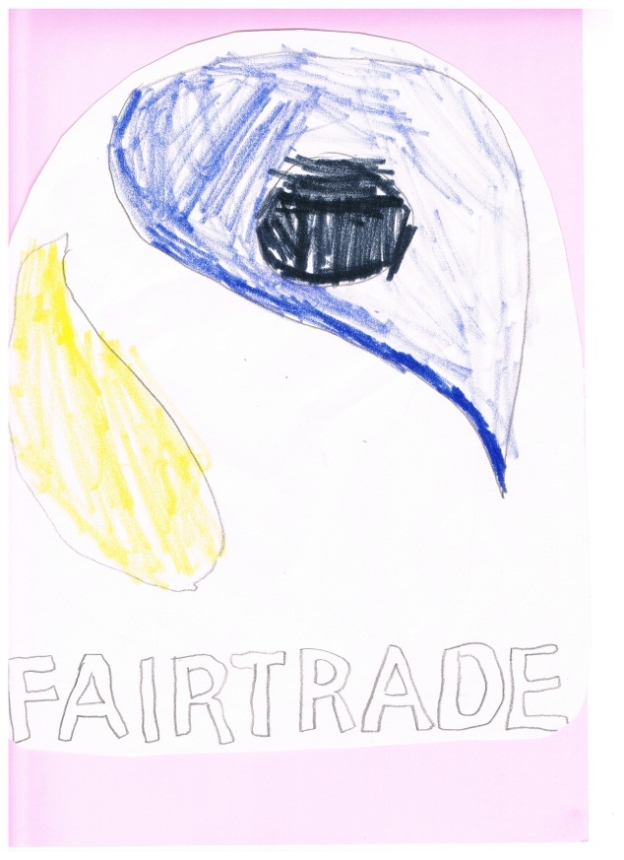
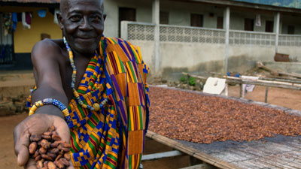
We have learned that Fairtrade is an organisation that wants the farmer to get a fairer share of the money made from selling chocolate.

