Slide 1
Labour Party
By
Piotr Lelinski

Slide 2
☺what does☺ ☺labour party☺ ☺stand for☺

Slide 3
☺Education☺

Slide 4
☺N.h.s☺

Slide 5
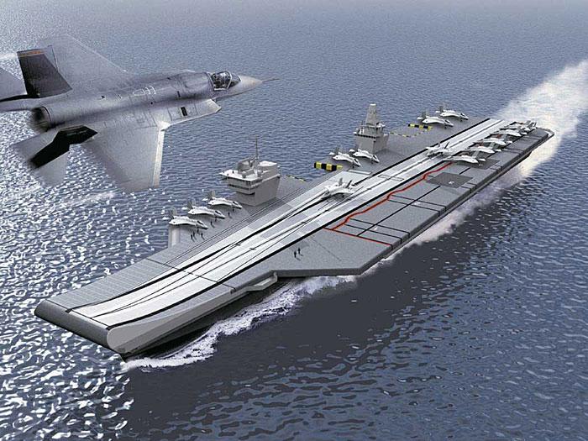
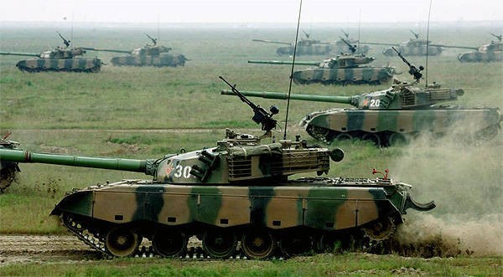
Armed forces

Slide 6
☹Conclusion☺

