Slide 1
Maths and Numeracy at Redwell Primary School

Slide 2
Early Years – Nursery to P7
Promote the understanding of number – NUMBER SENSE
Use the Clacks MATHS AND NUMERACY PROGRESSION PATHWAYS
Developed by Clacks Attainment Challenge Team (ACT)
Aligned to CfE Maths and Numeracy Benchmarks
Utilise many practical approaches to developing Number Sense

Slide 3
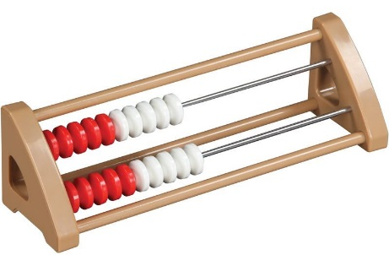
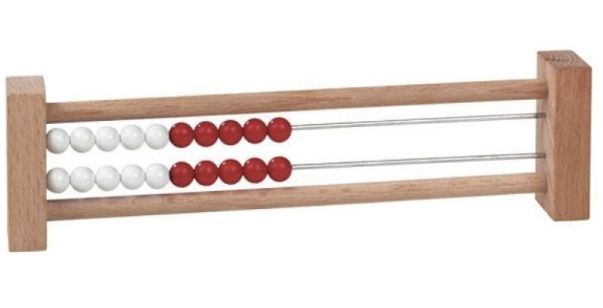
Rekenrek – also known as a Number Rack

Slide 4
Rekenrek
Combines the strengths of others models such as:
Counters
Number lines
Base 10 cubes and blocks

Slide 5
Rekenrek
Provides a visual model that encourages young learners to:
build numbers in groups of five and ten
use doubling and halving strategies
count-on from known relationships to solve addition and subtraction problems

Slide 6
Rekenrek
Aids the development of the understanding of NUMBER:
What number means
Their relationships to each other
How we operate with them
Promotes NUMBER SENSE

Slide 7
Rekenrek
An example of the Rekenrek in use:
Video https://www.youtube.com/watch?v=pk9TbuAPQ7E
Online tools and apps are also available:
Maths Learning Center https://www.mathlearningcenter.org/resources/apps

Slide 8
Rekenrek in Redwell
P1-P3 classes have access to class and group sets for use in the development of number sense.

Slide 9
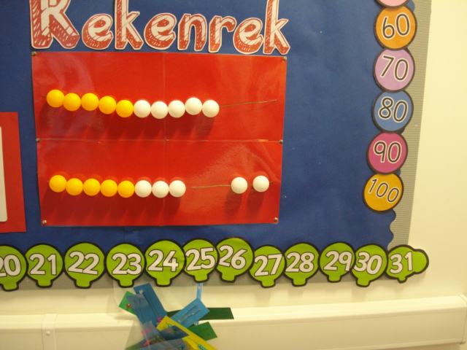
Rekenrek in Redwell
The can even be part of a wall display for whole class teaching.

Slide 10
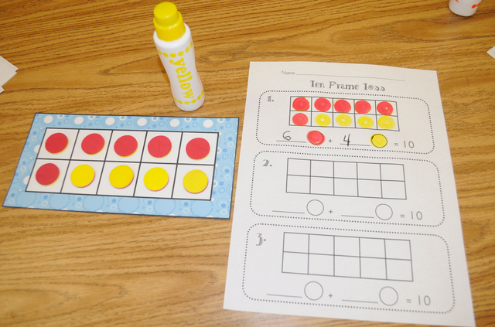
Ten Frames

Slide 11
10 Frames (and 5 Frames, and 20 Frames)
Helps children embed 5 and 10.
Promotes combinations that make 5.
Promotes combinations that make 10.
Can easily be extended to 20 in order to assist the bridging of 10 – an important stage.

Slide 12
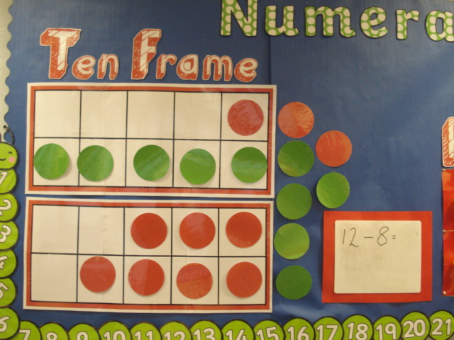
10 Frames in Redwell
P1-P3 classes have access to class and group sets …
… and can be part of a class display for whole class teaching.

Slide 13
10 Frames in Action.
Video https://www.youtube.com/watch?v=62epCIFdRa0
Shows 10-frame used a flashcard, as well as dot cards.
Online tools and apps are also available:
Maths Learning Center https://www.mathlearningcenter.org/resources/apps

Slide 15
Promoting Mental Maths Agility in Redwell
Agility is defined as the ability to move nimbly with speed and ease.
Maths Agility, therefore, refers to mental quickness and sharpness with numbers. An example of someone who possesses mental maths agility is someone who can easily complete mental maths problems.

Slide 16
Promoting Mental Maths Agility in Redwell
Standard Written Method or Mental Calculation?
Learners should not be exposed to standard written methods until they have had appropriate experience of using mental strategies. Premature exposure to working forms restricts learners’ ability and desire to use mental strategies.
In other words: Learners’ ability to mentally manipulate numbers enhances their ability to understand the ‘Formal’ or ‘Standard’ written methods of calculations.

Slide 17
Promoting Mental Maths Agility in Redwell
Mental Maths Strategies are taught on a daily basis where possible in Redwell from P1 through P7.
The strategies taught are age/stage appropriate and follow logical and adaptable Lines of Progression depending on the needs of a child, group or class.

Slide 18
Mental Agility – Equipping the Children
Teaching the strategies provides the children different methods and tools they can then use to solve problems.
There is no CORRECT strategy (except, perhaps, the one that works best for you!)

Slide 19
Mental Agility – Participation and Talking
Try to solve this simple problem …
What is 26 added to 69 ?
Number Talks (video 1:15-4:55)

Slide 20
Mental Agility – In Class Examples

Slide 21
Mental Agility – In Class Examples

Slide 22
Mental Agility – In Class Examples

Slide 23
Mental Agility – In Class Examples

Slide 24
Mental Agility – In Class Examples

Slide 25
Mental Agility – Participation and Talking
Times Tables Tennis
Metre Stick Challenge

Slide 26
Mental Agility – Mistakes Help Us Learn
Children are encouraged to feel safe with mistakes
Mistakes help us learn
Mistakes can be used to explain how to avoid them
(Video)

Slide 27
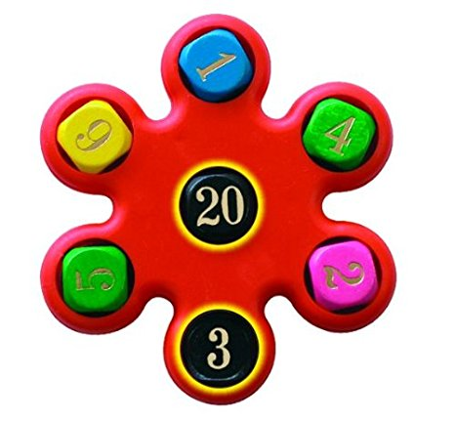
Maths Agility in Redwell – Some Examples
Magimixer – Handheld …
… and spreadsheet version

Slide 28
Maths Agility in Redwell – Online
Sumdog

Slide 29
Maths Agility in Redwell – Sumdog
Redwell School has purchased a School License enabling children to engage with maths and numeracy through the medium of interactive games.
The license allows teachers to target learning to identified skills and track progress.
Sumdog is designed to supplement teaching, and is aligned to the curriculum.
Sumdog can also be used at home – on PC’s, laptops, tablets and ipads.

