Slide 1
Anti-bullying
By Beth and Angus

Slide 2
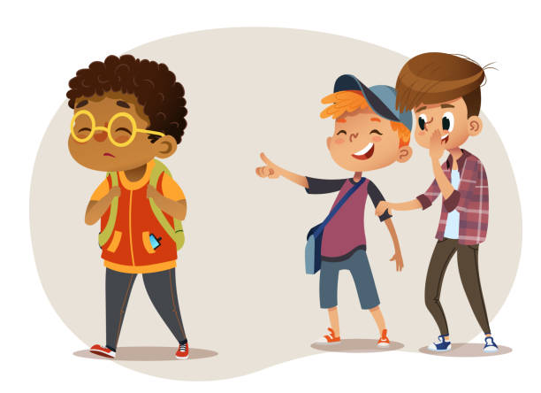
What Is Bullying?
There are different types of bullying.
Physical bullying is hitting, shoving, pushing, kicking or laying your hands on someone.
Verbal bullying is when someone calls you names, says nasty things to you, or threatens you.
Nobody deserves to be bullied.

Slide 3
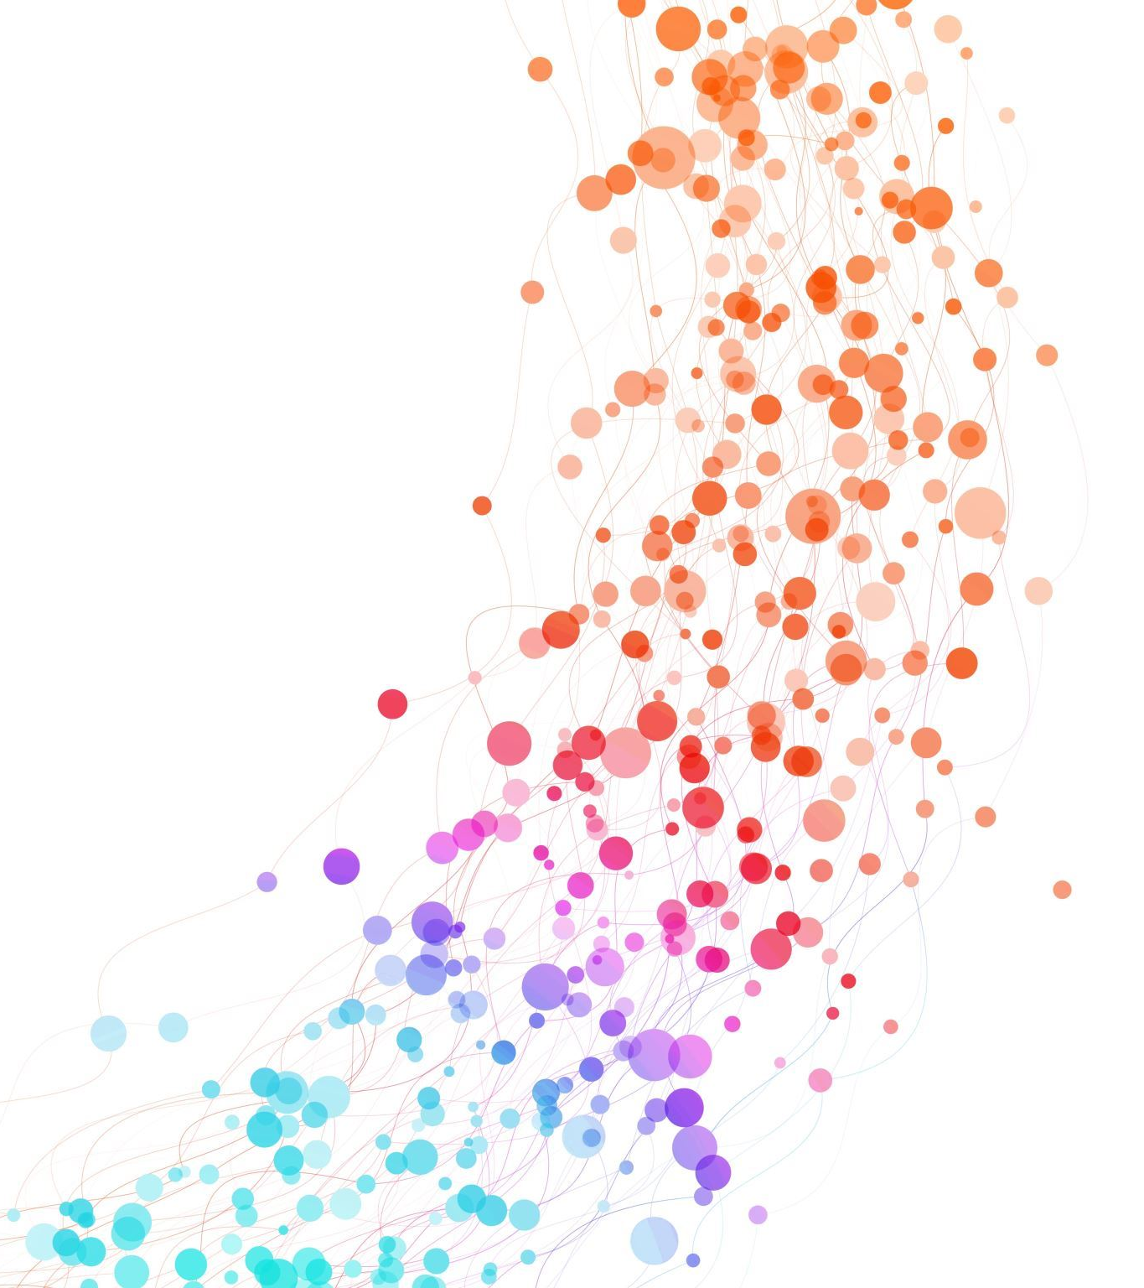
Kind or unkind
Now that you know all about bullying, we have a task for you to do.
We will give you a worksheet and you can decide if the things on it are kind or unkind.

Slide 4
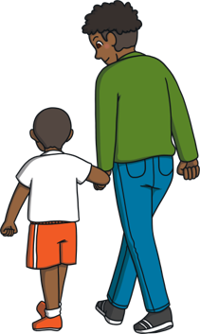
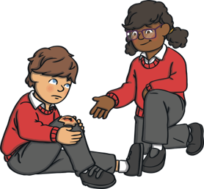
What can you do?
`Tell an adult you trust
Help someone being bullied
If you are being bullied, tell a parent, teacher, older brother or sister ,or a relative. They should help you sort it out in no time.
Someone who is being bullied can feel lonely, sad or scared. Smile at them, talk to them or include them in a game.

Slide 5
