Slide 1
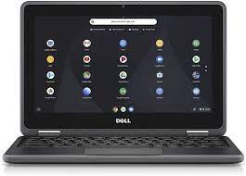
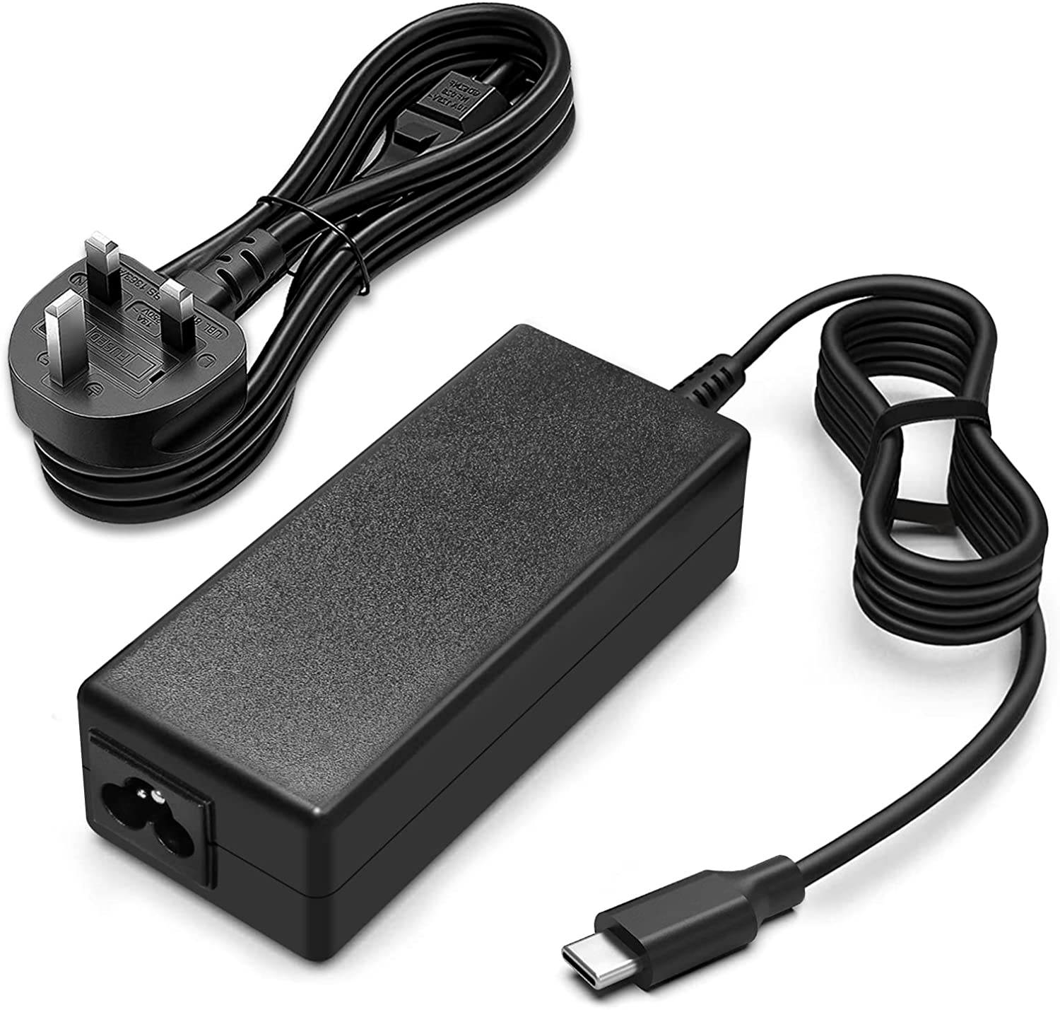
Return of Device
On return of a Chromebook, they are inspected by a member of staff. The Chromebook Agreement (signed prior to allocation) sets out the responsibilities of the school and individuals.
Fees will be charged for devices, lost, damaged, or returned dirty/not in working condition.
Allocated to: ______________________
Return Checklist
☐ Chromebook
☐ Charger (2 parts)
☐ Protective Sleeve
Inspection of Device
☐ Case free from cracks (beyond wear & tear)
☐ Hinges (open and close)
☐ Device Powers ON!
☐ Screen free from defects
☐ Keys/touchpad free from defects.
☐ Device returned in good working condition.
☐ Further action required to restore or repair. Details (incl costs) below:
Asset ID: ____________ Staff Initials: ____________ Date____________

